Slide 1

Mitigation Banking in PA 101
History, Process, and Results
January 14, 2026
JOSH SHAPIRO, GOVERNOR | JESSICA SHIRLEY, SECRETARY
Notes:
Good Morning
Introduce myself, who I work for, and in what program/capacity
Identify what I am going to be presenting on

Slide 2

Objectives
Discussing What Mitigation Banking Is
Framework for Mitigation Banking in PA
Mitigation Banking History and Activity
Notes:
Presenter: Dave Goerman: (15 minutes)
Discuss what mitigation banking is
Provide an overview of regulatory framework for mitigation banking in PA since the 2008 Federal Rule
Describe mitigation banking history and activity in PA with a snapshot of banks/bank sponsors across PA

Slide 3
What is Mitigation Banking
Mitigation bank
A site, or suite of sites, where resources (e.g., wetlands, streams, floodplains) are restored, enhanced, and/or preserved for the purpose of providing compensatory mitigation for impacts authorized by permits.
In general, a mitigation banker (third party) sells compensatory mitigation credits to permittees whose obligation to provide compensatory mitigation as part of their permit requirement is then transferred to the mitigation banker.
The operation and use of mitigation banks are governed by a mitigation banking instrument (USACE) and Chapter 105 permit (DEP). Source: adapted from 33CFR § 332.2 Definitions
Notes:
A bank site is usually comprised of multiple sites located within a watershed that are primarily reestablishment and rehabilitation of aquatic resources such as waterways, floodplains and wetlands.
A mitigation banker is referred to as a third-party compensation provider. Through credit sales they assume the liability of a permit holder’s compensatory mitigation requirements of PA state Ch. 105 and/or federal CWA Section 404 permit requirements

Slide 4
Regulatory Framework
Federal Regulatory Authority - 2008 Joint USACE and EPA Rules
USACE: PART 332—Compensatory Mitigation For Losses Of Aquatic Resources
EPA: PART 230 Subpart J—Compensatory Mitigation for Losses of Aquatic Resources
DEP is a Co-Chair of the USACE Interagency Review Team
Notes:
The federal rules governing mitigation banking are centered around the 2008 Joint US Army Corp of Engineers and Environmental Protection Agency
The federal rules provide a robust and comprehensive framework for mitigation banking across the nation.
DEP is the state Co-Chair on the Interagency Review Team which provides recommendations to the regulatory agencies over seeing the banking industry.

Slide 5
Regulatory Framework
State Regulatory Authority
25 Pa Code Chapter 105 – Mitigation is defined and allows
for providing substitute resources.
Ch. 105 does not contain any other specific language related to mitigation banking.
Mitigation—
(i) An action undertaken to accomplish one or more of the following:
(A) Avoid and minimize impacts by limiting the degree or magnitude of the action and its implementation.
(B) Rectify the impact by repairing, rehabilitating or restoring the impacted environment.
(C) Reduce or eliminate the impact over time by preservation and maintenance operations during the life of the action.
(ii) If the impact cannot be eliminated by following clauses (A)—(C), compensate for the impact by replacing the environment impacted by the project or by providing substitute resources or environments.
Notes:
PA DEP’s regulatory authority is derived from Chapter 105 regulations, but there is no specific language in the regulations related specifically to mitigation banking. DEP has relied upon the definition of mitigaiton since the 1990s to allow for third party compensation. This is achieved through interpreting the definition of mitigation.
The final step in the mitigation process is to compensate for unavoidable impacts. The bolded language on the screen related to compensating which references replacing the affected environments or providing substitute resources or environments. Mitigation banking does both of these actions.

Slide 6
Regulatory Framework
State Regulatory Authority
DEP issues Ch. 105 permits to operate, construct, and maintain mitigation banks.
DEP has separated the operation authority from the construction and maintenance authority for mitigaiton banking to provide comprehensive permit and regulatory oversight at the state level, through permit requirements.
Notes:
Due to differences in state and federal authorities, DEP is unable to sign the mitigation banking instruments established by the 2008 federal rules. To address this Dep issues a Chapter 105 permit to operate, construct, and maintain mitigation banks.
To better align with the federal rules DEP has separated the operation authority from the construction and maintenance authorities for mitigation banking. This allows DEP to conduct comprehensive oversight of the banking industry through its permitting requirements but maximizing administrative efficiencies.
The use of banking credits provides significant permit application processing efficiencies aside from the cost and time involved in developing PRM plans. Instructions on the requirements to use banking credits to meet compensatory mitigation requirements can be found in Module S4 of the EA Instructions.

Slide 7
Banking History and Activity
October 5, 2013 - First approval to operate mitigation banks in PA was issued to First Pennsylvania Resource LLC (aka RES)
Land Reclamation Group - 2/2020
Evergreen Envronmental - 5/2020
Naturion (aka Water and Land Solutions) - 2022
CNX/EIP Joint Partnership – 2024
3 currently in process of applying for approval
Notes:
Prio to 2008 Dep had only approved advanced wetland compensation site for PA DOT, there were no private mitigation banking companies operating in PA. First PA Resource LLC or RES was the first company to seek approval for mitigaiton banking in PA. RES was approved in 2013 to operate mitigation banks in PA.
It took another seven years to get approvals for two more companies, LRG and EG.
EIP - Ecosystem Investment Partners.

Slide 8
Banking History and Activity
All mitigation bank proposals must be comprehensive restoration proposals focused on reestablishing or rehabilitating stream and floodplain systems and wetlands.
Accomplished through use of an evidence-based approach to restoration
DEP requires the banker to demonstrate the resource is degraded (not synonymous with impaired). We use a systems basis approach not channel centric.
  Document historic unaltered natural conditions (site potential)
  Identify historic and modern alterations
  Identify modern constraints present that interfere with the ability to restore
Notes:
DEP upholds a high standard for prosed mitigation banking projects in PA. Proposals must be comprehensive restoration projects principally focused reestablishing and rehabilitating streams, floodplains and wetlands. DEP employs an evidence-based approach that includes degradation demonstration, documentation of historic natural conditions, identification of historic and modern alterations and identification of modern constraints affecting the design potential.

Slide 9
Banking History and Activity
Restoration plans for 25 sites (not including PADOT) have been approved for construction
Total of 315,000 linear feet (59.6 miles) of stream credits and 369 wetland acre credits have been approved/constructed (not including PADOT)
Preservation does not generate credits but can be considered when value of gains
Notes:
To date 25 restoration plans have been approved for 25 private mitigation bank sites
Total of 315,000 linear feet (59.6 miles) of stream credits and 369 wetland acre credits have been approved/constructed (not including PADOT)
Even though federal rules allow for it, PA does not approve preservation credits for compensation since they do not meet the definition of the mitigation as defined in Ch 105. DEP does recognize the importance of land conserved around wetlands and floodplains and does allow for adjusting credit awards to recognize when these areas are included in a comprehensive restoration plan.

Slide 10
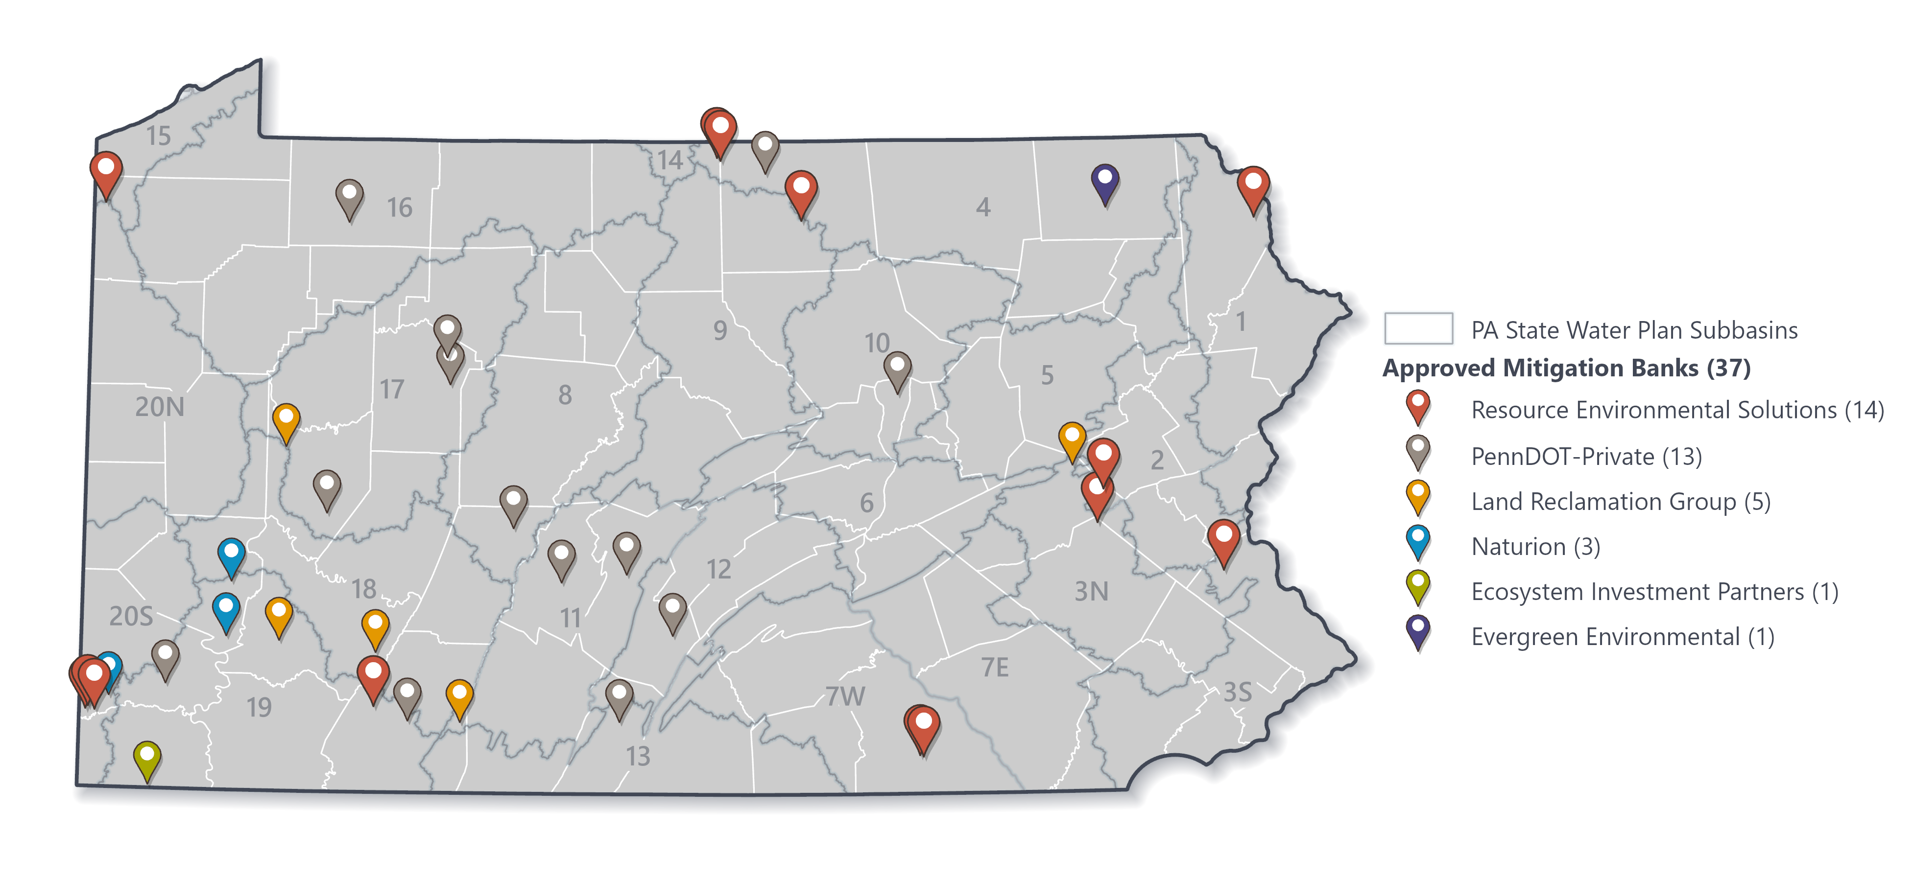
Banking History and Activity
Notes:
As mentioned earlier there are now 25 sites approved for construction the majority of which have been constructed in addition to the historic PADOT advanced compensation sites.
Read company site #s.
The mitigation banking industry has been expanding across PA, and the rate of site expansion is increasing.

Slide 11
Banking History and Activity
Mitigation bankers do not share their credit fee structures with the USACE or DEP. Using available industry averages, DEP estimates that the current market value of the mitigation banking industry in PA at:
  Riverine: $ 252 M
  Wetland: $66.5 M
This does not include other markets such as MS4 pollution reduction efforts
Notes:
Read through information on slides

Slide 12
Spill Over Benefits
Raised the bar of what restoration is
Expedited establishing a dedicated restoration industry
MS4 Pollution Reduction
Ches Bay Nutrient Reduction
Flood Hazard Reduction
Stormwater Management
T&E Species Reintroduction
Notes:
Read through information on slides

Slide 13

Get In Touch
David Goerman, Jr.
Bureau of Waterways Engineering and Wetlands
Division of Wetlands Encroachment and Training
400 Market Street
Harrisburg, PA 17101
…
717-772-5971/ dgoerman@pa.gov
The Department of Environmental Protection’s mission is to protect Pennsylvania’s air, land and water resources and to provide for the health and safety of its residents and visitors, consistent with the rights and duties established under the Environmental Rights Amendment (Article 1, Section 27 of the Pennsylvania Constitution).
Notes:
I appreciate the opportunity to be here and present this. Feel free to reach out to me if want to discuss or have questions, or ideas related to any of these trainings, or the topics in general. I will be here at the conference today and tomorrow so you can also catch me then.
Are there any questions?

