Slide 1
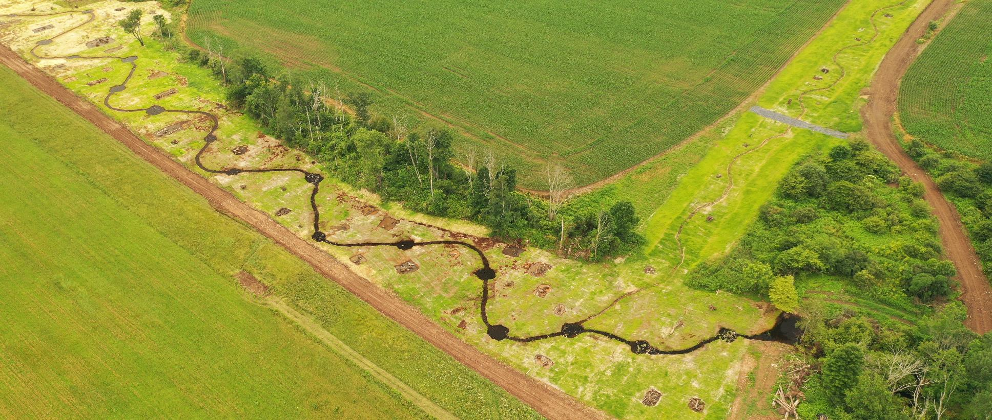
Introduction to Ecological Offsets
RES Overview
Evolution of PA Banking:
Process, Practice, and Outcomes

Slide 2
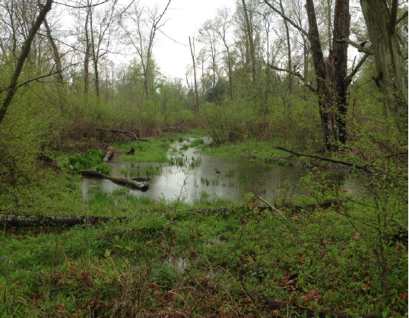
Regulations Prioritize Using Mitigation Bank Credits
USACE/EPA 2008 Final Rule, Section 332.3(b)(3)
Order of Preference for Compensatory Mitigation:
1. Mitigation Banks
2. In-Lieu Fee (ILF) Programs
3. On-site or Off-site Permittee Responsible Mitigation (PRM)
Reminder: always a priority to 1) avoid, 2) minimize, and then 3) mitigate

Slide 3
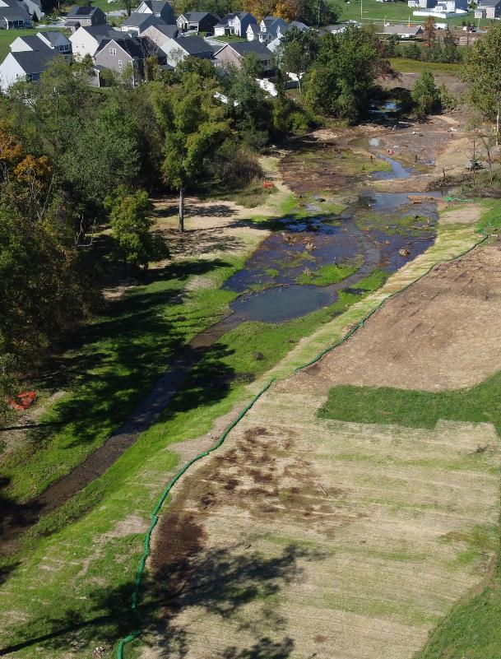
Why Use Mitigation Bank Credits?
Regulator Benefits
Less risk (easy button for them too)
Banks approved, with released credits “pre-approved” for satisfying mitigation
Significant time savings
300+ credit transactions past 10-12 years saving thousands of PADEP and USACE reviewer hours (a box to check)
Increased accountability for mitigation sponsors
Staged release of credits as bank milestones are met, over several years
No arguing 5+ years later about why the deer ate the trees, why it’s a pond and not a wetland, etc.

Slide 4

Why Use Mitigation Bank Credits?
Permittee Benefits
Less risk (easy button for permittee)
No uncertainty over whether the compensatory mitigation will be successful or accepted by regulators, so you can focus on your core-business
Save time and money
Reduced staff and administrative time (regulatory, legal/contracting, operations)
Faster permits
Reduce permit processing times to benefit of both regulators and applicants
National studies indicate a 30-50% reduction in permit-review-time when using credits

Slide 5
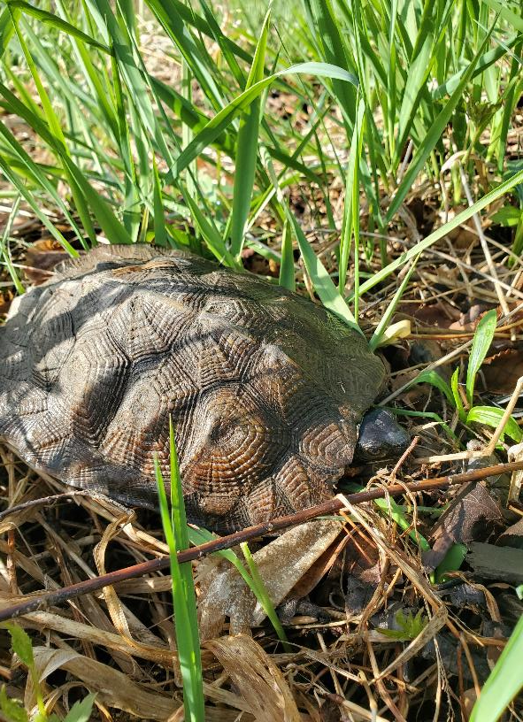
Why Use Mitigation Bank Credits?
Ecological Benefits
Bigger/ better restoration projects
Larger scale, more ecologically significant restoration
Less risk
Natural resource restoration, construction, and operations expertise
Permanently improved habitat and water quality
Robust O&M and perpetual, accountable long-term stewardship

Slide 6
Credit Timing (and Accountability)
Several regulatory, schedule, and management practices affect the release schedule

Slide 7
4-Step Process to Use Bank Credits
Coordination between applicant/project team and bank sponsor
Are credits available? Advanced planning is key to ensure released credits will be available at time of permit application submission, or permit authorization
Secure the credits you need
If you don’t buy them, someone else likely will
Credit commitment letter
Letter from RES to agencies, documenting commitment to provide credits to project, ideally with initial permit application
Ledger included, confirm bank has not been over-committed, and short mitigation narrative (Mitigation Approach)
Credit transfer letter
Use of credits noted in special conditions, bank sponsor confirms credits have been debited from bank (via email/PDF letter) and documents action on RIBITs

Slide 8
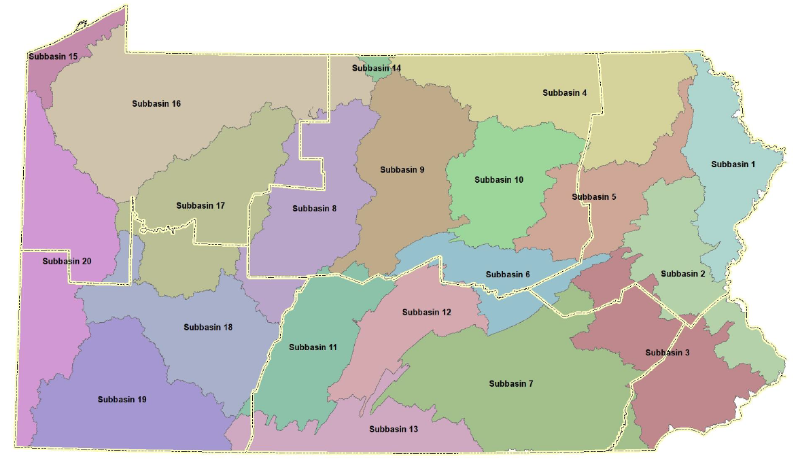
Service Areas/Watersheds (PA State Water Plan)

Slide 9
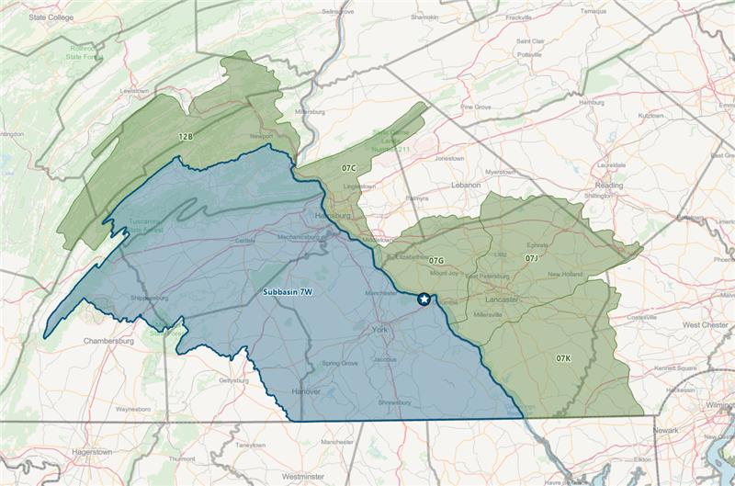
Example Bank: Primary vs Secondary Service Areas

Slide 10
Secondary Service Area Approval Process
Bank-credits are pre-approved for use as mitigation within primary service area (PSA), but…
Credits used in secondary service area (SSA) routinely, subject to PADEP and USACE permit-reviewer sign-off
SSA credits used if no banks exist in PSA, or not enough/right type of credits exist in PSA
Normal SOP, send SSA-request email to permit-writers and request written response

Slide 11
Quantifying Credits Needed
Bank sponsor and applicant propose anticipated mitigation quantities, using recent/relevant case studies and precedent, subject to permit-reviewer sign off
90-95% of the time precedent is followed
Rationale explained in short mitigation narrative (Mitigation Approach)

Slide 12
Quantifying Credits Needed
Normal variables and questions
Stream impacts largely mitigated at 1:1 ratio
(100.00 LF loss/fill/culvert = 100.00 stream credits)
Wetland impacts more variable, based upon:
Cover-class (PEM vs PSS vs PFO)
Nature of impact (permanent fill/loss vs cover-class change)
But uses same ratio-approach, example:
1.00 acre PFO wetland @ 2:1 ratio (1.00 acre PFO loss = 2.00 wetland credits)
Special consideration project-types/impacts:
Abandoned-mineland (AML) resources and other highly-degraded resources
After-the-fact/Compliance actions: at least 2:1, sometimes upwards of 8:1
Can use functional assessments (FCP, New England Highway Methodology, etc) to justify ratios

Slide 13
Projects Using Credits
Projects completed in every PADEP and USACE district
Transportation – PennDOT, PTC, airports
Energy – Pipelines, coal, powerlines/substations, oil and gas
Commercial/Residential Development – residential, mixed-use, logistics, industrial, data centers
And the atypical ones: 9-11 National Memorial Trail, NCD-stream restorations, Compliance actions, breweries, shooting ranges (lead remediation)
Project require either a Joint Permit or General Permit from DEP/USACE

Slide 14
But what if credits are not available, in time?
In-lieu Fee (ILF) or Pennsylvania Integrated Ecological Services program (PIESCES)
Effective backstop for some projects where bank credits are not available
Limited to state-only wetland or stream impacts (not approved currently by USACE)
Funds from small impacts accrued over time and then a larger, more impactful project is implemented when sufficient funds received
Utilizes the Functional Compensation Protocol to determine # of functional credit units (vs traditional ratio-based wetland and stream credits)
Alternative Solutions (PRM)
Similar to “standard” PRM’s in PA, but bigger and meet “bank” objectives
Financial assurances in construction/maintenance bonding and stewardship funding
Commercial agreement focused on credit-like procurement and implementation

Slide 15
Bank in PA: Headwaters on down…
Ensures benefits to the rest of the watershed downstream
More difficult for your site to be negatively affected by developments upstream from you
Mitigation Final Rule directs practitioners to use a watershed approach

Slide 16
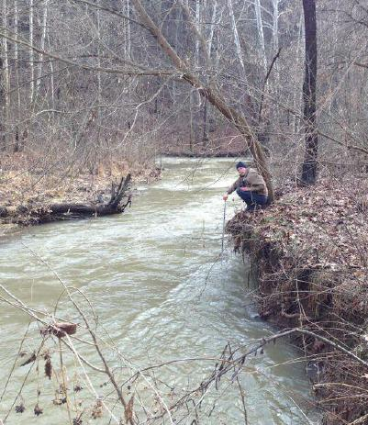
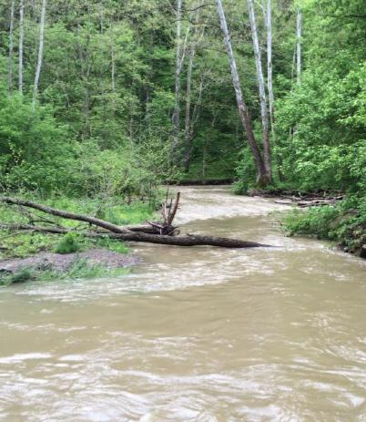
Just because it’s forested, doesn’t mean it’s high quality

Slide 17
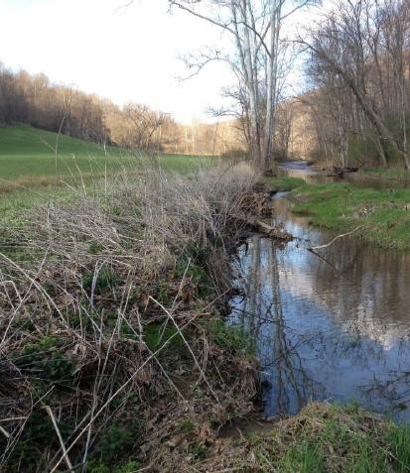
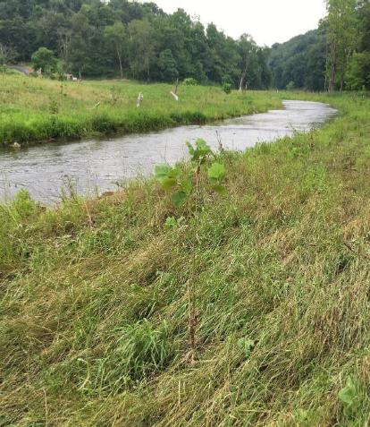
PA Bank Site: Larger Stream Reach

Slide 18
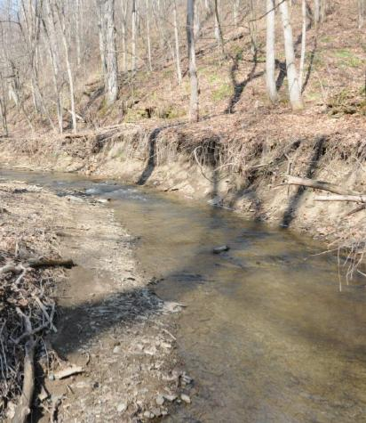
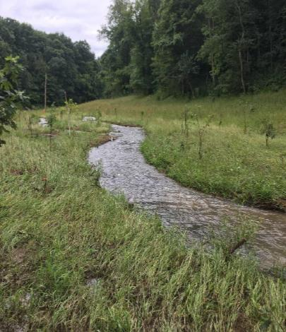
PA Bank Site: Example Mid-size Stream Reach

Slide 19
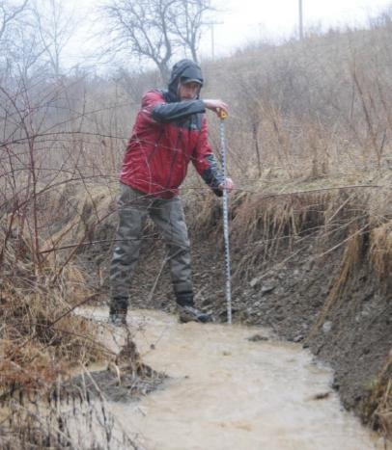
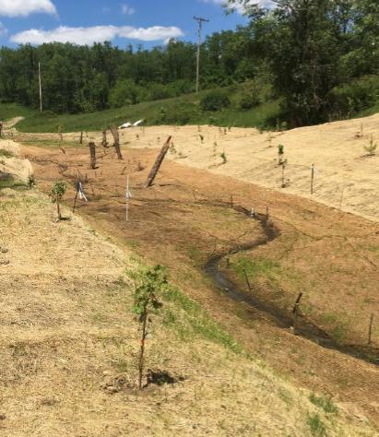
PA Bank Site: Headwater Stream Reach

Slide 20







Thank you for joining us today
Katie Wolff | Director, Regulatory
kwolff@res.us
Jon Kasitz | Client Solutions Manager
jkasitz@res.us
Dave Goerman | Water Program Specialist
dgoerman@pa.gov
WATCH YOUR INBOX
A follow-up email with resources and links will be sent following this webinar.

