Slide 1
Phase III Watershed Implementation Plans (WIPs)
Placeholder for Subtitle or Presenter Identification

Slide 2
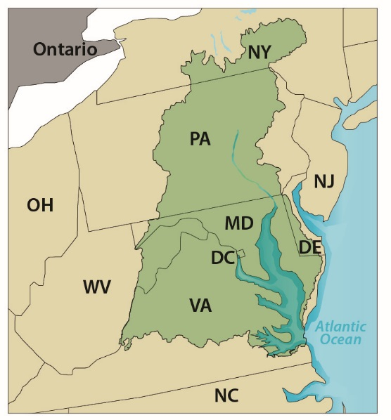
Required Pollution Reductions
The 2010 Bay TMDL requires specific reductions to meet water quality standards:
25% nitrogen.
24% phosphorus.
20% sediment.
This overall amount was divided among the seven watershed jurisdictions using:
State-of-the-art modeling tools.
Extensive monitoring data.
Peer-reviewed science.
Notes:
Chesapeake Bay Total Maximum Daily Load (Bay TMDL)
The seven Chesapeake Bay watershed jurisdictions: Delaware, the District of Columbia, Maryland, New York, Pennsylvania, Virginia and West Virginia.

Slide 3
WIPs Guide Actions
Allocations are assigned to jurisdictions (i.e., planning targets).
To meet target reductions by 2025, jurisdictions prepare WIPs that outline detailed, specific steps they’ll take to reduce pollution loads.
Jurisdictions have prepared two WIPs since the TMDL was established:
Phase I (covering 2010–2012).
Phase II (covering 2012–2017).
Jurisdictions are now developing their third WIP:
Phase III (covering 2018–2025).
Notes:
To help the seven Chesapeake Bay jurisdictions meet their targets to reduce pollution flowing into the Chesapeake Bay, they develop Watershed Implementation Plans, or WIPs.

Slide 4
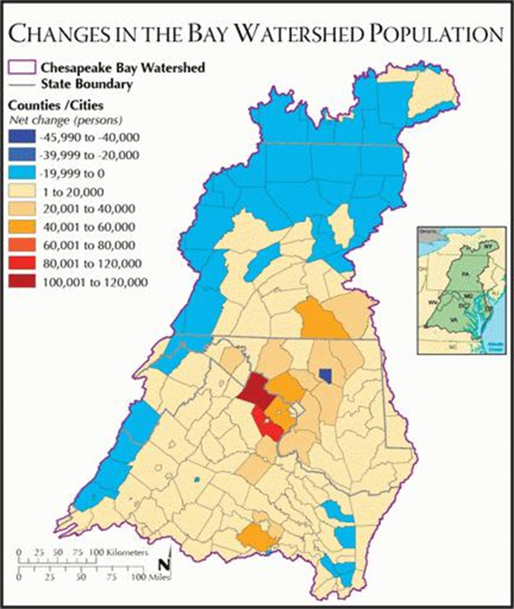
Phase III WIP Elements
In 2019, the jurisdictions will develop Phase III WIPs that:
Detail actions they and local partners will take (2018–2025) to meet pollution reduction goals.
Account for 2017 midpoint assessment results and future population growth (based on estimated land use in 2025).
Jurisdictions may update programmatic and/or numeric commitments during the 2018–2025 via two-year milestones.
Notes:
The Phase III WIPs will guide the jurisdictions and their local partners and stakeholders on what actions and controls they will need to take and put into practice to meet their pollution reduction goals by 2025.
The Phase III WIPs will take into account the results of the midpoint assessment as well as future population growth based on estimates of how the land in the Chesapeake Bay watershed will be used in 2025.
It is reasonable to assume that jurisdictions may need to update their commitments in the 2018 – 2025 timeframe and if so, jurisdictions may update their programmatic and/or numeric commitments through their two-year milestones.

Slide 5
Phase III Expectations
EPA released document outlining Phase III WIP expectations in January 2017.
Requests assurance that resources are in place to achieve 2025 target goals:
Funding/financing, cost-share.
Technical assistance.
Voluntary/incentive-based actions.
Policy, programmatic, legislative and regulatory infrastructures.
Notes:
EPA provided expectations for the jurisdictions’ Phase III WIPs to maintain accountability in the work of the Chesapeake Bay Program partnership, encourage continued adaptive management to the new information generated during the Bay TMDL midpoint assessment, and lay the groundwork for implementation of the next generation of innovative practices. These expectations are directed towards ensuring EPA and the public has reasonable assurance that the seven jurisdictions, and their local and federal partners, have in place, or are committed to put in place, the funding, financing, cost-share, technical assistance, voluntary, incentive, policy, programmatic, legislative, and regulatory infrastructures necessary to achieve their 2025 target goals.

Slide 6
WIP Element #1: Commitments
Jurisdictions define programmatic and numeric implementation commitments needed to achieve Phase III WIP planning targets for 2018–2025:
Identify specific programmatic actions and pollution-reducing practices.
Build capacity to implement agricultural and stormwater programs.
Target pollution-reducing practices in priority watersheds.
Document planned changes for sectors that fall under enhanced oversight status and backstop oversight status.
Notes:
First, jurisdictions must specify the commitments needed to achieve Phase III WIP planning targets. These commitments include:
Identifying programmatic actions and pollution-reducing practices that will be implemented to achieve pollution reduction goals.
Building capacity to oversee and implement agricultural and stormwater programs, particularly where programmatic gaps have been identified.
Targeting of more effective pollution-reducing practices in watersheds that take on more pollutant loads, based on modeling and monitoring data.
Providing more detailed documentation of planned changes for sectors (e.g. wastewater, stormwater) that fall under “enhanced oversight” (EPA-identified specific concerns with the strategy to meet TMDL goals) or “backstop oversight” (EPA-identified substantial concerns with strategy to meet TMDL goals), or for sectors not on track to achieve their 2017 pollution reduction targets.
Enhanced oversight status (EPA has specific concerns about ability to meet TMDL goals)
Backstop oversight status (EPA has substantial concerns about ability to meet TMDL goals)

Slide 7
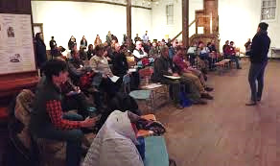
WIP Element #2: Engagement
Commit to strategy for local, regional and federal partner engagement during development and implementation of WIP. Address:
Specific roles that partners will play in implementation.
Required amount of funding and technical support.
Creation of a BMP verification program.
Accounting for growth.
Examples of successful models of engagement.
Notes:
Image source: https://www.allianceforthebay.org/2017/12/what-happens-when-you-put-80-sportsmen-and-conservation-professionals-in-one-room-together-partnership/
Jurisdictions are strongly encouraged to use decision support tools like the Chesapeake Assessment Scenario Tool (CAST) in engaging partners as part of WIP development and implementation.

Slide 8
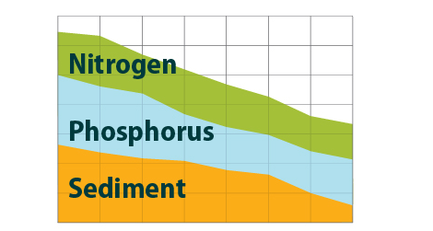

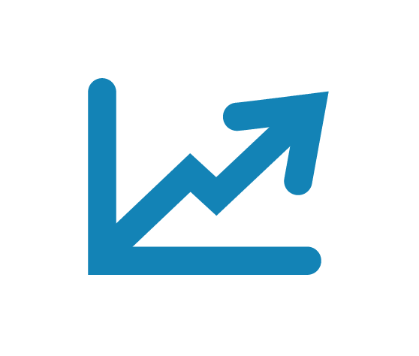

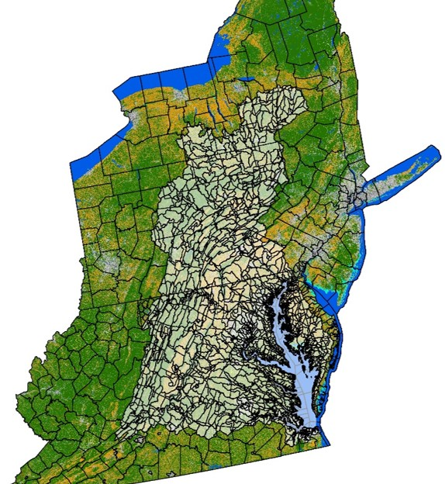

WIP Element #3: Changing Conditions
Account for changing conditions:
Climate change.
Conowingo Dam infill.
Population growth by 2025.
Changes in land uses.
Offset all new or increased nutrient and sediment pollutant loads.

Slide 9
WIP Element #4: Adjusting Targets
State-Basins
DC Potomac
DE Eastern Shore
MD Eastern Shore
MD Patuxent
MD Potomac
MD Susquehanna
MD Western Shore
NY Susquehanna
PA Eastern Shore
PA Potomac
PA Susquehanna
PA Western Shore
VA Eastern Shore
VA James
VA Potomac
VA Rappahannock
VA York
WV James
WV Potomac
Jurisdictions may adjust the following targets to incorporate new, updated information:
State-basin targets.
Bay segment-shed (the 92 individual Chesapeake Bay tidal segments).
Source sector (e.g., wastewater, agriculture, stormwater) goals.
Any changes to existing targets and goals cumulatively result in model-simulated achievement of applicable water quality standards.
Notes:
Each Bay jurisdiction may modify state-basin targets and Bay segment-shed and source sector goals to reflect new information from the midpoint assessment, EPA’s assessments of progress, long-term water quality monitoring trends and lessons learned.
Bay segment-shed and source sectors goals should cumulatively result in the achievement of their respective state-basin targets.
Tidal Bay jurisdictions (Delaware, the District of Columbia, Maryland and Virginia) should ensure there are plans in place to achieve, at minimum, the nutrient and sediment load reductions needed in each Bay segment-shed to achieve water quality standards in its own individual segment.

Slide 10
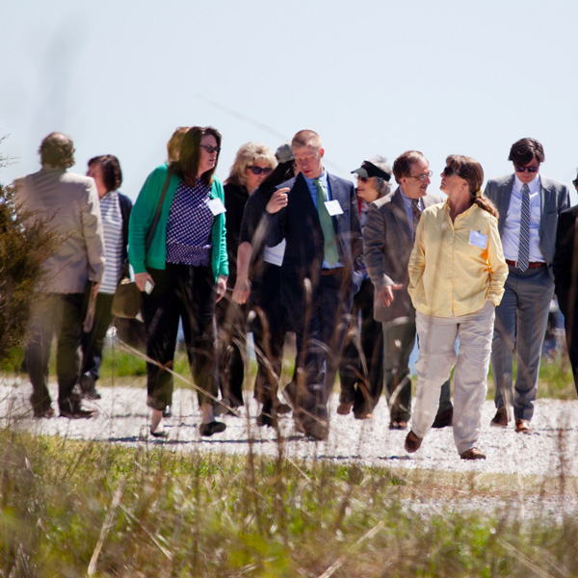
WIP Element #5: Local Planning Goals
Establish and articulate local planning goals—and the strategies to achieve them—for developing and implementing a WIP:
Local area targets should be at the scale and in the form best suited for engaging partners.
Engage local government leaders in the WIP development process:
Ensures the plans are realistic, reflect local priorities, benefit local communities and identify resources needed to meet goals.
Notes:
Photo source: http://www.google.com/url?sa=i&rct=j&q=&esrc=s&source=images&cd=&ved=2ahUKEwjH97SVpo3aAhVKS60KHR0fBxIQjhx6BAgAEAM&url=http%3A%2F%2Fwww.chesapeakeprogress.com%2Fengaged-communities%2Flocal-leadership&psig=AOvVaw3UdTC2T9ooWuVjXqegFpNN&ust=1522267401486318
More phosphorus coming into the model from Conowingo Dam and shore line erosion. Previously, the Partnership was overestimating the amount of phosphorus.

Slide 11
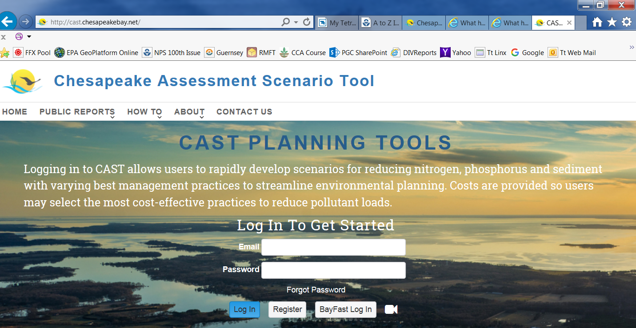
Chesapeake Assessment Scenario Tool
Chesapeake Assessment Scenario Tool (CAST)
Web-based nitrogen, phosphorus and sediment load estimator tool that streamlines environmental planning.
Helps local, regional and federal partners develop and implement WIPs.
Notes:
The Chesapeake Bay Program developed the Chesapeake Assessment Scenario Tool (CAST) to aid local, regional and federal partners in development and implementation of the WIPs.
Chesapeake Assessment Scenario Tool (CAST): https://cast.chesapeakebay.net

