Slide 1
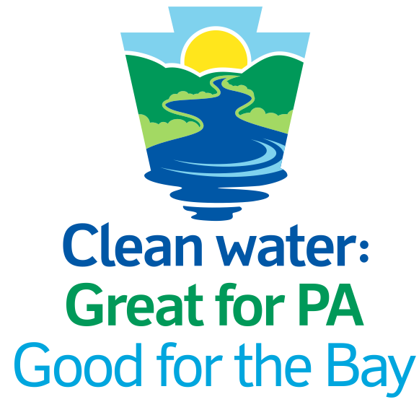
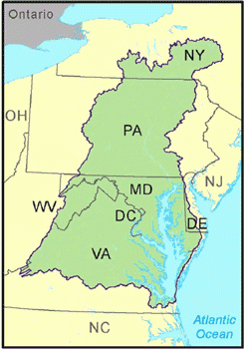
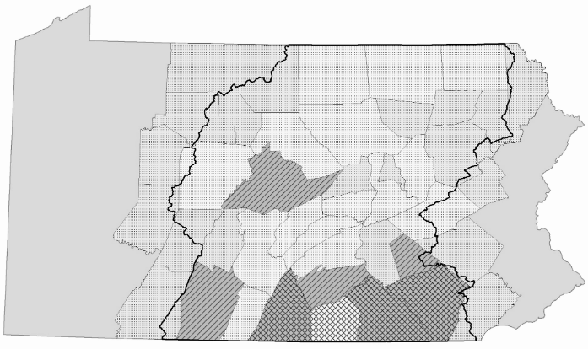
Phase 3 Watershed Implementation Plan for
PENNSYLVANIA
Pennsylvania is working alongside neighboring states to clean up our local waters that flow to the Chesapeake Bay. This effort is Pennsylvania’s Phase 3 Chesapeake Bay Watershed Implementation Plan (Phase 3 WIP).
The path to success for Pennsylvania’s Phase 3 WIP and clean water starts locally. This document summarizes the history, goals and recommendations for Pennsylvania’s Phase 3 WIP.
Pennsylvania is working with neighboring states to clean up our shared local waterways that run to the Chesapeake Bay. This effort is part of the Phase 3 Watershed Implementation Plan (Phase 3 WIP).
The path to success and clean water begins locally with landowners and local governments.
This document summarizes the history, goals, plan development process and workgroup recommendations for the Phase 3 WIP.
Pennsylvania’s Watershed Implementation Planning
Approximately half of Pennsylvania's land area drains into the Chesapeake Bay, primarily from the Susquehanna and Potomac River basins. The Susquehanna River is the largest tributary to the Bay, providing half of the total freshwater flow and 90 percent of the freshwater flow to the upper bay. Without the support of Pennsylvania, the Chesapeake Bay cannot be restored. Even more importantly, the water that feeds into the Chesapeake Bay is local to Pennsylvania. It is crucial that our local waters in Pennsylvania be restored for use by our citizens.
15,000
miles of Pennsylvania streams and rivers are impaired in the Chesapeake Bay Watershed .
14,358,159
50%
of freshwater flowing to the Chesapeake Bay comes from the Susquehanna River!
acres in the watershed
1,200 Communities!
The Phase 3 WIP is Pennsylvania’s roadmap for meeting its obligations under the Chesapeake Bay Total Maximum Daily Load (TMDL), established by the U.S. Environmental Protection Agency (EPA) in 2010. It specifies the steps Pennsylvania will take through 2025 to meet local water pollution reduction goals in the Chesapeake Bay watershed.
The Phase 3 WIP focuses on local solutions for nutrient and sediment reduction. It provides an opportunity to serve residents and businesses by cleaning up waterways, lowering flood risks, and improving the quality of life in local communities.
Development of the Phase 3 WIP was guided by the principle that clean water is
“Great for PA, Good for the Bay.”
Pennsylvania’s Phase 3 WIP effort is a team effort. Although Pennsylvania’s Department of Environmental Protection (DEP) is the primary agency tasked with implementing the Chesapeake Bay TMDL, hundreds of individuals representing state and local government, universities, businesses, agriculture, and environmental organizations have contributed their time and expertise to develop the Phase 3 WIP in a way that makes sense for Pennsylvania.

Slide 2
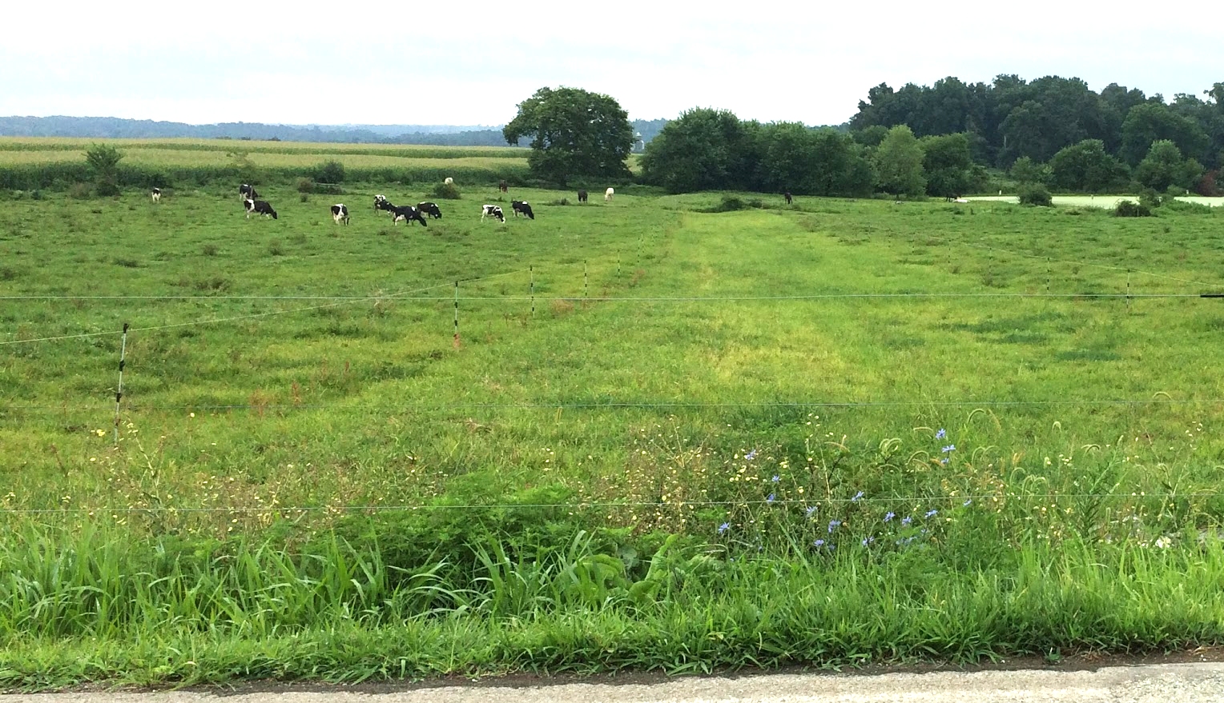
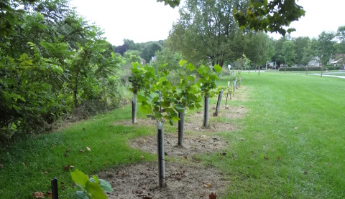
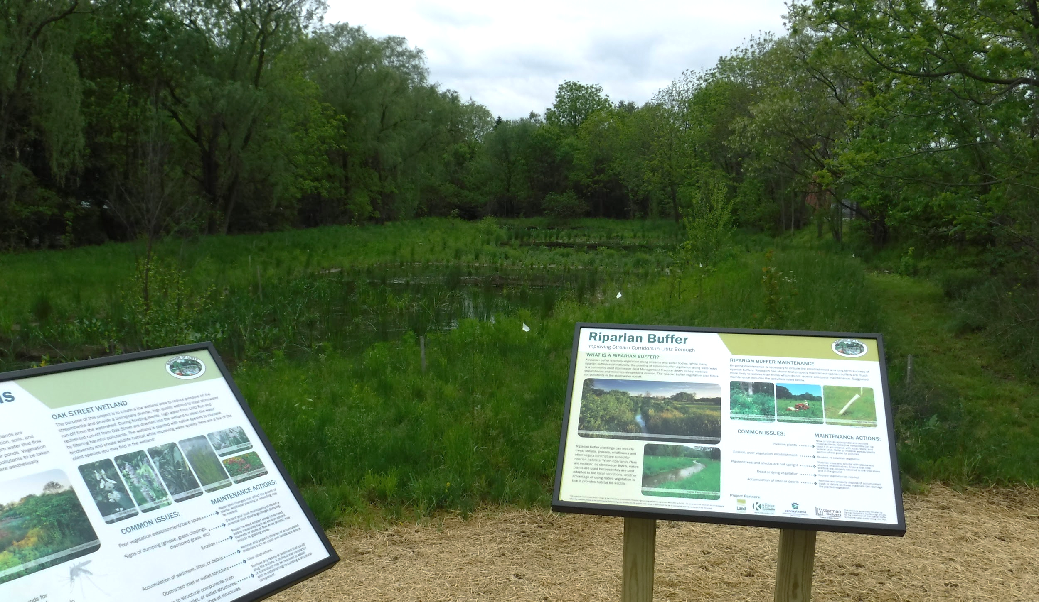
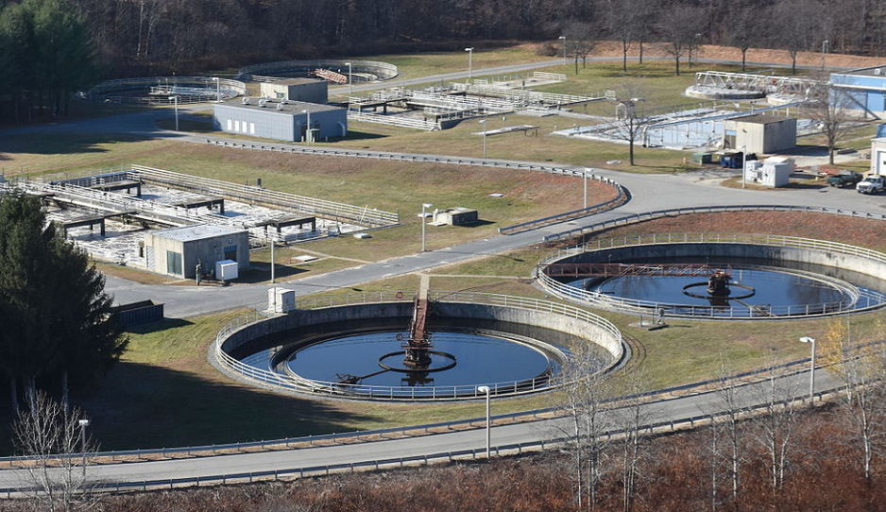

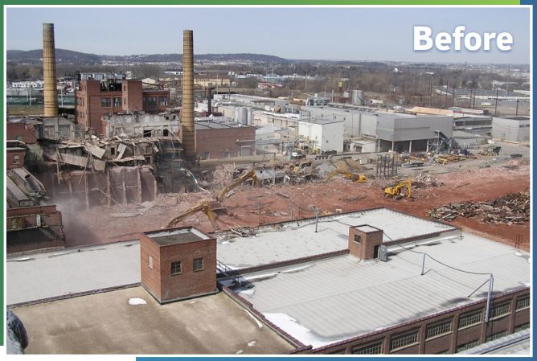
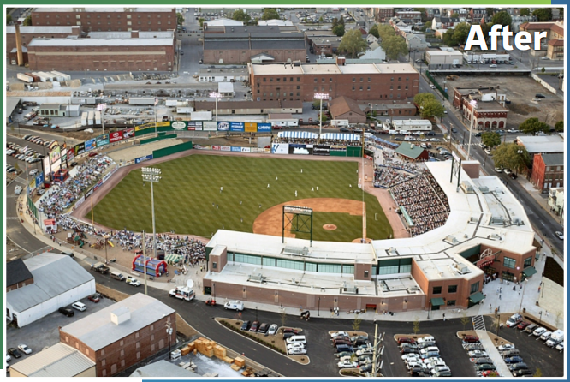
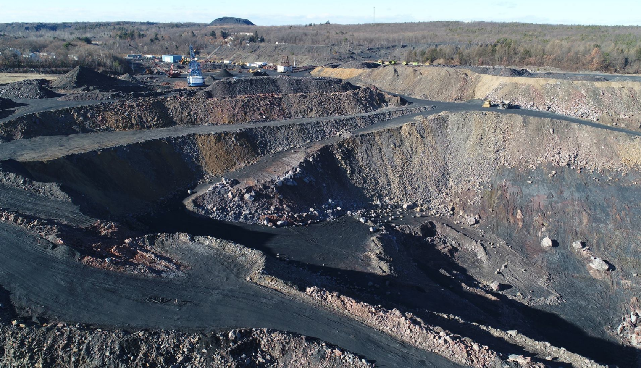
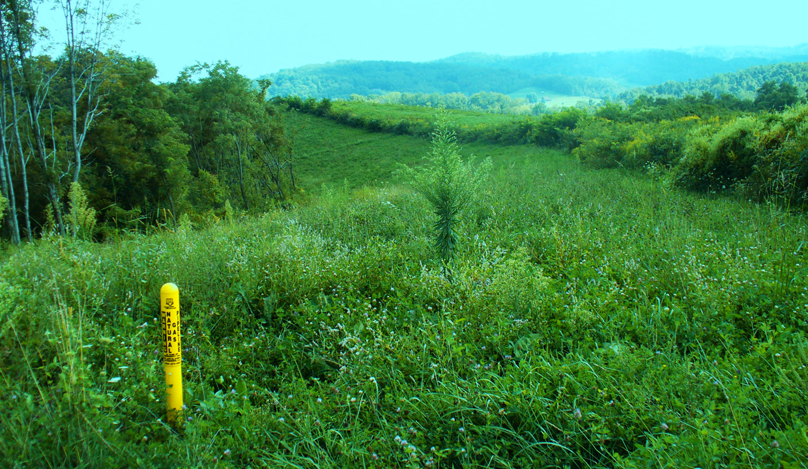
PA PHASE 3 WATERSHED IMPLEMENTATION PLAN
www.dep.pa.gov/chesapeakebay/phase3
Pennsylvania’s Phase 3 WIP is a Catalyst
Water pollution comes from many sources. Clean water is the end result of efforts to reduce and clean up pollution.
Agriculture
Pennsylvania’s agricultural sector presents a significant opportunity for restoration. The state and its partners will work with the agricultural community to increase use of best management practices.
Forestry
Forests and trees provide benefits to the community and to water quality. Forests are natural pollution filters — holding rainfall, trapping polluted runoff and stabilizing soils.
Stormwater
Stormwater best management practices can reduce local flooding, protect public health, and help to improve water quality. Increasing their use will provide many benefits to local communities.
Wastewater
Over $1.4 billion has been invested in Pennsylvania’s wastewater sector. Through sewage treatment plant improvements, this sector met federal reduction obligations ahead of schedule.
Air Quality
DEP’s Bureau of Air Quality is funding projects that reduce greenhouse gasses that reduce the amount of nitrogen delivered to local waterways and to the Bay.
Brownfield Cleanup & Redevelopment
DEP is working to identify opportunities to achieve additional nutrient and sediment pollution reductions from brownfield cleanup and redevelopment programs.
Mining, Monitoring & Regulation
Streams impacted by abandoned mine discharges are a significant source of nutrients entering the local waterways and the Bay. Stream restoration efforts will increase nutrient reductions.
Oil & Gas
Oil and gas activities that involve five or more acres of earth disturbance must have an Erosion and Sediment Control permit, as stated under Pennsylvania’s Clean Streams Law.
Pennsylvania’s Progress to Date
Pennsylvania has been working to reduce nitrogen and phosphorus pollution.
Some progress has been made, but more work is needed to achieve the 2025 planning goal.
1985
6.10M lbs Phosphorus
1985
122.40M lbs Nitrogen
2019
107.30M lbs Nitrogen
2019
3.80M lbs Phosphorus
2025 Target 3.04M lbs Phosphorus
2025 Target 73.18M lbs Nitrogen

Slide 3
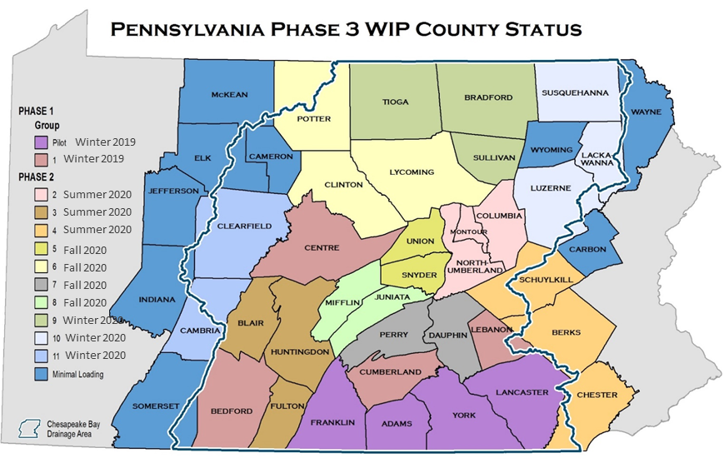
PA PHASE 3 WATERSHED IMPLEMENTATION PLAN
www.dep.pa.gov/chesapeakebay/phase3
Pennsylvania’s Phase 3 WIP Local Clean Water Planning
Pennsylvania has developed tools and support to assist in the county planning process. Tools and support are further explained in the Supporting Local Clean Water Planning in Pennsylvania handout.
43
counties in Pennsylvania have streams and rivers that run to the Susquehanna and Potomac Rivers, and eventually the Chesapeake Bay.
Counties play a key role In the Phase 3 WIP, and local efforts are vital to reach 2025 goals. The Commonwealth is seeking help from each of the 43 counties to determine the best way to clean up their fair share of the pollution. With support from the state, four counties went first — Lancaster, York, Adams and Franklin. Then, 39 other counties will follow, benefiting from the lessons learned in the four pilot counties.
Using a “Bottom Up” approach based on level of impact to meet its Phase 3 WIP goals, the Commonwealth will work with each county to develop Countywide Action Plans (CAPs) for clean water that are realistic and doable by local communities. County-level planning is the most feasible in terms of size, number, existing data, and ability to organize resources. Pennsylvania’s nitrogen and phosphorus reduction goals are broken down into local planning goals for each of the 43 counties.
County clean water goals do NOT establish any new requirement or regulatory obligation on counties. They are simply a way for Pennsylvania to engage with local partners on shared issues and focus resources on efforts that help Pennsylvania reach its goals. Pennsylvania will provide technical and staff support to assist counties in the development and implementation of CAPs.
Pennsylvania has developed several tools to assist county planning teams in the completion of CAPs.
Community Clean Water Guide (background and planning resources)
Community Clean Water Technical Toolbox (county specific data and technical resources)
Planning and Progress Template
Programmatic Recommendations Template
Community Clean Water Action Plan Narrative Template
Phase 1 (Begins Winter 2019 and lasts 6 to 8 months)
Efforts in this phase are focused on the eight Tier 1 & 2 counties that make up 54% of Pennsylvania’s nitrogen pollution load. Actions include:
Assist pilot counties with transition from planning to CAP implementation.
Begin planning process with remaining Tier 2 counties (6 to 8 months to build countywide coalitions and develop CAPs). Tier 2 counties begin the implementation phase immediately after plan development.
Begin outreach to Tier 3 and 4 counties.
Phase 2 (Begins Summer 2020 and lasts 12 months)
Efforts in this phase are focused on the thirty-five Tier 3 & 4 counties that make up 46% of Pennsylvania’s remaining nitrogen pollution load. Actions include:
Continue to assist Pilot and Tier 2 counties with ongoing CAP implementation.
Divide Tier 3 and 4 counties into regional groupings based on existing partnerships. Work with regional groups to assist Tier 3 and 4 counties with developing and implementing their individual CAPs.

Slide 4
PA PHASE 3 WATERSHED IMPLEMENTATION PLAN
www.dep.pa.gov/chesapeakebay/phase3
Pennsylvania’s Phase 3 WIP Implementation
Pennsylvania’s Phase 3 WIP is guided by the principle that clean water is “Great for PA, Good for the Bay.”
Hundreds of individuals representing state government, local government, universities, businesses, agriculture, and environmental organizations contributed their time and expertise to the development of Pennsylvania’s Phase 3 WIP. Their support remains central for successful implementation of Pennsylvania’s Phase 3 WIP.
The Phase 3 WIP is an opportunity for Pennsylvania government to serve our residents and businesses — cleaning up our water, lowering flood risks, and improving the quality of life in our communities. Here are some key elements for plan success.
Existing Programs. There are many existing programs managed by the state and by local partners that align with the clean water goals of the Phase 3 WIP. Successful plan implementation must include intentional coordinated efforts by such programs to work towards Phase 3 WIP goals and track and report outcomes.
Programmatic and Legislative Recommendations. The state has the opportunity to align current and future programs and legislation with Phase 3 WIP goals. Where relevant programs and legislation already exist, efforts should be made to use them to reach Phase 3 WIP goals.
State Recommendations. When and where possible, the state will provide support to governmental and non-governmental organizations working to help Pennsylvania reach Phase 3 WIP goals. The state will provide on the ground planning and technical support. There are also many existing state programs that local governments and organizations can work with to improve local water quality. If needs cannot be met through existing programs, new programs may be developed to support community efforts to reach Phase 3 WIP goals.
Countywide Action Plans. The Phase 3 WIP is unique in the focus on working with local communities at the county level to create plans to improve local water quality and meet local needs. The state will support development and implementation of Countywide Action Plans in all 43 watershed counties.
Undocumented Practices. Not all of the work currently underway to keep local Pennsylvania waters clean is documented. An important goal of the Phase 3 WIP is to capture these existing efforts to ensure Pennsylvania is getting full credit for all of the great work already being done around the state.
Verification Plan. Pennsylvania’s BMP verification plan was reviewed and improved. The resulting Pennsylvania BMP Verification Program ensures all practice implementation and continued operation and maintenance is accurately documented and verified, with the goal of a realistic and implementable process that meets the Chesapeake Bay Program Partnership Verification Program protocols.
Throughout Phase 3 WIP implementation, Pennsylvania will utilize an adaptive management approach.
This approach allows for progress assessment and targeted adjustments to programs and priorities to ensure the practices and controls called for in the Phase 3 WIP are achieved. Future activities will include implementation of practices; bi‐annual tracking and reporting of implementation for evaluation of milestone progress; and refinement of the Chesapeake Bay model. Federal, state and local coordination and partnership in these activities are vital.
For more information or to get involved in local planning efforts, please visit www.dep.pa.gov/chesapeakebay/phase3.
Produced and distributed by the PA Department of Environmental Protection through a U.S. Environmental Protection Agency Chesapeake Bay grant
3020-HD-DEP5256 2/2020

