Slide 1
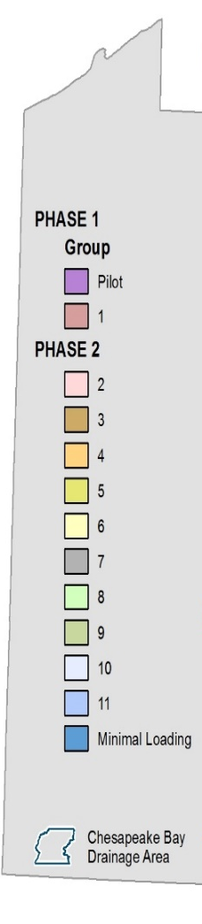

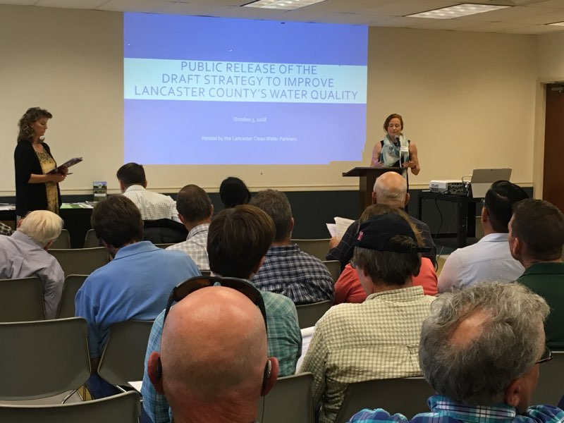
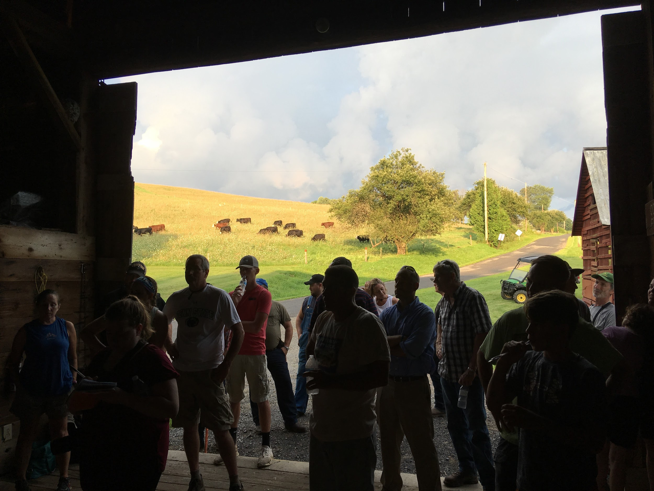
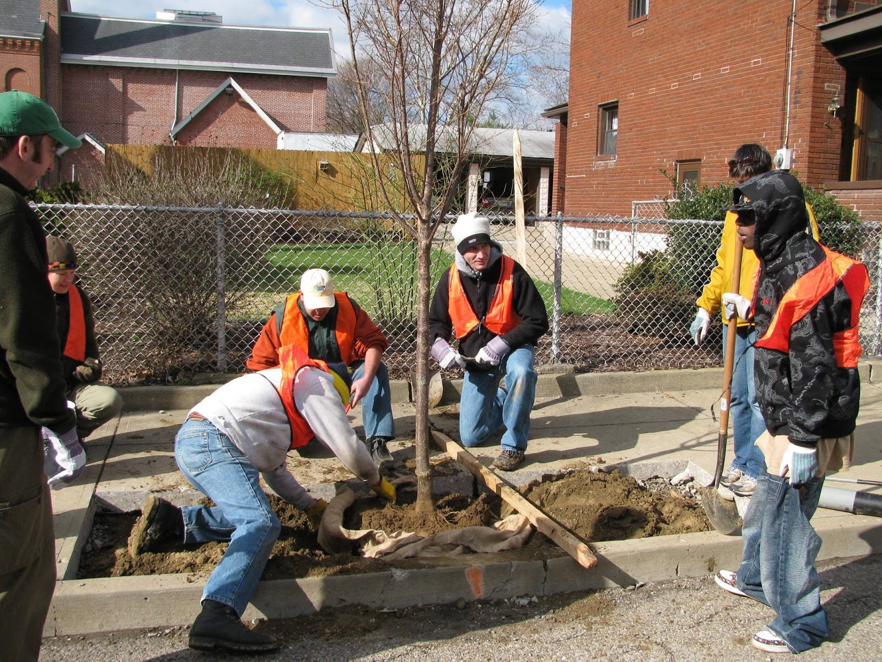
Clean Water Countywide Action Planning
County LOGO
Local Plans, Local Solutions
The Pennsylvania Phase 3 WIP focuses on local solutions for nutrient pollution reduction to local waterways. There are 43 counties in Pennsylvania whose waters run to the Chesapeake Bay. Pennsylvania has identified Countywide Action Plans (CAPs) as a way for local partners and stakeholders in those counties to decide how they will meet state nutrient pollution reduction goals and identify actions that address local issues, too. By creating a CAP, county participants can develop a strategy for cleaning up local waters, lowering flood risks, and improving the quality of life in their community.
Winter 2019
Winter 2019
Summer 2020
Summer 2020
Summer 2020
Fall 2020
Fall 2020
Fall 2020
Fall 2020
Winter 2020
Winter 2020
Winter 2020
Tier 1 - First 25% of Reductions | Tier 2 - Second 25% of Reductions | Tier 3 - Third 25% of Reductions |  | Tier 4 - Final 25% of Reductions
Lancaster -- Pilot York – Pilot | Franklin -- Pilot Lebanon (1) Cumberland (1) Centre (1) Bedford (1) | Adams – Pilot Northumberland (2) Perry (7) Snyder (5) Huntingdon (3) Columbia (2) Mifflin (8) Lycoming (6) | Schuylkill (4) Bradford (9) Juniata (8) Clinton (6) Tioga (9) Susquehanna (10) Clearfield (11) Fulton (3) | Union (5) Chester (4) Dauphin (7) Berks (4) Blair (3) Lackawanna (10) Luzerne (10) Montour (2) Cambria (11) Sullivan (9) | Potter (6) Somerset (min) Wyoming (min) Elk (min) Indiana (min) Cameron (min) Wayne (min) McKean (min) Jefferson (min) Carbon (min)

Slide 2
Developing Your Countywide Action Plan
Developing a Countywide Action Plan is a collaborative process. In each county, local stakeholders will convene a planning team and, with support from DEP, work together to create a plan that meets local clean water goals.
Assemble a Diverse Planning Team and Select Leaders
Key Resource: Community Clean Water Planning Guide
Participants are expected to come prepared to roll up their sleeves and get to work, so it’s important to ensure all the key players are at the table. Planning team members should include local residents, business owners, county and municipal staff, and representatives from relevant local, regional and state organizations. Team leaders should be committed, credible, open to new ideas, and skilled at leading groups and achieving consensus.
Set Meeting Schedule and Planning Strategy
Key Resource: Community Clean Water Planning Guide
Once the planning team is assembled, work together to set a regular meeting schedule and planning strategy. It can take up to 8 months to create a Countywide Action Plan, so setting a strategy for getting it done will keep the plan on track and use the team’s time efficiently. Include plan outreach and inclusion efforts from the beginning to ensure transparency in the group's decisions and garner community support for the completed plan.
Identify Countywide Goals and Steps to Reach Them
Key Resource: Community Clean Water Technical Toolbox
The Countywide Action Plan will help each planning team identify actions that address local issues AND meet DEP goals. By creating a Countywide Action Plan, counties can develop a strategy for: cleaning up local waters, lowering flood risks, and improving the quality of life in their community.
Assess Resource Needs and Opportunities
Key Resource: Community Clean Water Technical Toolbox
Once countywide goals are set, it’s time to figure out what resources are needed to reach them. Take the time to review existing plans and projects to see how they may overlap or compliment the Countywide Action Plan goals (e.g. county comprehensive plan, capital improvement projects, pollutant reduction plans, and watershed projects). Also, use this step to identify groups and organizations that could contribute to countywide efforts.
Finalize the Countywide Action Plan
Key Resources: Community Clean Water Planning Guide & Community Clean Water Technical Toolbox
Now that countywide goals are set and resource needs have been identified, it’s time to finalize the plan. Convene the planning team to review goals, action steps, and resources, invite community feedback and work together to finalize the plan. Be sure to include a plan for implementation and identify the implementation team members.
Implement the Countywide Action Plan
Key Resources: Community Clean Water Planning Guide & Community Clean Water Technical Toolbox
With planning complete, now it’s time for implementation. The implementation team should set up a regular meeting schedule, divide plan responsibilities, and work with partners to make progress towards Countywide Action Plan goals.
Track and Report Progress Towards Goals
Key Resources: Community Clean Water Planning Guide & Community Clean Water Technical Toolbox
Now that plan implementation is underway, it’s time to identify how progress towards countywide goals will be tracked and who will do it. Internal progress reporting should be part of Implementation Team meetings and community outreach. Each county will submit annual progress reports to the DEP using a standard reporting template.
For more information or to get involved in local planning efforts, please contact ___________at ____________.

