Slide 1
Chesapeake Bay Suite of Modeling Tools
December 19, 2017

Slide 2
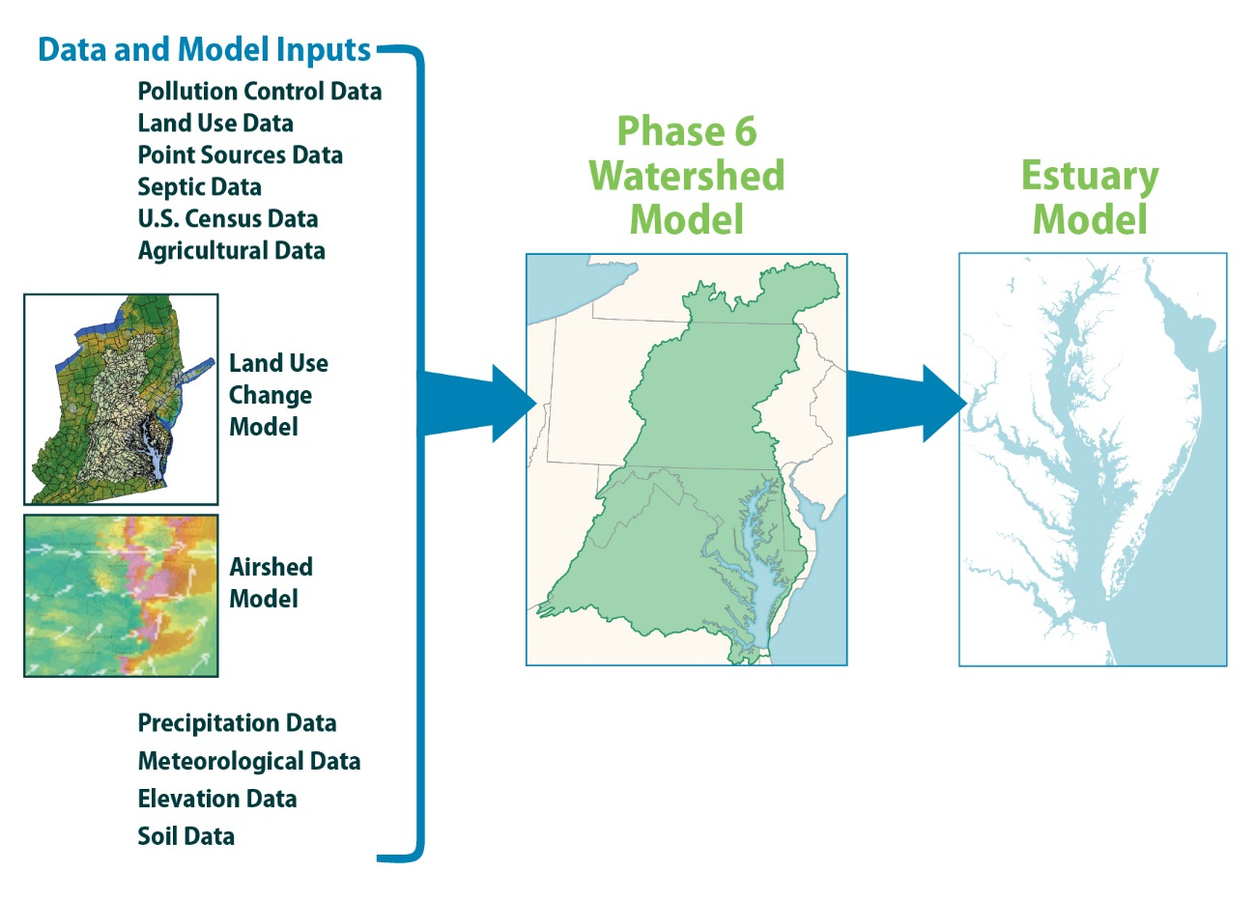
What is a model?
Scenarios, or model simulations, estimate how various changes or actions could affect an ecosystem (water quality, wildlife, aquatic life).
Model simulations, when combined with research and observations, provide best estimates based on the most up-to-date and corroborative science and data.
Notes:
Although model simulations are an important part of the Chesapeake Bay restoration effort, they are not considered to be perfect forecasts. Rather, simulations are best estimates based on state-of-the-art, extensively peer-reviewed science. Modeling is part of a broader toolkit that includes research and monitoring to gain the highest possible level of accuracy.

Slide 3

Why use a model for the Chesapeake Bay?
The Chesapeake Bay watershed and airshed are large and complex.
Scientists and decision makers rely on computer model simulations to see how efforts to reduce pollution affect water quality, wildlife and aquatic life.
Plays a key role in understanding and managing nutrient and sediment pollution.
Notes:
Image: Chickies Rock County Park in Columbia, PA, by Steve Droter, Chesapeake Bay Program (accessed from www.chesapeakebay.net)

Slide 4

The Chesapeake Bay Partnership
Applies state-of-the-art models of land use, the watershed, the airshed and the tidal Bay that are extensively peer-reviewed by the science community.
Accuracy and success of the models depend on the quality of data inputs, requiring partnerships with stakeholders.
Notes:
Image from meetings image page on www.chesapeakebay.net

Slide 5
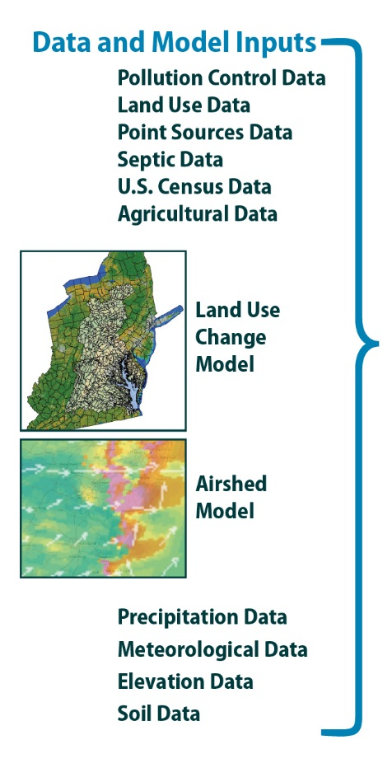
Chesapeake Bay Program Models
Suite of computer models that are among the most sophisticated, studied and respected in the world.
  Links to a variety of Bay-related models, data sources and other resources
Provides a comprehensive view of the Bay ecosystem, from the depths of the Bay to the upper reaches of the watershed, from land to air.
Can be used to determine what pollution control measures should be implemented.

Slide 6
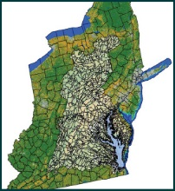
Land Use Change Model
Analyzes and forecasts the effects of urban land use and population on sewer and septic systems.
Forecasts are based on:
  Reported changes from the U.S. Census Bureau in housing, population and migration
  Sewer service areas
  County-level population projections
  Land cover trends (including the conversion of forests and farmland to development) derived from analysis of high-resolution land cover data and satellite imagery.
Information is input into the Watershed and Estuary Models.

Slide 7
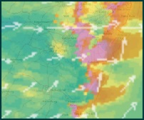
Airshed Model
Uses information about nitrogen emissions from power plants, vehicles and other sources to estimate the amount and location where reactive nitrogen oxides and ammonia are deposited.
National model run by the Environmental Protection Agency.
Information is input into the Watershed and Estuary Models.

Slide 8
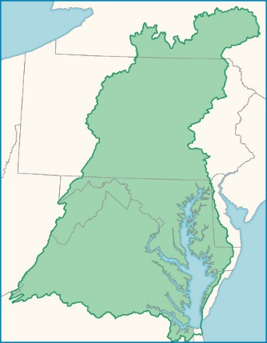
Phase 6 Watershed Model
Estimates amount and origin of nutrients and sediment reaching the Bay.
Divides the Bay into more than 2,000 segments delineating political and physical boundaries.
Can be used at smaller scales for state-developed TMDLs.
Helps connect monitoring data and the planning and implementation of restoration practices.
Past, present and future simulations help to evaluate management actions and alternatives.
Notes:
Incorporates information about land use, fertilizer applications, wastewater plant discharges, septic systems, air deposition, farm animal populations, management practices, watershed characteristics, stream characteristics, weather and other variables to estimate the amount of nutrients and sediment reaching the Chesapeake Bay and where these pollutants originate.
TMDLs are total maximum daily loads (may need to define this term, depending on the audience)
Built through a collaborative process through Chesapeake Bay Program partnership, which directed a development team made up of federal, academic, nonprofit and contractor staff.
Uses multiple models and lines of evidence to estimate the delivery of nutrients and sediment to the Bay.

Slide 9
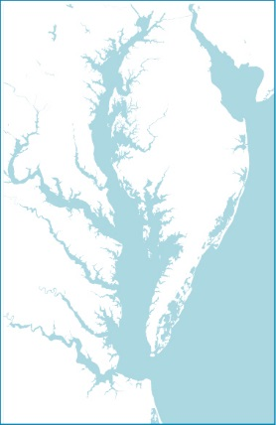
Estuary Model
Also called the Water Quality and Sediment Transport Model.
Examines the effects that pollution loads generated by the Watershed Model and Airshed Model have on water quality in the tidal waters of the Bay.
Examines model estimates of dissolved oxygen, chlorophyll a and water clarity to assess the protections of living resources (fish, shellfish, other invertebrates, submerged aquatic vegetation).
Notes:
The Chesapeake 2000 Agreement included commitments for adopting living resource-based water quality standards that would be protective of fish, shellfish, other invertebrates, and SAV. Dissolved oxygen, water clarity, and chlorophyll a criteria were determined and guidance was published based on protection for Chesapeake Bay living resources. https://www.chesapeakebay.net/documents/Deriving_Chesapeake_Water_Quality_Standards_10-13.pdf

Slide 10
Chesapeake Bay Suite of Modeling Tools

Slide 11
How do models determine pollution loads?
Built on current land use (e.g., forests, farms, developed) and determined by satellite imagery and U.S. Department of Agriculture Census of Agriculture.
Further refined by land management features (e.g., cover crops on farm fields, stormwater controls in urban areas).
Use of regional models to help pinpoint the types and amounts of pollution that run off due to a particular land use.

Slide 12
How do models determine pollution loads? (continued)
Pollution loads are cross-checked with recent research and studies.
Outputs include observed data and measureable features of the landscape.
Loads are further adjusted based on in-stream monitoring data
Simulations of the past, coupled with conservation practices, management actions and pollution controls help estimate current reductions.
Notes:
The types and amounts of pollution that run off a particular land use are based on comprehensive reviews of the latest scientific literature. For example, the pollution loads incorporated into the Watershed Model are based on research from more than 100 academic papers. This comprehensive literature review provides the average pollution loads that various land uses contribute.
In-stream monitoring data increases land use and location accuracy.

Slide 13
Web-based models
The suite of modeling tools are available online as the Chesapeake Assessment Scenario Tool, or CAST.
  Estuary and Airshed models are also open and free for anyone to use.
Virginia and Maryland have their own web-based modeling tool based on the Watershed Model
  Virginia Assessment Modeling Tool (VAST)
  Maryland Assessment Modeling Tool (MAST)
Chesapeake Bay Facility Assessment Scenario Tool, or BayFAST, is a web-based version of the suite of modeling tools that is geared toward federal facilities.
Notes:
It is recommended that only those that have familiarity and knowledge of how these models work use them.
Chesapeake Assessment Scenario Tool (CAST): https://cast.chesapeakebay.net
Chesapeake Bay Facility Assessment Scenario Tool (BayFAST): http://www.bayfast.org/default.aspx?AcceptsCookies=yes

Slide 14
New features of the Phase 6 Watershed Model
Easier to work with and understand.
Contains almost double the amount of data.
Uses high-resolution land cover data (1 meter by 1 meter resolution), providing 900 times the amount of information.
Brings more scientific and partnership input than ever before.
Includes new science, new data and new inputs from the agriculture community, including those from industries not previously involved.
Notes:
Most recent version of the Chesapeake Bay Watershed Model – replaces version 5.3.2 which was used to set the 2011 planning targets and track the Phase II Watershed Implementation Plans (WIPs).

Slide 15
New features of the Phase 6 Watershed Model (continued)
Over 30 years’ worth of monitoring data can be used to determine the accuracy of the land use and location simulations.
Includes new BMPs; others have been re-analyzed for their effectiveness.
Incorporates management decisions (Conowingo Dam, climate change and population growth).
Unifies CAST and the Watershed Model; replaces MAST and VAST.
Notes:
All loads are identical between CAST and the Watershed Model because the calculation engine will be the same and only the interfaces will differ.
With the unification of these modeling tools, MAST and VAST will be replaced by CAST.
MAST: http://www.mastonline.org/default.aspx?AcceptsCookies=yes
VAST: no longer available
Conowingo Dam is a large hydroelectric dam in the lower Susquehanna River near the town of Conowingo, Maryland. The dam supports a 9,000-acre reservoir about 9.9 miles from the river mouth at the Chesapeake Bay. The dam traps sediment from the Susquehanna River and ensures additional pollution does not reach the Chesapeake Bay. Recently, studies have questioned whether Conowingo is a viable sediment management strategy. The Conowingo dam could be opened and pollution currently trapped by the dam could enter the watershed.

