Slide 1


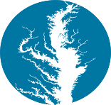
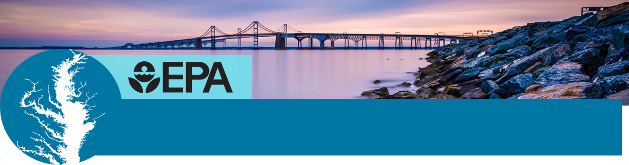
Phase III Watershed Implementation Plans
Including programmatic outcomes in your planning to provide co-benefits for your community and reduce pollution
NAME
TITLE
DATE

Slide 2
Why are we here today?
To explain why building certain conservation practices into your Phase III Watershed Implementation Plans (WIPs) can benefit:
  you and your community by providing economic and public health benefits,
  your state by helping to meet their goals for reducing nutrient pollution,
  and your local waterways by helping with their restoration and protection.
Notes:
This PowerPoint is designed for audiences that have some background in watershed implementation plans and knowledge of the Chesapeake Bay Total Maximum Daily Load (Bay TMDL).
It will inform your audience about the co-benefits associated with implementing certain conservation practices. The majority of these practices not only help in meeting your state’s water quality goals under the Bay TMDL, but also can meet other restoration goals not only for the Chesapeake Bay, but for the local waterways in your community.
These conservation practices can benefit you and your community by providing economic and public health benefits; your state by helping to meet their goals for reducing nutrient pollution; and your local waterways by helping with their restoration and protection.

Slide 3
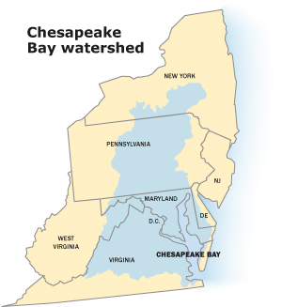
What are the Phase III WIPs?
Detailed, specific steps to address nutrient and sediment pollution.
Required to meet the pollution reduction goals set in the Chesapeake Bay Total Maximum Daily Load, or Bay TMDL.
Your conservation practices can be credited to help your state meet their pollution goals.
Beneficial for keeping your local waterways healthy.
Notes:
First, let’s start off with a simple explanation of what Watershed Implementation Plans are. They are required for each of the six watershed states and the District of Columbia to develop under the 2010 Chesapeake Bay Total Maximum Load or Bay TMDL.
These jurisdictions are in the process of developing Phase III of the WIPs, which call for engagement with their local partners and communities.
Conservation practices that you implement in your own communities, or on your own property can not only help your state meet their pollution reductions, but they also can provide you with economic benefits, provide a healthy area for your family and friends to reside in and they can help fulfil other commitments to help restore and protect the local waterways in your backyard.
WIPs are beneficial as they help track progress toward meeting pollution reduction goals, identify gaps and ensure the Bay and your local waterways are remaining healthy.

Slide 4
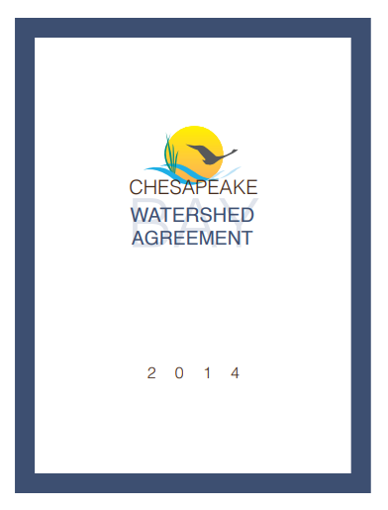
Chesapeake Bay Watershed Agreement
Signed in 2014 by the six watershed states, the District of Columbia, the Environmental Protection Agency and the Chesapeake Bay Commission.
Contains 10 goals and 31 outcomes to advance the restoration and protection of the Bay watershed.
Notes:
The Chesapeake Bay Program’s Watershed Agreement contains several goals that strive to create a healthy Bay watershed for all of its citizens.
Each of the six watershed states and the District of Columbia have signed on to meet various goals, which includes everything from stream health to environmental literacy.
Each goal is related to an outcome. Each outcome has an associated management strategy, which explains how we will accomplish the outcomes and how we will monitor, assess and report progress.
These ten goals are interrelated – improvements in water quality can mean healthier fish and shellfish; the conservation of land can mean more habitat for wildlife; and a boost in environmental literacy can mean a rise in stewards of the Bay’s resources.
Many conservation practices can help meet the outcomes within the Watershed Agreement.

Slide 5
Why are co-benefits important?
Implementing certain conservation practices can help meet your state’s pollution reduction goals but also can….
Help meet the goals of the Watershed Agreement
Provide economic benefits to and your community
Improve the health and welfare of your friends and family
Notes:
So, let’s just recap for a second. If you implement certain conservation practices to help meet pollution reduction goals, you can also help improve fish habitat, help underwater grasses and increase the brook trout population (among others)?
Let’s look a little bit closer to how this all is connected.

Slide 6
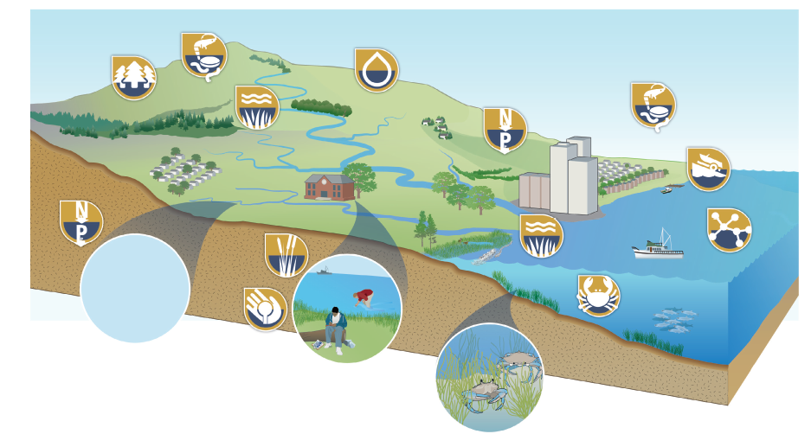
How can these outcomes provide co-benefits?
DRAFT
Notes:
Now let’s see how others have put these practices into action.
This is incredibly draft, but this is the first stab at putting together a graphic that shows how all of the outcomes of the watershed agreement are tied together.

Slide 7
A Rural Story – Mercer Vu Farms
Benefits: cost savings, innovative uses of by-products, reduction in air pollution and minimal climate impacts.
Outcomes met: climate resiliency, forest buffers, stream health
Conservation practices implemented: no-till farming, cover crops and riparian buffers.
Notes:
Location – Mercer Vu Farms, 1,500 acres in Franklin County, Pennsylvania.
In 2002, the farmers implemented a system of extracting water from the manure generated by their 1,500 dairy cows, which saved them money and reduced their carbon footprint. They connected with a company that makes mining equipment to purchase a machine that removes most of the sand that is used as bedding for the cows which gets mixed in with manure when the barns are flushed out with water. A centrifuge known as a cyclone separator spins at high speeds to remove even more fine solid particles from the liquid. These fine particles contain 40 percent of the manure’s phosphorus, which would otherwise leach into the ground and run off into the surrounding waterways of the farm.
The farmer is left with three products that he can now reuse on his farm: sand, dry manure and liquid manure. The sand is used as bedding for livestock and the dry manure is composted. The practice also cuts the farm’s use of fossil fuels from transportation by an estimated 3,500 tons of greenhouse gas emissions a year. Lightweight dry fertilizer is less expensive to haul to the fields than heavy liquid manure. It is easier to precisely control the application of dry, nutrient-rich fertilizer so it doesn’t wash into nearby waterways.
Further reducing its climate impact, the farm added a plastic cover to its 7.8 million gallon lagoon used to store the liquid manure following the separation process. The cover reduces the amount of nitrogen escaping into the air by 90 percent! The cover prevents rainwater from collecting in the lagoon, which translates into additional cost savings but not having to haul it out.
The farm is also 100 percent no-till and makes extensive use of cover crops. These practices allow stormwater to soak into the ground instead of causing erosion and flowing nutrient pollution into local waterways. The farm has also planted riparian buffers around the fields to absorb runoff.
The farm was able to implement these conservation practices through grants from the U.S. Department of Agriculture’s National Resources Conservation Service.
These conservation practices are credited toward meeting Pennsylvania’s nutrient and sediment reduction goals under the Phase III WIPs.

Slide 8
A Suburban Story – READY Program
Conservation practices implemented: rain gardens, forest buffers, rain barrels, impervious surface treatment
Benefits: job creation, environmental education, reduced stormwater loads
Outcomes met: forest buffers, tree canopy, diversity, environmental literacy
Notes:
Restoring the Environment and Developing Youth (READY) is a program working to create green jobs for young adults while improving watershed health through the reduction of stormwater runoff and providing additional environmental protection services.
READY members are trained in the design and installation of green stormwater techniques such as rain gardens and rain barrels, maintenance of public and private installations, and stormwater assessment techniques. They receive job skills training and are exposed to local and regional environmental issues.
The recent economic recession has created difficult employment conditions in many areas. There are also few opportunities for young men and women to earn money for education and/or acquire job skills to succeed in today’s competitive job market. At the same time, local jurisdictions are also being required to accelerate the implementation of stormwater controls in a slow growing economy with continued high unemployment.
This particular case study took place in Howard County, Maryland, but similar programs are ramping up in Lancaster and Anne Arundel County, Maryland. When this project took place in 2015, READY team members treated over 70,000 square feet of impervious surface, installed 20 rain gardens and eight BayScape gardens and conducted BMP maintenance, stream cleanups, tree plantings and environmental education with students.
The core of this project aims to provide jobs for young adults who have little access to environmental jobs and help to reduce stormwater loads coming from regional roads, rooftops, and parking areas. More deeply, it will help to engage the suburban and urban underserved communities in environmental activities. It will also provide a pipeline of trained and enthusiastic young people ready to accept jobs with environmental groups and institutions working to protect our environment.
Funding for this program came from several partners: the majority of it came from the state of Maryland, but local congregations that were already members of the Alliance for the Chesapeake Bay’s RiverWise Congregations program provided fee for service support. The local county also provided grants and work contracts. Additional funding came from other non-governmental partners, businesses and school systems.

Slide 9
An Urban Story – Greening Virginia’s Capital
Conservation practices implemented: green alleys, permeable pavers, rain gardens
Benefits: nitrogen and phosphorus reductions, abated stormwater runoff, recreation
Outcomes met: toxic contaminants, healthy watersheds, climate resiliency, fish habitat
Notes:
The project’s goal was to help free two neighborhoods from dangerous traffic, lack of green space and economic concerns, while at the same time reduce stormwater pollution, specifically nitrogen, phosphorus and sediment that is carried to rivers and streams during storm events.
Funding for this project largely came from the U.S. EPA, with additional grants from the Department of Housing and Urban Development and the Department of Transportation.
The project built upon a community vision and ongoing work to increase pedestrian and cyclist safety, develop pocket parks and continue the area’s economic comeback.
The partners worked together to install green alleys, permeable pavers, rain gardens, urban food gardens and BayScapes on Capitol Square and surrounding city streets. These projects were estimated to reduce stormwater runoff flowing into Richmond’s sewer system by 64%, phosphorus by 69% and nitrogen by 70%. However by the end of the project, we were pleased to learn that those projections were exceeded. The actual amount of stormwater runoff reduced was 70%, phosphorus was 86%, and nitrogen was 90%.

Slide 10
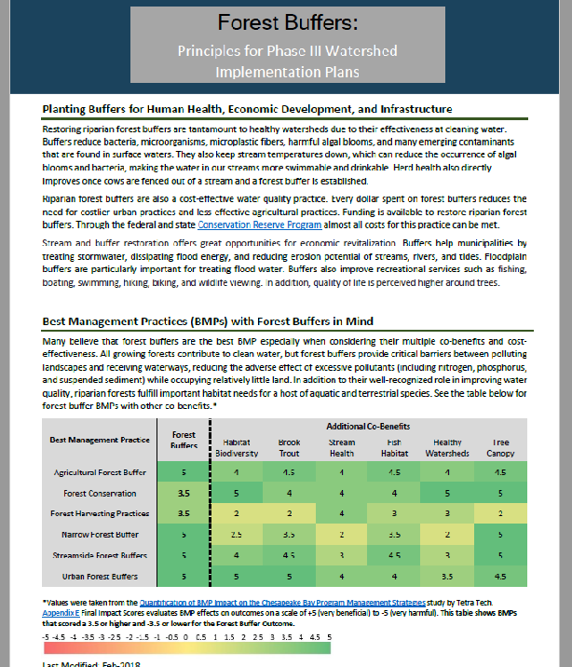
Name of outcome.
Short summary about the outcome and its co-benefits.
Table showing best management practices with co-benefits in mind. The table shows the effects of best management practices on outcomes on a scale from +5 (very beneficial) to -5 (very harmful).
Notes:
The workgroups at the Chesapeake Bay Program are recommending twelve outcomes to consider when planning your conservation practices. We’ll get into them shortly.
They’ve developed a series of templates, which are available for you to take today and also on their website – www.chesapeakebay.net – to help you understand why they are beneficial and what would be the best for your and your community’s needs.
A note about the table: the Chesapeake Bay Program conducted a survey to determine how conservation practices can be quantified. Each of these twelve outcomes have different conservation practices that are most beneficial to them. Each of these conservation practices provide co-benefits to other outcomes as well, but they vary.

Slide 11
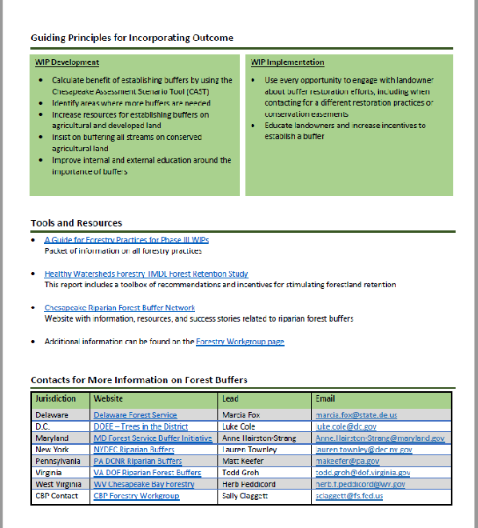
Guiding principles for incorporating outcome (WIP development and implementation).
Additional tools and resources.
Points of contact.
Notes:
Each template includes guiding principles for incorporating the outcome – both in the development and the implementation of the WIP.
It also includes a section for additional tools and resources, as well as the Bay Program and jurisdictional point of contact.

Slide 12
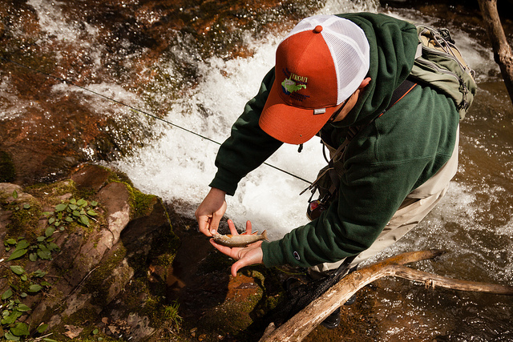
Brook Trout

Slide 13
Outcome: Restore and sustain naturally reproducing brook trout populations in Chesapeake headwater streams with an eight percent increase in occupied habitat by 2025.
Progress: A formal indicator of progress for brook trout is under development.
Implementing these conservation and restoration practices:
Agricultural forest buffers
Streamside forest buffers
Will also benefit these outcomes!
Habitat and biodiversity
Stream health
Fish habitat
Healthy watersheds
Forest buffer
Tree canopy
Notes:
The Chesapeake Bay Program has not yet established an indicator to track progress for the brook trout outcome. However, an assessment by the Eastern Brook Trout Joint Venture found that wild brook trout occupy 33,200 square kilometers of habitat in the Chesapeake Bay watershed. There are 13,500 square kilometers of ‘wild brook trout’ only streams in the watershed, which compromise 990 separate patches, which means that 14,600 square kilometers of habitat occupied only by wild brook trout will serve as the baseline of our restoration goal.
To better understand how implementing conservation practices to benefit brook trout will also benefit other outcomes, let’s take a look at some examples.
A survey conducted by the Chesapeake Bay Program to quantify the impact of conservation practices, or best management practices, found that agricultural forest buffers and streamside forest buffers would benefit brook trout the most out of any other practice, while at the same time benefiting habitat and biodiversity, stream health, fish habitat, healthy watershed, forest buffer and tree canopy. More examples of conservation practices and their co-benefits are found in the brook trout outcome template.

Slide 14
What should I know about brook trout?
Water quality is imperative to sustaining a healthy brook trout habitat. They thrive in clean, cool streams (under 68 degrees Fahrenheit). Plant agriculture and streamside buffers conserve nearby forests to reduce temperature and sediment inputs.
Brook trout are highly prized by recreational anglers who spend millions of dollars annually on related goods and services, including travel, that would directly benefit local and state economies.

Slide 15
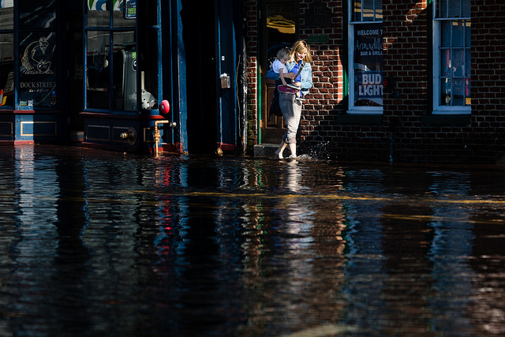
Climate Resiliency

Slide 16
Goal: Increase the resiliency of the Chesapeake Bay watershed, including its living resources, habitats, public infrastructure and communities, to withstand adverse impacts from changing environmental and climate conditions.
Progress: A formal indicator of progress for climate adaption and climate monitoring and assessment is under development.
Implementing these conservation and restoration practices:
Urban Forest Buffers
Forest Conservation
Will also benefit these outcomes!
Climate adaption
Energy efficiency
Flood risk mitigation
Notes:
The Chesapeake Bay Program has two indicators under its Climate Resiliency goal: Climate adaption and Climate Monitoring and Assessment. The Bay Program’s Climate Resiliency Workgroup is developing a suite of climate-related indicators that can be used to track and analyze trends, impacts and progress towards advancing climate resiliency. The suite will include measurements of physical and chemical environmental attributes; measurements of ecological, economic and societal impacts; and measurements of programmatic progress toward adaption and resilience over time. The initial subset of indicators should be available by July 2018.
A survey conducted by the Chesapeake Bay Program to quantify the impact of conservation practices, or best management practices, found that urban forest buffers and forest conservation would benefit climate resiliency the most out of any other practice, while at the same time benefiting climate adaption, energy efficiency and flood risk mitigation. More examples of conservation practices and their co-benefits are found in the climate resiliency outcome template.

Slide 17
What should I know about climate resiliency?
Addressing climate impacts in conjunction with ongoing restoration efforts will prepare your community for greater variability and can help achieve cost savings and reduce risks.
Considering future impacts during the planning, siting, design and implementation of conservation practices can help to reduce the vulnerability of a project to fail.
Assessing climate impacts at the initial stage of watershed implementation planning will increase effectiveness, decrease maintenance costs and contribute toward meeting pollution reduction goals.

Slide 18
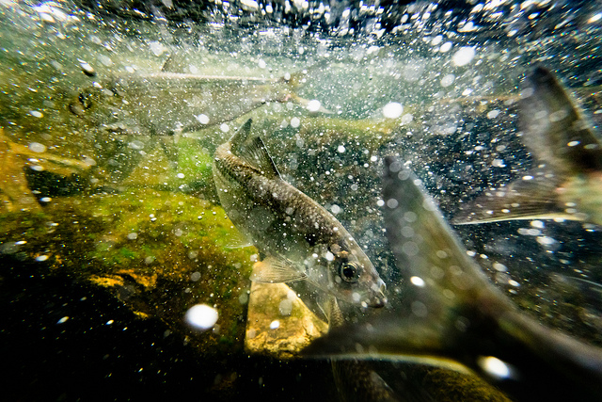
Fish Habitat

Slide 19
Outcome: Continually improve effectiveness of fish habitat conservation and restoration efforts by identifying and characterizing critical spawning, nursery and forage areas within the Bay and tributaries for important fish and shellfish, and use existing and new tools to integrate information and conduct assessments to inform restoration and conservation efforts.
Progress: A formal indicator of progress for fish habitat is under development.
Implementing these conservation and restoration practices:
Agricultural forest buffer.
Streamside forest buffer.
Urban stream restoration.
Will also benefit these outcomes!
Protected lands.
Habitat biodiversity.
Brook trout.
Blue crab.
Recreation.
Forage fish.
Wetlands.
Notes:
Due to the range of areas that comprise fish habitat and the existing gaps in our understanding of which habitats offer the highest value for fish reproduction, feeding, growth or refuge, there is no established baseline for this outcome at this time.
Findings from the Smithsonian Environmental Research Center found that fish and crustacean abundance is lower in areas near hardened shorelines, highlighting the importance of living shorelines, the conservation or restoration of coastal wetlands, and other alternatives to traditional shoreline hardening.
A survey conducted by the Chesapeake Bay Program to quantify the impact of conservation practices, or best management practices, found that agricultural forest buffers, streamside forest buffers and urban stream restoration would benefit fish habitat the most out of any other practice, while at the same time benefiting protected lands, habitat biodiversity, brook trout, blue crab, recreation, forage fish and wetlands. More examples of conservation practices and their co-benefits are found in the fish habitat outcome template.

Slide 20
What do I need to know about fish habitat?
Fish are important to ecosystem function and provide economic and social benefits.
Local land use decisions impact the production and sustainability of fish resources.
If designed effectively, infrastructure projects and conservation practices can improve fish habitat, create resiliency to projected climate change impacts and decrease erosion.
Notes:
Fish are important to ecosystem function, but they also provide economic and social benefits through tourism, food service and fishing opportunities. The resource needs fish habitat to live and thrive, including roots and underwater grasses to inhabit as juveniles, unimpeded waters to spawn, and shallow areas to hide from aquatic predators.
Local land use decisions impact the production and sustainability of fish resources. Continuous habitat is more favorable for supporting fish than fragmented habitat, and fish are more responsive to restoration efforts in watersheds with less impervious surface. Development and hardening of nearshore areas threaten fish habitat and the benefits these fish provide to people. It is always cheaper to protect habitat than it is to restore it!
Fortunately, many fish habitat needs can be improved through BMP / infrastructure projects. If designed effectively, infrastructure projects can improve fish habitat, create resiliency to projected climate change impacts, and decrease erosion. But not all BMPs provide this co-benefit.
Slowing runoff helps fish communities. It will reduce nutrients and sediments but also may reduce contaminants and toxins into the water. This can also improve fish health and provide a healthier food product when fish are consumed.
Don’t impound water near coldwater streams. It will raise the stream temperature and is harmful to certain fish.

Slide 21
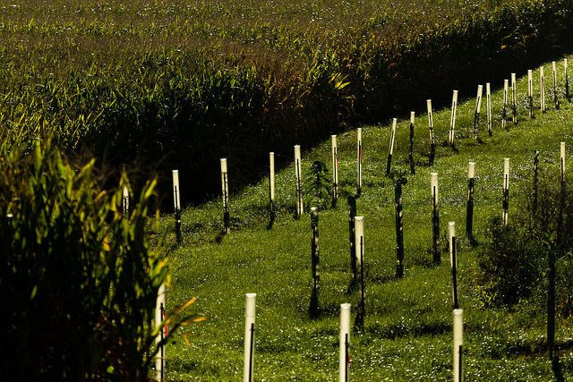
Forest Buffers

Slide 22
Outcome: Continually increase the capacity of forest buffers to provide water quality and habitat benefits throughout the watershed. Restore 900 miles per year of riparian forest buffer and conserve existing buffers until at least 70 percent of riparian areas throughout the watershed are forested.
Progress: As of 2015, seven percent of the annual target achieved.
Implementing these conservation and restoration practices:
Agricultural forest buffer.
Forest conservation.
Urban forest buffers.
Will also benefit these outcomes!
Habitat biodiversity.
Brook trout.
Stream health.
Fish habitat.
Healthy watersheds.
Tree canopy.
Notes:
A survey conducted by the Chesapeake Bay Program to quantify the impact of conservation practices, or best management practices, found that agricultural forest buffers, forest conservation and urban forest buffers would benefit forest buffers the most out of any other practice, while at the same time benefiting habitat biodiversity, brook trout, stream health, fish habitat, healthy watersheds and tree canopy. More examples of conservation practices and their co-benefits are found in the forest buffer outcome template.

Slide 23
What do I need to know about forest buffers?
Riparian forest buffers reduce bacteria, microorganisms, microplastic fibers, harmful algal blooms, and many emerging contaminants that are found in surface waters, including drinking water.
Riparian forest buffers keep streams cool for fish and wildlife.
Buffers help municipalities by treating stormwater, dissipating flood energy, and reducing erosion potential of streams, rivers, and tides. Buffers also improve recreation like fishing, boating, swimming, hiking, biking, and wildlife viewing.

Slide 24
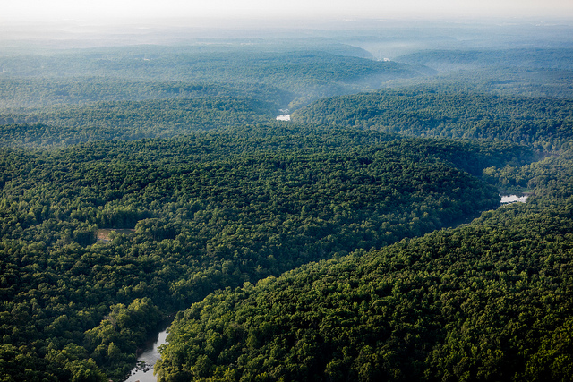
Healthy Watersheds

Slide 25
Outcome: 100 percent of state-identified currently healthy waters and watersheds remain healthy.
Progress: Each of the six watershed states and the District of Columbia have different definitions of healthy waters and watersheds in which they use to track and support protection.
Implementing these conservation and restoration practices:
Agricultural forest buffers.
Forest conservation.
Urban forest buffers.
Urban growth reduction.
Urban stream restoration.
Will also benefit these outcomes!
Protected lands.
Biodiversity habitat.
Brook trout.
Stream health.
Fish habitat.
Forage fish.
Flood mitigation.
Recreation.
Notes:
The Chesapeake Bay Program has established a baseline of healthy waters and watersheds across the region. Using federal, state and local data, a new initiative has launched to track the status of state-identified healthy waters and watersheds in order to identify vulnerabilities and assess whether watershed health is being maintained.
A survey conducted by the Chesapeake Bay Program to quantify the impact of conservation practices, or best management practices, found that agricultural forest buffers, forest conservation, urban forest buffers, urban growth reduction and urban stream restoration would benefit healthy watersheds the most out of any other practice, while at the same time benefiting protected lands, habitat biodiversity, brook trout, stream health, fish habitat, forage fish, flood mitigation and recreation. More examples of conservation practices and their co-benefits are found in the healthy watersheds outcome template.

Slide 26
What should I know about healthy watersheds?
It’s important to know where the healthy waters and watersheds in your community and state are located.
Intact healthy ecosystems prevent costly restoration and ecosystem service replacement and provide long-term societal benefits.
Implementation of planning incentives, tools and policies aimed at reducing the rate of conversion of natural lands (within healthy watersheds) to development can help:
  offset future urban growth,
  increase conservation,
  provide flood mitigation,
  maintain source water and
  help meet water quality pollution reduction goals.

Slide 27
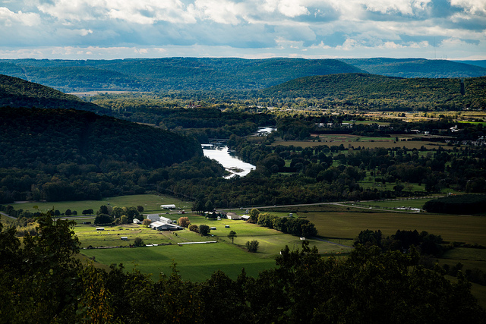
Protected Lands

Slide 28
Outcome: By 2025, protect an additional two million acres of lands throughout the watershed – currently identified as high conservation priorities at the federal, state or local level – including 225,000 acres of wetlands and 695,000 acres of forest land of highest value for maintaining water quality.
Progress: As of 2015 – 2016, fifty percent of the outcome had been achieved.
Implementing these conservation and restoration practices:
Agricultural forest buffers.
Forest conservation.
Urban forest buffers.
Also benefit these outcomes!
Biodiversity and habitat.
Wetlands.
Healthy watersheds.
Land use metrics and methods.
Fish habitat.
Climate adaption.
Forest buffers.
Recreation.
Notes:
A survey conducted by the Chesapeake Bay Program to quantify the impact of conservation practices, or best management practices, found that agricultural forest buffers, forest conservation and urban forest buffers would benefit protected lands the most out of any other practice, while at the same time benefiting habitat biodiversity, wetlands, healthy watersheds, land use metrics and methods, fish habitat, climate adaption, forest buffers and recreation. More examples of conservation practices and their co-benefits are found in the protected lands outcome template.

Slide 29
What should I know about protected lands?
Preserving lands increase the economic benefits generated by the outdoor recreation industry and improves human health and well-being through regularity of spending time in nature.
Local economies are buoyed by tourism to preserve historic, cultural and heritage sites and landscapes.
The Chesapeake Bay Program is perfecting for the first time a set of new “Conservation Plus Best Management Practices” with estimated pollution load reductions for the retention of high quality forests, agricultural lands, and growth management. These new conservation practices will be available for localities projected to experience future growth and development to consider in preparing their Phase III WIPs.

Slide 30
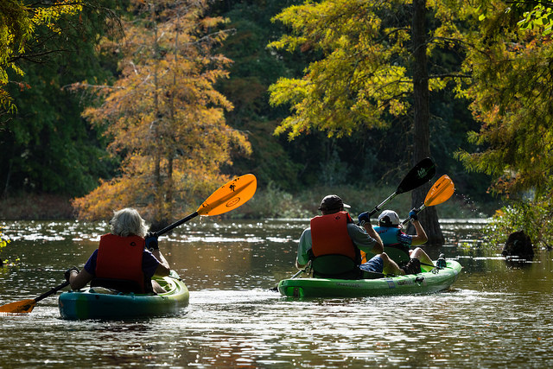
Public Access

Slide 31
Outcome: By 2025, add 300 new public access sites, with a strong emphasis on providing opportunities for boating, swimming and fishing, where feasible.
Progress: As of 2016, 44 percent of the outcome has been achieved.
Implementing these conservation and restoration practices:
Agricultural forest buffer.
Forest conservation.
Urban stream restoration.
Also benefit these outcomes!
Biodiversity habitat.
Brook trout.
Stream health.
Healthy watersheds.
Fish habitat.
Forage fish.
Notes:
A survey conducted by the Chesapeake Bay Program to quantify the impact of conservation practices, or best management practices, found that agricultural forest buffers, forest conservation and urban stream restoration would benefit public access the most out of any other practice, while at the same time benefiting habitat biodiversity, brook trout, stream health, healthy watersheds, fish habitat and forage fish. More examples of conservation practices and their co-benefits are found in the public access outcome template.

Slide 32
What do I need to know about public access?
Providing public access is a significant contributor to the economy of the Bay watershed. According to the 2006 study The Active Outdoor Recreation Economy, paddle-based recreation and fishing alone have a total national economic value of $97.5 billion.
Open, green spaces and waterways with ample public access bolster public health and quality of life. Outdoor time strengthens family bonds and nurtures creative children, while building personal connections with the very places that have shaped life in the region for centuries—especially its streams, rivers and bays.
Designing and developing access sites in harmony with major infrastructure needs such as roads, utilities and schools can help to maximize benefits of dollars spent. Appropriate conservation practices developed as part of other infrastructure needs close to an access site may reduce the potential development impact of the access facility.

Slide 33
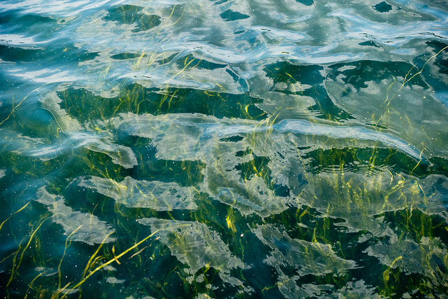
Underwater Grasses

Slide 34
Outcome: Sustain and increase the habitat benefits of underwater grasses in the Chesapeake Bay. Achieve and sustain the ultimate outcome of 185,000 acres of grasses Bay-wide necessary for a restored Bay. Progress toward this ultimate outcome will be measured against a target of 90.000 acres of 2017 and 130,000 acres by 2025.
Progress: Fifty-three percent of the outcome has been achieved.
Implementing these conservation and restoration practices:
Nutrient management plan.
Wetland and streamside wetland restoration.
Agriculture stream restoration.
Advanced grey infrastructure nutrient discovery program.
Also can benefit these outcomes!
Wetlands.
Blue crab abundance.
Oyster.
Stream health.
Fish habitat.
Forage fish.
Drinking water protection/security.
Notes:
A survey conducted by the Chesapeake Bay Program to quantify the impact of conservation practices, or best management practices, found that nutrient management plans, wetland and streamside wetland restoration, agriculture stream restoration and advanced grey infrastructure nutrient discovery program would benefit underwater grasses the most out of any other practice, while at the same time benefiting wetlands, blue crab abundance, oysters, stream health, fish habitat, forage fish and drinking water protection/security. More examples of conservation practices and their co-benefits are found in the underwater grasses outcome template.

Slide 35
What should I know about underwater grasses?
Underwater grasses are integral to the life cycle of many bay creatures; it provides oxygen, food and shelter for blue crabs and juvenile rockfish, supporting the health of valuable commercial and recreational fisheries.
Underwater grasses are sensitive to changes in water quality, particularly clarity. Large sediment and nutrient loads lead to impaired conditions; it needs sunlight to grow.
  Avoid increases in nearby impervious surface
Underwater grasses are sensitive to sea level rise; it requires adjacent non-hardened shoreline in order to migrate and sustain.

Slide 36
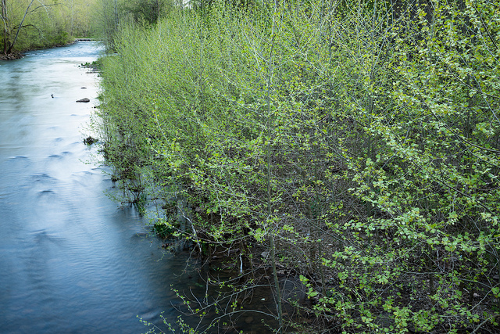
Stream Health

Slide 37
Outcome: Continually improve stream health and function throughout the watershed. Improve health and function of ten percent of stream miles above the 2008 baseline for the Chesapeake Bay watershed.
Progress: As of 2010, 43 percent of streams across the watershed were in fair, good or excellent condition.
Implementing these conservation and restoration practices:
  Forest conservation.
  Agricultural forest buffers.
  Urban forest buffers.
  Urban stream restoration.
Also benefit these outcomes!
  Brook trout.
  Healthy watersheds.
  Forest buffers.
  Flood control/mitigation.
  Protected lands.
Notes:
A survey conducted by the Chesapeake Bay Program to quantify the impact of conservation practices, or best management practices, found that agricultural forest buffers, forest conservation, urban forest buffers and urban stream restoration would benefit stream health the most out of any other practice, while at the same time benefiting brook trout, healthy watersheds, forest buffers, flood control/mitigation and protected lands. More examples of conservation practices and their co-benefits are found in the stream health outcome template.

Slide 38
What should I know about stream health?
Healthy streams and floodplains provide benefits for water filtration, flood mitigation and recreational opportunities while removing public safety and infrastructure hazards.
Threats to streams include increased water volume and velocity due to land use changes, channelization and erosion from human development, as well as alteration of habitat features and water quality that reflect riparian development.
When functioning together, stream and wetland complexes should be considered a powerful resource for complete upland filtration and habitat benefits.

Slide 39
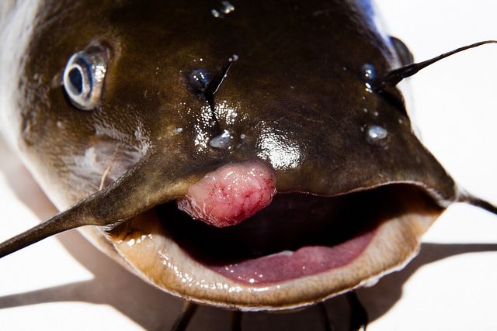
Toxic Contaminants

Slide 40
Goal: Ensure that the Bay and its rivers are free of effects of toxic contaminants on living resources and human health.
Progress: Eighty percent of the Chesapeake Bay and its tidal tributaries was partially or fully impaired by toxic contaminants in 2014.
Implementing these conservation and restoration practices:
Narrow forest buffer.
Agricultural forest buffer.
Urban forest buffers.
Also benefit these outcomes:
Urban pollutants.
Agricultural pollutants.
Steam health.
Forage fish.
Citizen stewardship.
Notes:
A survey conducted by the Chesapeake Bay Program to quantify the impact of conservation practices, or best management practices, found that agricultural forest buffers, narrow forest buffers and urban forest buffers would benefit toxic contaminants the most out of any other practice, while at the same time benefiting urban pollutants, agricultural pollutants, stream health, forage fish and citizen stewardship. More examples of conservation practices and their co-benefits are found in the toxic contaminants outcome template.

Slide 41
What should I know about toxic contaminants?
Approximately 80 percent of the Bay’s tidal water segments are at least partially impaired by one or more toxic contaminants, indicating that the problem is widespread.
Contaminants vary by source sector and many are associated with either agricultural or urban land uses.
Toxic contaminants can be partially controlled through practices that manage sediment—this applies to all sectors (urban, agricultural, forested and open spaces).
Notes:
Agricultural pollutants of priority include pesticides (herbicides, insecticides and other pesticides) and hormones from animal waste. Example priority urban pollutants include PCBs, PAHs and mercury.
This includes buffer practices, exclusion fencing, shoreline management, and any stormwater and runoff control practices. In agricultural sectors, managing animal waste can prevent biogenic hormones from entering surface waters.

Slide 42

Tree Canopy

Slide 43
Outcome: Continually increase urban tree canopy capacity to provide air quality, water quality and habitat benefits throughout the watershed. Expand urban tree canopy by 2,400 acres by 2025.
Progress: A formal indicator of progress for climate adaption and climate monitoring and assessment is under development.
Implementing these conservation and restoration practices:
Agricultural forest buffers.
Forest conservation.
Urban forest buffers.
Also benefit these outcomes:
Habitat biodiversity.
Air quality.
Land use methods.
Fish habitats.
Healthy watersheds.
Forest buffers.
Notes:
A survey conducted by the Chesapeake Bay Program to quantify the impact of conservation practices, or best management practices, found that agricultural forest buffers, forest conservation and urban forest buffers would benefit tree canopy the most out of any other practice, while at the same time benefiting habitat biodiversity, air quality, land use methods, fish habitats, healthy watersheds and forest buffers. More examples of conservation practices and their co-benefits are found in the tree canopy outcome template.

Slide 44
What should I know about tree canopy?
Tree canopy provides numerous benefits to human and watershed health.
The shading powers of tree canopy produce energy savings to homeowners, businesses, local governments and utilities.
Trees are the ‘green infrastructure’ of communities. Green stormwater infrastructure is designed to mimic the function of a natural forest. Tree intercept and slow the delivery of stormwater runoff to local waterways while filtering and taking up pollutants.

Slide 45
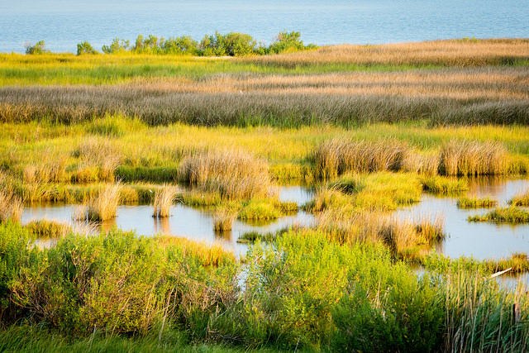
Wetlands

Slide 46
Outcome: Continually increase the capacity of wetlands to provide water quality and habitat benefits throughout the watershed. Create or re-establish 85,000 acres of tidal and non-tidal wetlands and enhance the function of an additional 150,000 acres of degraded wetlands by 2025. These activities may occur in any land use (including urban) but primarily occur in agricultural or natural landscapes.
Progress: As of 2015, nine percent of the outcome has been achieved.
Implementing these conservation and restoration practices:
Wetlands.
Wet ponds.
Urban forest buffers.
Also benefit these outcomes:
Black ducks.
Climate adaption.
Flood control/mitigation.
Groundwater recharge/infiltration.
Recreation.
Notes:
A survey conducted by the Chesapeake Bay Program to quantify the impact of conservation practices, or best management practices, found that wetlands, wet ponds and urban forest buffers would benefit wetlands the most out of any other practice, while at the same time benefiting black ducks, climate adaption, flood control/mitigation, groundwater recharge/infiltration and recreation. More examples of conservation practices and their co-benefits are found in the wetlands outcome template.

Slide 47
Wetlands provide areas of infiltration for water and runoff to connect with the groundwater, thus filtering pollutants and toxins and recharging below ground reserves, while also creating vital habitat patches for wildlife which provide hunting and recreational opportunities with economic benefits to surrounding communities.
Wetlands are threatened by direct land use conversation as well as development and land use changes that affect groundwater flow patterns, which can isolate wetlands from the rest of the landscape or permanently remove the source of water.
When functioning together, wetland and stream complexes should be considered a powerful resource for complete upland filtration and habitat benefits.

Slide 48

Therefore…
Co-benefits can be powerful!

Slide 49
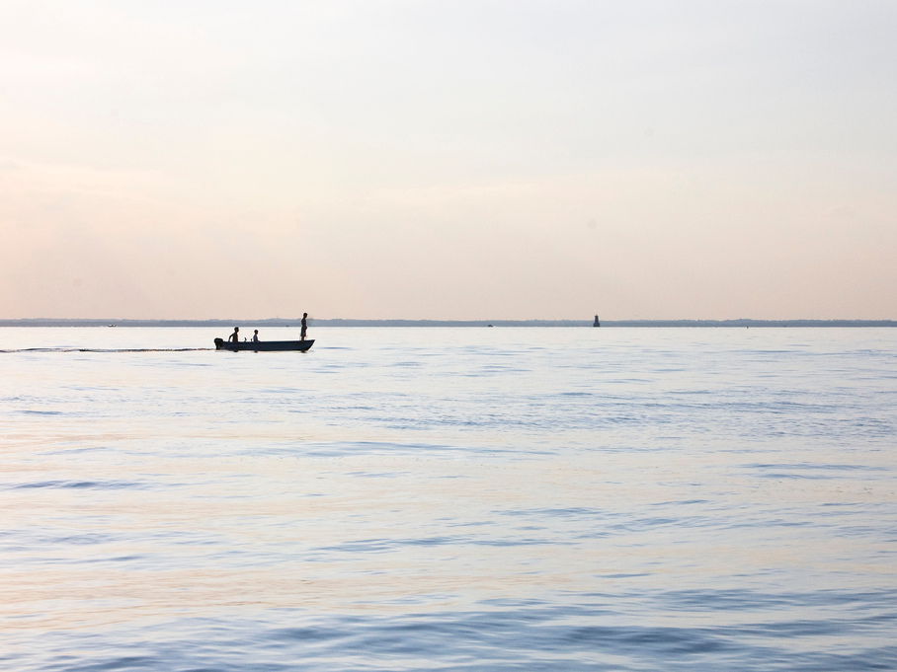
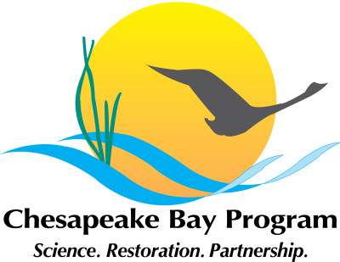
NAME
TITLE
CONTACT INFORMATION

