Slide 1

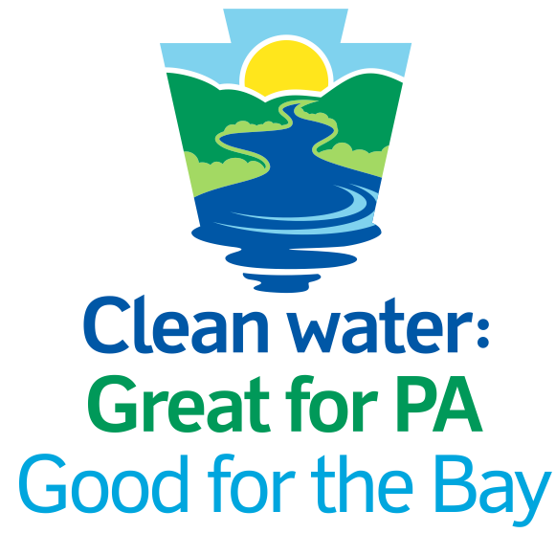
XYZ County Action Plan
Healthy Waters, Healthy Communities
What the Pennsylvania Phase 3 Watershed Implementation Plan (WIP3) means for Agriculture
Your Logo Here
June 2020

Slide 2
Today’s Agenda
Overview: Phosphorus & Nitrogen Pollution
What It Means for XZY County
XYZ County Action Plan:
What
Who
When
How
Questions
Contact Info
June 2020

Slide 3
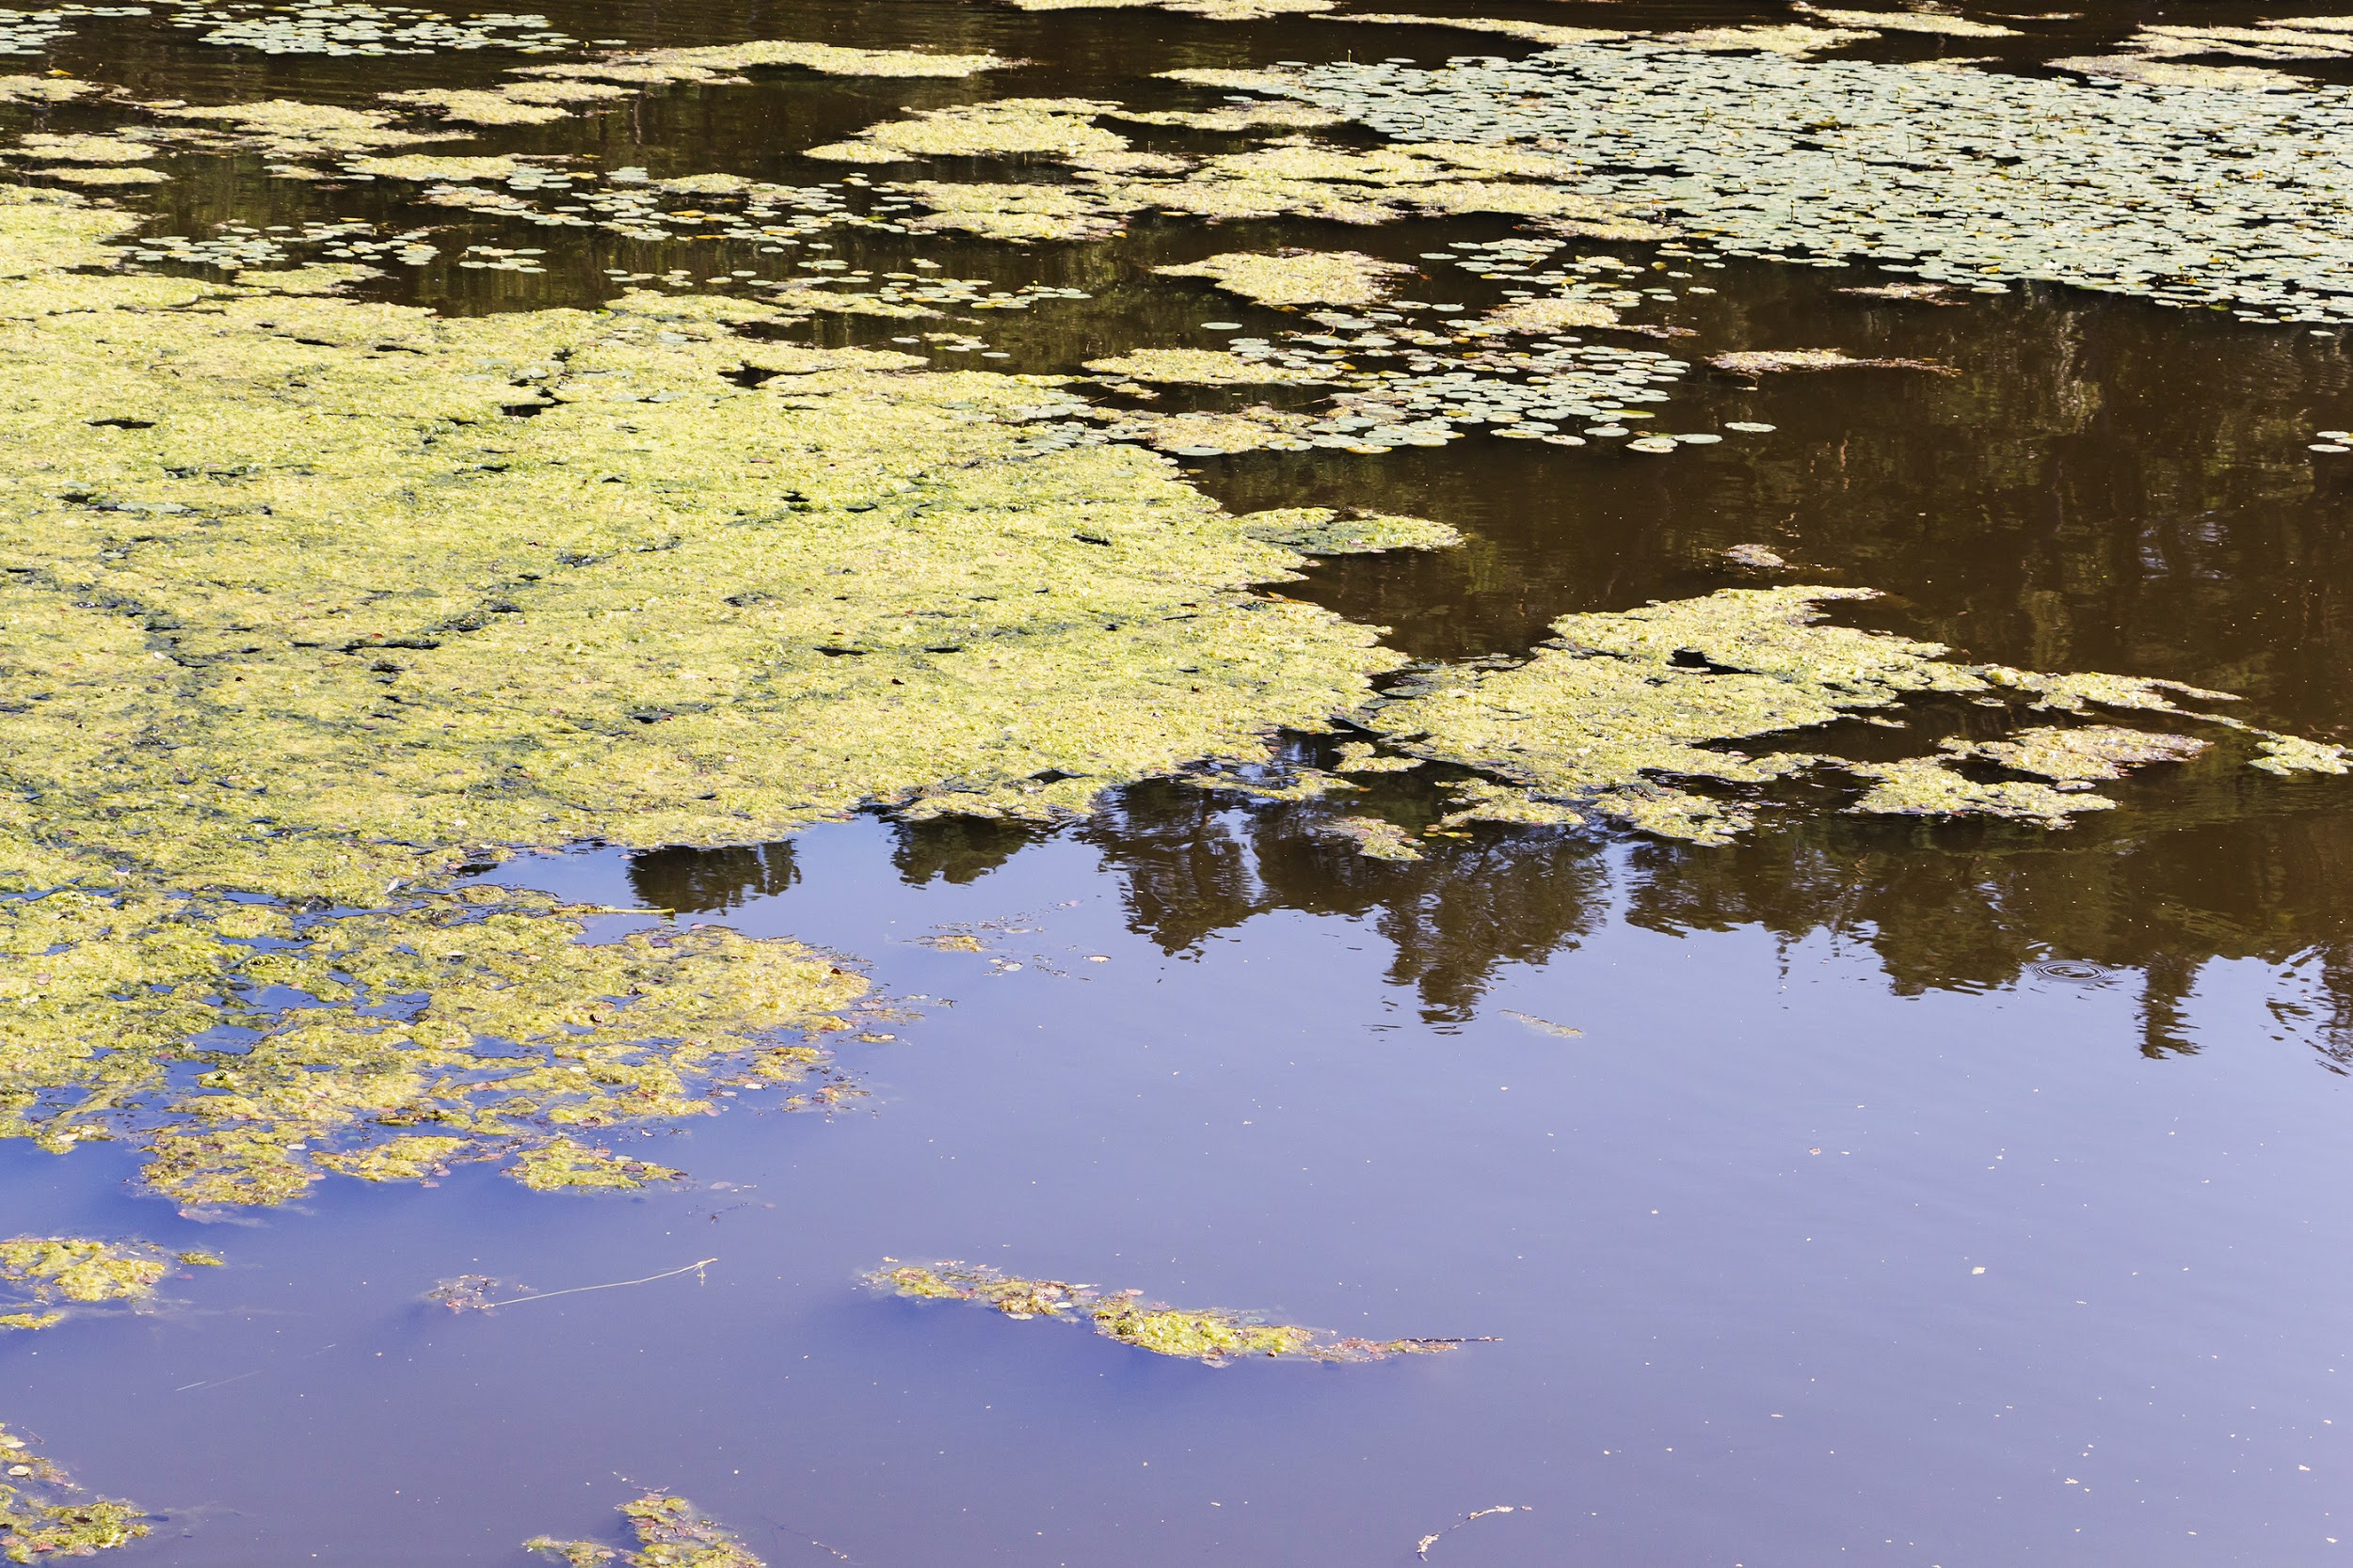
Close up of water pollution from phosphorus and nitrogen

Slide 4
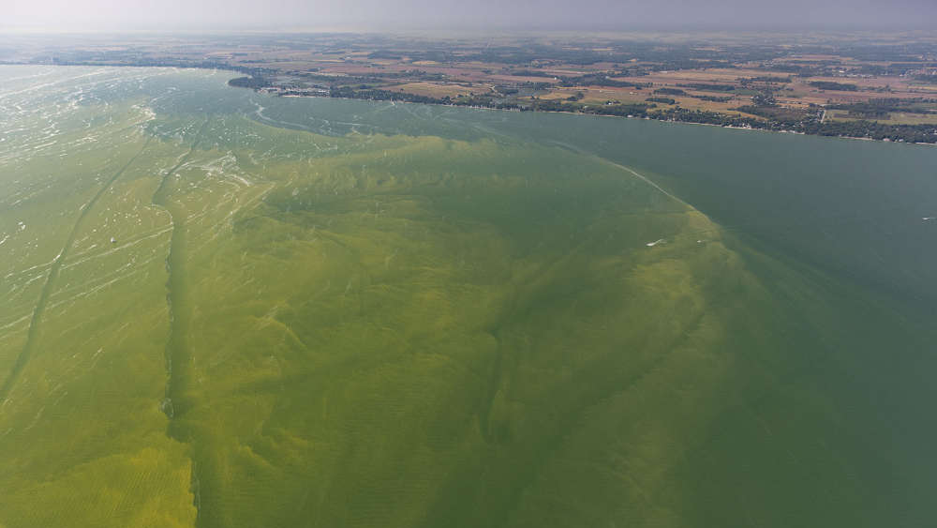
Aerial of pollution from phosphorus and nitrogen

Slide 5
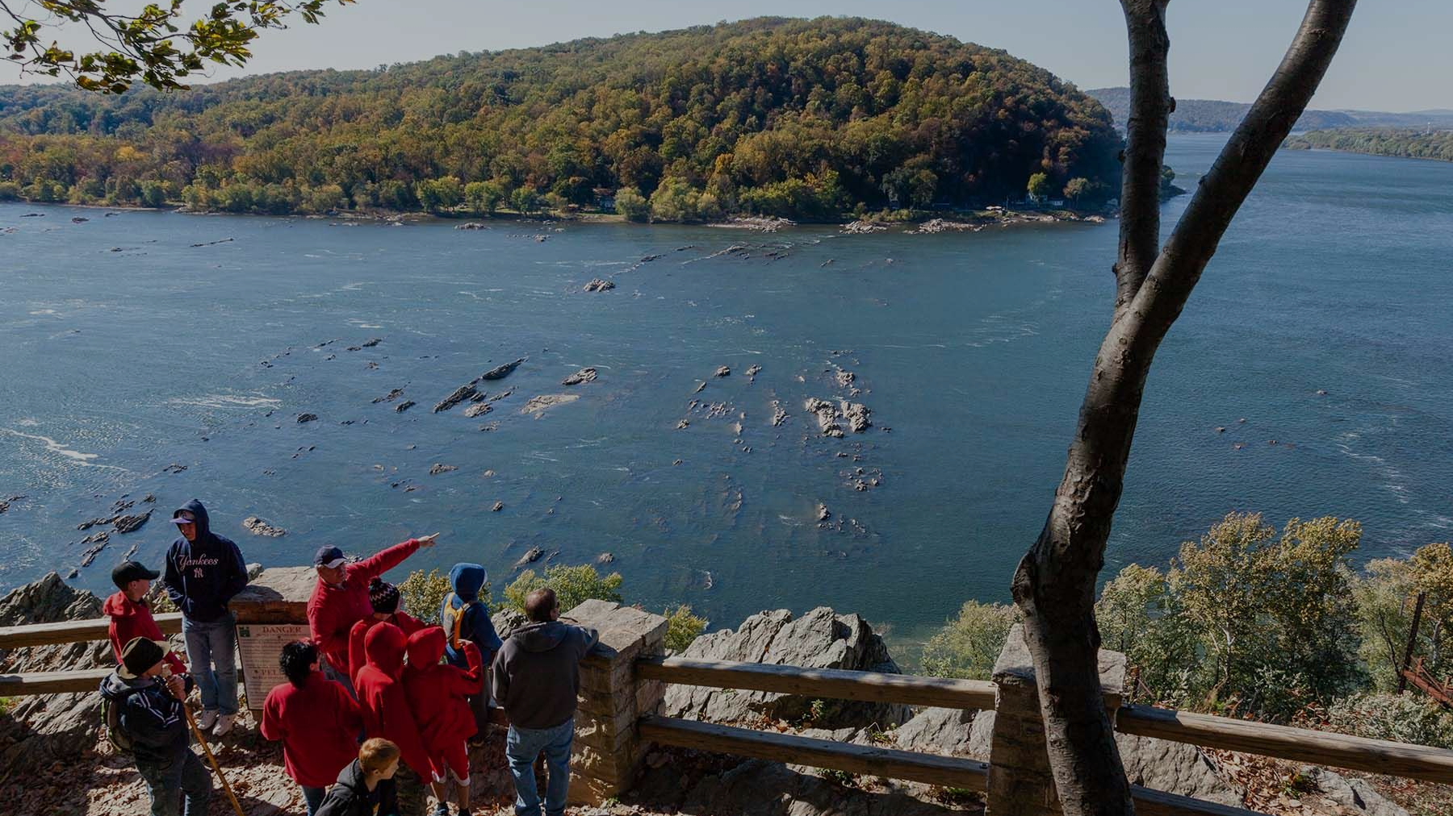
Overview
This pollution you just saw is caused by phosphorus and nitrogen running off the land. Between now and 2025, we will implement our Countywide Action Plan to reduce this pollution, improve our waterways (and meet state and federal regulatory requirements).

Slide 6
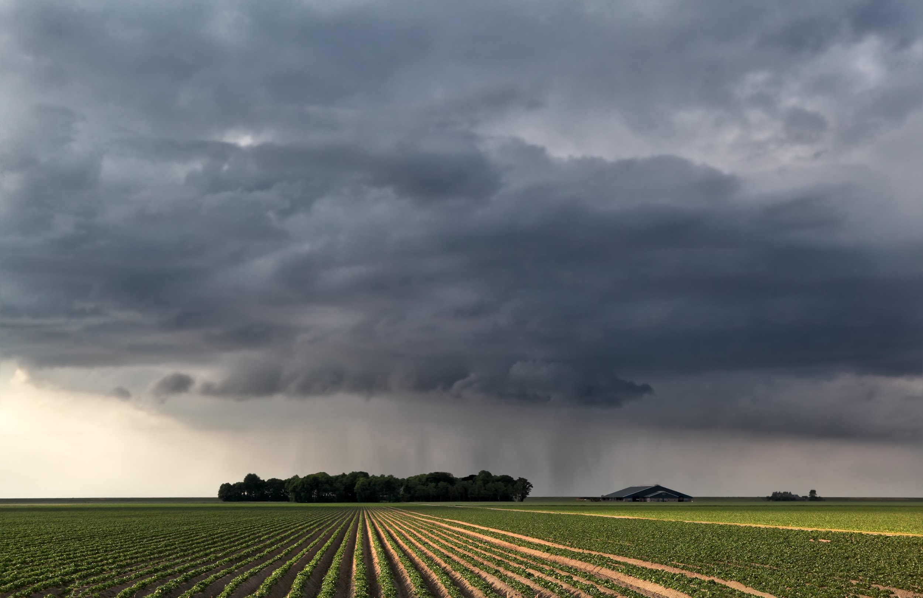
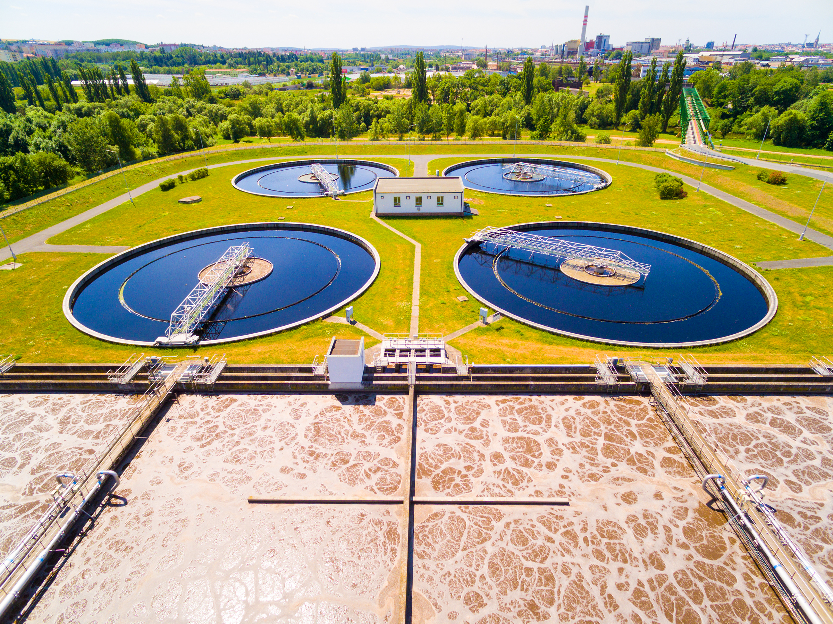

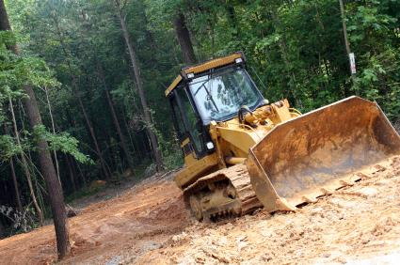
Phosphorus and Nitrogen Pollution Comes From...
Farm fields and pasturelands
Sewage treatment plants
Over fertilized lawns and landscaping
Construction sites and eroded stream banks
Your Logo Here
June 2020
...and many other sources
June 2020

Slide 7
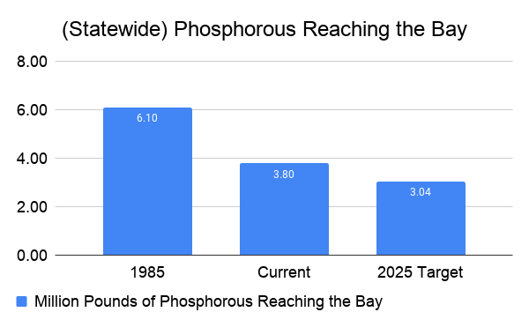
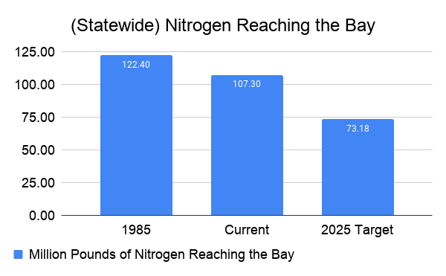
Overview: Pennsylvania is Making Progress
Your Logo Here
June 2020
Notes:
Healthy Waters, Healthy Communities focuses on reducing nutrients – nitrogen and phosphorus – and sediment running off the land, or being discharged by wastewater treatment facilities, into streams, rivers, and lakes. It identifies the specific amounts of these pollutants that we need to eliminate.
Say “runoff” rather than “nonpoint source” water pollution. It’s easier to understand.
Use a constructive tone oriented toward now and the future: While Pennsylvania made progress on nutrient and sediment reductions in two earlier efforts in the watershed, much more remains to be done, and there’s a new level of partnership, shared commitment, and momentum to do it.
note: Current year represents 2017

Slide 8
Overview
By 2025, our county must do its fair share to:
Reduce phosphorus pollution by XYZ123 pounds per year
Reduce nitrogen pollution by XYZ123 pounds per year
Your Logo Here
June 2020

Slide 9
If we succeed: Improved soil and less erosion

Slide 10
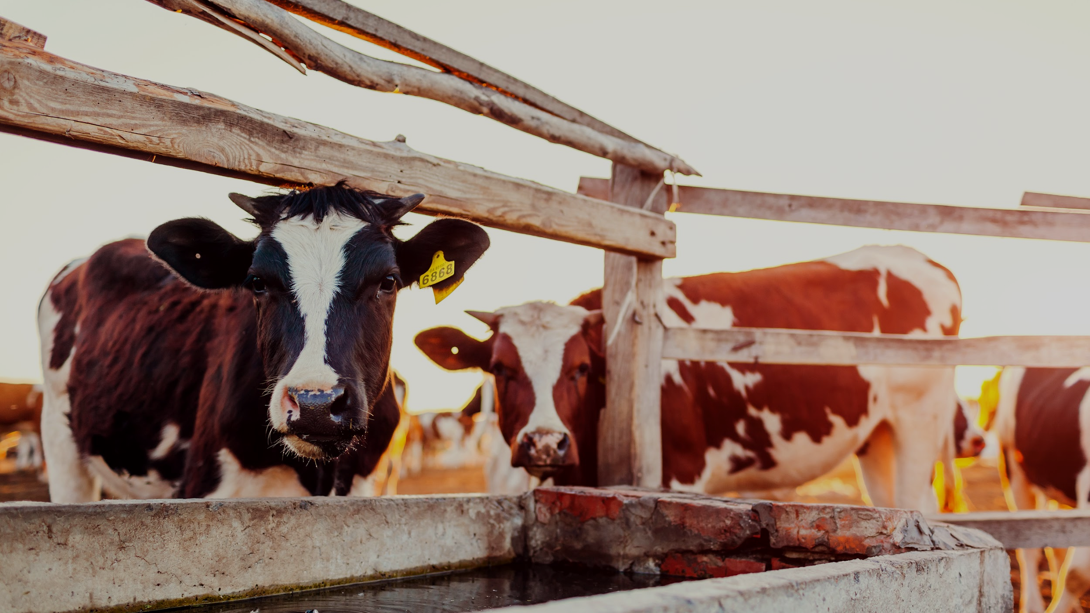
If we succeed: Safer water for livestock

Slide 11
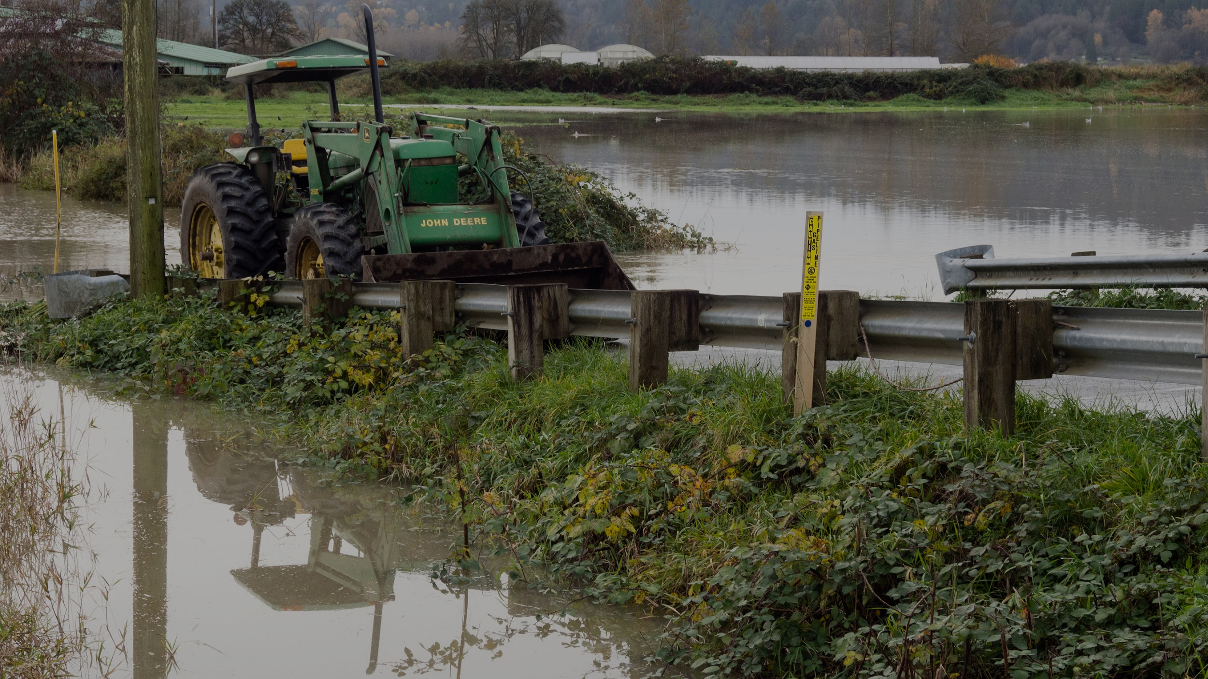
If we succeed: Less frequent and severe floods

Slide 12
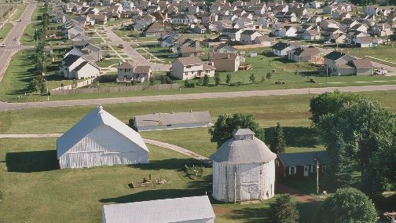
If we succeed: Profitable farms stay in the family

Slide 13
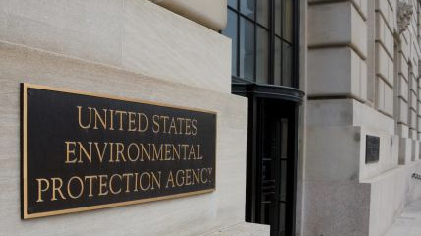
If we fail: More federal regulations

Slide 14

If we fail: Higher compliance costs and fewer choices

Slide 15
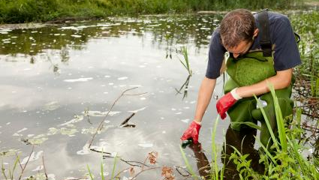
If we fail: Polluted rivers, streams, and lakes

Slide 16
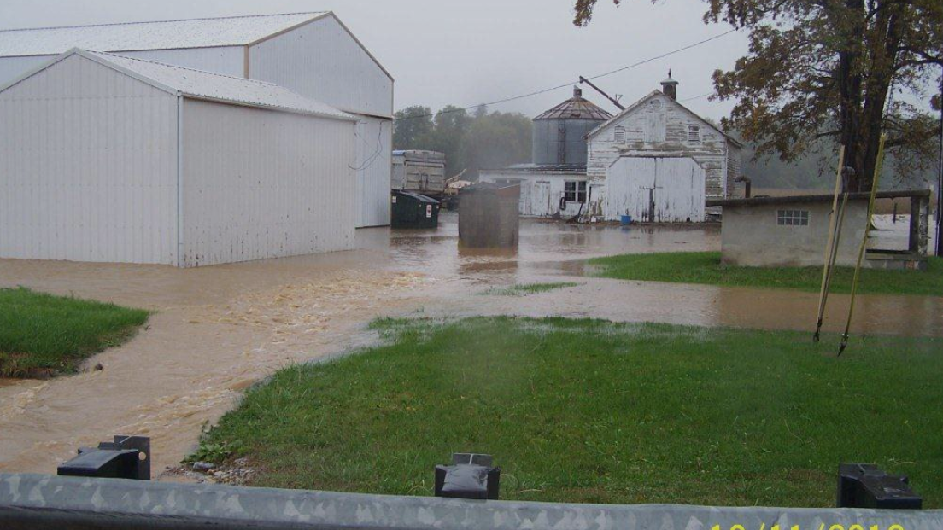
If we fail: More frequent and severe floods

Slide 17
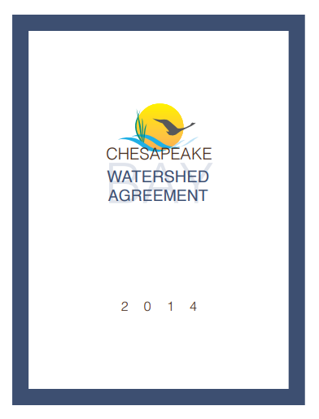
Overview
Pennsylvania signed the Chesapeake Bay Watershed Agreement in 2014 with five other watershed states, the District of Columbia, the Environmental Protection Agency and the Chesapeake Bay Commission.
The agreement contains 10 goals and 31 outcomes to advance the restoration and protection of the Bay watershed.
Your Logo Here
June 2020
Notes:
The Chesapeake Bay Program’s Watershed Agreement contains several goals that strive to create a healthy Bay watershed for all of its citizens.
Each of the six watershed states and the District of Columbia have signed on to meet various goals, which includes everything from stream health to environmental literacy.
Each goal is related to an outcome. Each outcome has an associated management strategy, which explains how we will accomplish the outcomes and how we will monitor, assess and report progress.
These ten goals are interrelated – improvements in water quality can mean healthier fish and shellfish; the conservation of land can mean more habitat for wildlife; and a boost in environmental literacy can mean a rise in stewards of the Bay’s resources.
Many conservation practices can help meet the outcomes within the Watershed Agreement.

Slide 18
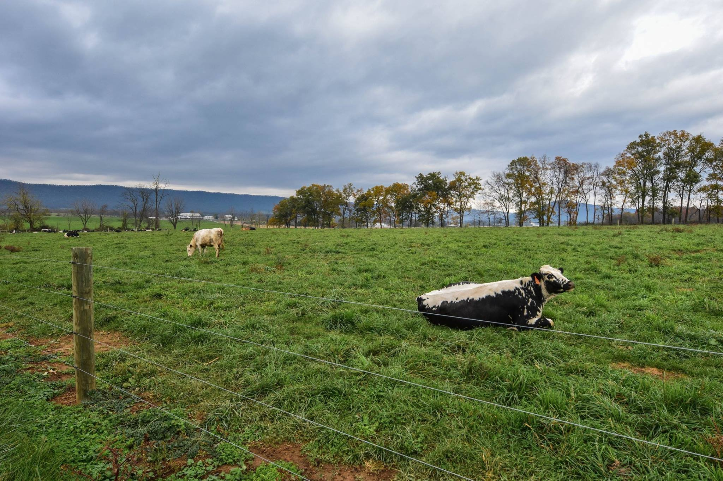
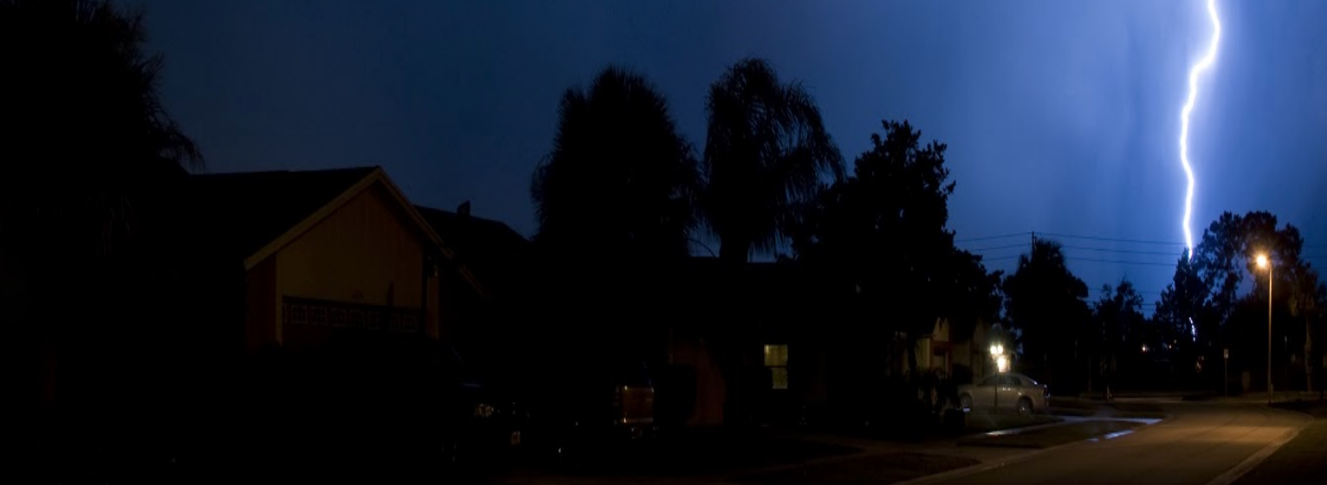
Overview
If local PA communities don’t reduce pollution to our local waters then EPA can:
Subject more livestock operations and municipalities to federal regulations
Require additional reductions from point sources, such as wastewater and industrial facilities
Impose new water quality standards stream-by-stream in Pennsylvania
Redirect or withhold EPA funding
Your Logo Here
More than 98% of Pennsylvania farms do NOT have to get federal discharge permits. That could change!
75% of developed areas in Pennsylvania are NOT subject to the federal MS4 stormwater management regulatory program. That could change!
June 2020

Slide 19
Overview
The bottom line is we are REQUIRED to reduce pollution into our local waters and the Chesapeake Bay.
Right now how we do it is up to us.
If we do not meet the EPA requirements,
the EPA will step in and make it happen their way.
Your Logo Here
June 2020

Slide 20
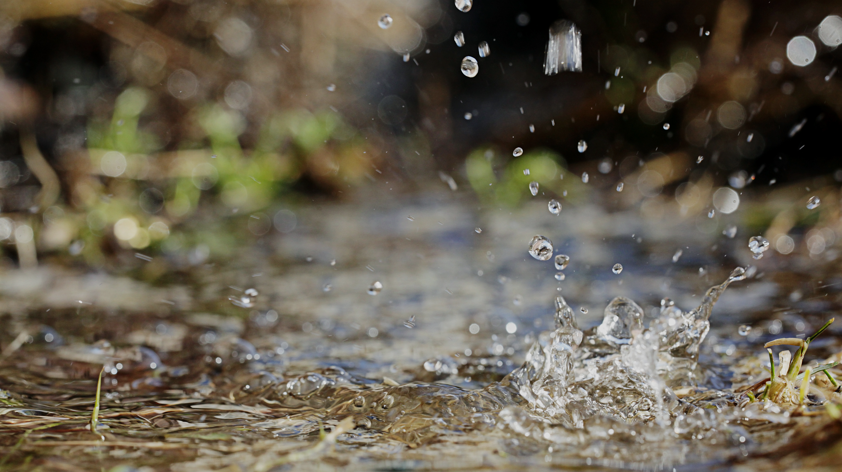
XYZ County Action Plan: What, Who, When & How

Slide 21
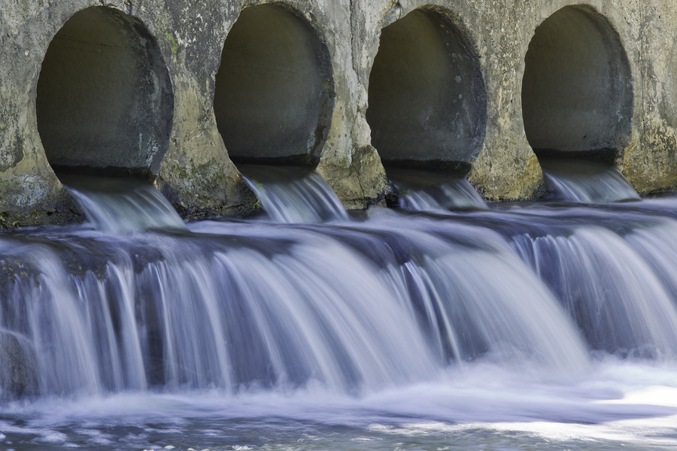
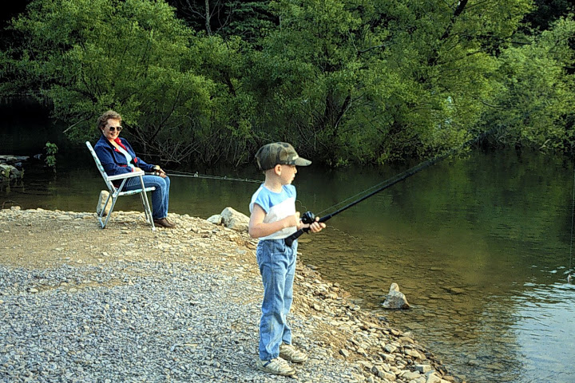
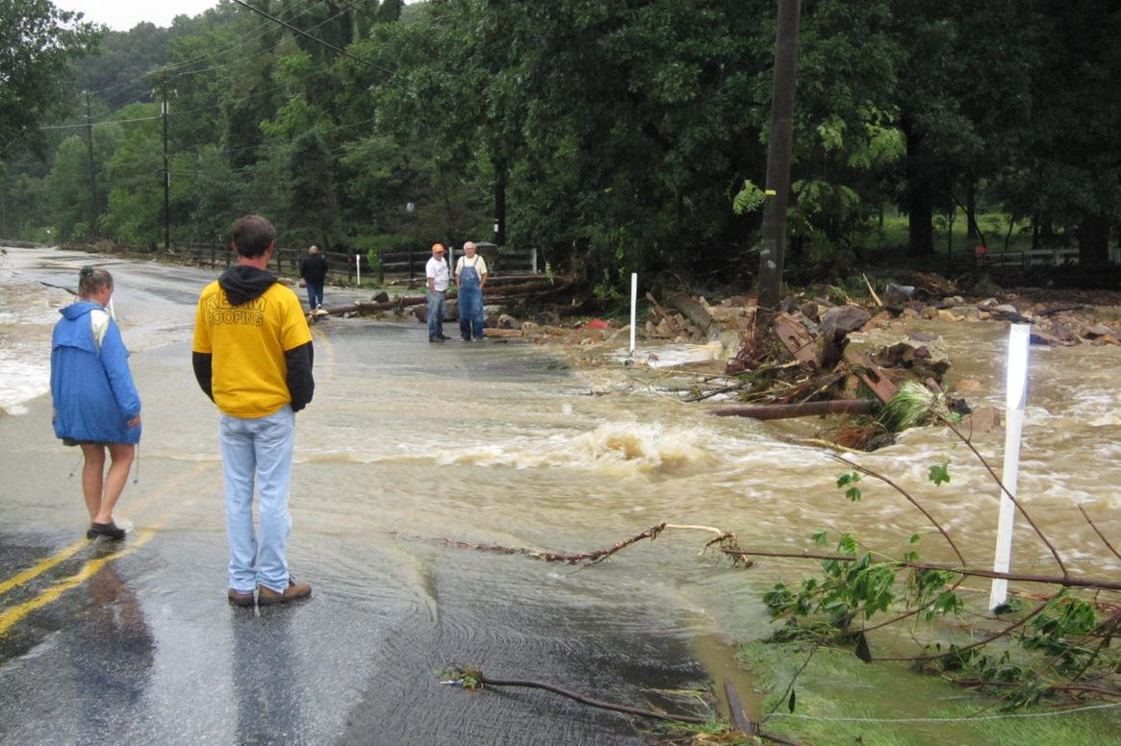
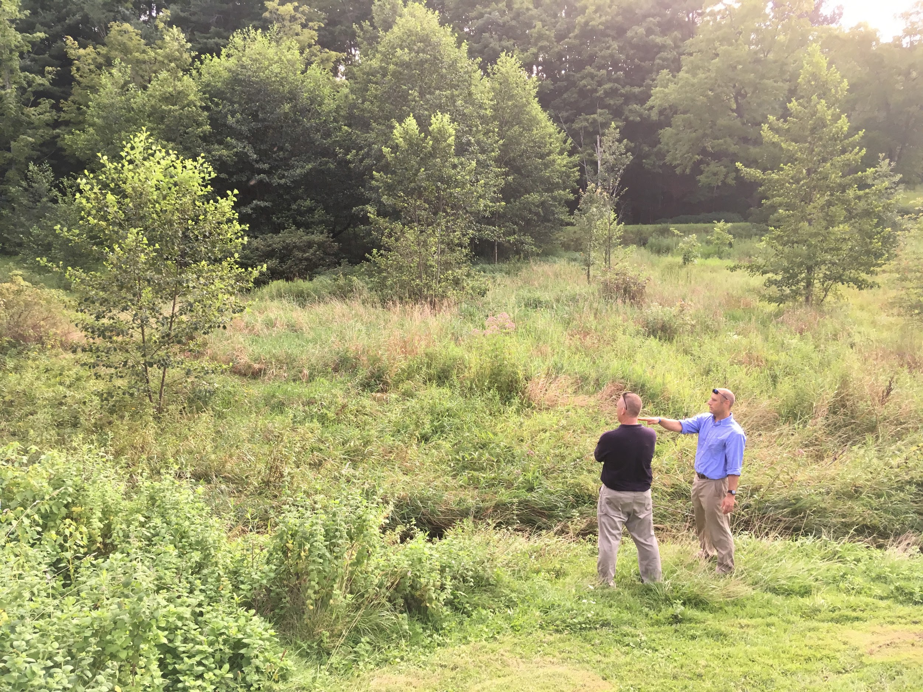
What Is The Countywide Action Plan For?
It’s an opportunity to reduce water pollution...
...improve our quality of life...
...address flooding problems...
Photo: York County Planning Commission
..and, get credit with state and federal regulators for the work we are already doing.
Your Logo Here
June 2020
Notes:
Healthy streams, rivers, and lakes bring great community, economic, and environmental benefits, for example:
Needed for drinking water.
Serve enormous farming, commercial, and industry uses in Pennsylvania.
Contribute to an outdoor recreation industry that delivers millions of jobs and about $13 billion to Pennsylvania’s economy annually.
Support thriving communities, as people increasingly look to live near access to green space.
For more benefits, see the storymap, the Phase 3 WIP website, and handouts.
Refer to benefits not only for Pennsylvanians now, but also for future generations of Pennsylvanians.

Slide 22
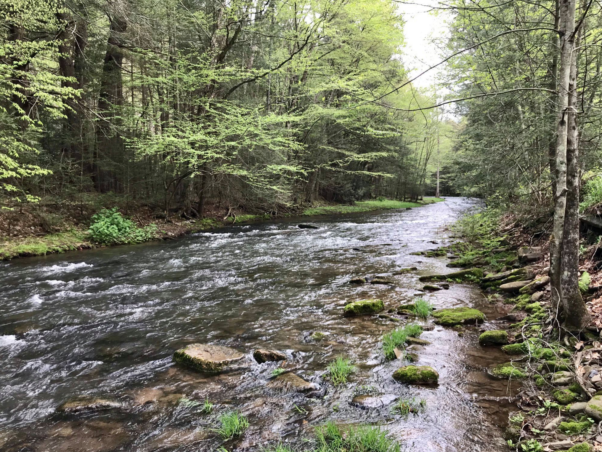
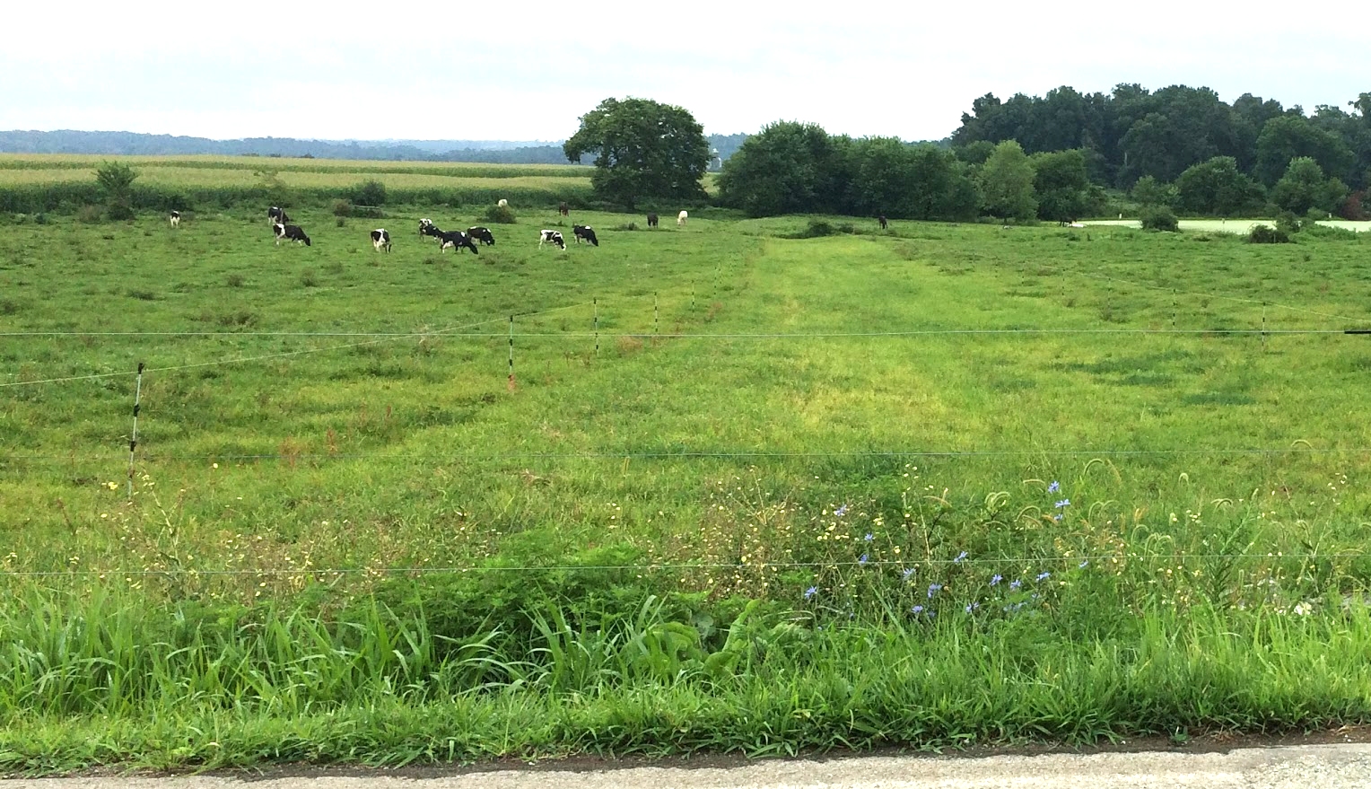
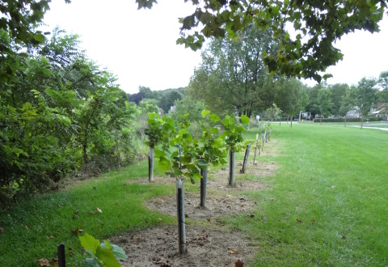
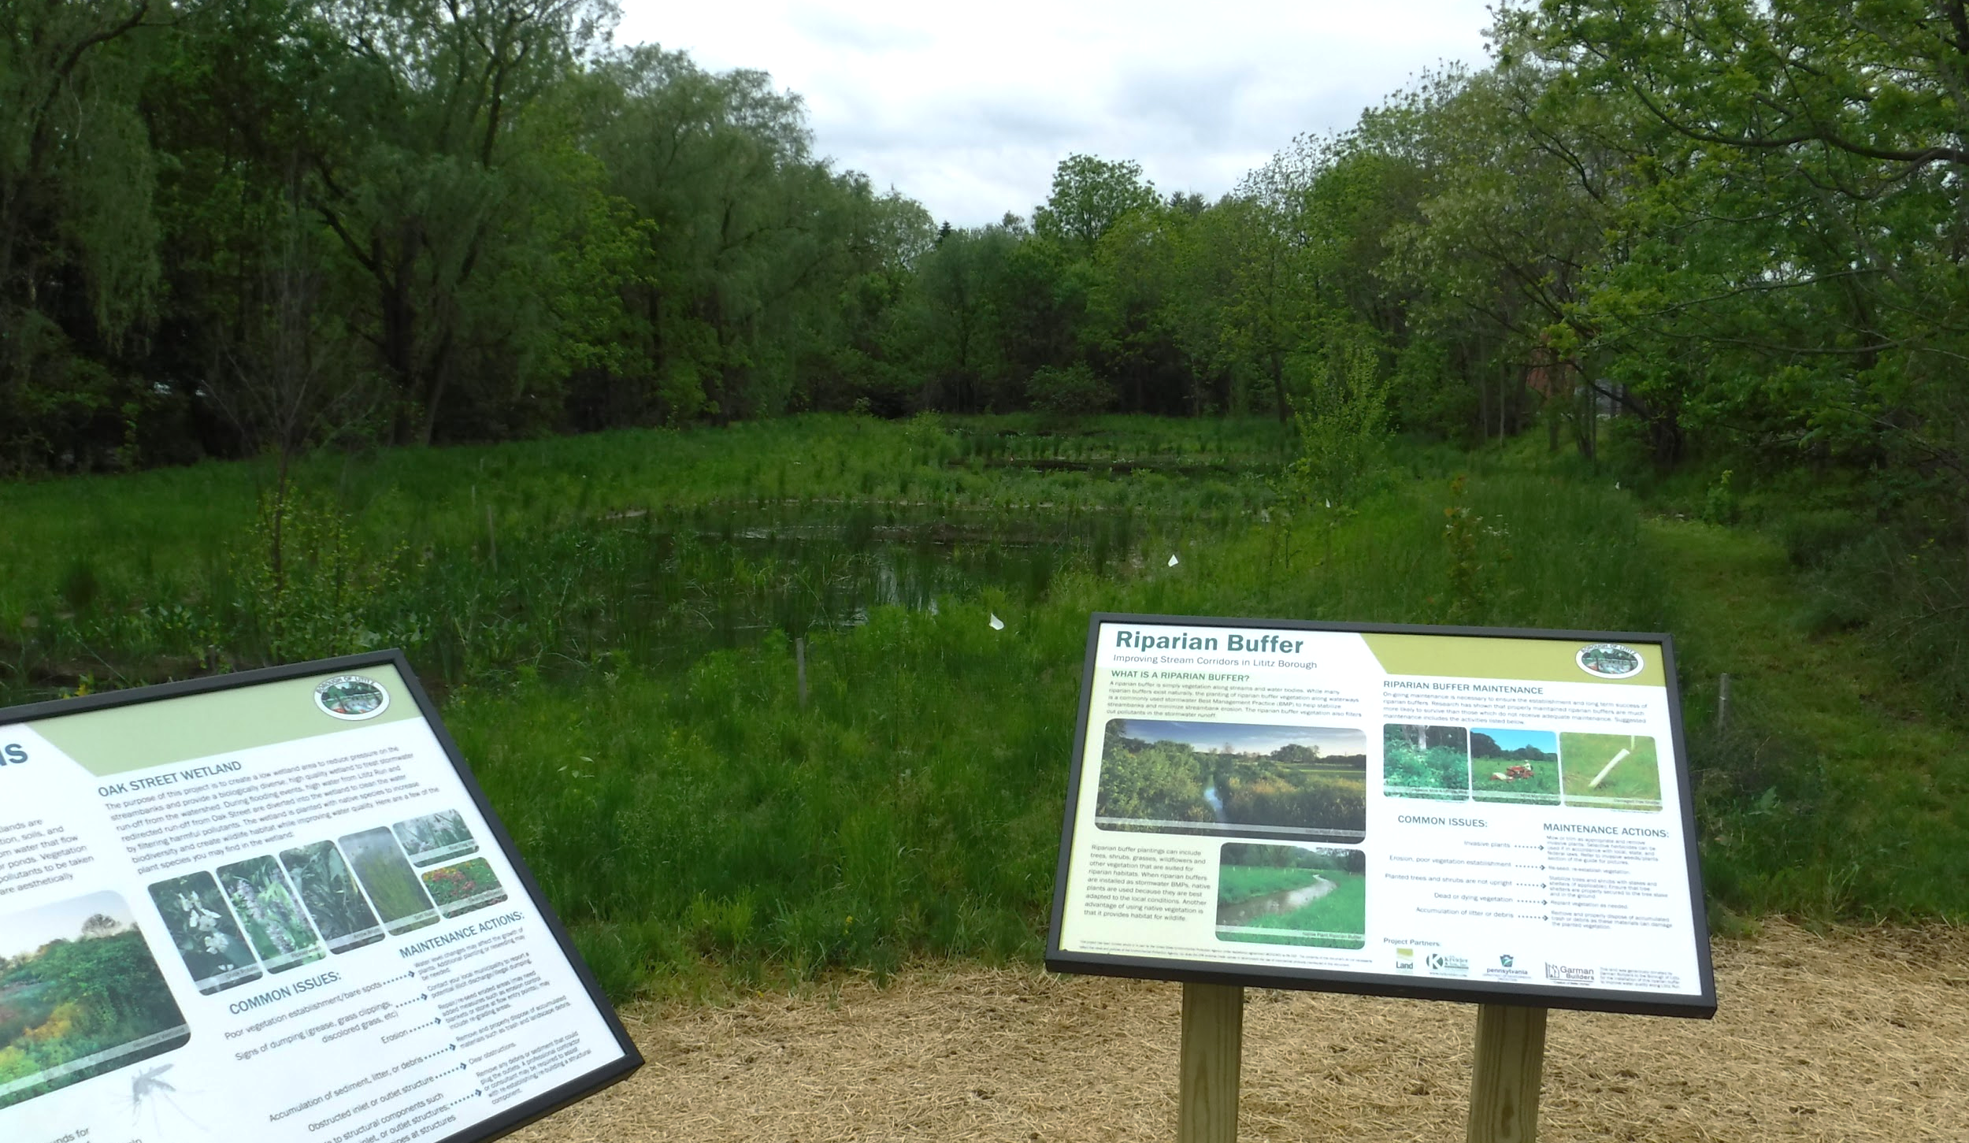
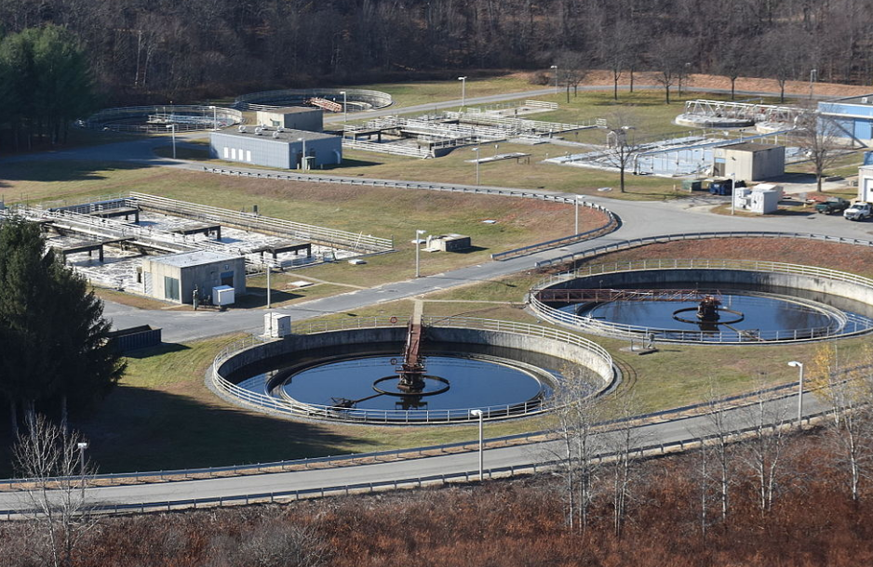

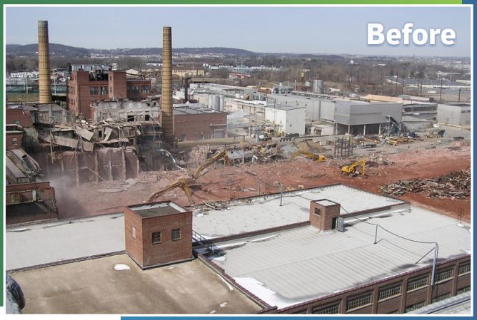
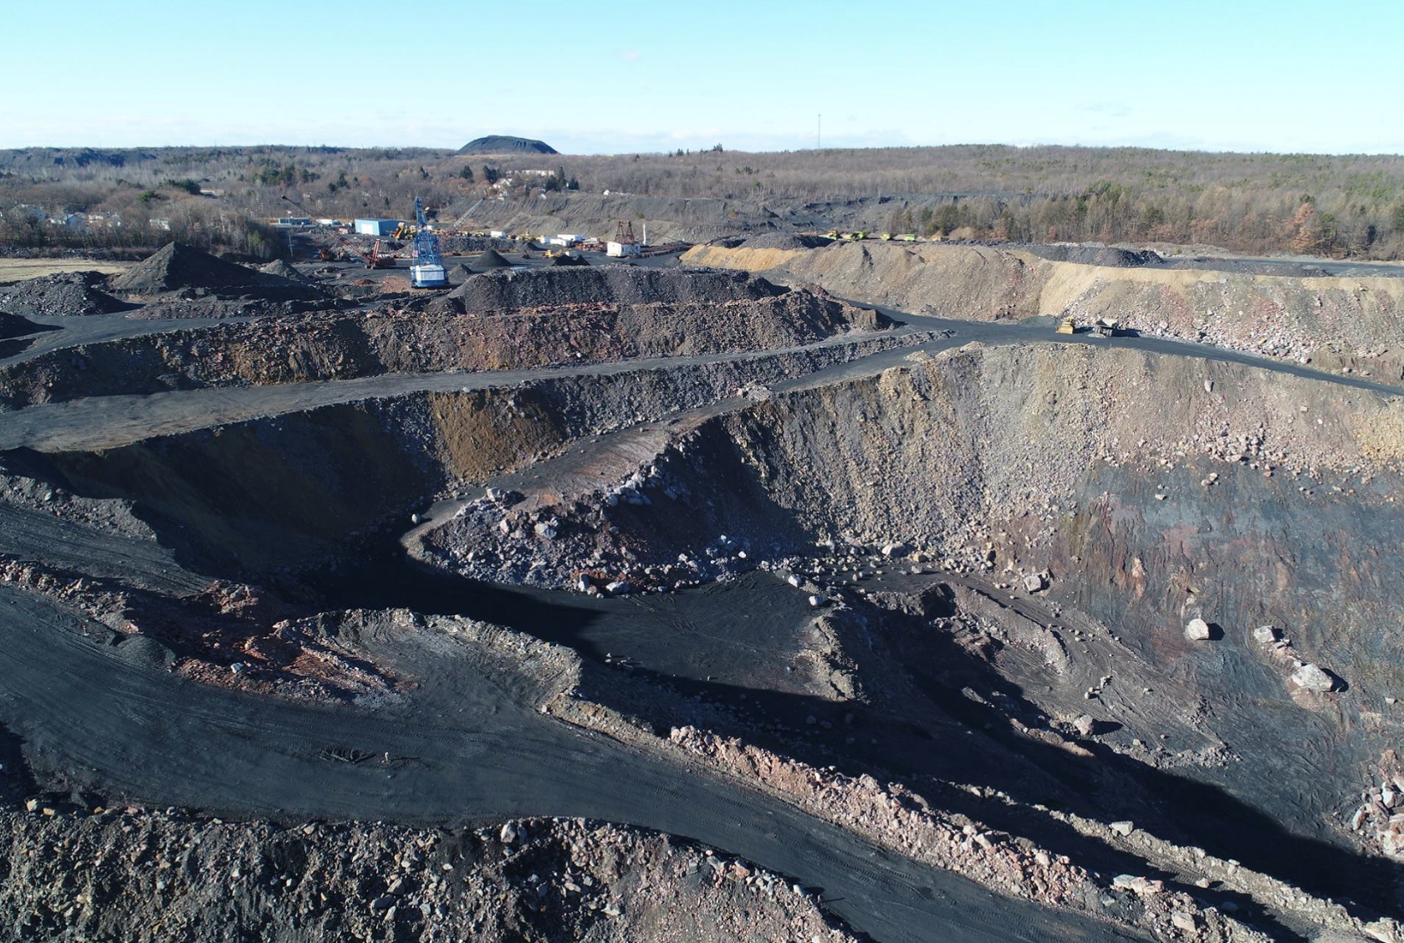
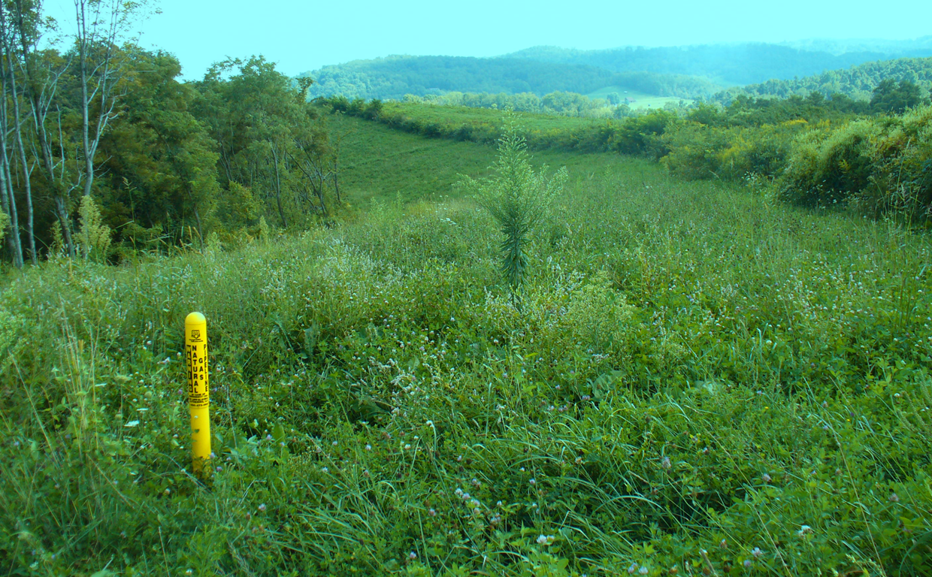
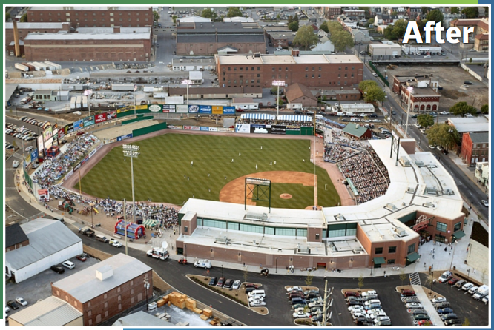
What is the Countywide Action Plan?
It’s a catalyst. Water pollution comes from many sources. Clean water is the end result of efforts to reduce and clean up pollution.
Agriculture
Forestry
Stormwater
Wastewater
Air Quality
Brownfield Cleanup & Redevelopment
Mining, Monitoring & Regulation
Oil & Gas
After

Slide 23

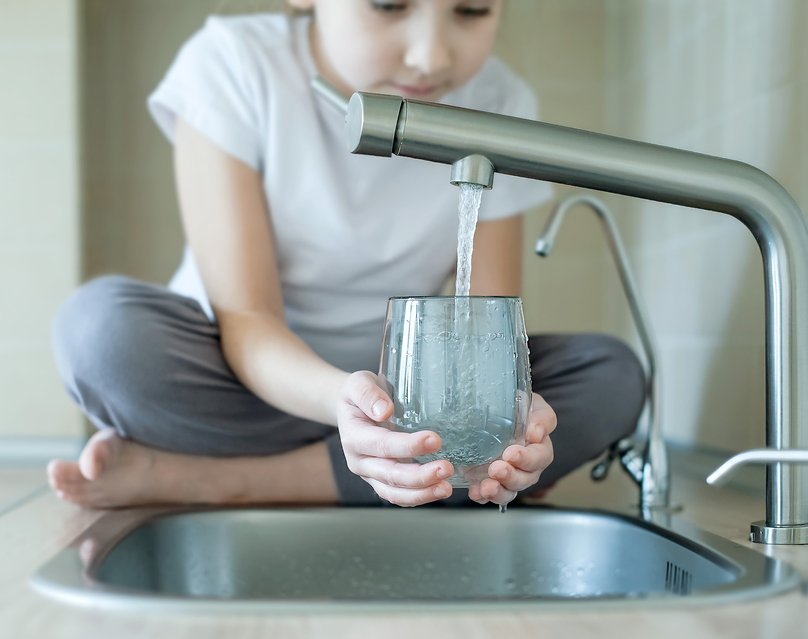



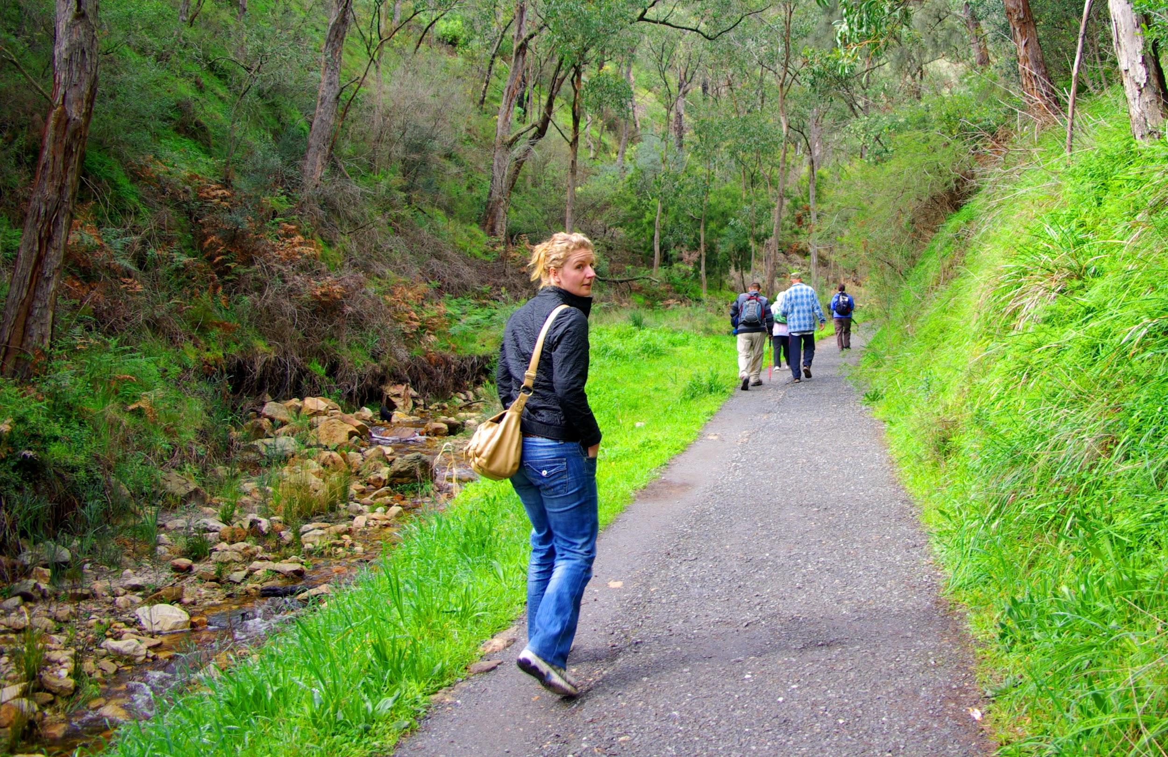
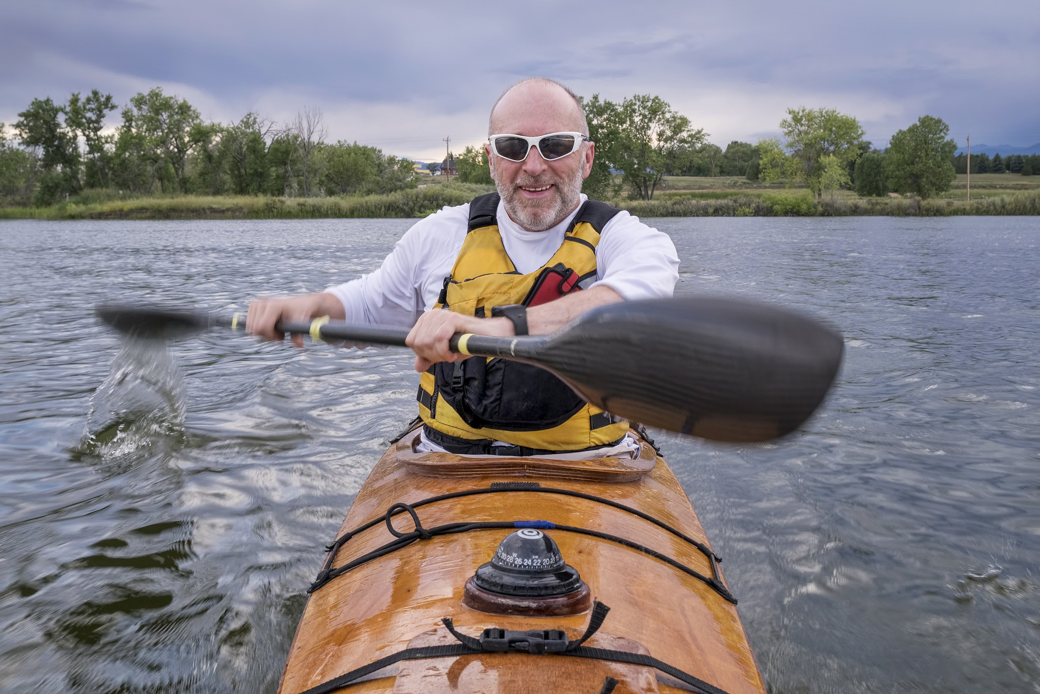

What is the Countywide Action Plan?
It’s a catalyst. Cleaner land and water means increased local economic, public health and social benefits.
Increased Property Values
Cleaner Drinking Water
Less Flooding and More Flood Resilience
Ecotourism Opportunities
Higher Quality of Life
Aesthetic Value
Recreation Opportunities
Community Gardens and Parks

Slide 24
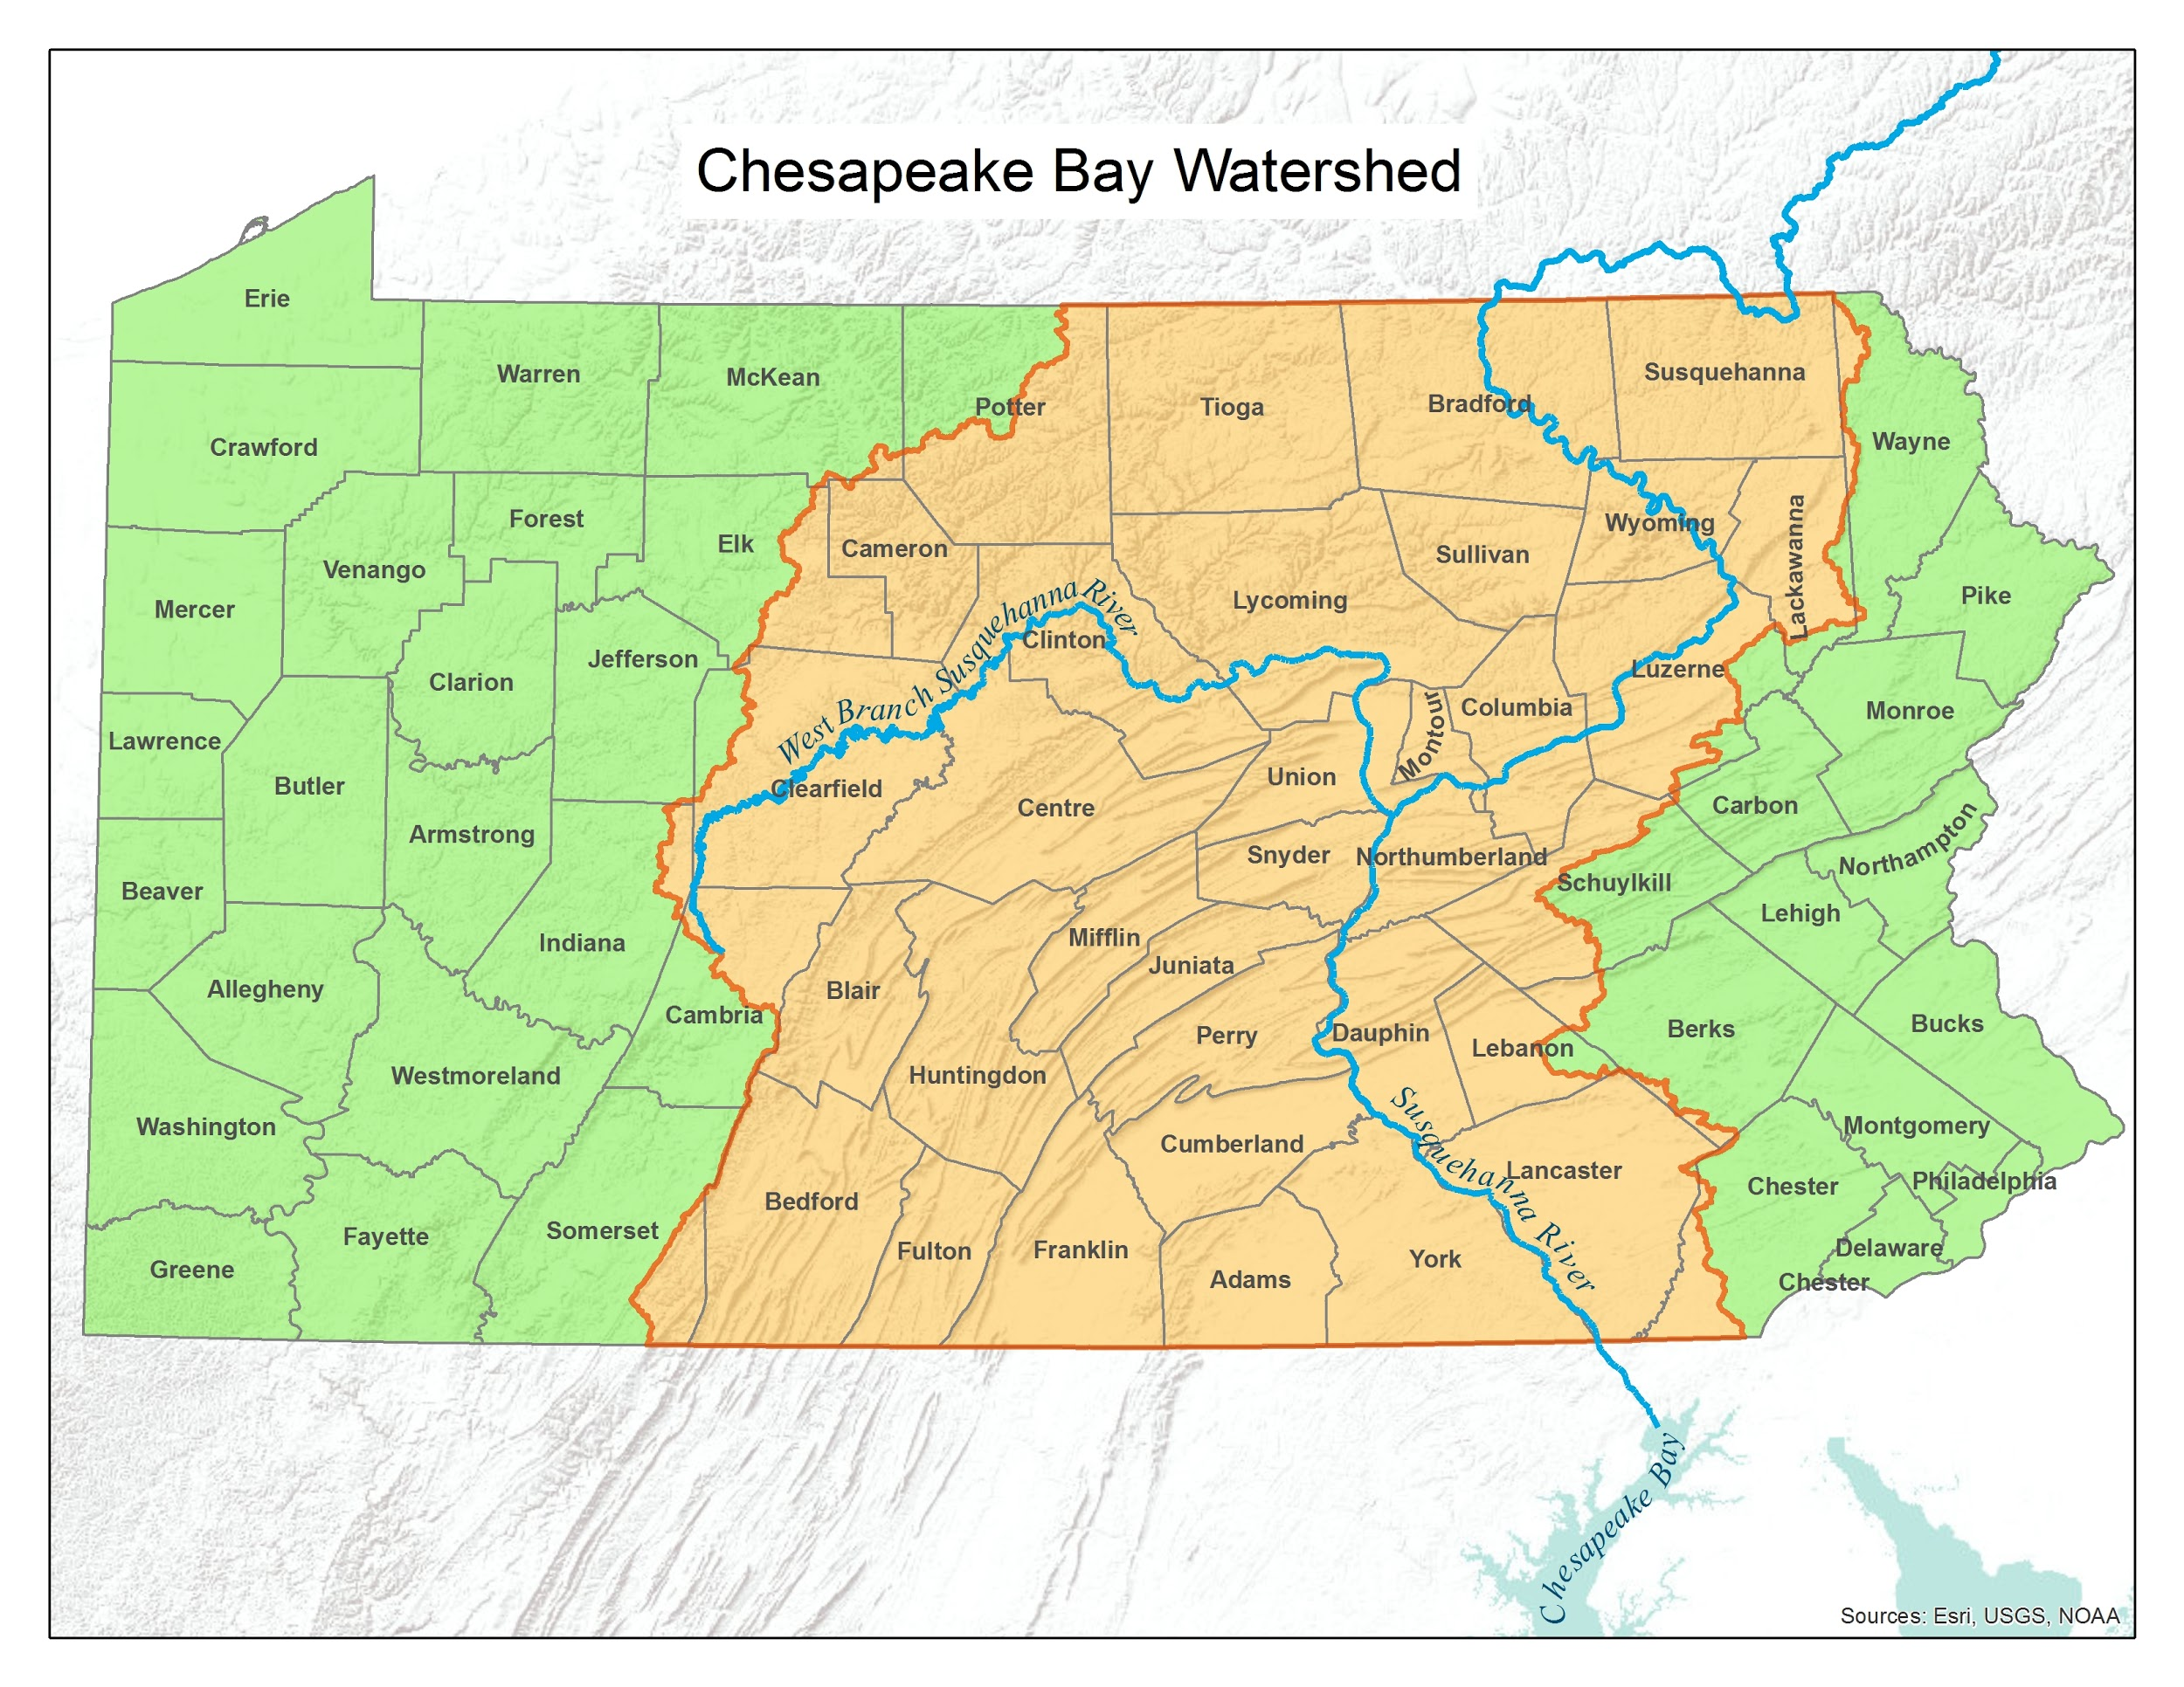
Who Is Involved?
We are one of 43 counties that drain to either the Susquehanna or the Potomac River Basins.
All of these counties will do something similar.
Our neighbors — New York, Maryland, Virginia, West Virginia, Delaware, and Washington DC — are doing their part to clean up the waterways we share.
Your Logo Here
June 2020
Notes:
Communications should energetically focus locally on our share of the watershed. Right here where it is in Pennsylvania, the watershed is a highly functioning natural system that greatly benefits Pennsylvanians (regardless of where it ultimately drains out).
Keep references to the bay to a minimum. Some people are aware of a federal mandate focused on the bay, the watershed states agreement and partnership, and so on. When necessary, acknowledge and answer any questions, but don’t get sidetracked from your Pennsylvania focus.

Slide 25
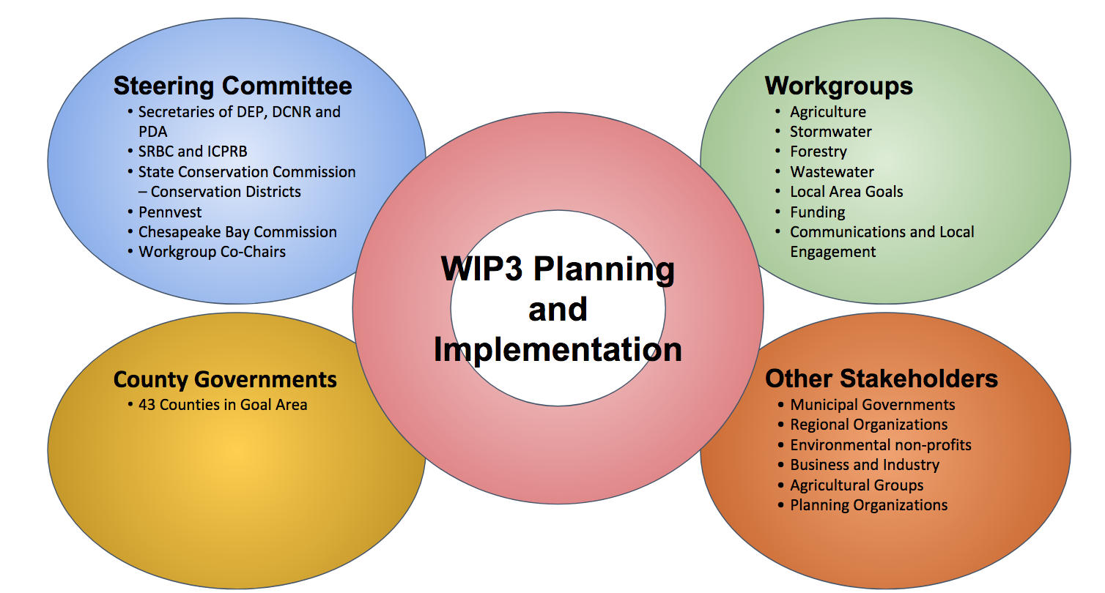
Who Is Involved?
Your Logo Here
Replace this Org Chart with One for your County
June 2020
Notes:
Healthy Waters, Healthy Communities outlines the lion’s share of nutrient and sediment pollutant reductions that Pennsylvania is federally required to achieve by 2025. An aggressive adaptive management approach, with six-month progress reviews, will ensure additional actions toward further reductions.
Pennsylvania is committed to having projects and practices in place by 2025 to reach our nutrient and sediment reduction goals.
State agencies are providing as much funding as they can. The 2019 Pennsylvania Farm Bill, a historic $23.1 million investment, includes new and expanded conservation funding, including grants to assist farmers in the watershed with implementing best management practices.
DEP, responding to county leaders’ feedback, launched a new block grant program with EPA support to make it easier for counties to access and use funding for projects in their Countywide Action Plans. The goal is for DEP to award these block grants to counties annually, as they make progress.
More funding is available to counties from the DEP Growing Greener and Agricultural Plan Reimbursement Programs, the Department of Conservation and Natural Resources Community Conservation Partnerships Program, the Keystone Tree Fund, and other sources.
To bring them all together, PENNVEST is developing a new one-stop shop of resources called the Center for Water Quality Excellence for landowners working to reduce runoff pollution.
Many community leaders have endorsed Governor Wolf’s Restore Pennsylvania initiative as a potential source of large-scale funding. If passed by the legislature, it would invest $4.5 billion statewide in resources for water quality as well as blighted properties, internet access, storm preparedness, and disaster recovery.

Slide 26
Who Can Participate?
Everyone who cares about their community and their waterways is welcome to participate! We have a special need for:
Streamside property owners, land owners, homeowners, and farmers
County Conservation Districts and Planning Commissions
Agricultural, watershed, environmental and outdoor organizations who know their waterways first hand
Leaders in any sector that have strong connections to waterways, such as local government, agriculture, forestry, construction, and water and wastewater authorities
Your Logo Here
June 2020

Slide 27
Who Can Participate?
Getting involved is an opportunity to make a difference in your community. If you join us, you can expect to:
Attend meetings and conference calls
Brainstorm around solutions
Offer your opinion on the best way for your county to meet its goals
Review draft project plans and documents
Help write memos and brief your local elected officials
Insert cover image of your Countywide Action Plan here
Your Logo Here
June 2020
Notes:
Your participation is 100% voluntary.
First, let’s start off with a simple explanation of what Watershed Implementation Plans are. They are required for each of the six watershed states and the District of Columbia to develop under the 2010 Chesapeake Bay Total Maximum Load or Bay TMDL.
These jurisdictions are in the process of developing Phase III of the WIPs, which call for engagement with their local partners and communities.
Conservation practices that you implement in your own communities, or on your own property can not only help your state meet their pollution reductions, but they also can provide you with economic benefits, provide a healthy area for your family and friends to reside in and they can help fulfil other commitments to help restore and protect the local waterways in your backyard.
WIPs are beneficial as they help track progress toward meeting pollution reduction goals, identify gaps and ensure the Bay and your local waterways are remaining healthy.

Slide 28
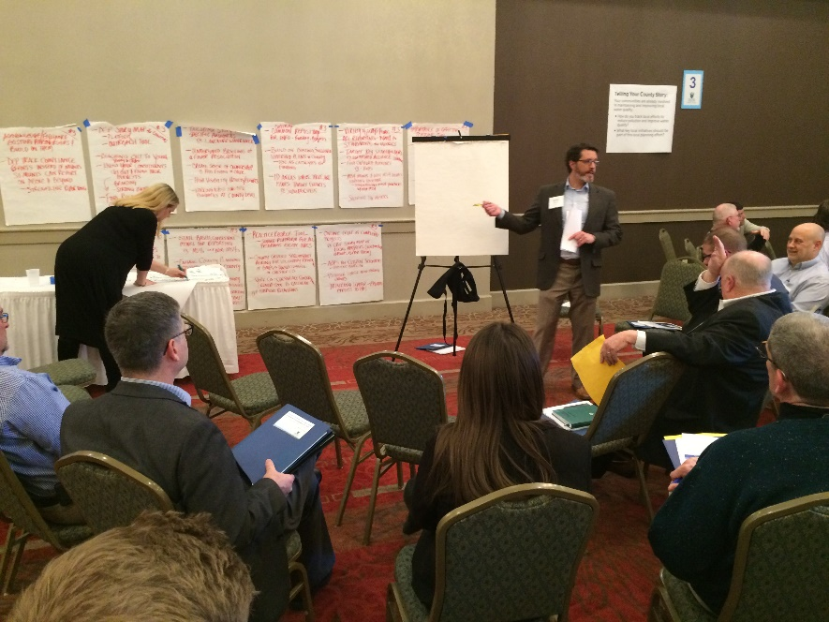
When Will This Work Happen?
Please update with a local timeline
Your Logo Here
June 2020

Slide 29
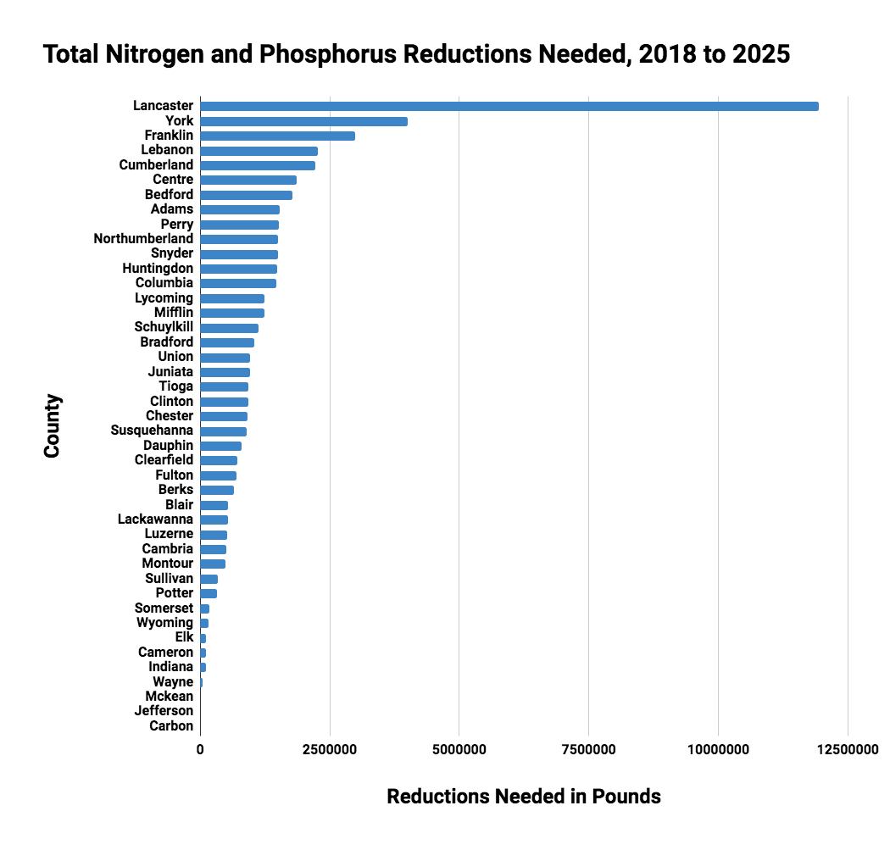
How Were Our County Goals Calculated?
PADEP calculated county goals using sound science
Each county’s goals are achievable, if we work together
County goals are their fair share of Pennsylvania’s targets
Your Logo Here
June 2020

Slide 30
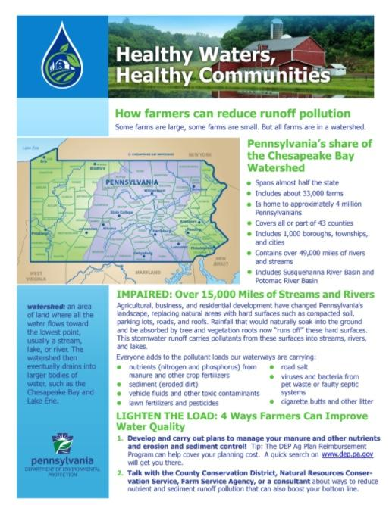
To Learn More
We have prepared a short handout for you

Slide 31
Questions?
Your Logo Here
June 2020

Slide 32
Contact Information:
Your Name
Your Email
(987) 654-3210
DEP Chesapeake Bay Program Website:
http://www.dep.pa.gov/ChesapeakeBay
Phase 3 WIP Website:
www.dep.pa.gov/chesapeakebay/phase3
Your Logo Here
June 2020

Slide 33
Optional Extra Slides

Slide 34

The Public
Benefits of Success
If our effort is a success, you will enjoy:
Cleaner water to enjoy in our streams, rivers, and lakes!
Safer water supplies
Less frequent and severe floods
Consequences of Failure
If our effort is a failure, the consequences may include:
Polluted streams, rivers, and lakes
Higher water treatment costs
Increased flooding
New federal regulations
Your Logo Here
June 2020
Notes:
Educate people that everyone contributes to runoff water pollution as part of modern daily life. Agriculture, forestry, stormwater management, and wastewater treatment are main areas of focus for significant reductions.

Slide 35
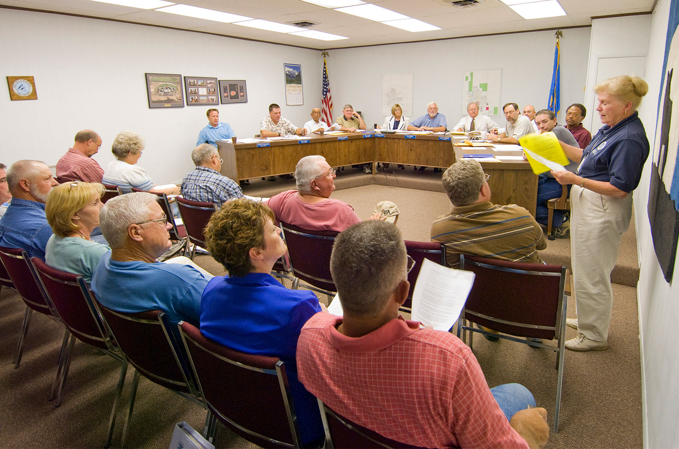
Local Government
Benefits of Success
If our effort is a success, you will enjoy:
You retain control of your agenda for local water resources
You identify new pollution and flood reduction solutions
You identify previously unknown grant and cost-share opportunities
Consequences of Failure
If our effort is a failure, the consequences may include:
Missed opportunities to address local water pollution and flooding
More regulation and government oversight
Higher costs for compliance
Your Logo Here
June 2020
Notes:
Educate people that everyone contributes to runoff water pollution as part of modern daily life. Agriculture, forestry, stormwater management, and wastewater treatment are main areas of focus for significant reductions.

Slide 36

Agriculture
Benefits of Success
If our effort is a success, you will enjoy:
Improved soil health and retention
Increased profitability for farms
Reduced tillage costs
Credit for existing BMPs
Stronger voice in environmental planning
Positive public perception
Consequences of Failure
If our effort is a failure, the consequences may include:
More regulation/government oversight on all farms
Higher costs for compliance
Missed funding opportunities
Impaired streams in your backyard
Your Logo Here
June 2020
Notes:
Educate people that everyone contributes to runoff water pollution as part of modern daily life. Agriculture, forestry, stormwater management, and wastewater treatment are main areas of focus for significant reductions.
Agriculture Secretary Russ Redding refers to farmers as the “original stewards of our land.”

Slide 37
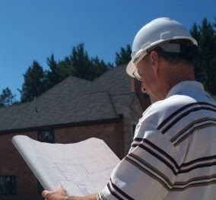
Developers and Construction
Benefits of Success
If our effort is a success, you will enjoy:
A predictable regulatory and permit program, managed by state and local officials
Increased access to technical and cost share assistance for stormwater controls
Consequences of Failure
If our effort is a failure, the consequences may include:
New developed areas subject to federal regulation
Stepped up federal enforcement of stormwater permits
Stricter water quality standards in areas where streams run to the Potomac or Susquehanna rivers
Your Logo Here
June 2020
Notes:
Educate people that everyone contributes to runoff water pollution as part of modern daily life. Agriculture, forestry, stormwater management, and wastewater treatment are main areas of focus for significant reductions.

Slide 38
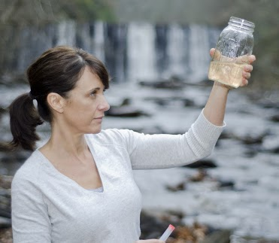
Environmental Organizations
Benefits of Success
If our effort is a success, you will enjoy:
Local stakeholders renew their commitment to do their part
Cleaner water sooner
Partners achieve shared goals
Your supporters see success for your efforts
Consequences of Failure
If our effort is a failure, the consequences may include:
Local cleanup efforts stall
Water cleanup is further politicized
Missed funding opportunities
Your supporters see lack of progress
Your Logo Here
June 2020
Notes:
Educate people that everyone contributes to runoff water pollution as part of modern daily life. Agriculture, forestry, stormwater management, and wastewater treatment are main areas of focus for significant reductions.

Slide 39

Water & Wastewater
Benefits of Success
If our effort is a success, you will enjoy:
Cleaner source water to your treatment plants
Other sectors step up their investment
Confidence that no future mandates are forthcoming
Consequences of Failure
If our effort is a failure, the consequences may include:
Requirements for additional investments in your treatment capacity
Increased regulation of waterways that you draw from or discharge to
Your Logo Here
June 2020
Notes:
Educate people that everyone contributes to runoff water pollution as part of modern daily life. Agriculture, forestry, stormwater management, and wastewater treatment are main areas of focus for significant reductions.

