Slide 1

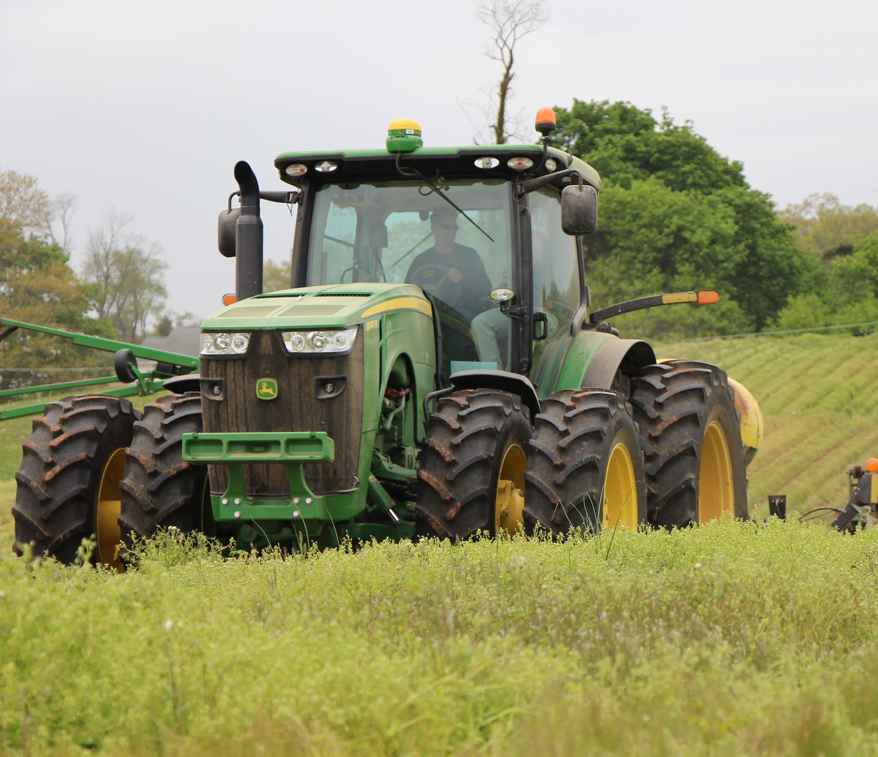
Agricultural Best Management Practices for
PENNSYLVANIA
Pennsylvania is working alongside neighboring states to clean up our local waters that flow to the Chesapeake Bay. This effort is Pennsylvania’s Phase 3 Chesapeake Bay Watershed Implementation Plan (Phase 3 WIP).
The path to success for Pennsylvania’s Phase 3 WIP starts locally, and farmers have an important role to play. This document summarizes seven farm practices that reduce nutrient and sediment pollution to local waters and to the Chesapeake Bay.
AGRICULTURAL COMPLIANCE
Action: Ensure farmers are implementing their state required Agricultural Erosion and Sediment Control (Ag E&S) or conservation plan, Manure Management/Nutrient Management Plan, and implementing required barnyard runoff controls, where needed. Goal 1: Continue the compliance, inspection and enforcement programs associated with Pennsylvania’s Clean Streams Law and federal requirements.
SOIL HEALTH
Action: Use crop and soil management practices that improve long-term soil health and stability. Goal 1: Conservation tillage on 20% of croplands. Goal 2: High Residue Low Disturbance tillage (No-till) on 47% of croplands. Goal 3: Non-harvested cover crops on 33-50% of croplands. Goal 4: Prescribed grazing on 50% pastures, including exclusion fencing, where appropriate.
EXPANDED NUTRIENT MANAGEMENT
Action: Farmlands use precision nutrient management practices. Goal 1: 20% of non-manure croplands have and implement Nutrient Management Plans. Goal 2: 20% of manured and non-manure croplands use the “4Rs” principles of “Right Source, Right Rate, Right Time and Right Place” for increased nitrogen and phosphorus reductions.
MANURE STORAGE FACILITIES
Action: Install and use manure storage systems that meet state or federal standards. Goal 1: 90% of swine and poultry operations have adequate manure storage facilities. Goal 2: 75% of other livestock operations have adequate manure storage facilities.
DAIRY PRECISION FEEDING
Action: Use precision feed management to reduce nitrogen and phosphorus in manure. Goal 1: 70% of dairy cows fed with precision feed management.
INTEGRATED SYSTEMS FOR ELIMINATION OF EXCESS MANURE
Action: Create integrated county or regional programs for removal of or beneficial use of excess manure. Goal 1: Develop coordinated regional systems for removing excess manure (through treatment or transportation) from the Chesapeake Bay watershed.
FOREST AND GRASS RIPARIAN BUFFERS
Action: Plant forest buffers and grassy vegetation along streams. For accreditation buffers must be a minimal of 35 feet in width up to 300 feet in width from the edge of the stream. Goal 1: 25% of non-buffered streamside farm lands add 35 foot wide forest buffer. (based on up to 300 ft available streamside area) Goal 2: 15% of non-buffered streamside farm lands add 35 foot wide grass buffer. (based on up to 300 ft available streamside area)

Slide 2
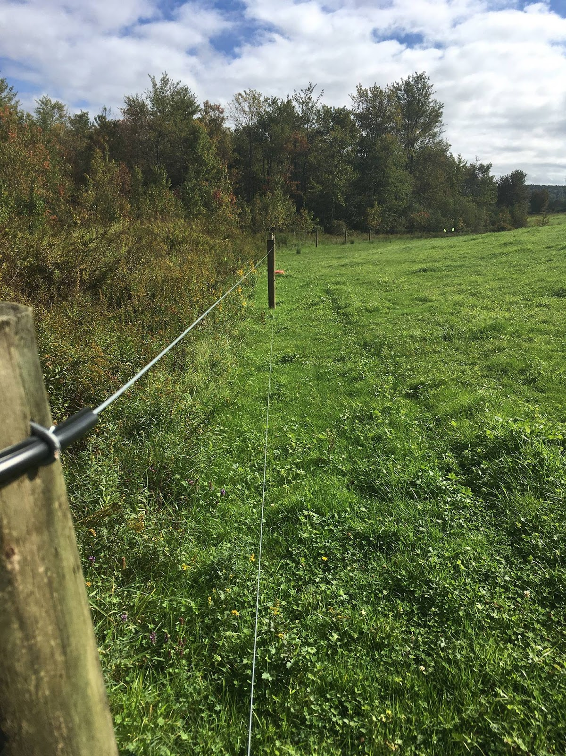
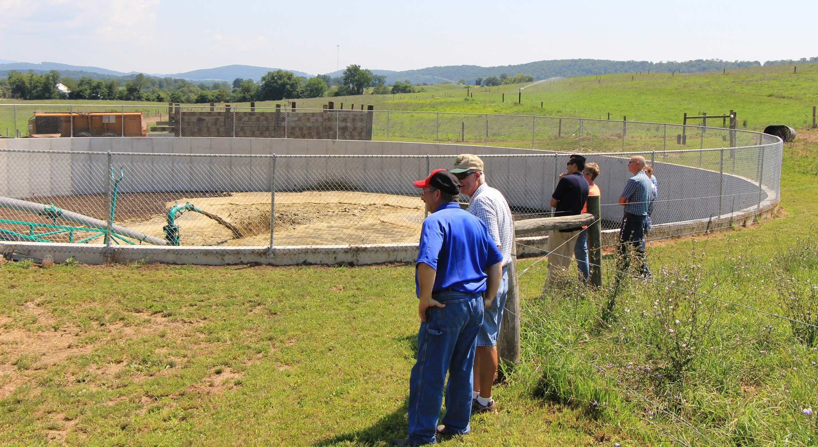
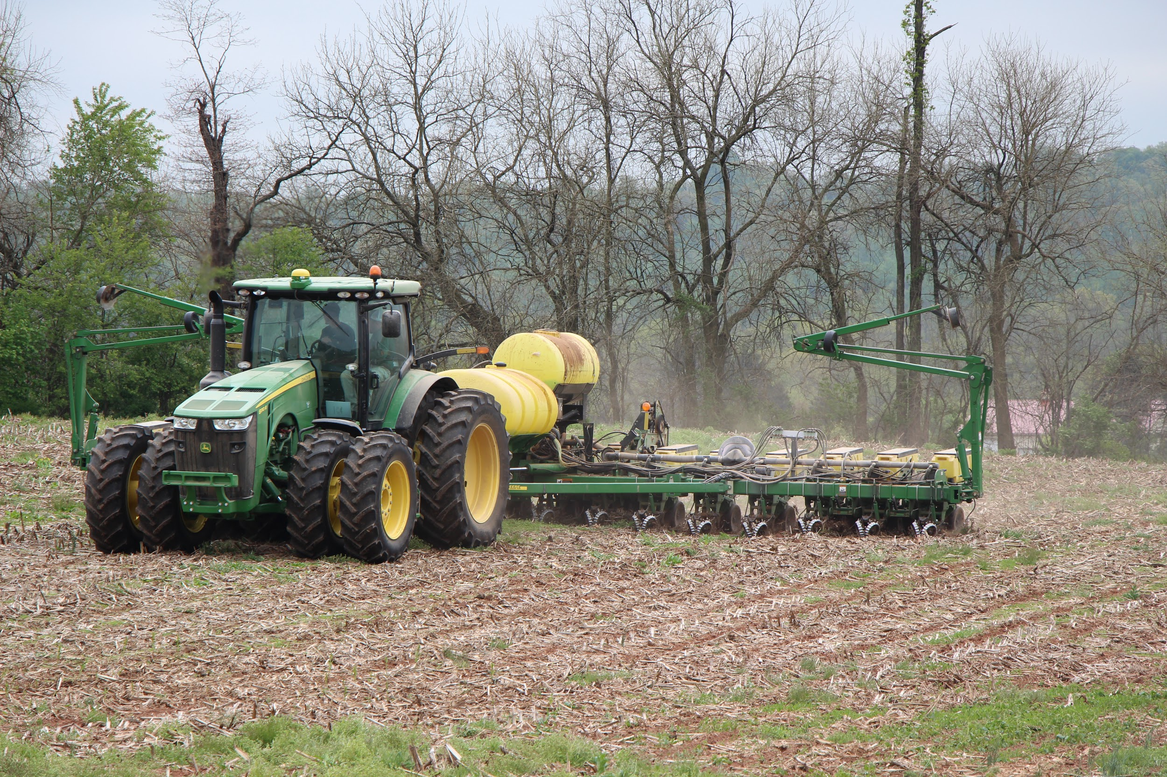
PA PHASE 3 WIP AGRICULTURE BMPs
www.dep.pa.gov/chesapeakebay/phase3
Resource Needs
To reach these goals, the state, local partners and farmers will need additional support:
Agricultural Compliance (Permitting, Compliance Assurance, Inspection, Enforcement).Agencies need continued funding for current staff, plus additional staff for the expanded ag compliance program:
  DEP – Maintain current staff; plus 12.5 additional staff positions ($1,432,814)
  Conservation Districts – Continue funding for Nutrient Management (35 staff) and Chesapeake Bay Technicians (39 staff)
Technical Assistance for BMP Design, Oversight and Implementation. Partners need additional staff to provide technical assistance to the agricultural community:
  Conservation District staff – All time spent on technical assistance ($5,400,500):
    50 additional Chesapeake Bay Technicians
    10 additional Chesapeake Bay Engineers
  Private Industry/NGO/NRCS – All time spent on technical assistance, no inspections or planning:
    87 additional private industry/NGO/NRCS staff
Financial Assistance for BMP Design and Implementation. Significant funding is needed to support the implementation of agricultural BMPs.
  It will cost approximately $354 million a year to fund agricultural BMPs through 2025
  A simple application process for public support funds is needed to encourage BMP implementation.

Slide 3
PA PHASE 3 WIP AGRICULTURE BMPs
www.dep.pa.gov/chesapeakebay/phase3
Action Steps
Pennsylvania will take the following action steps to support agricultural nutrient and sediment pollution reduction efforts:
Communications and Outreach
              Continue communication, outreach and stewardship programs to increase the use of conservation tillage and no-till practices.
Continue communication, outreach and stewardship programs to increase implementation of cover crops.
Continue communication, outreach and stewardship programs to increase implementation of pasture management.
Funding and Resources
Investigate the incorporation of alternative manure treatment technologies and other potential strategies to address areas of excess manure nutrient generation and capital investment required for implementation of manure treatment systems.
Expanding Capacity and Technical Assistance
Initiate implementation of Pennsylvania’s Agriculture Conservation Stewardship Program
Work with third parties, integrators and co-ops to identify alternative methods to support and assess compliance with regulations without use of regulatory entities
Implementation of animal waste management systems
Develop web-based and in-person training for Manure Management and Agriculture Erosion and Sediment planning.
Reporting and Tracking Progress
Work with the Chesapeake Bay Program partnership to establish a creditable practice or combination of practices for implementation of advanced soil health strategies or plans on farms in the Chesapeake Bay Watershed Model for future crediting of these initiatives. Once established as a practice or set of practices that can be credited for progress in the model, commit additional funding or the technical and financial assistance necessary to implement these practices.
Expand reporting of Dairy Precision Feeding
Expand reporting of Enhanced Nutrient Management
Expand reporting of Grassed Buffers
Compliance
Implement NPDES Concentrated Animal Feeding Operation (CAFO) Program Delegation
Complete complaint follow up for Concentrated Animal Feeding Operation (CAFO) and non-CAFO facilities
Implement Chesapeake Bay Agriculture Inspection Program, Phase 1, with an emphasis on meeting state planning requirement on non-CAFO operations
Implement Chesapeake Bay Agriculture Inspection Program, Phase 2, with an emphasis on meeting both state planning and implementation requirements on non-CAFO operations
For more information or to get involved in local planning efforts, please visit www.dep.pa.gov/chesapeakebay/phase3.
Produced and distributed by the PA Department of Environmental Protection through a U.S. Environmental Protection Agency Chesapeake Bay grant.
3020-HD-DEP5258 2/2020

