Slide 1
Wrap-up
Completing a Manure Management Plan Workshop
v.01.2018
Notes:
This module focuses on completing the Manure Management Plan Checklist.

Slide 2
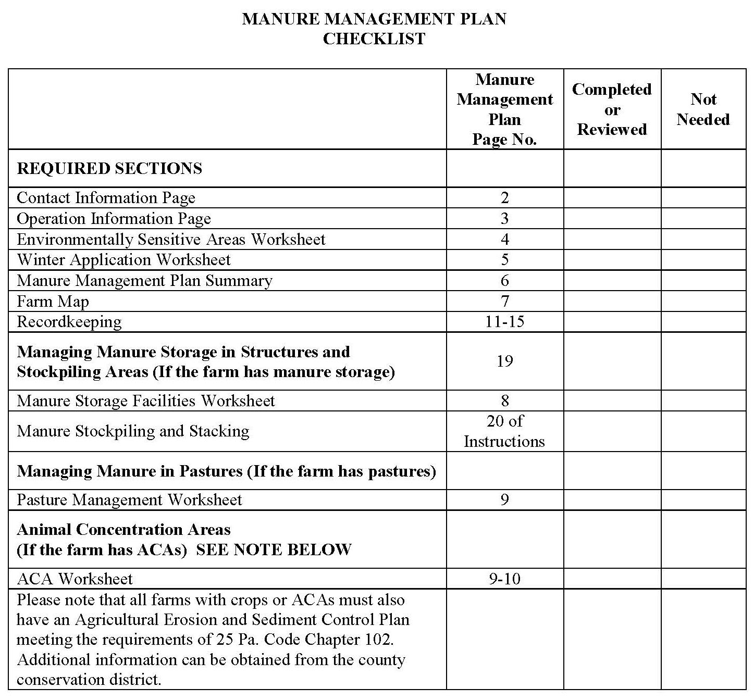
Manure Management Plan Checklist (p.1)
Notes:
At this point the farmers should have the blank Manure Management Plan Checklist in front of them. This is page 1 of the Manure Management Plan Workbook section.

Slide 3
Complete Manure Management Plan checklist
Manure Management Plan Exercise – Page 1
May need to be completed later when the plan is fully complete.
Notes:
This exercise completes the Manure Management Plan Checklist.

Slide 4
Manure Management Manual Webpage
www.panutrientmgmt.cas.psu.edu
Locating the Manure Management Manual page
On the left tool bar click on the “Manure Management Manual Program” tab
Click on the “Farmer Information” link
Information available
Land Application of Manure - Manure Management Plan Guidance
Manure Management Workbook
Nutrient Balance Sheet & User Guide
Manure Spreader Calibration factsheet
Pa One Stop Mapping link
Penn State Agronomy Guide
Notes:
The PA Nutrient Management Website is a great online source, with factsheets and tables that will aid you in completing the Manure Management Workbook. (The manure management manual program link is on the left hand side under main menu).

Slide 5
Manure Management Manual Education Program
http://extension.psu.edu/plants/nutrient-management/manure
Pennsylvania Nutrient Management Education Program
http://extension.psu.edu/plants/nutrient-management
Charlie White cmw29@psu.edu (814) 863-1016 |  | Jerry Martin jmartin@psu.edu (717) 394-6851

