Slide 1
Winter application worksheet
Completing a Manure Management Plan Workshop
v.12.2012
Notes:
This module focuses on completing the Winter Application Worksheet.
Facilitators should review and be familiar the guidance on pages 8-9 of “Land Application of Manure”.

Slide 2
Winter Application Worksheet (p.5)
Winter application is discouraged
DEP encourages farmers to seek other management solutions
Solid manure stacking
Liquid manure storage
For the MMP winter includes any one of the following:
December 15 through February 28; or
Anytime the ground is frozen at least 4 inches; or
Anytime that the ground is snow covered
Individual fields must be identified
Additional winter application flexibility may be obtained by:
Using a Certified Nutrient Management Planner to develop a nutrient management plan for the farm using the Act 38 plan format
Obtaining approval from DEP or county conservation district
Notes:
At this point the farmers should have the blank Winter Application Worksheet in front of them. This is page 5 of the Manure Management Plan Workbook section.

Slide 3
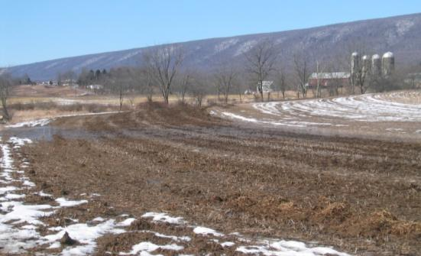
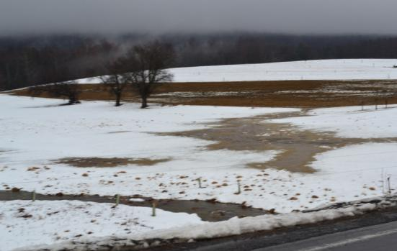
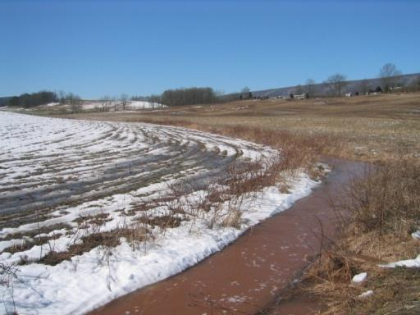
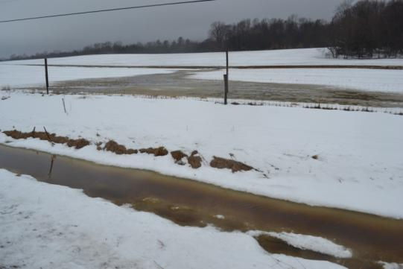
Winter Manure Application
= High Risk
Notes:
Photos to illustrate the high risk of environmental impact from winter application of manure. While winter application of manure is allowed in Pennsylvania it is strongly discouraged.

Slide 4
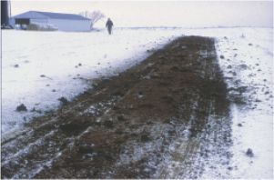
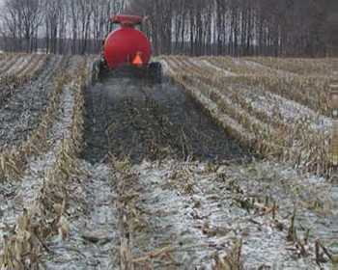
Winter Application Rate Limits
Farmers that apply manure in the winter will need to meet the following criteria:
The maximum application rate for the winter season
5000 gallons per acre of liquid manure
20 tons per acre of dry non-poultry manure per acre
3 tons of dry poultry manure per acre
An alternative maximum rate using Nutrient Balance Sheets
Calculate and apply manure to the phosphorus removal rate for the coming year’s crop

Slide 5
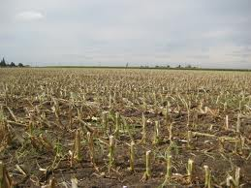
Winter Application Cover Requirements
Farmers that apply manure in the winter will need to meet the following criteria:
Must have at least 25% crop residue at application time or an established and growing cover crop
Highest priority should be given to:
Hay and sod fields
Fields with an established cover crop
Pasture fields
Where no cover crop is established the following will generally be excluded:
Corn silage fields
Corn grain fields where most of the fodder has been removed
Low yielding soybean fields

Slide 6
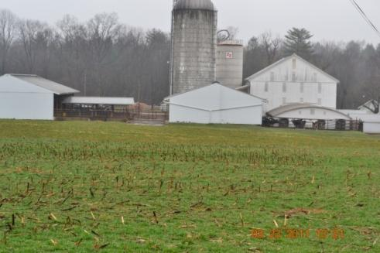
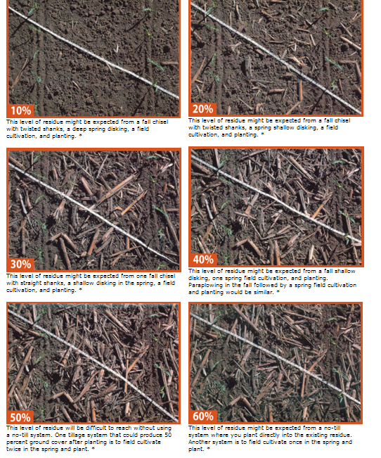
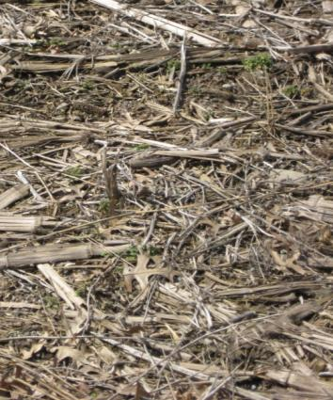
Cover Crops & Residue
NRCS Crop Residue
Cover Crop
Crop Residue

Slide 7
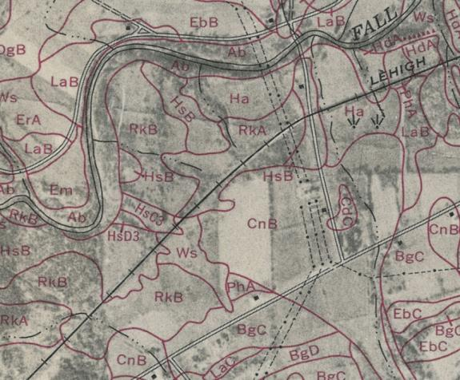
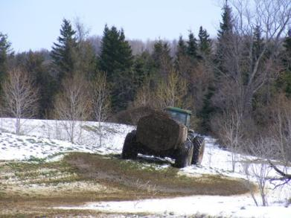
Winter Application Slope Limits
Farmers that apply manure in the winter will need to meet the following criteria:
Manure may not be applied on fields with slopes greater than 15%
NRCS soil survey slope designations of “A”, “B” or “C” slopes are acceptable for winter application determinations
20%

Slide 8
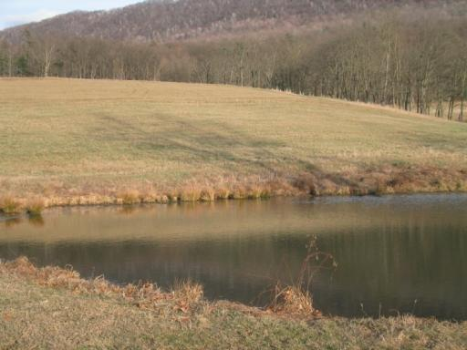
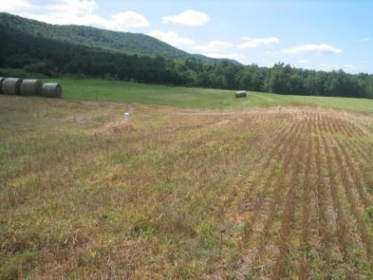
Winter Application Setbacks
Farmers that apply manure in the winter will need to meet the following criteria:
Specific application setbacks
100 feet from the top of the bank of a stream which generally flows during the winter or spring
100 feet of a lake or a pond
100 feet from an above ground inlet to an agricultural drainage system
Such as inlet pipes to piped outlet terraces
Where surface water flow is toward the above ground inlet
Along with all the other application setbacks outlined earlier in this section
50 ft Setback
100 ft Setback
35 ft Vegetated Buffer

Slide 9
Manure Management Plan Exercise – Page 3
Complete operation information page e
Notes:
This exercise completes part e of the Operation Information Page noting if winter manure application occurs on the farm.
Facilitators may want to refer participants to the completed example of the Operation Information Page. This is page 5 in “Land Application of Manure”.

Slide 10
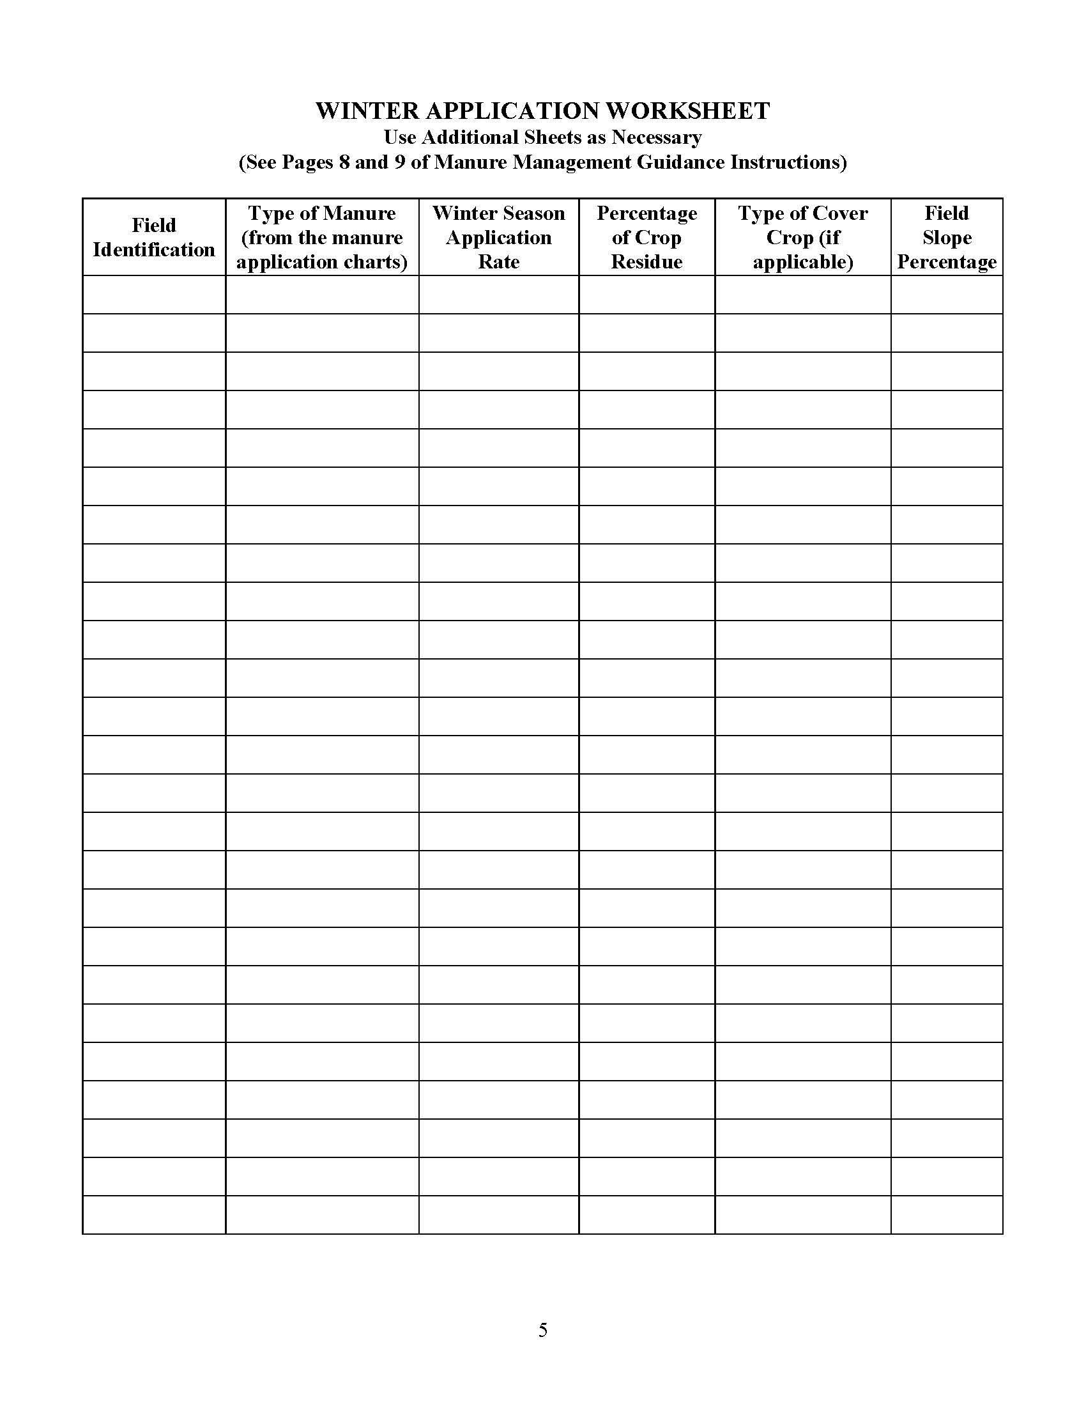
Winter Application Worksheet (p.5)
List each field that may receive winter manure applications
For each of the winter application fields list the following:
Type of manure to be applied
Winter application rate
Percentage of crop residue
Type of cover crop if applicable
Field slope percentage
Or slope designation
Slope information sources
Web: http://websoilsurvey.nrcs.usda.gov/app/HomePage.htm
County Soil Survey books
Conservation District or NRCS office

Slide 11
Complete winter application worksheet
Manure Management Plan Exercise – Page 5
Notes:
This exercise completes the first three sections of the Winter Application Worksheet.
Facilitators may want to refer participants to the completed example of the Winter Application Worksheet. This is page 9 in “Land Application of Manure”.

Slide 12
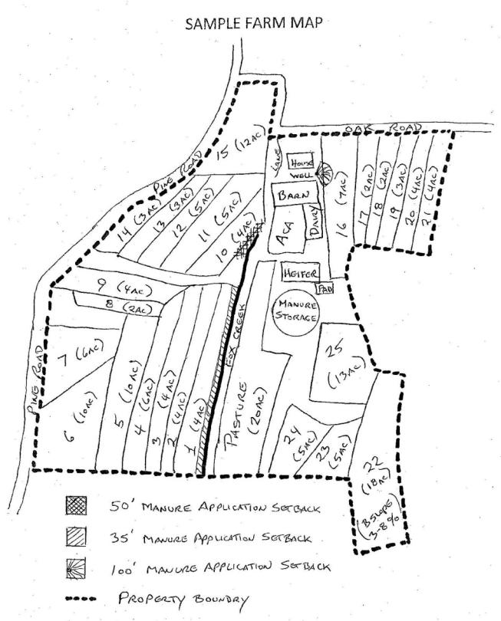
Record field slope or designation on the farm map
Farm Map Development
Notes:
This purpose of this exercise is to note the slope designation for each field receiving winter application of manure on the farm map.
Facilitators may want to refer participants to the completed example of the Farm Map. This is page 14 in “Land Application of Manure” and page 7 of the Manure Management Plan Workbook section.

