Slide 1
Record Keeping
Completing a Manure Management Plan Workshop
v.12.2012
Notes:
This module focuses on a brief review of the record keeping requirements in implementing a manure management plan.
Facilitators should review and be familiar the guidance on pages 15-17 of “Land Application of Manure”.

Slide 2
Recordkeeping
Two types of records must be maintained
Worksheets completed as part of the MMP development
Records that demonstrate that the MMP has been implemented
These records must be retained for 3 years
All records must be made available to DEP or the county conservation district upon request
Two types of MMP implementation records
Manure application records for each crop year
Manure Application Rate Record
Crop Yield Record
Manure Transfer Record
Manure Storage Facility Record
Monthly Inspection Form (Liquid & Semi-Solid Storages)
Farmers can use their own recordkeeping system
As long as it contains the required information
Forms are provided in the Manure Management Manual

Slide 3
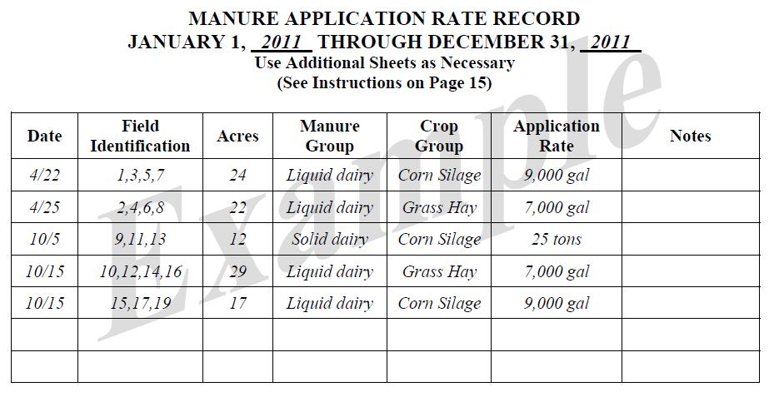
Manure Application Rate Record (p.12)
Notes:
Facilitators may want to refer participants to the completed examples of record keeping forms. This is pages 15-17 in “Land Application of Manure”.

Slide 4
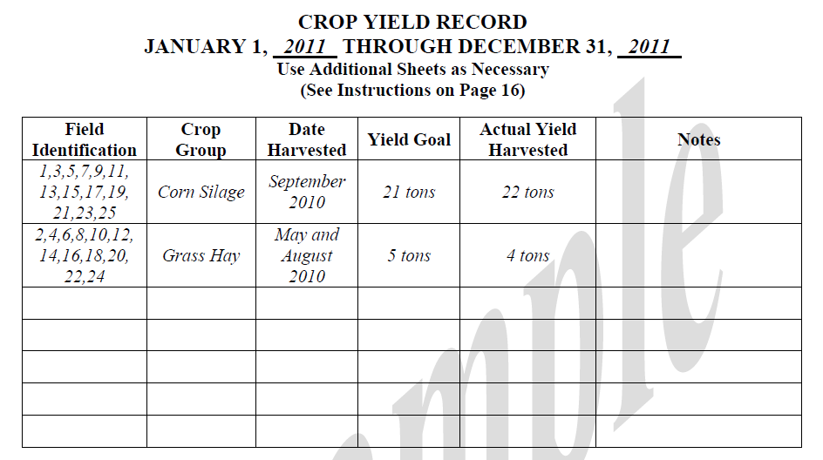
Crop Yield Record (p.13)

Slide 5
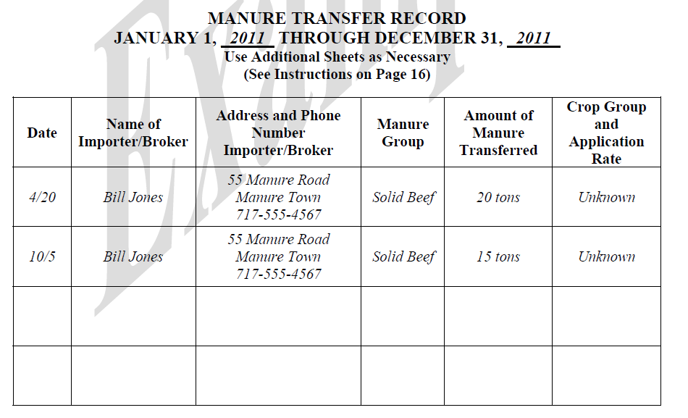
Manure Transfer Record (p.14)

Slide 6
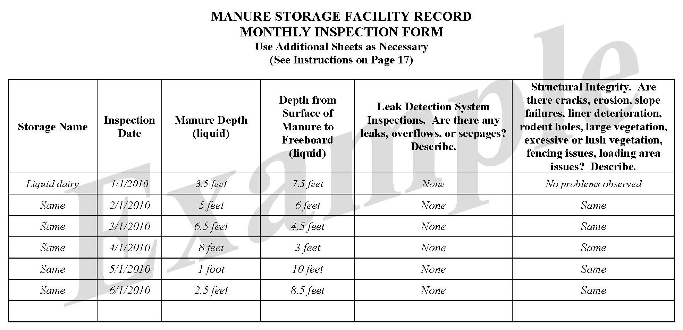
Manure Storage Facility Record (p.15)

Slide 7
Recordkeeping
Recordkeeping should begin immediately
Can begin keeping records before the MMP is completed
Determine which records are required for your operation
Manure Application Rates
Crop Yields
Manure Transfer
Manure Storage Facilities
Get started!
Notes:
Facilitators may want to refer participants to the blank record keeping forms. This is pages 11-15 of the Manure Management Plan Workbook section.

