Slide 1
Pasture management worksheet
Completing a Manure Management Plan Workshop
v.11.2014
Notes:
This module focuses on completing the Pasture Management Worksheet.
Facilitators should review and be familiar the guidance on page 21 of “Land Application of Manure”.

Slide 2
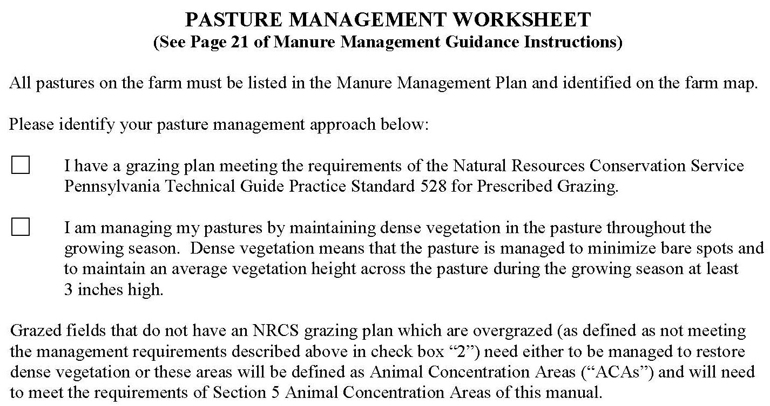
Pasture Management Worksheet (p.9)
All pastures on the farm must be included in the plan
Identified on the farm map
Notes:
At this point the farmers should have the blank Pasture Management Worksheet in front of them. This is page 9 of the Manure Management Plan Workbook section.

Slide 3
Manure Management Plan Exercise – Page 3
Complete operation information page h
Notes:
This exercise completes part h of the Operation Information Page noting if pastures exist on the farm and the total acres of both owned and rented pasture.
Facilitators may want to refer participants to the completed example of the Operation Information Page. This is page 5 in “Land Application of Manure”.

Slide 4
Pasture Management Options
Two pasture management options
Option 1: Grazing plan that meets the requirements of the PA Tech Guide Prescribed Grazing (528) standard (or)
Option 2: Assure that pasture management:
Maintains dense vegetation in the pasture throughout the growing season
Minimizes bare spots
Maintains an average vegetation height across the pasture during the growing season at least 3 inches high
Pastures which currently are overgrazed and do not meet one of the 2 management options must:
Implement one of the two options to restore dense vegetation (or)
Designate the pasture an Animal Concentration Area (ACA)
Meet ALL the management requirements for ACAs

Slide 5
Pasture Management Decisions
If you are not currently managing your pastures under an NRCS grazing plan or maintaining dense vegetation…
The most practical approach is to restore dense vegetation
In most cases it is impractical to manage entire pastures as an ACA
Pasture goals and purpose may be helpful in determining which management approach
Goal: Maximize feed value from pastures
NRCS grazing plan is best option
Goal: Exercise, fresh air, less manure to handle
Manage to restore and maintain dense vegetation
Both of these options will require management changes and often some “sacrifice”
Notes:
The purpose of this slide is to help farmers determine which management approach is best for them if they are not currently managing their pastures to meet the two pasture requirements for a manure management plan.
In addition, strong emphasis should be made that it is not desirable or practical in most cases to manage a vegetated pasture as and ACA.

Slide 6
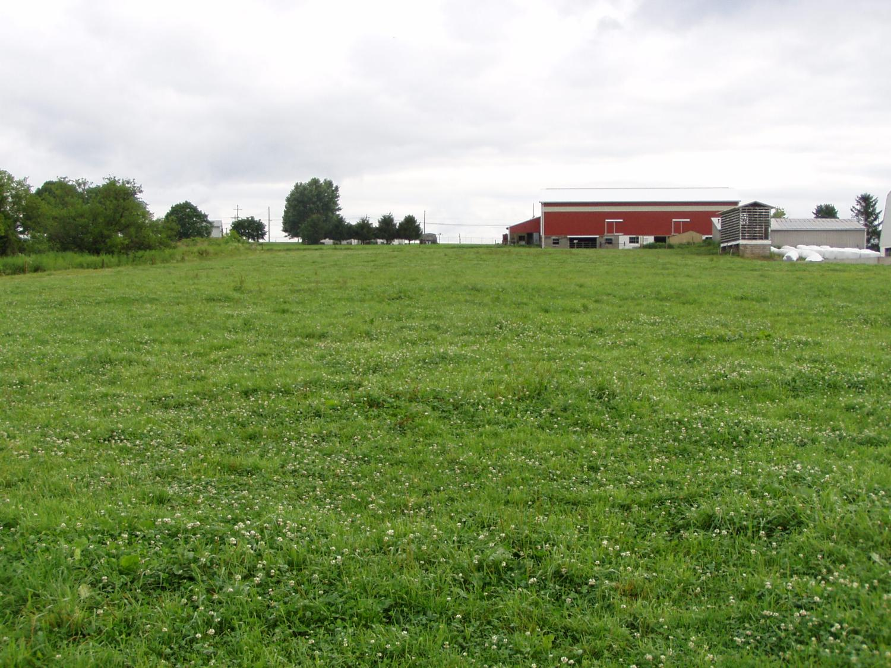
Evaluating Dense Vegetation
Standard – Maintain Density & Height
Notes:
This and the following slides illustrate the dense vegetation requirement for pastures.

Slide 7
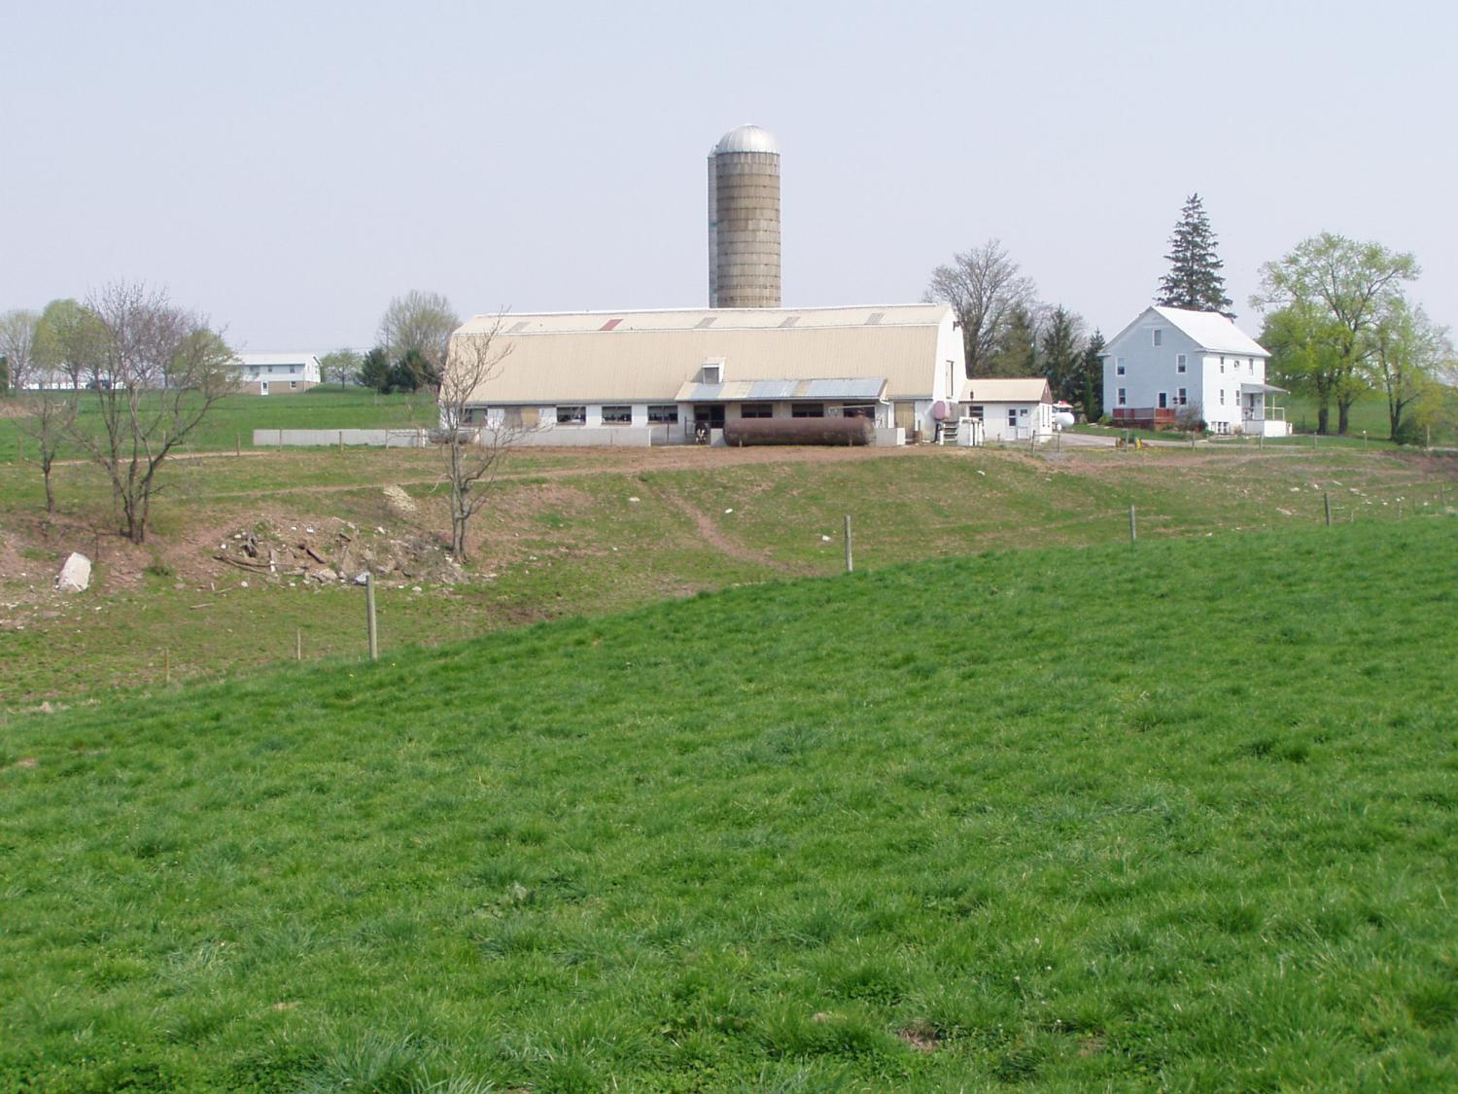
Evaluating Dense Vegetation
Unacceptable
Acceptable
Standard – Maintain Density & Height

Slide 8
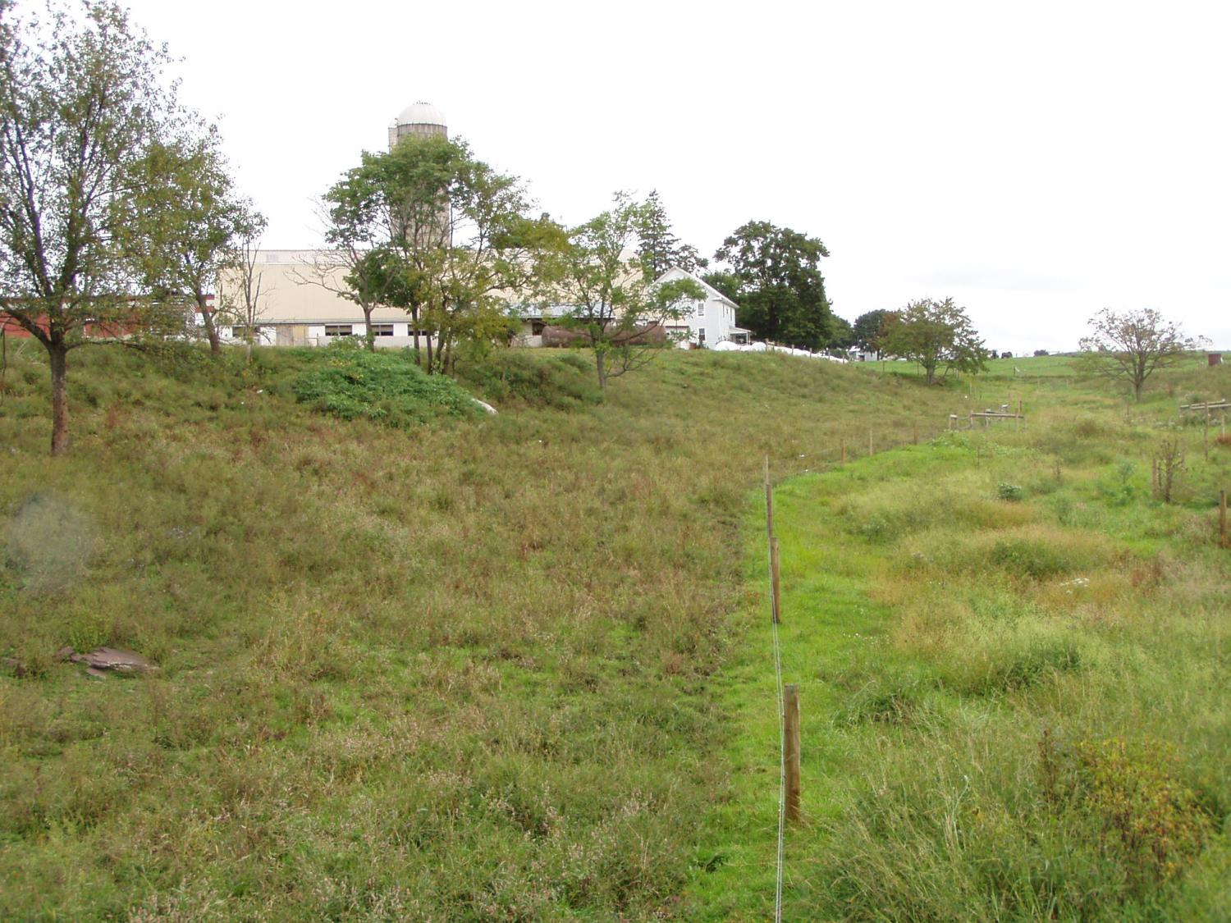
Evaluating Dense Vegetation
Acceptable ???
Standard – Maintain Density & Height

Slide 9
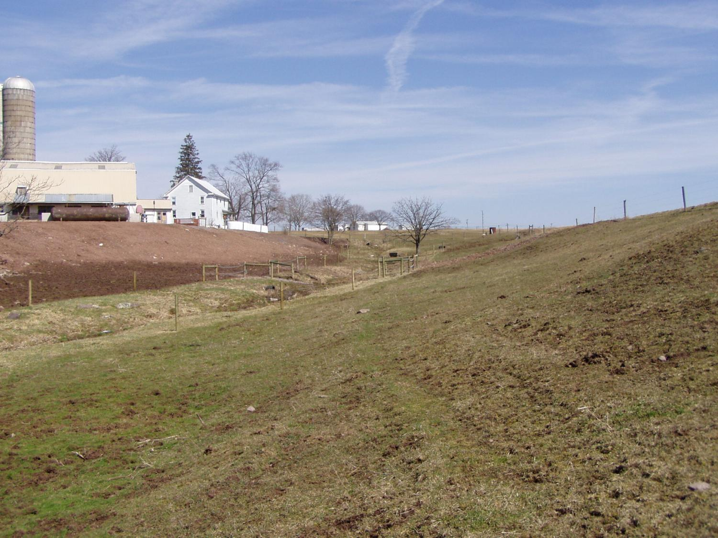
Evaluating Dense Vegetation
Standard – Maintain Density & Height

Slide 10
Rotational Lot Management Systems
One pasture option is a Rotational Lot Management System
Modified form of rotational grazing consisting of a series of grassed lots and a sacrifice lot
Cattle are rotated through the grassed lots based on sod condition
Cattle are kept on the sacrifice lot when sod conditions are wet
The sacrifice lot is managed to meet the ACA requirements
The pasture is managed to meet the dense vegetation requirements
Paddock 1
Sacrifice
Lot
Paddock 2
Paddock 3
Barn
Notes:
Rotational lot management systems are not a required best management practice, but a very inexpensive and workable solution to establishing and maintaining dense vegetation on pastures.

Slide 11
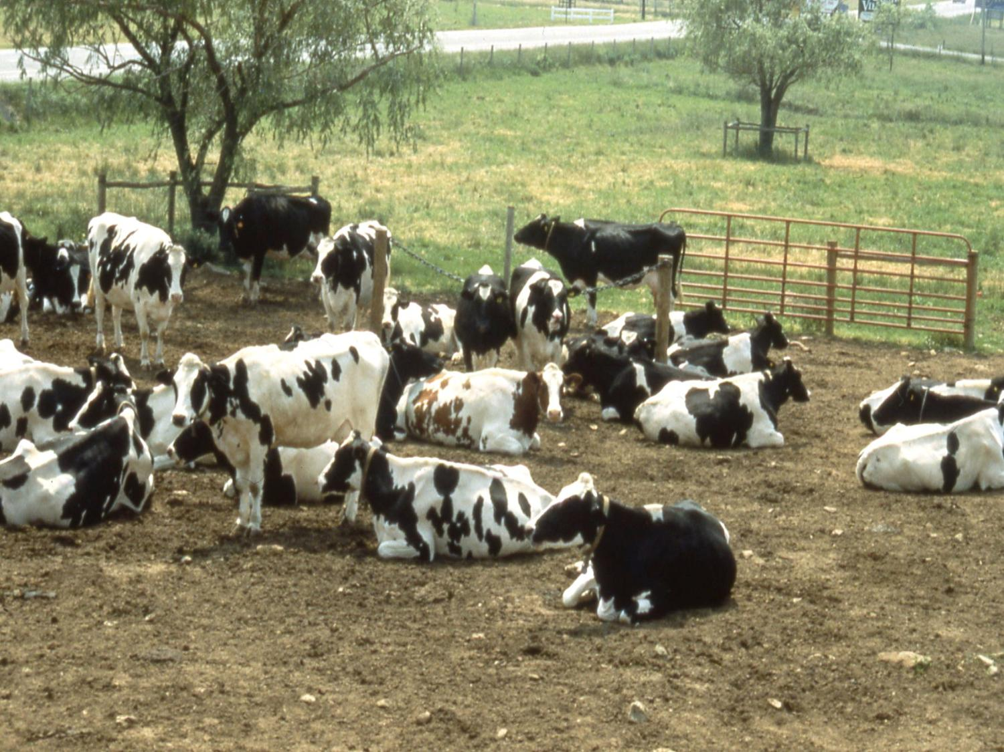
Notes:
Photo of a sacrifice lot.

Slide 12
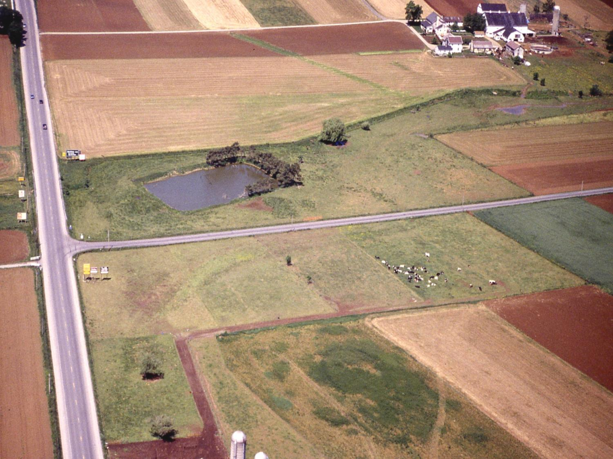
Notes:
Photo of a rotational lot management system. A portion of the sacrifice lot in the previous slide is in the lower right hand corner. The different paddocks of the system can be seen to the left and above the access lane leaving the sacrifice area.

Slide 13
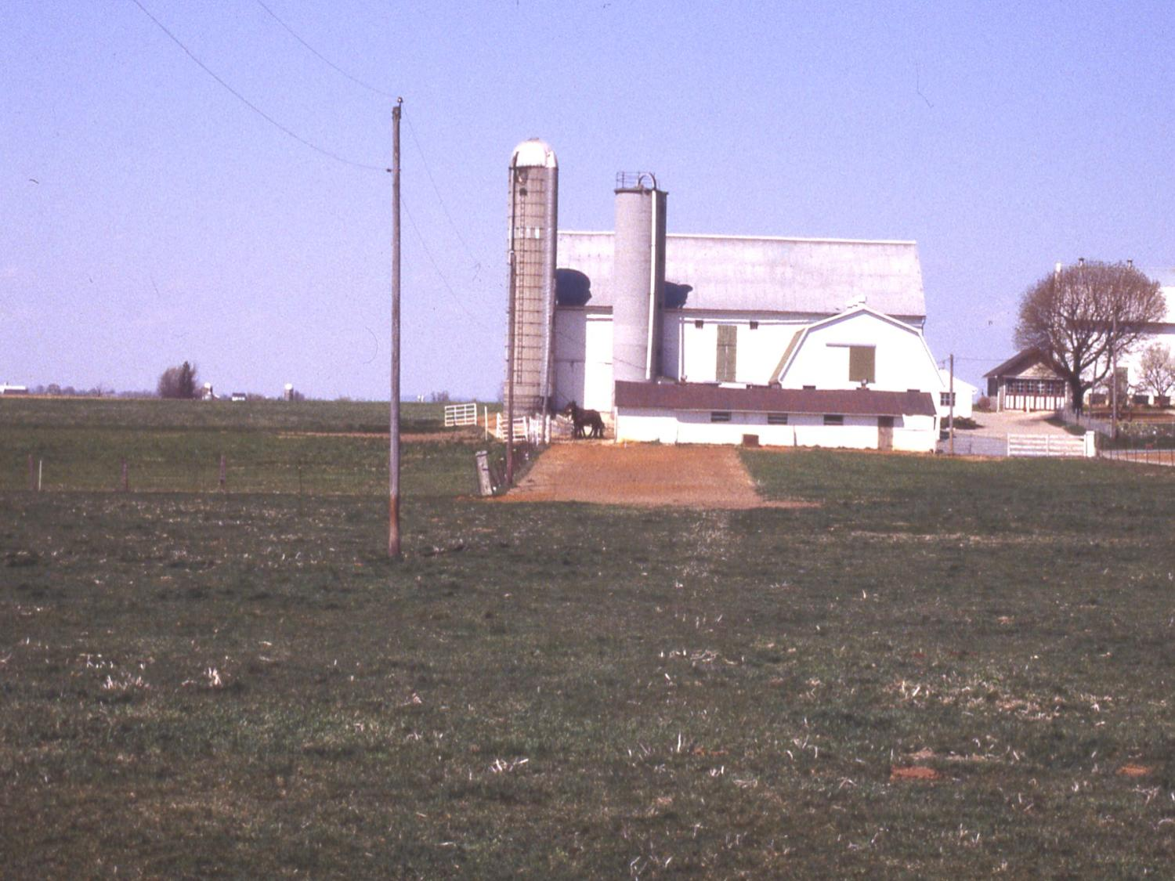
Notes:
Another photo of a sacrifice lot.

Slide 14
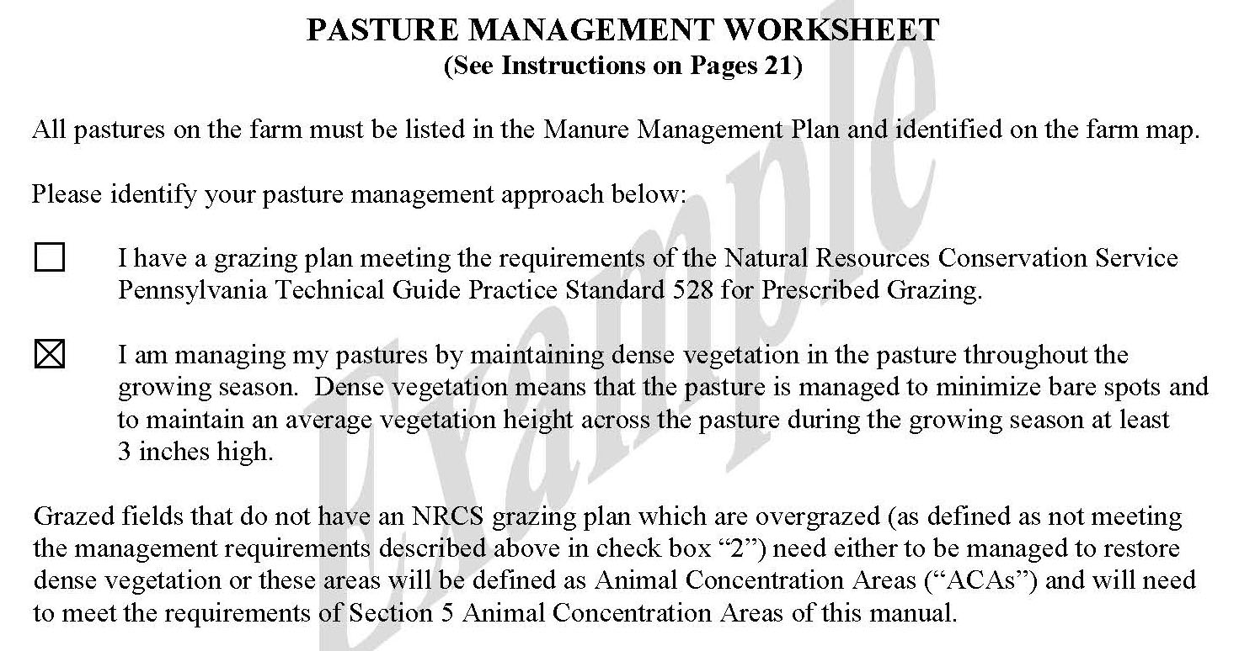
Complete pasture management worksheet
Manure Management Plan Exercise – Page 9
Notes:
This exercise completes the first three sections of the Pasture Management Worksheet.
Facilitators may want to refer participants to the completed example of the Pasture Management Worksheet. This is page 21 in “Land Application of Manure”.

Slide 15
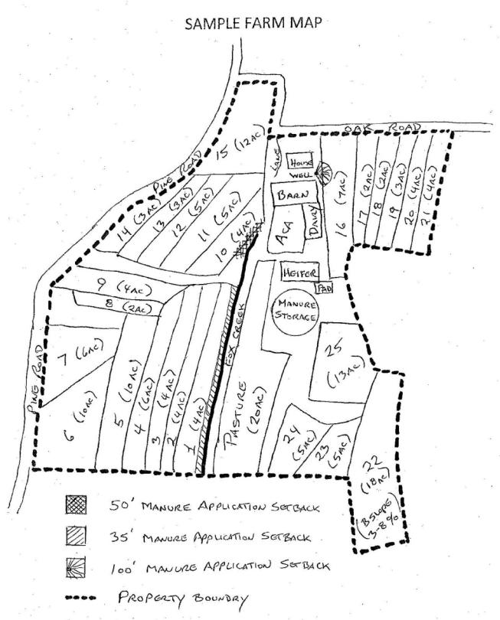
Note pasture fields on the farm map
Farm Map Development
Notes:
This purpose of this exercise is to note each pasture area on the farm map.
Facilitators may want to refer participants to the completed example of the Farm Map. This is page 14 in “Land Application of Manure” and page 7 of the Manure Management Plan Workbook section.

