Slide 1
Manure storage facilities
Completing a Manure Management Plan Workshop
v.02.2016
Notes:
This module focuses on completing the Manure Storages Facilities worksheet.
Facilitators should review and be familiar the guidance on pages 18-20 of “Land Application of Manure”.

Slide 2
Manure Storage Facilities & Stacking Areas
Facility or area used for the storage of:
  Manure
  Agricultural process wastewater
3 categories
  Manure Storage Facilities
    Designed and constructed facility
  Farmstead Stacking Areas
    Must use an improved stacking pad or covered area
    In most cases “improved” means a designed and constructed facility
  In-Field Stacking Areas
Notes:
The purpose of this slide is explain what is included in the definition of manure and the three types of storages required to be addressed in the manure management plan.

Slide 3
Manure Storage Facilities & Stacking Areas
Completing and maintaining the Manure Management Plan requires:
  Identifying each manure storage facility and stacking area on the farm
  Noting key information about each storage
  Initial evaluation of each storage when completing the plan which includes:
    Identification of problems or inadequate practices
    Planned BMPs or management changes to address problems
    Immediately correcting any problems that are identified
  Monthly evaluations to maintain the plan which includes:
    Recording the results of the evaluation on the “Monthly Inspection Form”
Notes:
This is an overview of the manure storage requirements both from planning, ongoing maintenance and recordkeeping.

Slide 4
Manure Storage Facilities
Examples of manure storage facilities
  Concrete tank
  Metal tank
  Under building structure
  Pond or lagoon
    Concrete lined
    Synthetic lined
    Earthen or clay (bentonite) lined
  Roofed stacking pad
  Exposed concrete stacking pad
Liquid or semi-solid manure storage facilities built in the year 2000 and later
  Must be designed and certified by a licensed Pennsylvania Professional Engineer
  Copy of engineer’s certification must be maintained
Notes:
This slide lists the various types of manure storages.
The following slides provides photos of the various types of manure storages.

Slide 5
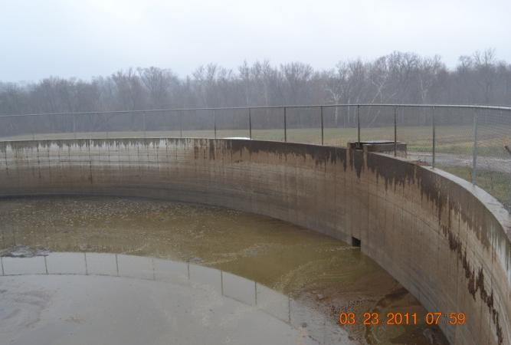
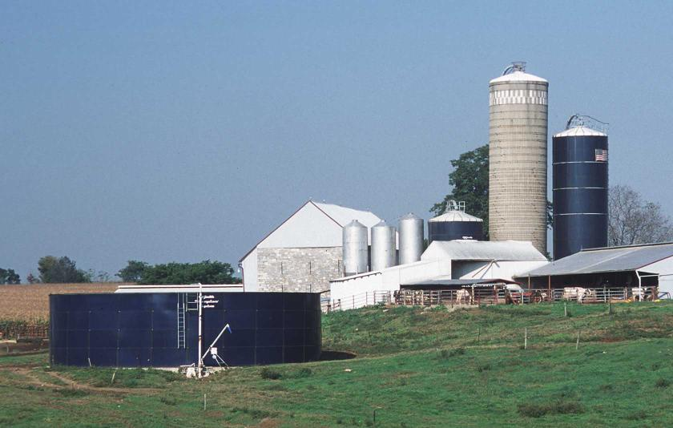
Concrete & Metal Tanks

Slide 6
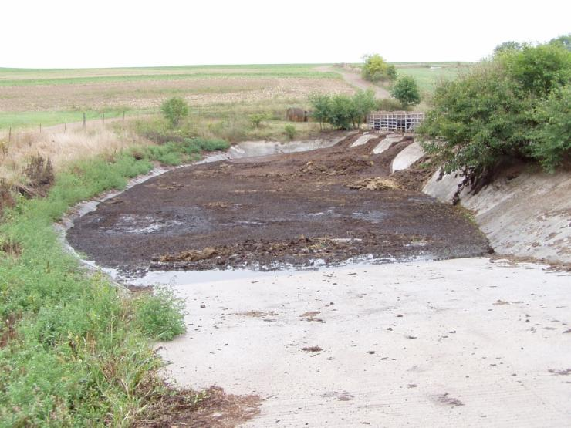
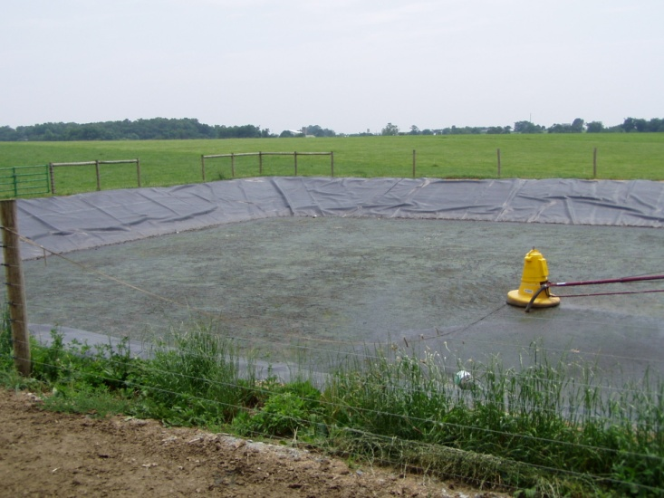
Lined Ponds & Lagoons

Slide 7
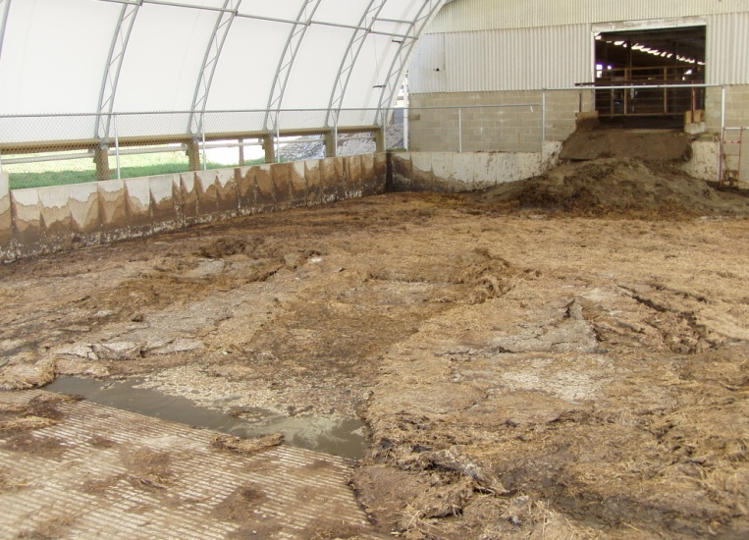
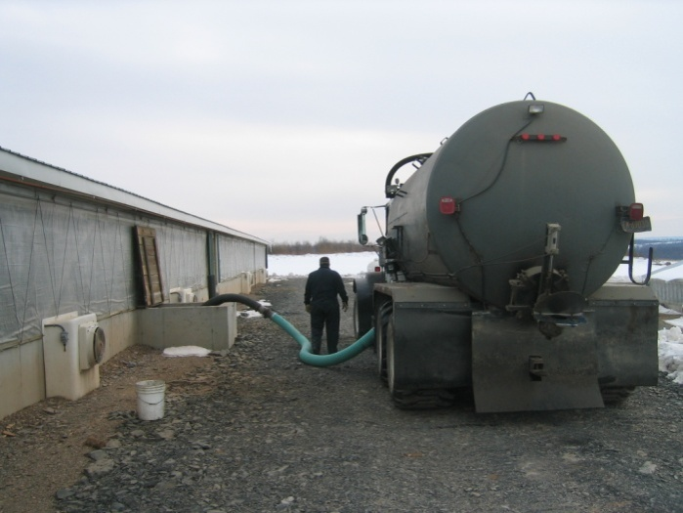
Roofed or Under Building Storages

Slide 8
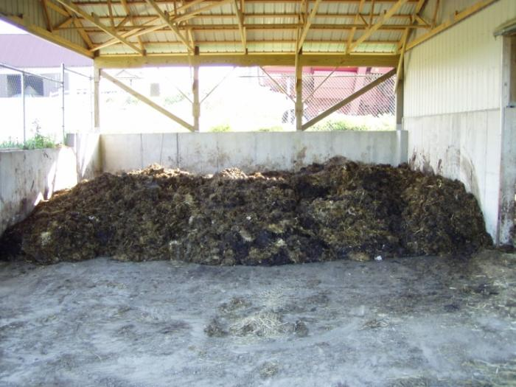
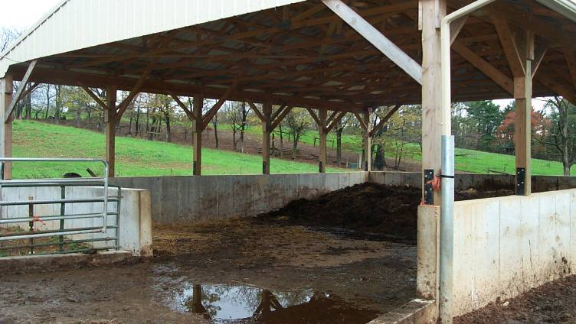
Roofed Stacking Pads

Slide 9
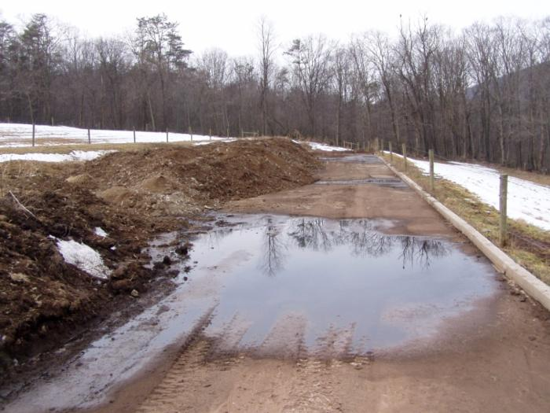
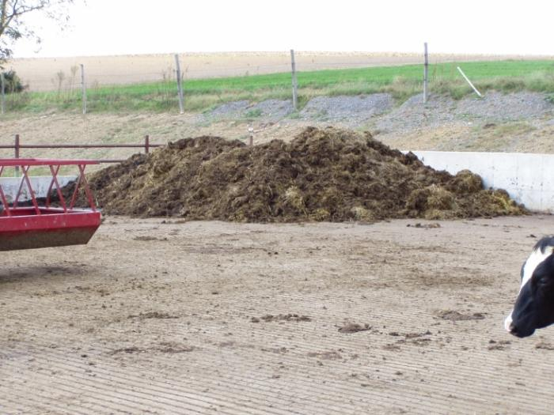
Exposed Stacking Pads

Slide 10

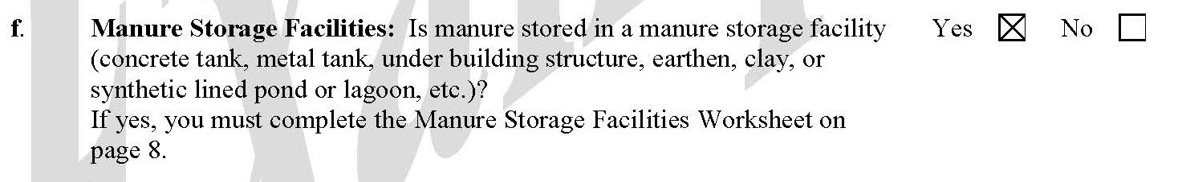
Manure Management Plan Exercise – Page 3
Complete operation information page F
Notes:
This exercise completes part f of the Operation Information Page noting if manure storages exist on the farm.
Facilitators may want to refer participants to the completed example of the Operation Information Page. This is page 5 in “Land Application of Manure”.

Slide 11
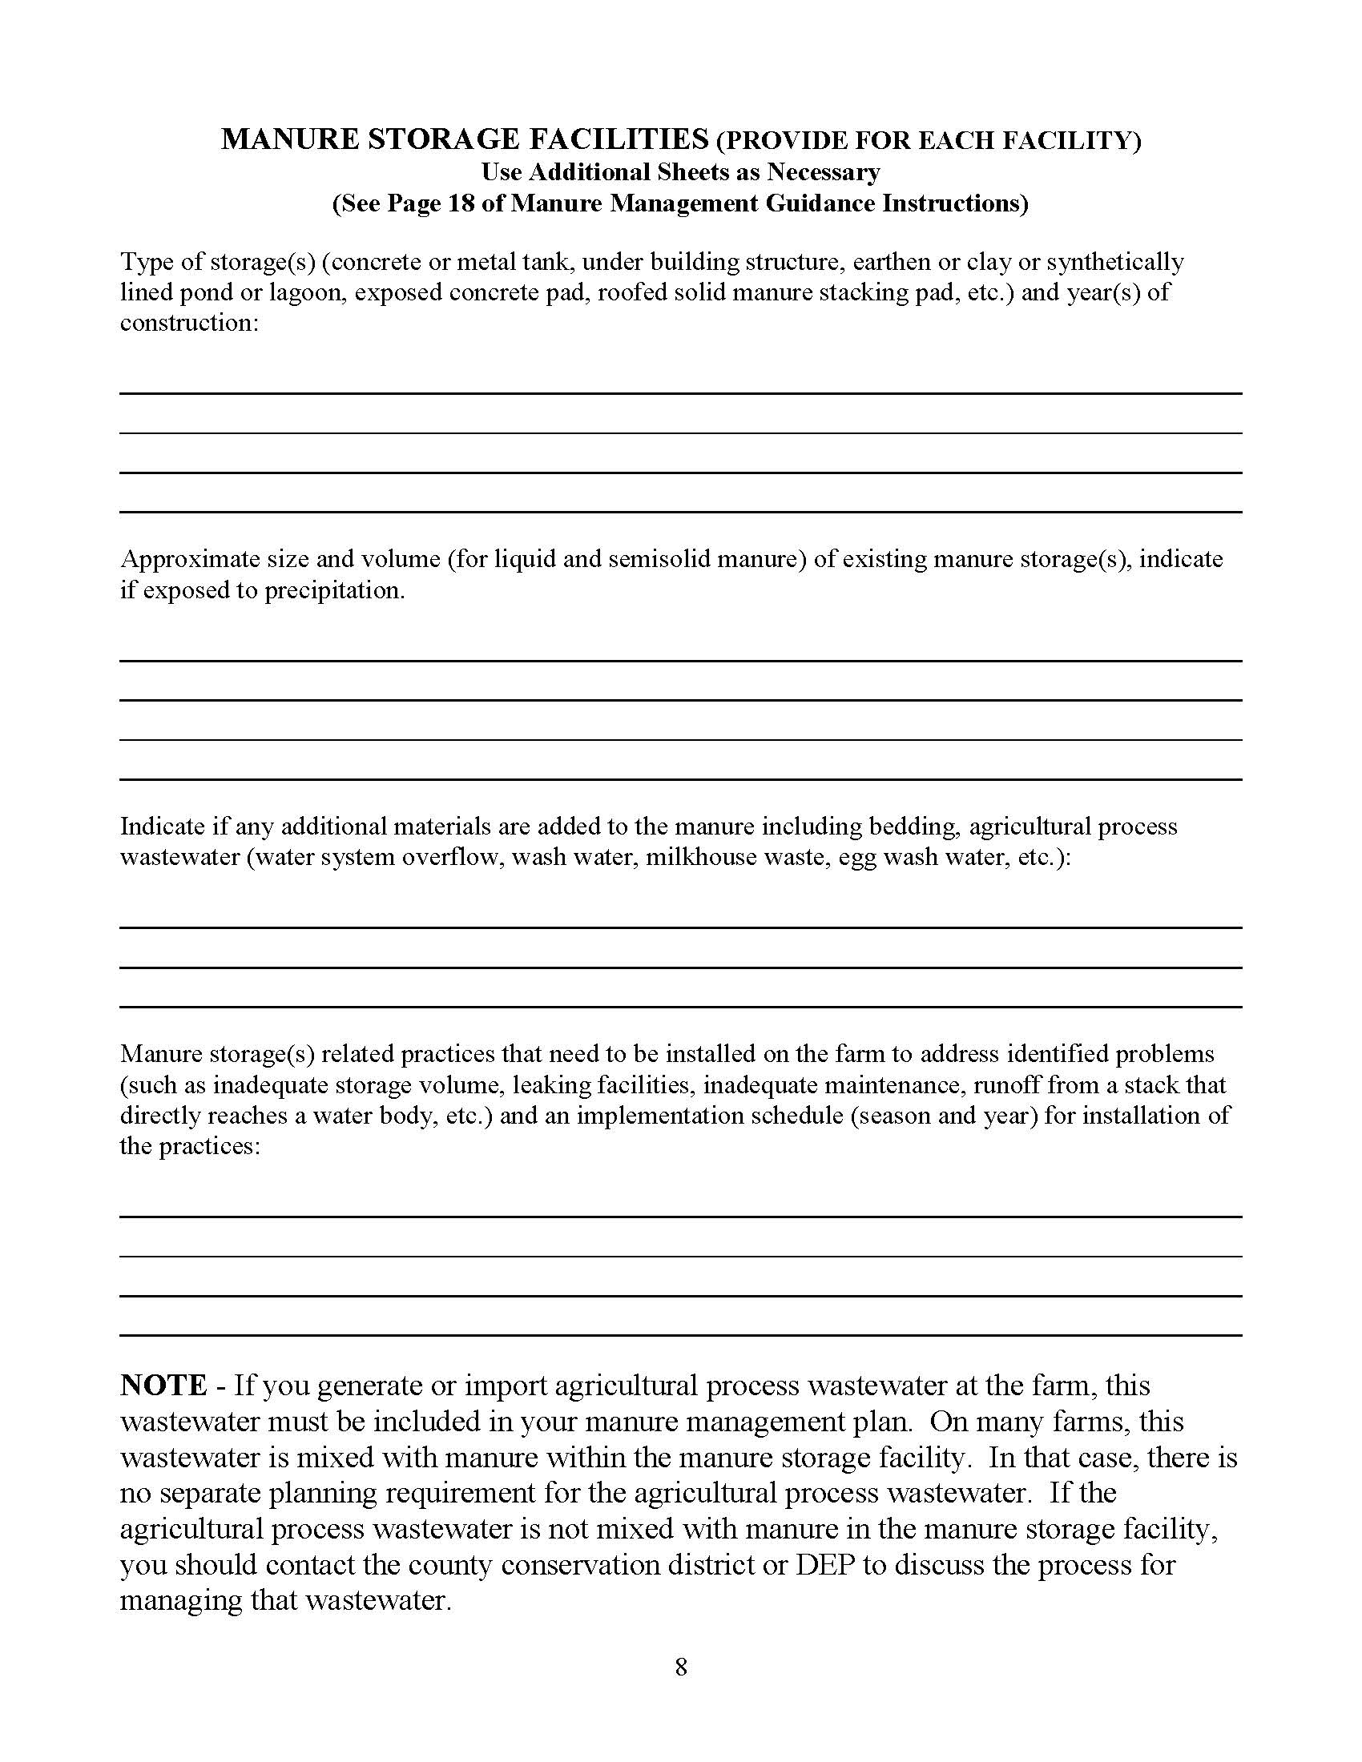
Manure Storage Facilities Worksheet (p.8)
Part 1 – List each storage facility or area
  Type of storage
  Year of construction
Part 2 - List for liquid or semi-solid storages
  Size and volume
  Note if exposed to rainfall
Part 3 - List additions to manure for each storage facility or area
  Bedding – note type
  Wastewater – note source
Notes:
At this point the farmers should have the blank Manure Storages Facilities worksheet in front of them. This is page 8 of the Manure Management Plan Workbook section.
Note that a separate worksheet needs to be completed for each manure storage on the farm.

Slide 12
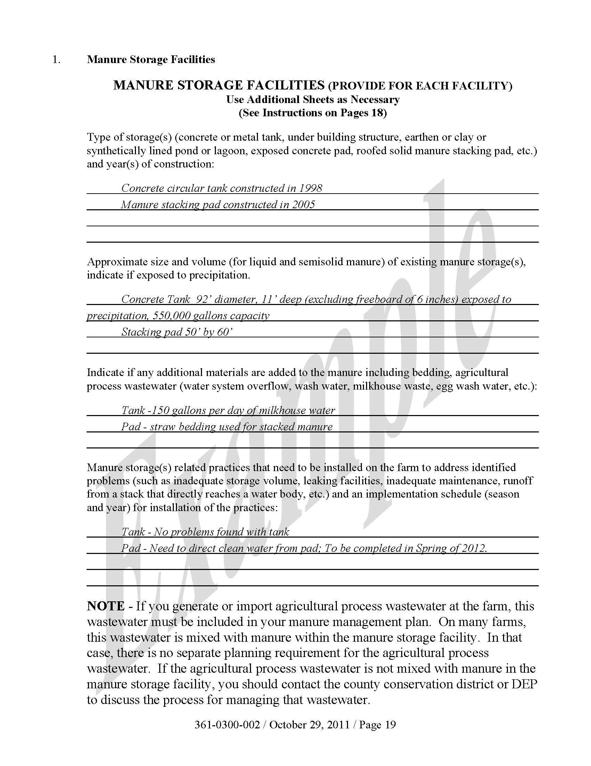
Complete parts 1, 2, & 3
Manure Management Plan Exercise – Page 8
Notes:
This exercise completes the first three sections of the Manure Storages Facilities worksheet.
Facilitators may want to refer participants to the completed example of the Manure Storages Facilities worksheet. This is page 19 in “Land Application of Manure”.

Slide 13
Manure Storage Facilities Worksheet (p.8)
Part 4 – Documentation of an initial evaluation of each storage facility or area
  Problems identified
  Practices that need to be installed to address problems
  Date to correct problems and install practices
NRCS or conservation district specialists can provide assistance
Notes:
This and the following slides provide a brief review of the evaluation process required for each manure storage which needs to be summarized in the fourth section of the Manure Storages Facilities worksheet.
At this point the farmers should have the blank Manure Storages Facilities worksheet in front of them. This is page 8 of the Manure Management Plan Workbook section.

Slide 14
Manure Storage Facility Evaluation
MMP must assure proper and safe storage of manure and agricultural process wastewater
Liquid or semi-solid manure storage facilities must be evaluated by the farmer monthly
  No evidence of overtopping or leakage from the manure storage facility
    Maintain a minimum 12-inch freeboard for all ponds at all times
    Maintain a minimum 6-inch freeboard for all other manure storage facilities at all times
  No visible cracking, rodent holes, tree or shrub growth on the berms or other problems with manure storage facilities that would lead to leakage
  No visible slope failures, visible deterioration or tears of any liner, or knowledge of any local water pollution issues associated with the storage facility
Monthly evaluation is not required for solid manure storage facilities
Any problems identified in these three areas must be addressed immediately
Written records must be maintained
  See recordkeeping guidance and worksheet

Slide 15
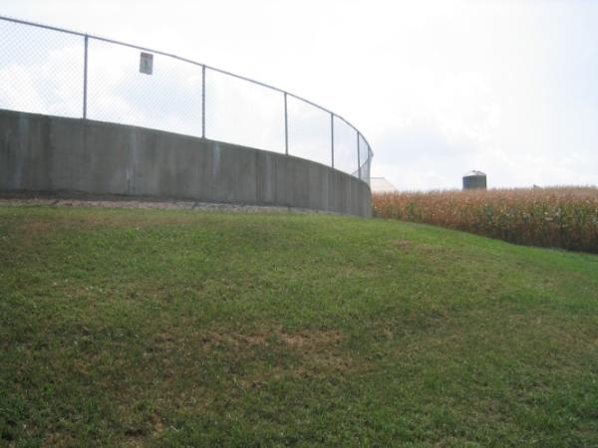
Good Storage Management
No large vegetation
Keep surrounding area mowed & trimmed
Roots
  Can decrease the integrity of storage structures
  Can act as liquid flow paths

Slide 16
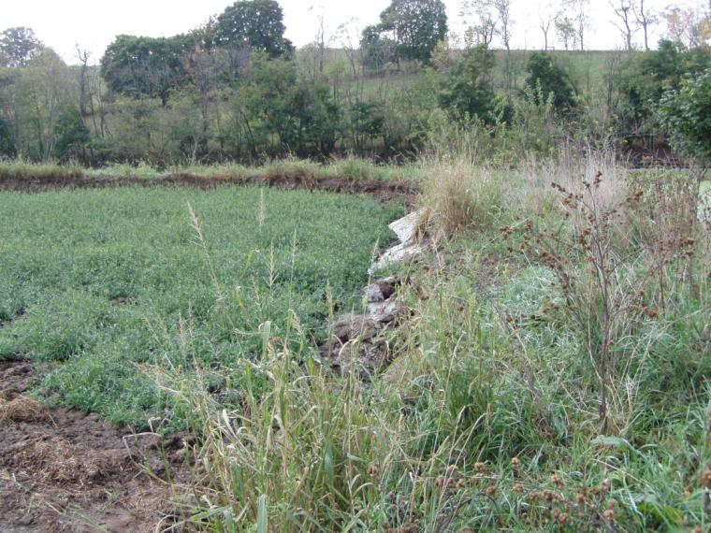
Good Storage Management
Avoid animal damage
  Keep banks mowed
“When the groundhog meets the muskrat you have trouble.”

Slide 17
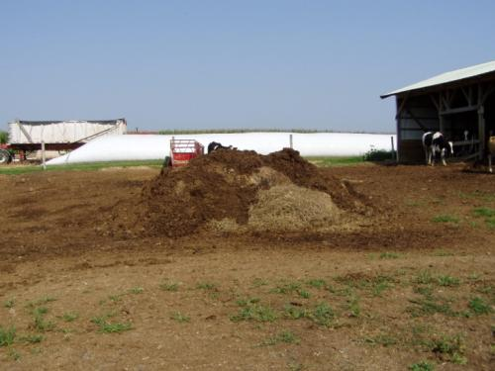
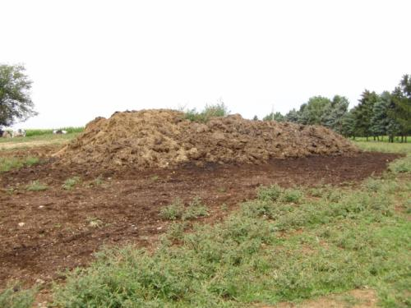
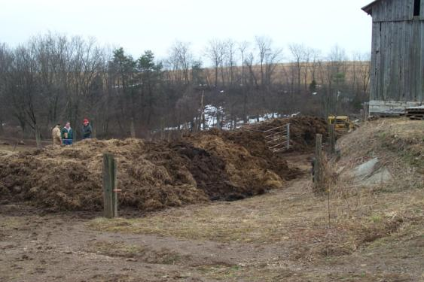
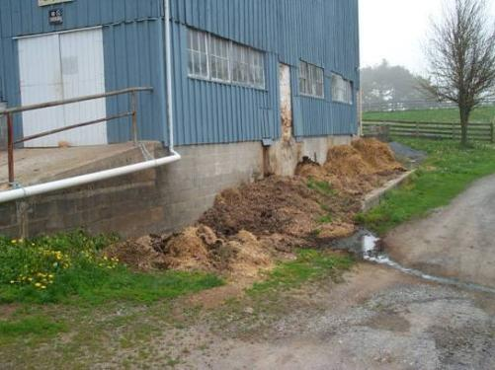
Unimproved & Unacceptable
Farmstead Manure Stacking
Notes:
Why are these stacking areas considered ‘Unacceptable’? Do you they pose an environmental threat? When evaluating your farms manure storage, the main and most important concept to remember – keep clean water clean.

Slide 18
Complete part 4
Manure Management Plan Exercise – Page 8
May need to be completed later and may require technical assistance to determine appropriate practices and timeframes.
Notes:
This exercise directs the farmers to complete the fourth section of the Manure Storages Facilities worksheet.
Facilitators may want to refer participants to the completed example of the Manure Storages Facilities worksheet. This is page 19 in “Land Application of Manure”.

Slide 19
Record Keeping Requirements
Liquid or semi-solid manure storage facilities must be evaluated by the farmer monthly
  Use Manure Storage Facility Record – Monthly Inspection Form
Information Recorded
  Storage name
  Inspection date
  Manure depth (liquid)
  Depth from surface of manure to freeboard (liquid)
  Leak detection system inspections
  Structural integrity
Notes:
This and the next slide cover the recordkeeping requirements related to manure storages. It is intended to provide an awareness emphasis.
Facilitators may choose to skip this and cover it in the Record Keeping module.

Slide 20
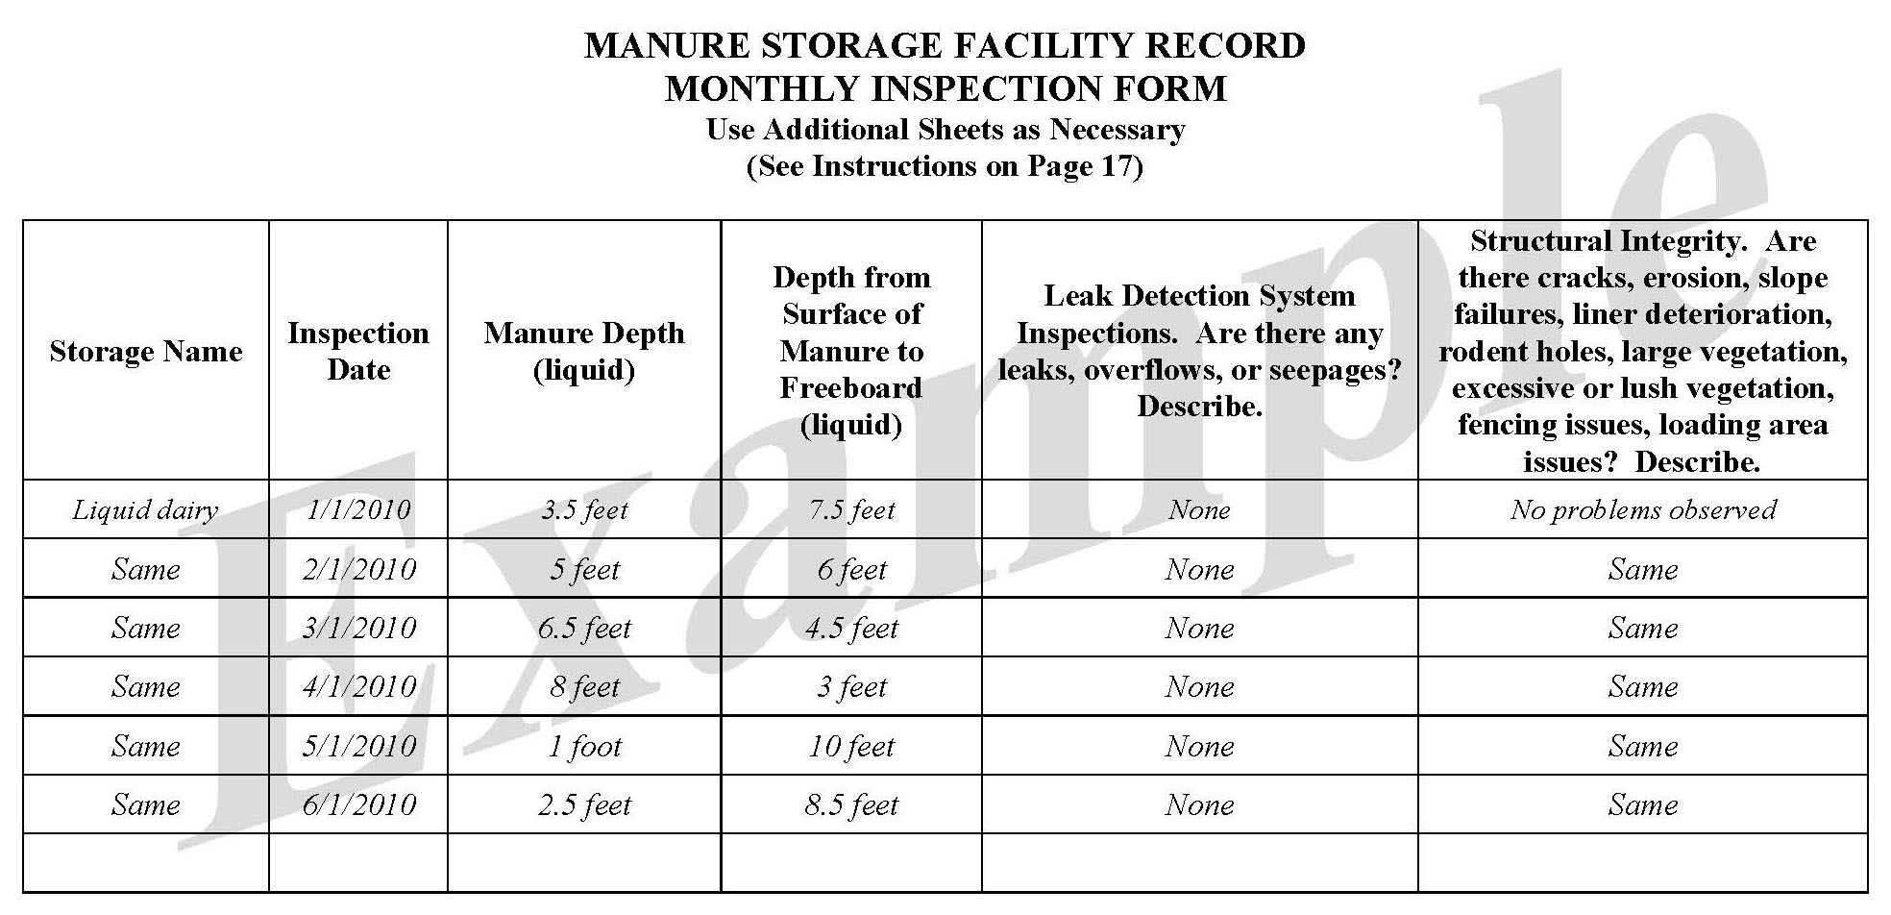
Manure Storage Facility Record

Slide 21
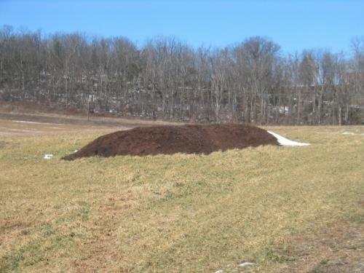
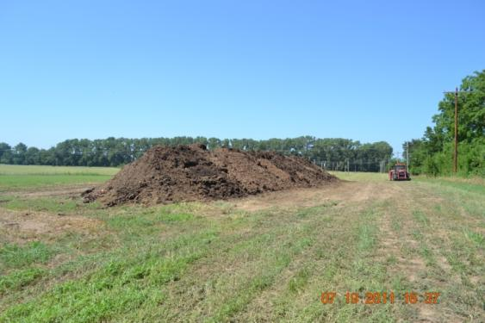
Temporary In-Field
Manure Stacking
Notes:
Here are two examples of proper in–field manure stacking.

Slide 22
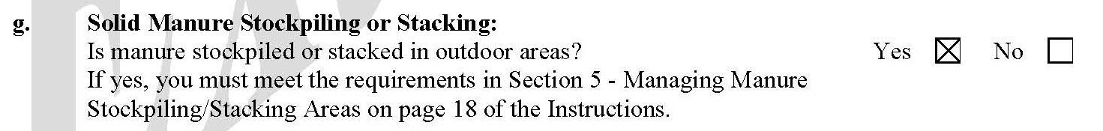
Manure Management Plan Exercise – Page 3
Complete operation information page G
Notes:
This exercise completes part g of the Operation Information Page noting if stacking or stockpiling of manure storages is practiced on the farm.
Facilitators may want to refer participants to the completed example of the Operation Information Page. This is page 5 in “Land Application of Manure”.

Slide 23
Manure Stockingpiling and Stacking Areas
Requirements for temporary stacking in non-farmstead areas such as crop fields:
  Keep at least 100 feet from sensitive areas
    Streams, lakes, ponds, open sinkholes, drinking water wells
  Cannot be placed within an area of concentrated water flow
    Swale, ditch or waterway
  Use properly constructed improved stacking pads whenever possible
  In-field stacking areas should not be in the same location each year
  Place at the top of a hill, where possible
    Divert upslope water away from stacking areas
  Place on areas with less than 8% slope.
  Manure must be dry enough to allow for stacking at least 4 feet in height
  Limit volume to amount that can be spread on fields nearby to the stack
  Stack must be covered if it will be in place longer than 120 days

Slide 24
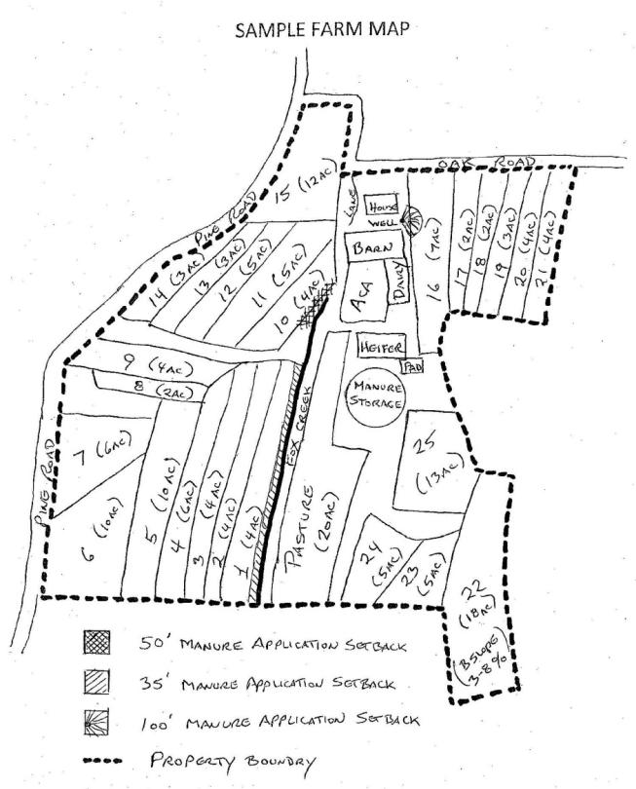
Locate manure storages & Stacking areas on the farm map
Farm Map Development
Notes:
This purpose of this exercise is to note each manure storage and manure stacking location on the farm map.
Facilitators may want to refer participants to the completed example of the Farm Map. This is page 14 in “Land Application of Manure” and page 7 of the Manure Management Plan Workbook section.

