Slide 1
Manure management plan summary – MMP NBs
Completing a Manure Management Plan Workshop
v.01.2018
Notes:
This is an optional module that illustrates how to determine manure application rates using the MMP Nutrient Balance Worksheet. It could be used in place of the Manure Application Rate Tables module if most of the farmers need to or prefer to use balance sheets.

Slide 2
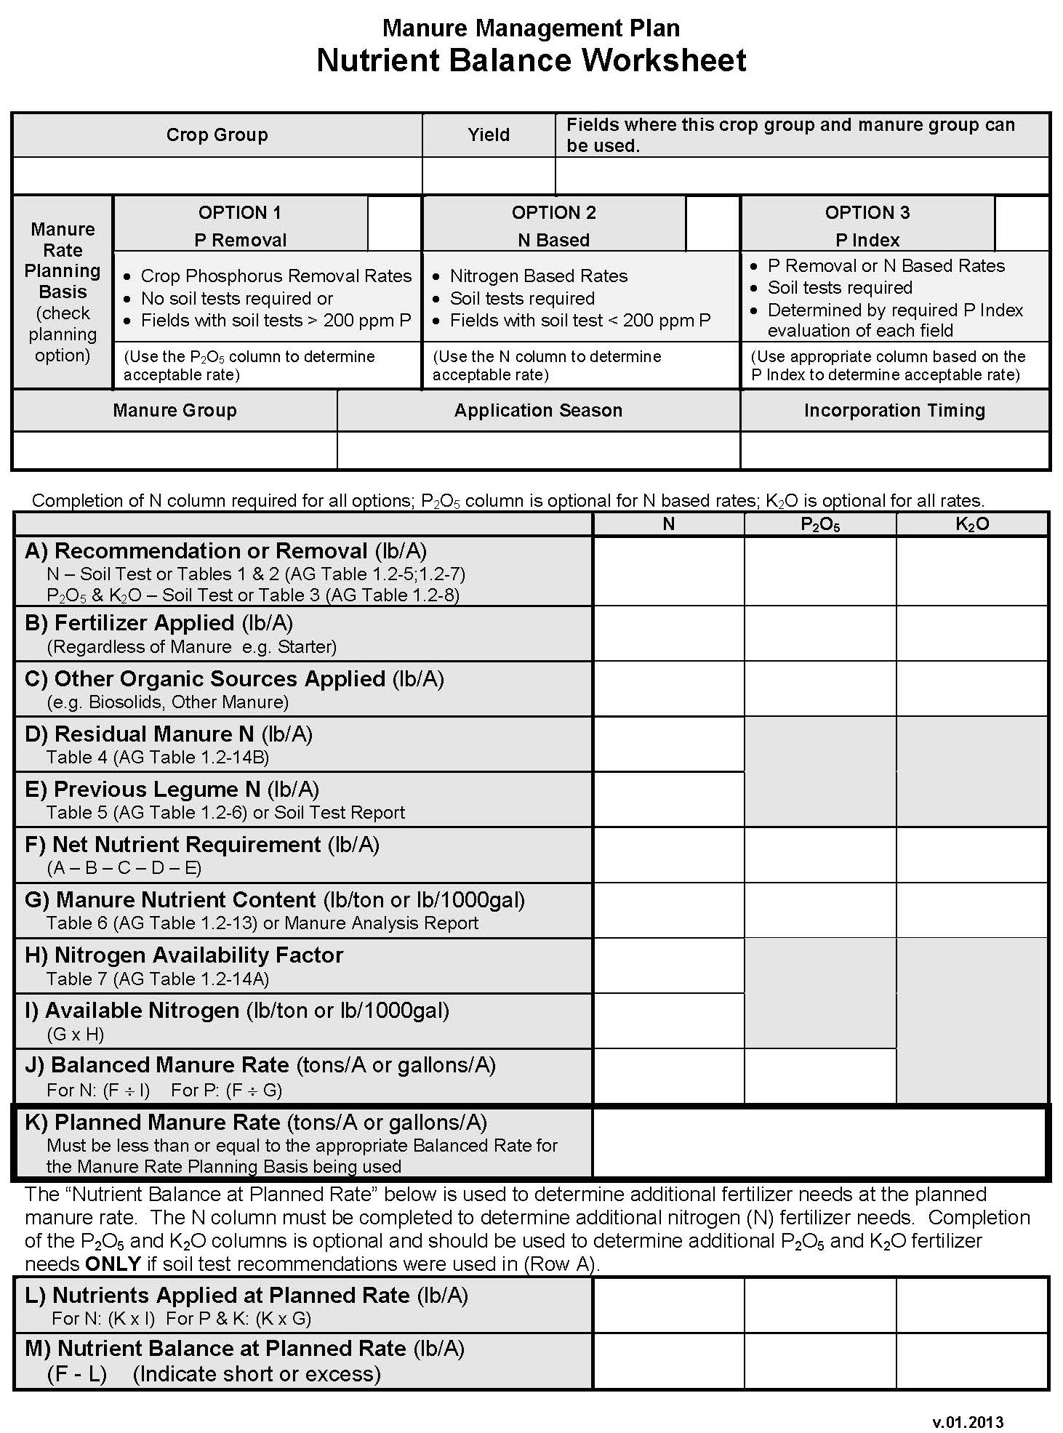
Nutrient Balance Sheets
Nutrient Balance Sheets may be used instead of the Manure Application Rate Tables
Farm and crop specific
Better utilize manure to meet crop nutrient needs
Reduces need to purchase fertilizer
Nutrient Balance Sheets
Act 38 Nutrient Balance Sheets
Paper or Excel spreadsheet versions
Nutrient Balance Worksheet User Guide
MMP Nutrient Balance Sheets
Paper version
MMP Nutrient Balance Worksheet User Guide
Excel version

Slide 3
Manure Management Plan Nutrient Balance Worksheet
Purpose of the worksheet is to calculate a planned manure rate for a specific crop management scenario.
Planned Manure Rate

Slide 4
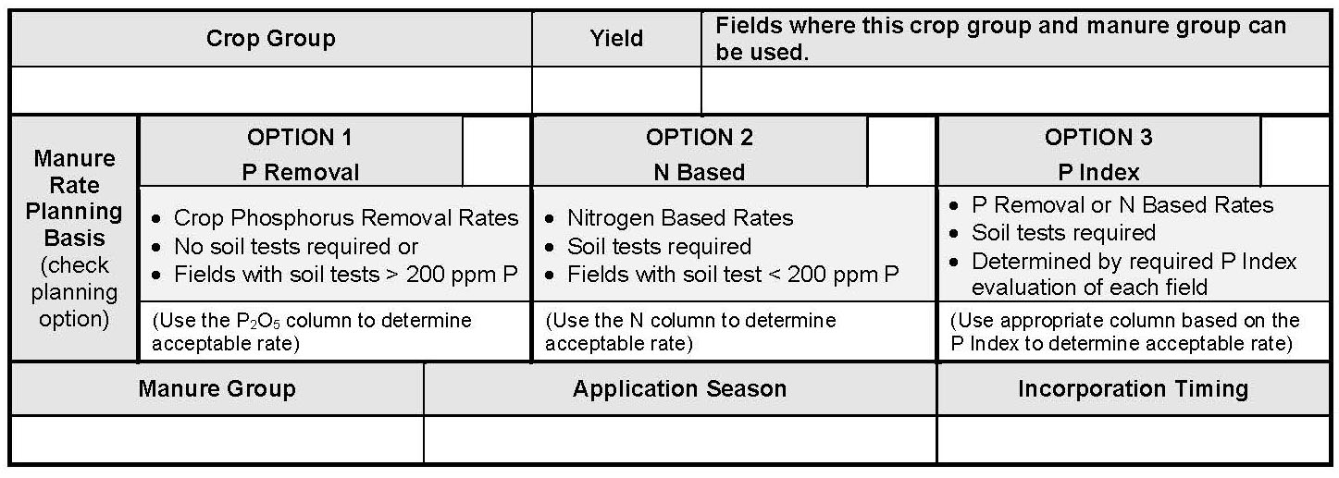
Crop Management Scenarios
Management scenarios are created by different combinations of:
Planning Basis (Nitrogen or Phosphorus)
Crop Groups (and Yields)
Manure Groups
Application Seasons
Incorporation Timing

Slide 5
Manure Management Plan Summary
Crop Group and Yield (a) | Manure Group (b) | Application Season (c ) | Planned Application Rate from C, NBS, PI * (d) | Incorporation Timing (e) | Commercial Fertilizer Application Rate (f) | Fields where this crop group can be used (g)
Corn Silage (23 T/A) | Liquid Dairy | Spring |  | No lncorporation
Corn Silage (23 T/A) | Liquid Dairy | Spring |  | Inc. < 1 Week
Corn Silage (23 T/A) | Liquid Dairy | Fall |  | No lncorporation
Corn Silage (23 T/A) | Solid Dairy | Spring |  | No lncorporation
Corn Silage (23 T/A) | Solid Dairy | Fall |  | No lncorporation
Corn Silage (23 T/A) | Solid Dairy | Winter |  | Cover Crop
Corn Silage After Alfalfa (23 T/A) | Liquid Dairy | Spring |  | Inc. < 1 Week
Grass Hay (4 T/A) | Liquid Dairy | Summer |  | No lncorporation
Notes:
This slide is intended to illustrate the concept of crop group scenarios based on different combinations of the 4 columns. If this module is not used in conjunction with the Depending on how this module is used the Rate Tables Module it is recommended that this slide be replaced with the slides from the Rate Tables Module that cover these 4 columns in detail.

Slide 6
Crop Management Scenarios
Management scenarios are created by different combinations of:
Planning Basis
P Removal
N Based
Crop Groups (and Yields)
Crop Harvest (e.g. corn silage vs. corn grain)
Crop Rotation (e.g. corn after legume vs. corn after non-legume)
Manure Groups
Different storage locations
Different seasons or times of application
Application Seasons
Spring or Summer
Early Fall
Late Fall or Winter
Incorporation Timing
Incorporated (and how soon after application) vs. not incorporated

Slide 7
Determining Planning Basis
Option 1 – P Removal
Manure application rates based on crop removal of phosphorus
Planning requirements
No soil tests required
Fields with soil tests greater than 200 ppm P
Management considerations
P removal based manure rates are lower than N rates
Generally less than one-half
Will most likely require supplemental N fertilizer
Option 2 – N Based
Manure application rates based on net nitrogen requirement
Planning requirements
Soil tests required
Only fields with soil tests less than 200 ppm P
Management considerations
Maximum manure application rates can be applied
N requirement based manure rates will most likely apply excess phosphorus

Slide 8
Determining Crop Groups
Step 1
Make a list of all the crops grown on the operation
Example:
Corn
Soybeans
Barley
Alfalfa
Step 2
Make the list more specific if a crop is harvested differently
Example:
Corn Grain
Corn Silage
Soybeans
Barley
Alfalfa

Slide 9
Determining Crop Groups
Step 3
Make the list more specific for crops that follow a legume in the rotation
Example:
Corn Grain
Corn Grain After Soybeans
Corn Grain After Alfalfa
Corn Silage
Corn Silage After Soybeans
Corn Silage After Alfalfa
Soybeans
Barley
Alfalfa
Step 4
Eliminate crops from the list that do not receive manure
Example:
Corn Grain
Corn Grain After Soybeans
Corn Grain After Alfalfa
Corn Silage
Corn Silage After Soybeans
Corn Silage After Alfalfa

Slide 10
Determining Crop Groups
Step 5
Make the list more specific if certain crops have different yields
Example:
Corn Grain 150 bu/A
Corn Grain 200 bu/A
Corn Grain After Soybeans
Corn Grain After Alfalfa
Corn Silage
Corn Silage After Soybeans
Corn Silage After Alfalfa
Crop groups
Not tied to a field or crop year
Options 1 and 2 can use the “crop group” approach
Will be valid for a number of crop years
Until there is some change
Include all the fields that will have that crop over the crop rotation
Option 3 requires the P Index
The planning basis must be annual and “field by field”
Must be prepared by an “authorized” specialist
P Index training

Slide 11
Determining Manure Groups
Manure groups are different kinds of manure applied to fields
To determine manure groups on the operation answer two questions
Question #1: Where do you physically get the manure to load in the spreader?
Each location is usually a different manure group
Examples: storage tank, box stalls, stacking pad, broiler house
Question #2: When (season) do you load manure in the spreader from this location?
Different season means different manure groups
Give the manure groups names that mean something to you
Including the season in name is helpful in planning and implementing the plan
Examples : Pit Spring, Heifer Barn Fall, Stack Pad Spring

Slide 12
Determining Application Seasons
Important aspect of manure application management
Determines how much nitrogen will be available to the crop
Two parts to this determination
Previously began this determination when identifying manure groups
When is the manure in a storage location land applied?
Which crops will a manure group be applied to?
Example: liquid manure on grass hay but not solid manure
Use Table 7 in Nutrient Balance Worksheet User Guide
First column: Planned manure application season
Typical application seasons
Spring or summer
Early Fall
Different options for double crops and use of cover crops
Late Fall or Winter

Slide 13
Determining Incorporation Timing
Second important aspect of manure application management
Determines how much nitrogen will be available to the crop
Use Table 7 in Nutrient Balance Worksheet User Guide
Second and third columns
Planned manure target crop utilization
Application management
Typical management options
Manure incorporation up to 7 days
Incorporation after 7 days or no incorporation
No cover crop
Cover crop
Cover crop harvested for silage
Cover crop used as green manure
This will provide a “Nitrogen availability factor”
Used in the worksheet – row H

Slide 14
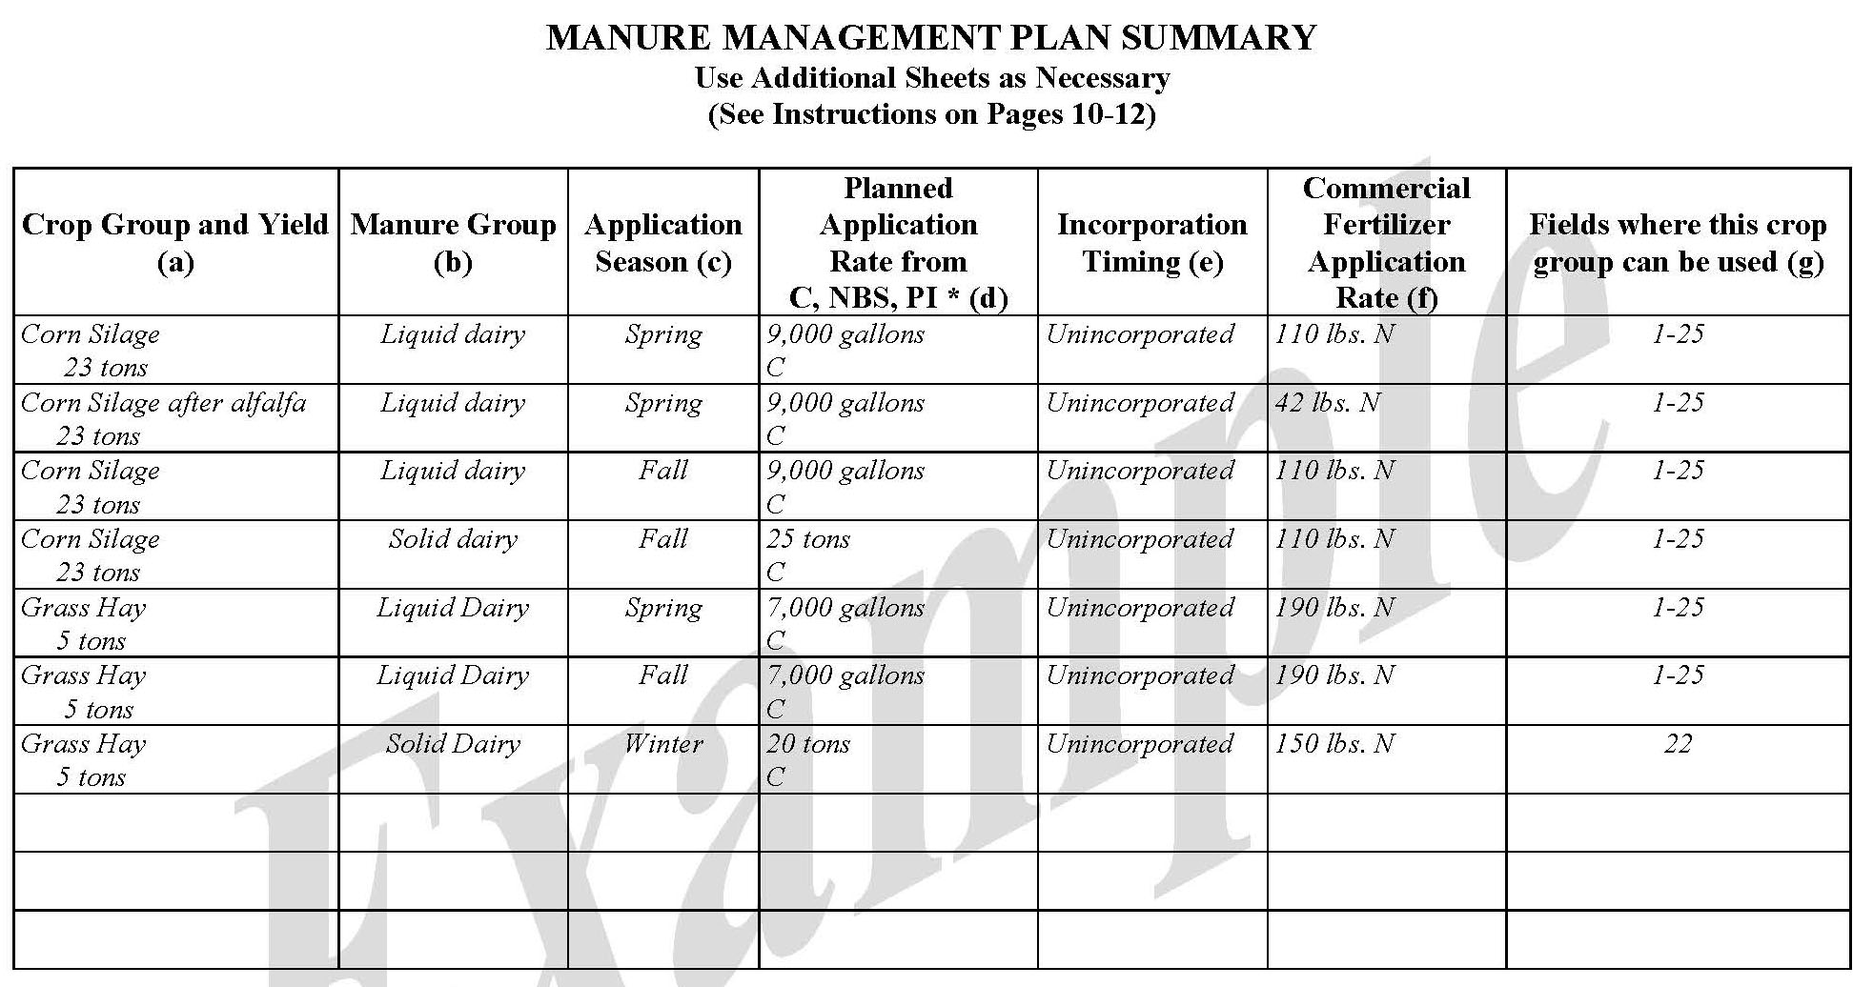
Manure Management Plan Exercise – Page 6
Complete 4 “Crop Management Scenario” Columns

Slide 15
Manure Management Plan Summary
Crop Group and Yield (a) | Manure Group (b) | Application Season (c ) | Planned Application Rate from C, NBS, PI * (d) | Incorporation Timing (e) | Commercial Fertilizer Application Rate (f) | Fields where this crop group can be used (g)
Corn Silage (23 T/A) | Liquid Dairy | Spring |  | No lncorporation
Corn Silage After Alfalfa (23 T/A) | Liquid Dairy | Spring |  | Inc. < 1 Week
Grass Hay (4 T/A) | Liquid Dairy | Summer |  | No lncorporation
Corn Silage (23 T/A) | Liquid Dairy | Spring |  | Inc. < 1 Week
Corn Silage (23 T/A) | Liquid Dairy | Fall |  | No lncorporation
Corn Silage (23 T/A) | Solid Dairy | Spring |  | No lncorporation
Corn Silage (23 T/A) | Solid Dairy | Fall |  | No lncorporation
Corn Silage (23 T/A) | Solid Dairy | Winter |  | Cover Crop
Each “crop management scenario”:
Requires the completion of a separate MMP Nutrient Balance Worksheet.

Slide 16
MMP Nutrient Balance Worksheet
Complete top section of the MMP NBS
Include all the fields that will have this “crop management scenario” over the crop rotation
Corn Silage after Alfalfa
23 T/A
All Fields
X
Liquid Dairy
Spring
Incorporated 2-4 days

Slide 17
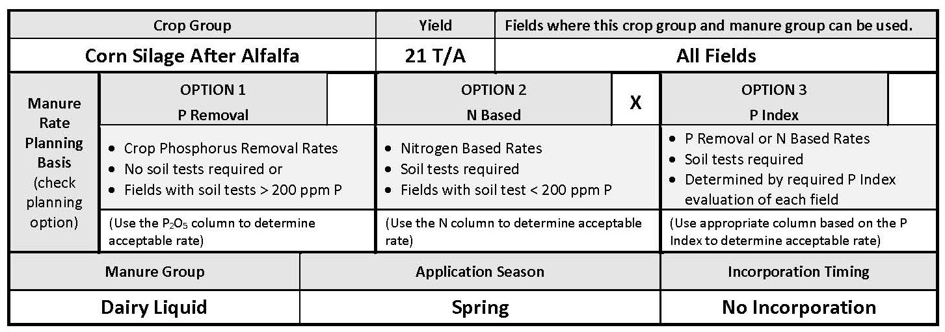
MMP Nutrient Balance Worksheet Exercise
Complete Top Section of MMP NBS

Slide 18
Crop Nutrient Requirements
Basis for determining a planned manure rate
Net crop requirement for either nitrogen or phosphorus removal
How is “net crop requirement” determined?
Start with base recommendation
Soil test recommendations or crop removal
Need to account for other known sources of nutrients
Subtracted from recommendation or removal amounts
Four primary adjustments (or reductions)
Fertilizer Applied
Regardless of manure: starter, herbicide carrier, etc.
Other Organic Sources Applied
Other manure, biosolids
Residual Manure N
From previous manure applications
Residual Legume N
From previous year’s legume crop
Recommendations – Adjustments = Net Crop Requirement

Slide 19
Manure Management Plan Nutrient Balance Worksheet
Net Nutrient Requirement
Note which columns are required:
N – all options
P₂O₅ – optional for N based rates
K₂O – optional for all rates

Slide 20
Nutrient Balance Sheet Example Scenario
Planned crop
Corn for Silage
23 ton/A expected yield
Starter Fertilizer
100 lb/A 10-10-10
Other manure to be applied
None
Manure history
Lactating dairy cow manure applied ~3 / 5 yrs
Crop Rotation
Following Alfalfa, 25-50% stand, moderate productivity soil

Slide 21
Recommendation or Removal
 | N | P₂O₅ | K₂O
A) Recommendation or Removal (lb/A)
B) Fertilizer Applied (lb/A)
C) Other Organic Sources Applied (lb/A)
D) Residual Manure N (lb/A)
E) Previous Legume N (lb/A)
F) Net Nutrient Requirement (lb/A) (A – B – C – D – E)
G) Manure Nutrient Content (lb/ton or lb/1000gal)
H) Nitrogen Availability Factor
I) Available Nitrogen (lb/ton or lb/1000gal) (G x H)
J) Balanced Manure Rate (tons/A or gallons/A) For N: (F ÷ I) For P: (F ÷ G)
K) Planned Manure Rate (tons/A or gallons/A)
L) Nutrients Applied at Planned Rate (lb/A) For N: (K x I) For P & K: (K x G)
M) Nutrient Balance at Planned Rate (lb/A) (F - L) (Indicate short or excess)
Soil test report recommendations
Nitrogen Removal
NBS Tables 1 or 2
P₂O₅ & K₂O Removal
NBS Table 3

Slide 22
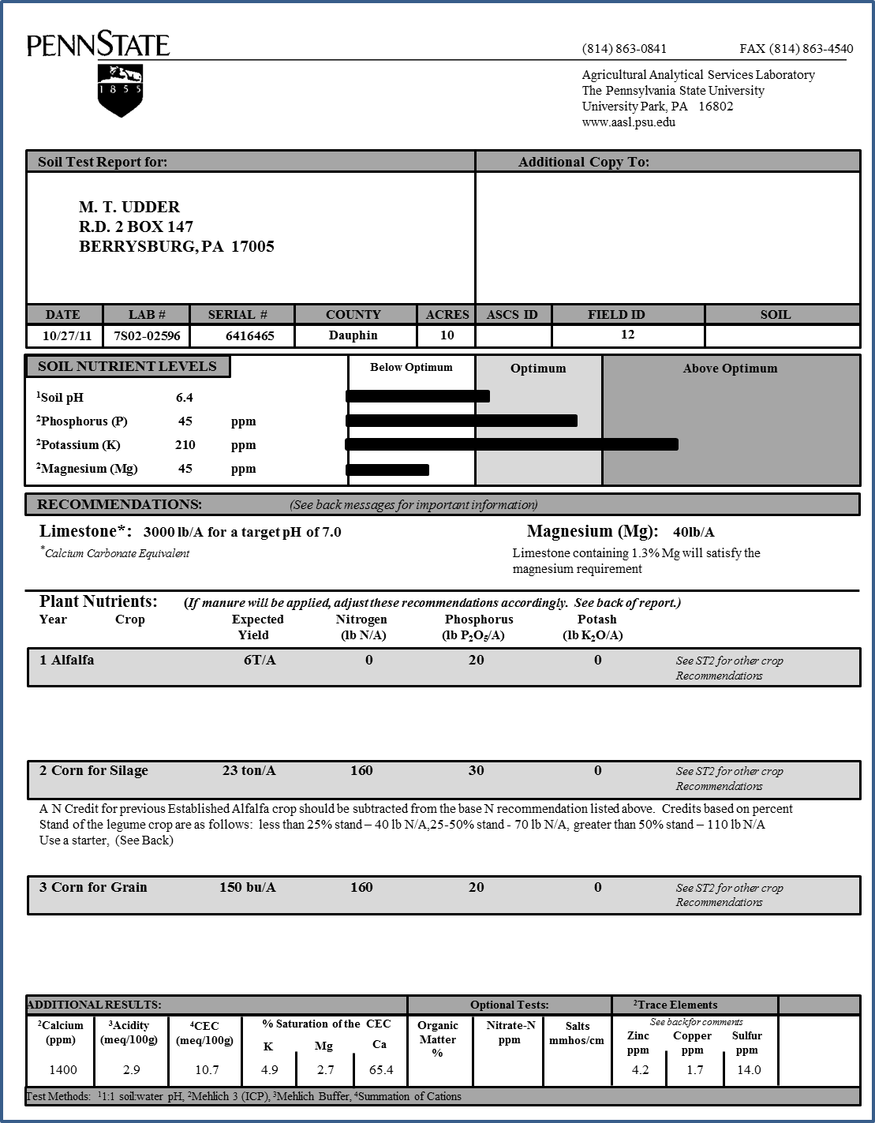
Soil Test Report
Recommendations
Nitrogen
160 lb N/A
P₂O₅
30 lb P₂O₅/A
K₂O
0 lb K₂O/A

Slide 23
Recommendation
 | N | P₂O₅ | K₂O
A) Recommendation or Removal (lb/A) | 160 | 30 | 0
B) Fertilizer Applied (lb/A)
C) Other Organic Sources Applied (lb/A)
D) Residual Manure N (lb/A)
E) Previous Legume N (lb/A)
F) Net Nutrient Requirement (lb/A) (A – B – C – D – E)
G) Manure Nutrient Content (lb/ton or lb/1000gal)
H) Nitrogen Availability Factor
I) Available Nitrogen (lb/ton or lb/1000gal) (G x H)
J) Balanced Manure Rate (tons/A or gallons/A) For N: (F ÷ I) For P: (F ÷ G)
K) Planned Manure Rate (tons/A or gallons/A)
L) Nutrients Applied at Planned Rate (lb/A) For N: (K x I) For P & K: (K x G)
M) Nutrient Balance at Planned Rate (lb/A) (F - L) (Indicate short or excess)
Nitrogen
160 lb N/A
P₂O₅
30 lb P₂O₅/A
K₂O
0 lb K₂O/A

Slide 24
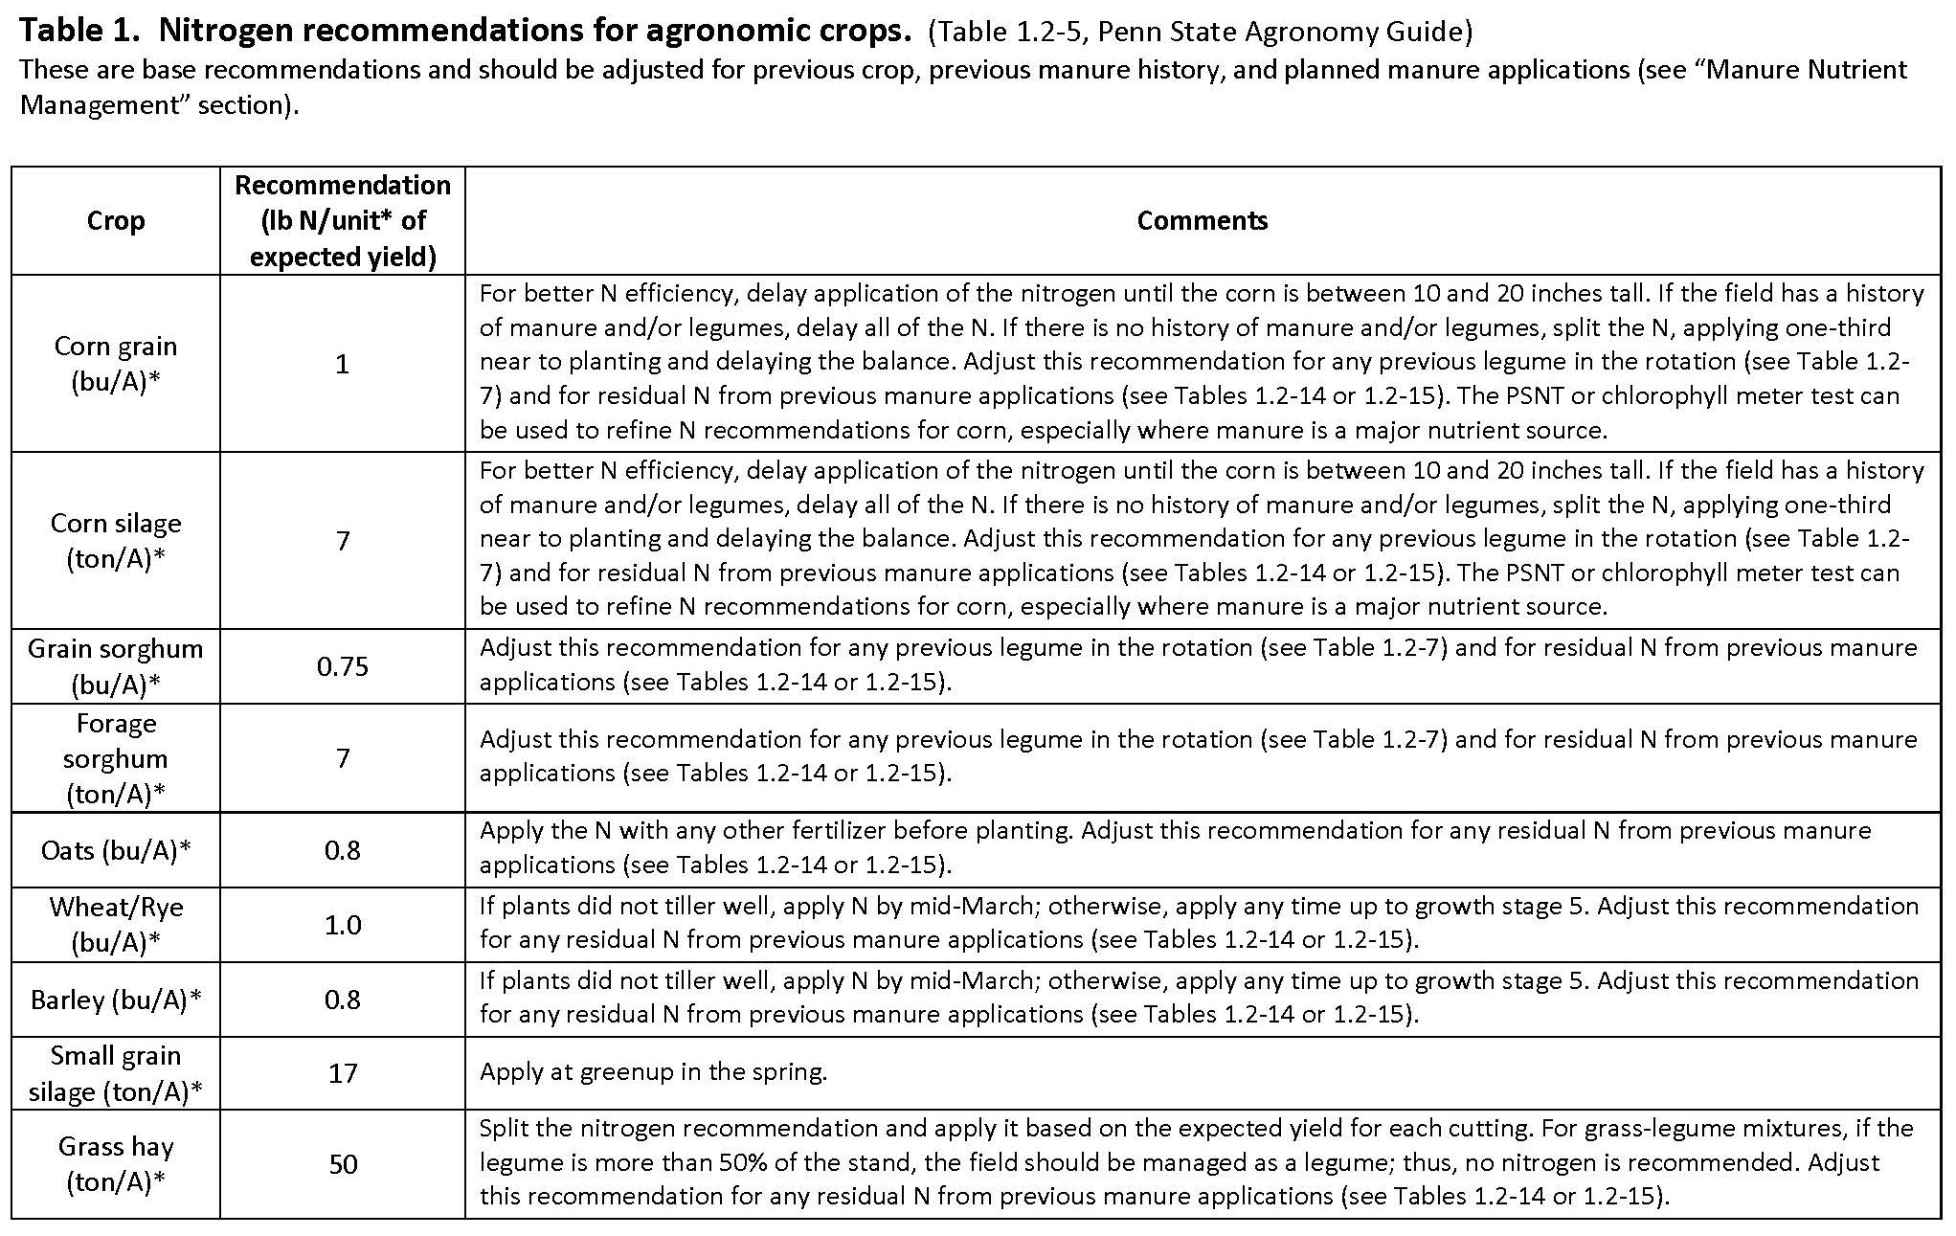
Determining Nitrogen Recommendation NBS Table 1 (Agronomy Guide Table 1.2-5)

Slide 25
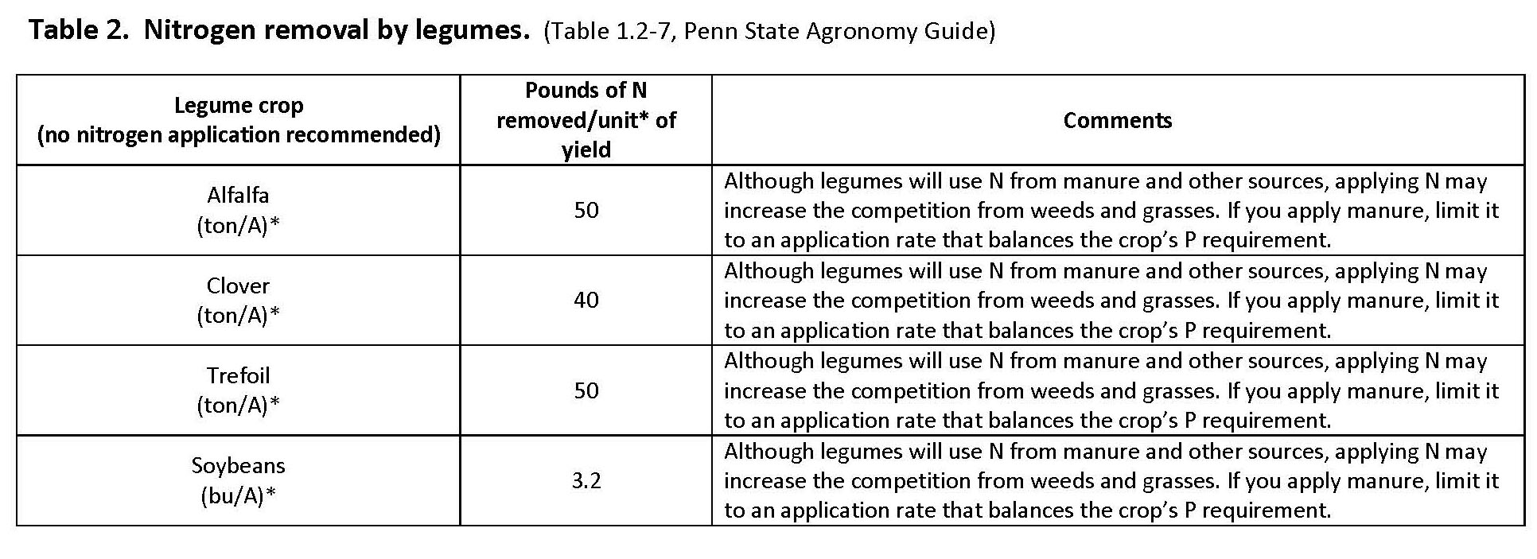
Determining Nitrogen Removal NBS Table 2 (Agronomy Guide Table 1.2-7)
Legume crops do not require nitrogen fertilizer
Soil test recommendations are “0”
No value from the manure N
Manure can be applied to legumes
Based on N removal by the legume crop

Slide 26
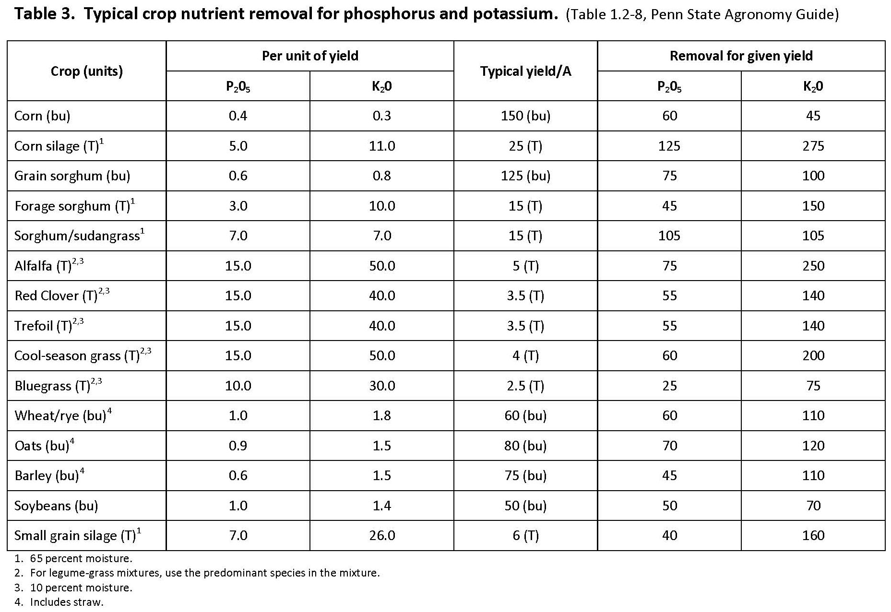
Determining P & K Removal NBS Table 3 (Agronomy Guide Table 1.2-8)

Slide 27
Crop Removal Yield x removal/unit yield
 | N | P₂O₅ | K₂O
A) Recommendation or Removal (lb/A) | 161 | 92 | 184
B) Fertilizer Applied (lb/A)
C) Other Organic Sources Applied (lb/A)
D) Residual Manure N (lb/A)
E) Previous Legume N (lb/A)
F) Net Nutrient Requirement (lb/A) (A – B – C – D – E)
G) Manure Nutrient Content (lb/ton or lb/1000gal)
H) Nitrogen Availability Factor
I) Available Nitrogen (lb/ton or lb/1000gal) (G x H)
J) Balanced Manure Rate (tons/A or gallons/A) For N: (F ÷ I) For P: (F ÷ G)
K) Planned Manure Rate (tons/A or gallons/A)
L) Nutrients Applied at Planned Rate (lb/A) For N: (K x I) For P & K: (K x G)
M) Nutrient Balance at Planned Rate (lb/A) (F - L) (Indicate short or excess)
Nitrogen
23 t/A x 7 lb N/ton =
161 lb N/A
P₂O₅
23 t/A x 4 lb P2O5/ton =
92 lb P₂O₅/A
K₂O
23 t/A x 8 lb K2O/ton =
184 lb K₂O/A

Slide 28
Fertilizer Applied
 | N | P₂O₅ | K₂O
A) Recommendation or Removal (lb/A) | 160 | 30 | 0
B) Fertilizer Applied (lb/A)
C) Other Organic Sources Applied (lb/A)
D) Residual Manure N (lb/A)
E) Previous Legume N (lb/A)
F) Net Nutrient Requirement (lb/A) (A – B – C – D – E)
G) Manure Nutrient Content (lb/ton or lb/1000gal)
H) Nitrogen Availability Factor
I) Available Nitrogen (lb/ton or lb/1000gal) (G x H)
J) Balanced Manure Rate (tons/A or gallons/A) For N: (F ÷ I) For P: (F ÷ G)
K) Planned Manure Rate (tons/A or gallons/A)
L) Nutrients Applied at Planned Rate (lb/A) For N: (K x I) For P & K: (K x G)
M) Nutrient Balance at Planned Rate (lb/A) (F - L) (Indicate short or excess)
Fertilizer nutrients to be applied regardless of manure
Starter
Herbicide carrier
Other
Other organic nutrients applied
Other manure application
Imported biosolids
Other

Slide 29
Fertilizer Applied
 | N | P₂O₅ | K₂O
A) Recommendation or Removal (lb/A) | 160 | 30 | 0
B) Fertilizer Applied (lb/A) | 10 | 10 | 10
C) Other Organic Sources Applied (lb/A)
D) Residual Manure N (lb/A)
E) Previous Legume N (lb/A)
F) Net Nutrient Requirement (lb/A) (A – B – C – D – E)
G) Manure Nutrient Content (lb/ton or lb/1000gal)
H) Nitrogen Availability Factor
I) Available Nitrogen (lb/ton or lb/1000gal) (G x H)
J) Balanced Manure Rate (tons/A or gallons/A) For N: (F ÷ I) For P: (F ÷ G)
K) Planned Manure Rate (tons/A or gallons/A)
L) Nutrients Applied at Planned Rate (lb/A) For N: (K x I) For P & K: (K x G)
M) Nutrient Balance at Planned Rate (lb/A) (F - L) (Indicate short or excess)
Starter
100 lb/A 10 - 10 – 10
N: 100 lb/A x 0.10 =
10 lb N/A
P: 100 lb/A x 0.10 =
10 lb P₂O₅/A
K: 100 lb/A x 0.10 =
10 lb K₂O/A

Slide 30
Other Organic Sources Applied
 | N | P₂O₅ | K₂O
A) Recommendation or Removal (lb/A) | 160 | 30 | 0
B) Fertilizer Applied (lb/A) | 10 | 10 | 10
C) Other Organic Sources Applied (lb/A) | - | - | -
D) Residual Manure N (lb/A)
E) Previous Legume N (lb/A)
F) Net Nutrient Requirement (lb/A) (A – B – C – D – E)
G) Manure Nutrient Content (lb/ton or lb/1000gal)
H) Nitrogen Availability Factor
I) Available Nitrogen (lb/ton or lb/1000gal) (G x H)
J) Balanced Manure Rate (tons/A or gallons/A) For N: (F ÷ I) For P: (F ÷ G)
K) Planned Manure Rate (tons/A or gallons/A)
L) Nutrients Applied at Planned Rate (lb/A) For N: (K x I) For P & K: (K x G)
M) Nutrient Balance at Planned Rate (lb/A) (F - L) (Indicate short or excess)
Multiple applications on a field
Enter “Nutrients applied at Planned Rate “ (Row L) from other application into “Other organic sources” (Row C) for this application
None in this example
Transfer this from L in other application NBS.

Slide 31
Residual Manure N
 | N | P₂O₅ | K₂O
A) Recommendation or Removal (lb/A) | 160 | 30 | 0
B) Fertilizer Applied (lb/A) | 10 | 10 | 10
C) Other Organic Sources Applied (lb/A) | - | - | -
D) Residual Manure N (lb/A)
E) Previous Legume N (lb/A)
F) Net Nutrient Requirement (lb/A) (A – B – C – D – E)
G) Manure Nutrient Content (lb/ton or lb/1000gal)
H) Nitrogen Availability Factor
I) Available Nitrogen (lb/ton or lb/1000gal) (G x H)
J) Balanced Manure Rate (tons/A or gallons/A) For N: (F ÷ I) For P: (F ÷ G)
K) Planned Manure Rate (tons/A or gallons/A)
L) Nutrients Applied at Planned Rate (lb/A) For N: (K x I) For P & K: (K x G)
M) Nutrient Balance at Planned Rate (lb/A) (F - L) (Indicate short or excess)
N accumulated in the soil from previous manure applications
Total N
Soluble
Mineral N
Organic N
Mineral N
Readily available similar to urea fertilizer. Susceptible to volatilization.
Organic N
Must be broken down into mineral forms before it is available. Releases over a period of years.

Slide 32
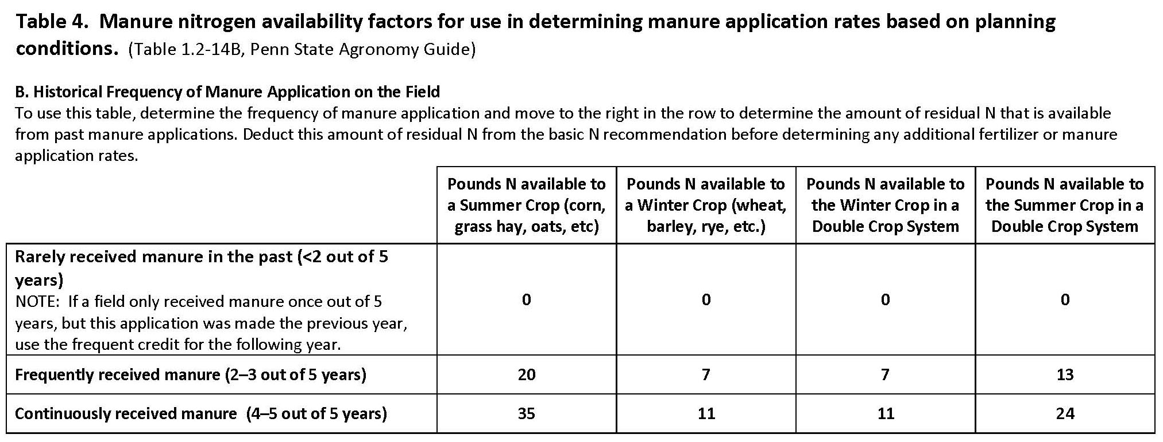
Residual N Previous Manure Applications Table 4 (Agronomy Guide Table 1.2-14B)

Slide 33
Residual Manure N
 | N | P₂O₅ | K₂O
A) Recommendation or Removal (lb/A) | 160 | 30 | 0
B) Fertilizer Applied (lb/A) | 10 | 10 | 10
C) Other Organic Sources Applied (lb/A) | - | - | -
D) Residual Manure N (lb/A) | 20
E) Previous Legume N (lb/A)
F) Net Nutrient Requirement (lb/A) (A – B – C – D – E)
G) Manure Nutrient Content (lb/ton or lb/1000gal)
H) Nitrogen Availability Factor
I) Available Nitrogen (lb/ton or lb/1000gal) (G x H)
J) Balanced Manure Rate (tons/A or gallons/A) For N: (F ÷ I) For P: (F ÷ G)
K) Planned Manure Rate (tons/A or gallons/A)
L) Nutrients Applied at Planned Rate (lb/A) For N: (K x I) For P & K: (K x G)
M) Nutrient Balance at Planned Rate (lb/A) (F - L) (Indicate short or excess)
Manure history
Dairy manure
Applied ~3 / 5 yrs
Frequent
20 lb N/A

Slide 34
Previous Legume N
 | N | P₂O₅ | K₂O
A) Recommendation or Removal (lb/A) | 160 | 30 | 0
B) Fertilizer Applied (lb/A) | 10 | 10 | 10
C) Other Organic Sources Applied (lb/A) | - | - | -
D) Residual Manure N (lb/A) | 20
E) Previous Legume N (lb/A)
F) Net Nutrient Requirement (lb/A) (A – B – C – D – E)
G) Manure Nutrient Content (lb/ton or lb/1000gal)
H) Nitrogen Availability Factor
I) Available Nitrogen (lb/ton or lb/1000gal) (G x H)
J) Balanced Manure Rate (tons/A or gallons/A) For N: (F ÷ I) For P: (F ÷ G)
K) Planned Manure Rate (tons/A or gallons/A)
L) Nutrients Applied at Planned Rate (lb/A) For N: (K x I) For P & K: (K x G)
M) Nutrient Balance at Planned Rate (lb/A) (F - L) (Indicate short or excess)
Properly inoculated legumes meet their N requirement by fixing atmospheric N
Significant N remains in residue from legume when crops are rotated
Adjust following crop N requirement for legume N contribution

Slide 35
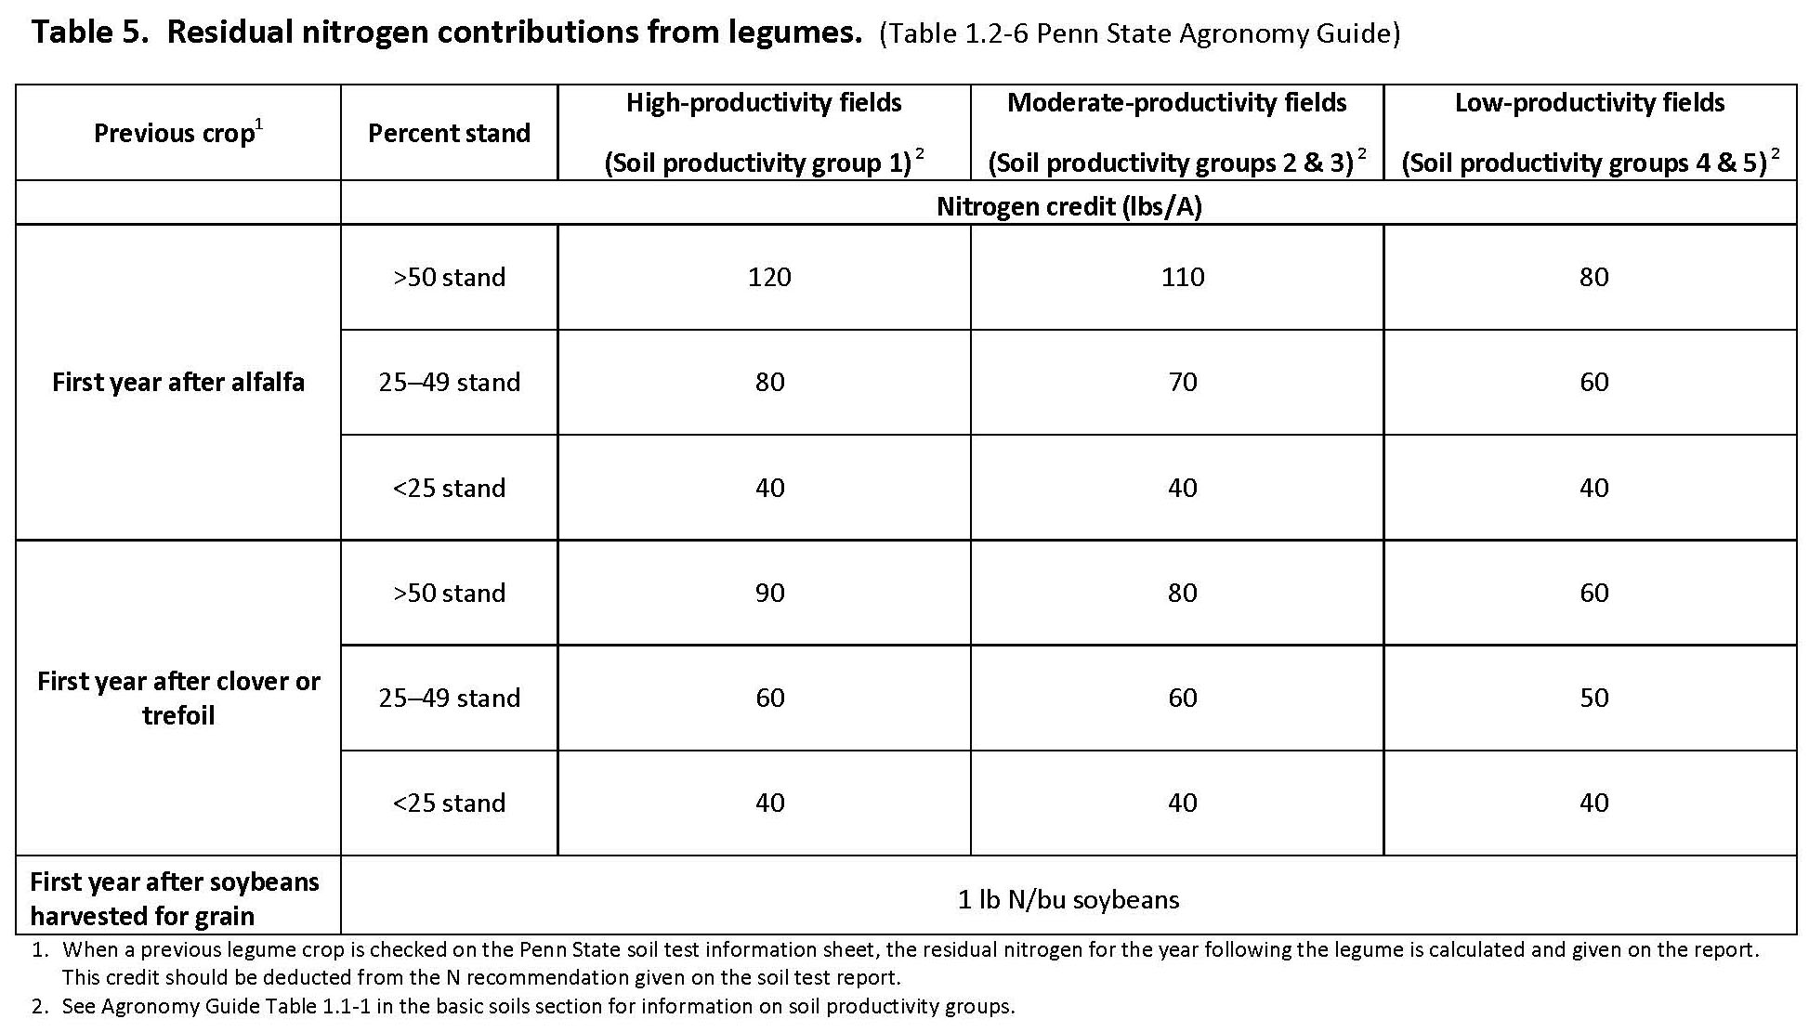
Residual N Previous Legume Crops NBS Table 5 (Agronomy Guide Table 1.2-6)

Slide 36
Previous Legume
Also on PSU soil test report if the previous crop is entered as a legume

Slide 37
Previous Legume N
 | N | P₂O₅ | K₂O
A) Recommendation or Removal (lb/A) | 160 | 30 | 0
B) Fertilizer Applied (lb/A) | 10 | 10 | 10
C) Other Organic Sources Applied (lb/A) | - | - | -
D) Residual Manure N (lb/A) | 20
E) Previous Legume N (lb/A) | 70
F) Net Nutrient Requirement (lb/A) (A – B – C – D – E)
G) Manure Nutrient Content (lb/ton or lb/1000gal)
H) Nitrogen Availability Factor
I) Available Nitrogen (lb/ton or lb/1000gal) (G x H)
J) Balanced Manure Rate (tons/A or gallons/A) For N: (F ÷ I) For P: (F ÷ G)
K) Planned Manure Rate (tons/A or gallons/A)
L) Nutrients Applied at Planned Rate (lb/A) For N: (K x I) For P & K: (K x G)
M) Nutrient Balance at Planned Rate (lb/A) (F - L) (Indicate short or excess)
Previous Alfalfa
20-50% Stand
Moderate Productivity Soil
70 lb N/A

Slide 38
Net Nutrient Requirement
 | N | P₂O₅ | K₂O
A) Recommendation or Removal (lb/A) | 160 | 30 | 0
B) Fertilizer Applied (lb/A) | 10 | 10 | 10
C) Other Organic Sources Applied (lb/A) | - | - | -
D) Residual Manure N (lb/A) | 20
E) Previous Legume N (lb/A) | 70
F) Net Nutrient Requirement (lb/A) (A – B – C – D – E) | 60 | 20 | (10)
G) Manure Nutrient Content (lb/ton or lb/1000gal)
H) Nitrogen Availability Factor
I) Available Nitrogen (lb/ton or lb/1000gal) (G x H)
J) Balanced Manure Rate (tons/A or gallons/A) For N: (F ÷ I) For P: (F ÷ G)
K) Planned Manure Rate (tons/A or gallons/A)
L) Nutrients Applied at Planned Rate (lb/A) For N: (K x I) For P & K: (K x G)
M) Nutrient Balance at Planned Rate (lb/A) (F - L) (Indicate short or excess)
Recommendation or removal
Subtract
Fertilizer applied
Other organic sources applied
Residual manure N
Residual legume N
= Net Nutrient Requirement
Note: Include excesses
10 lb excess K₂O/A

Slide 39
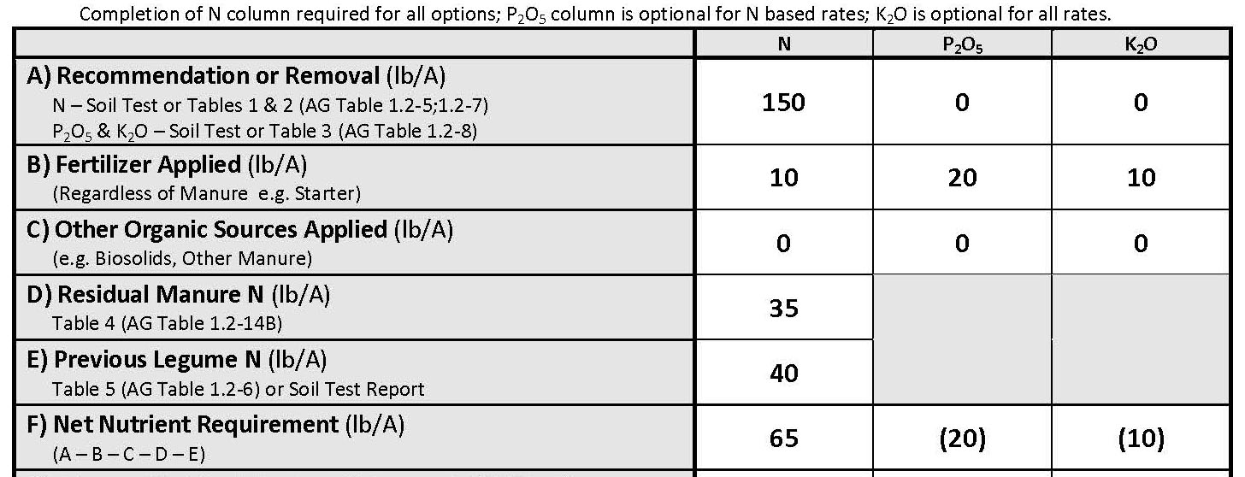
MMP Nutrient Balance Worksheet Exercise
Complete Nutrient Balance Worksheet – Rows A - F

Slide 40
N-Based Balanced Manure Rate
Rate or amount of manure applied to a crop field where:
available manure N equals
net crop N requirement

Slide 41
Manure Nutrient Content
 | N | P₂O₅ | K₂O
A) Recommendation or Removal (lb/A) | 160 | 30 | 0
B) Fertilizer Applied (lb/A) | 10 | 10 | 10
C) Other Organic Sources Applied (lb/A) | - | - | -
D) Residual Manure N (lb/A) | 20
E) Previous Legume N (lb/A) | 70
F) Net Nutrient Requirement (lb/A) (A – B – C – D – E) | 60 | 20 | (10)
G) Manure Nutrient Content (lb/ton or lb/1000gal)
H) Nitrogen Availability Factor
I) Available Nitrogen (lb/ton or lb/1000gal) (G x H)
J) Balanced Manure Rate (tons/A or gallons/A) For N: (F ÷ I) For P: (F ÷ G)
K) Planned Manure Rate (tons/A or gallons/A)
L) Nutrients Applied at Planned Rate (lb/A) For N: (K x I) For P & K: (K x G)
M) Nutrient Balance at Planned Rate (lb/A) (F - L) (Indicate short or excess)
Manure Analysis Report (Preferred)
NBS Table 6

Slide 42
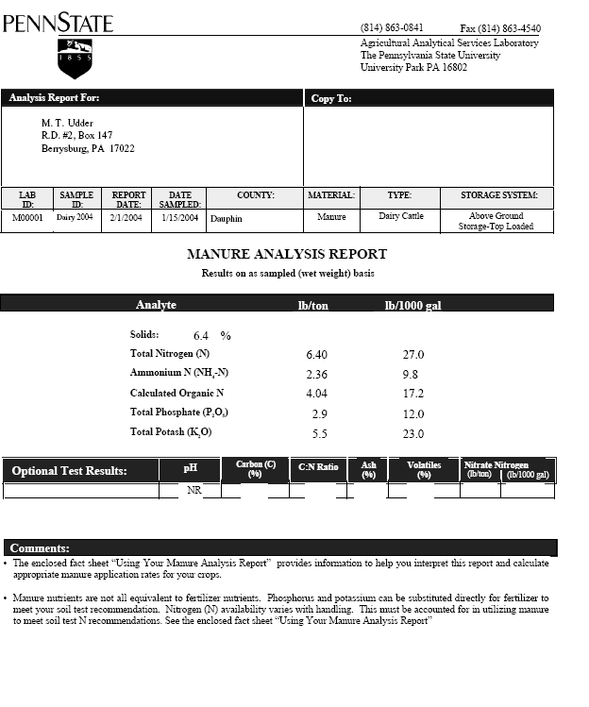
Manure Analysis Report
Manure analysis is the most reliable estimation of manure nutrient content
Use lb/ton if manure is spread as ton/A
Use lb/1000 gal if manure is spread as gallons/A

Slide 43
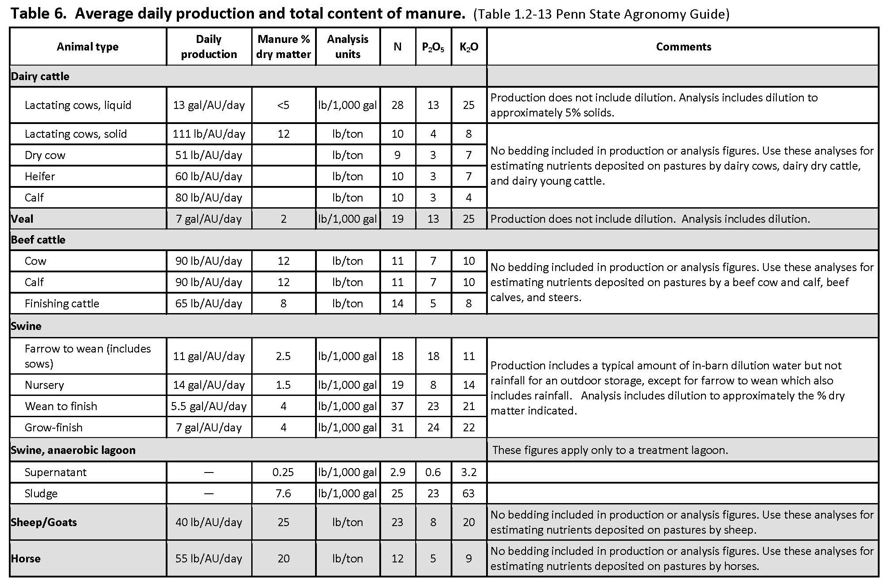
Manure Nutrient Content Table 6 (Agronomy Guide Table 1.2-13)

Slide 44
Manure Nutrient Content
 | N | P₂O₅ | K₂O
A) Recommendation or Removal (lb/A) | 160 | 30 | 0
B) Fertilizer Applied (lb/A) | 10 | 10 | 10
C) Other Organic Sources Applied (lb/A) | - | - | -
D) Residual Manure N (lb/A) | 20
E) Previous Legume N (lb/A) | 70
F) Net Nutrient Requirement (lb/A) (A – B – C – D – E) | 60 | 20 | (10)
G) Manure Nutrient Content (lb/ton or lb/1000gal) | 27 | 12 | 23
H) Nitrogen Availability Factor
I) Available Nitrogen (lb/ton or lb/1000gal) (G x H)
J) Balanced Manure Rate (tons/A or gallons/A) For N: (F ÷ I) For P: (F ÷ G)
K) Planned Manure Rate (tons/A or gallons/A)
L) Nutrients Applied at Planned Rate (lb/A) For N: (K x I) For P & K: (K x G)
M) Nutrient Balance at Planned Rate (lb/A) (F - L) (Indicate short or excess)
Lactating dairy cows
Liquid
Manure Analysis
From manure analysis
Book values
28 lb N/1000 gal
13 lb P₂O₅/1000 gal
25 lb K₂O/1000 gal

Slide 45
MMP Nutrient Balance Worksheet Exercise
Complete Nutrient Balance Worksheet – Row G

Slide 46
Nitrogen Fractions in Manure
Only a percentage of manure N is available to the crop in the year that it applied
Two factors determine this amount
Type of manure
Ratio ammonium N and organic N
Application management
How quickly the manure is incorporated
Total Manure N
Soluble Mineral N | Organic N
Readily available similar to urea fertilizer. Susceptible to volatilization. | Must be broken down into mineral forms before it is available. Releases over a period of years.

Slide 47
Nitrogen Availability Factor
 | N | P₂O₅ | K₂O
A) Recommendation or Removal (lb/A) | 160 | 30 | 0
B) Fertilizer Applied (lb/A) | 10 | 10 | 10
C) Other Organic Sources Applied (lb/A) | - | - | -
D) Residual Manure N (lb/A) | 20
E) Previous Legume N (lb/A) | 70
F) Net Nutrient Requirement (lb/A) (A – B – C – D – E) | 60 | 20 | (10)
G) Manure Nutrient Content (lb/ton or lb/1000gal) | 27 | 12 | 23
H) Nitrogen Availability Factor
I) Available Nitrogen (lb/ton or lb/1000gal) (G x H)
J) Balanced Manure Rate (tons/A or gallons/A) For N: (F ÷ I) For P: (F ÷ G)
K) Planned Manure Rate (tons/A or gallons/A)
L) Nutrients Applied at Planned Rate (lb/A) For N: (K x I) For P & K: (K x G)
M) Nutrient Balance at Planned Rate (lb/A) (F - L) (Indicate short or excess)
NBS Table 7

Slide 48
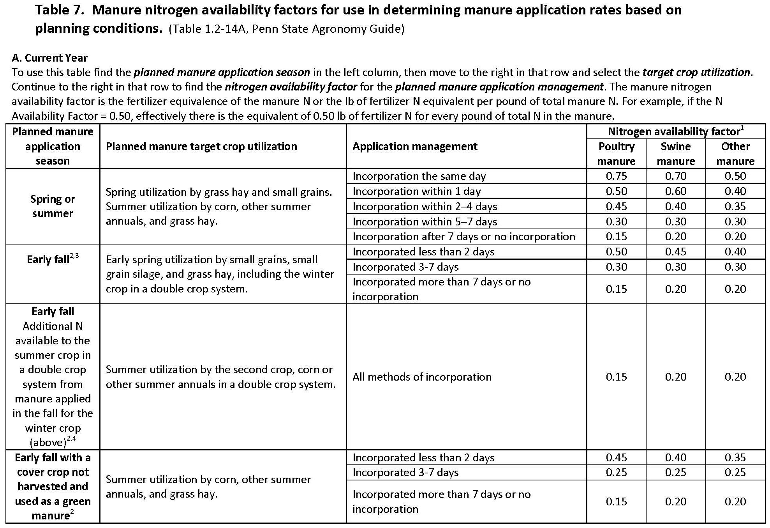
Manure Nitrogen Availability Table 7 (Agronomy Guide Table 1.2-14A)

Slide 49
Nitrogen Availability Factor
 | N | P₂O₅ | K₂O
A) Recommendation or Removal (lb/A) | 160 | 30 | 0
B) Fertilizer Applied (lb/A) | 10 | 10 | 10
C) Other Organic Sources Applied (lb/A) | - | - | -
D) Residual Manure N (lb/A) | 20
E) Previous Legume N (lb/A) | 70
F) Net Nutrient Requirement (lb/A) (A – B – C – D – E) | 60 | 20 | (10)
G) Manure Nutrient Content (lb/ton or lb/1000gal) | 27 | 12 | 23
H) Nitrogen Availability Factor | .35
I) Available Nitrogen (lb/ton or lb/1000gal) (G x H)
J) Balanced Manure Rate (tons/A or gallons/A) For N: (F ÷ I) For P: (F ÷ G)
K) Planned Manure Rate (tons/A or gallons/A)
L) Nutrients Applied at Planned Rate (lb/A) For N: (K x I) For P & K: (K x G)
M) Nutrient Balance at Planned Rate (lb/A) (F - L) (Indicate short or excess)
NBS Table 7
Manure is:
Spring applied
For corn crop
Incorporated 2-4 days
Dairy manure
Nitrogen availability factor
.35

Slide 50
Available Nitrogen
 | N | P₂O₅ | K₂O
A) Recommendation or Removal (lb/A) | 160 | 30 | 0
B) Fertilizer Applied (lb/A) | 10 | 10 | 10
C) Other Organic Sources Applied (lb/A) | - | - | -
D) Residual Manure N (lb/A) | 20
E) Previous Legume N (lb/A) | 70
F) Net Nutrient Requirement (lb/A) (A – B – C – D – E) | 60 | 20 | (10)
G) Manure Nutrient Content (lb/ton or lb/1000gal) | 27 | 12 | 23
H) Nitrogen Availability Factor | .35
I) Available Nitrogen (lb/ton or lb/1000gal) (G x H) | 9.45
J) Balanced Manure Rate (tons/A or gallons/A) For N: (F ÷ I) For P: (F ÷ G)
K) Planned Manure Rate (tons/A or gallons/A)
L) Nutrients Applied at Planned Rate (lb/A) For N: (K x I) For P & K: (K x G)
M) Nutrient Balance at Planned Rate (lb/A) (F - L) (Indicate short or excess)
Available N =
Manure N Analysis x Availability Factor
Available N
27 lb N/1000 gal x .35 =
9.45 lb Available N/1000 gal

Slide 51
MMP Nutrient Balance Worksheet Exercise
Complete Nutrient Balance Worksheet – Rows H - I

Slide 52
Balanced Manure Rate
 | N | P₂O₅ | K₂O
A) Recommendation or Removal (lb/A) | 160 | 30 | 0
B) Fertilizer Applied (lb/A) | 10 | 10 | 10
C) Other Organic Sources Applied (lb/A) | - | - | -
D) Residual Manure N (lb/A) | 20
E) Previous Legume N (lb/A) | 70
F) Net Nutrient Requirement (lb/A) (A – B – C – D – E) | 60 | 20 | (10)
G) Manure Nutrient Content (lb/ton or lb/1000gal) | 27 | 12 | 23
H) Nitrogen Availability Factor | .35
I) Available Nitrogen (lb/ton or lb/1000gal) (G x H) | 9.45
J) Balanced Manure Rate (tons/A or gallons/A) For N: (F ÷ I) For P: (F ÷ G) | 6349
K) Planned Manure Rate (tons/A or gallons/A)
L) Nutrients Applied at Planned Rate (lb/A) For N: (K x I) For P & K: (K x G)
M) Nutrient Balance at Planned Rate (lb/A) (F - L) (Indicate short or excess)
Balanced manure rate =
Net N Requirement ÷ Available N
Balanced N manure rate
60 lb/A ÷ 9.45 lb Avail. N/1000 gal =
6349 gallons/A

Slide 53
P-Removal Based Balanced Manure Rate
Rate or amount of manure applied to a crop field where:
Available manure P₂O₅ equals
Net crop P₂O₅ requirement

Slide 54
Balanced Manure Rate
 | N | P₂O₅ | K₂O
A) Recommendation or Removal (lb/A) | 160 | 30 | 0
B) Fertilizer Applied (lb/A) | 10 | 10 | 10
C) Other Organic Sources Applied (lb/A) | - | - | -
D) Residual Manure N (lb/A) | 20
E) Previous Legume N (lb/A) | 70
F) Net Nutrient Requirement (lb/A) (A – B – C – D – E) | 60 | 20 | (10)
G) Manure Nutrient Content (lb/ton or lb/1000gal) | 27 | 12 | 23
H) Nitrogen Availability Factor | .35
I) Available Nitrogen (lb/ton or lb/1000gal) (G x H) | 9.45
J) Balanced Manure Rate (tons/A or gallons/A) For N: (F ÷ I) For P: (F ÷ G) |  | 1666
K) Planned Manure Rate (tons/A or gallons/A)
L) Nutrients Applied at Planned Rate (lb/A) For N: (K x I) For P & K: (K x G)
M) Nutrient Balance at Planned Rate (lb/A) (F - L) (Indicate short or excess)
Balanced manure rate =
Net P₂O₅ Requirement ÷ Manure P₂O₅
Balanced P₂O₅ manure rate
20 lb/A ÷ 12 lb P₂O₅ /1000 gal =
1666 gallons/A
6349

Slide 55
MMP Nutrient Balance Worksheet Exercise
Complete Nutrient Balance Worksheet – Row J

Slide 56
Planned Manure Rate
 | N | P₂O₅ | K₂O
A) Recommendation or Removal (lb/A) | 160 | 30 | 0
B) Fertilizer Applied (lb/A) | 10 | 10 | 10
C) Other Organic Sources Applied (lb/A) | - | - | -
D) Residual Manure N (lb/A) | 20
E) Previous Legume N (lb/A) | 70
F) Net Nutrient Requirement (lb/A) (A – B – C – D – E) | 60 | 20 | (10)
G) Manure Nutrient Content (lb/ton or lb/1000gal) | 27 | 12 | 23
H) Nitrogen Availability Factor | .35
I) Available Nitrogen (lb/ton or lb/1000gal) (G x H) | 9.45
J) Balanced Manure Rate (tons/A or gallons/A) For N: (F ÷ I) For P: (F ÷ G) | 6349
K) Planned Manure Rate (tons/A or gallons/A)
L) Nutrients Applied at Planned Rate (lb/A) For N: (K x I) For P & K: (K x G)
M) Nutrient Balance at Planned Rate (lb/A) (F - L) (Indicate short or excess)
Must be less than or equal to the N balanced rate

Slide 57
Practical Application Rates
Planned manure rates must be realistic and achievable
Selected planned manure rates are determined by manure spreader calibration
Agronomy Facts 68: Manure Spreader Calibration

Slide 58
Planned Manure Rate – N-Based
 | N | P₂O₅ | K₂O
A) Recommendation or Removal (lb/A) | 160 | 30 | 0
B) Fertilizer Applied (lb/A) | 10 | 10 | 10
C) Other Organic Sources Applied (lb/A) | - | - | -
D) Residual Manure N (lb/A) | 20
E) Previous Legume N (lb/A) | 70
F) Net Nutrient Requirement (lb/A) (A – B – C – D – E) | 60 | 20 | (10)
G) Manure Nutrient Content (lb/ton or lb/1000gal) | 27 | 12 | 23
H) Nitrogen Availability Factor | .35
I) Available Nitrogen (lb/ton or lb/1000gal) (G x H) | 9.45
J) Balanced Manure Rate (tons/A or gallons/A) For N: (F ÷ I) For P: (F ÷ G) | 6349
K) Planned Manure Rate (tons/A or gallons/A)
L) Nutrients Applied at Planned Rate (lb/A) For N: (K x I) For P & K: (K x G)
M) Nutrient Balance at Planned Rate (lb/A) (F - L) (Indicate short or excess)
Calibrated rates
9000 gallons/A
4000 gallons/A
4000

Slide 59
Planned Manure Rate – P-Removal
 | N | P₂O₅ | K₂O
A) Recommendation or Removal (lb/A) | 160 | 30 | 0
B) Fertilizer Applied (lb/A) | 10 | 10 | 10
C) Other Organic Sources Applied (lb/A) | - | - | -
D) Residual Manure N (lb/A) | 20
E) Previous Legume N (lb/A) | 70
F) Net Nutrient Requirement (lb/A) (A – B – C – D – E) | 60 | 20 | (10)
G) Manure Nutrient Content (lb/ton or lb/1000gal) | 27 | 12 | 23
H) Nitrogen Availability Factor | .35
I) Available Nitrogen (lb/ton or lb/1000gal) (G x H) | 9.45
J) Balanced Manure Rate (tons/A or gallons/A) For N: (F ÷ I) For P: (F ÷ G) |  | 1666
K) Planned Manure Rate (tons/A or gallons/A)
L) Nutrients Applied at Planned Rate (lb/A) For N: (K x I) For P & K: (K x G)
M) Nutrient Balance at Planned Rate (lb/A) (F - L) (Indicate short or excess)
Balanced P-removal rate
Very low rate
Calibrated rates
9000 gallons/A
4000 gallons/A
Impractical to obtain a planned rate
<1666 ??

Slide 60
MMP Nutrient Balance Worksheet Exercise
Complete Nutrient Balance Worksheet – Row K

Slide 61
Nutrients Applied at Planned Rate – N-Based
 | N | P₂O₅ | K₂O
A) Recommendation or Removal (lb/A) | 160 | 30 | 0
B) Fertilizer Applied (lb/A) | 10 | 10 | 10
C) Other Organic Sources Applied (lb/A) | - | - | -
D) Residual Manure N (lb/A) | 20
E) Previous Legume N (lb/A) | 70
F) Net Nutrient Requirement (lb/A) (A – B – C – D – E) | 60 | 20 | (10)
G) Manure Nutrient Content (lb/ton or lb/1000gal) | 27 | 12 | 23
H) Nitrogen Availability Factor | .35
I) Available Nitrogen (lb/ton or lb/1000gal) (G x H) | 9.45
J) Balanced Manure Rate (tons/A or gallons/A) For N: (F ÷ I) For P: (F ÷ G) | 6349
K) Planned Manure Rate (tons/A or gallons/A) | 4000
L) Nutrients Applied at Planned Rate (lb/A) For N: (K x I) For P & K: (K x G) | 38 | 48 | 92
M) Nutrient Balance at Planned Rate (lb/A) (F - L) (Indicate short or excess)
Multiply planned rate by
Available manure N
P & K manure analysis
4000 gal/A x
9.45 lb available N/1000 gal = 38 lb N/A
12 lb P₂O₅/1000 gal = 48 lb P₂O₅/A
23 lb K₂O/1000 gal = 92 lb K₂O/A

Slide 62
Nutrient Balance at Planned Rate – N-Based
 | N | P₂O₅ | K₂O
A) Recommendation or Removal (lb/A) | 160 | 30 | 0
B) Fertilizer Applied (lb/A) | 10 | 10 | 10
C) Other Organic Sources Applied (lb/A) | - | - | -
D) Residual Manure N (lb/A) | 20
E) Previous Legume N (lb/A) | 70
F) Net Nutrient Requirement (lb/A) (A – B – C – D – E) | 60 | 20 | (10)
G) Manure Nutrient Content (lb/ton or lb/1000gal) | 27 | 12 | 23
H) Nitrogen Availability Factor | .35
I) Available Nitrogen (lb/ton or lb/1000gal) (G x H) | 9.45
J) Balanced Manure Rate (tons/A or gallons/A) For N: (F ÷ I) For P: (F ÷ G) | 6349
K) Planned Manure Rate (tons/A or gallons/A) | 4000
L) Nutrients Applied at Planned Rate (lb/A) For N: (K x I) For P & K: (K x G) | 38 | 48 | 92
M) Nutrient Balance at Planned Rate (lb/A) (F - L) (Indicate short or excess) | 22 | (28) | (102)
Subtract Manure Nutrients Applied at Planned Rate from Net Nutrient Requirement
Positive = nutrient deficit
Negative = excess nutrients
No excess N allowed by law

Slide 63
Planned Manure Rate – P-Removal
 | N | P₂O₅ | K₂O
A) Recommendation or Removal (lb/A) | 160 | 30 | 0
B) Fertilizer Applied (lb/A) | 10 | 10 | 10
C) Other Organic Sources Applied (lb/A) | - | - | -
D) Residual Manure N (lb/A) | 20
E) Previous Legume N (lb/A) | 70
F) Net Nutrient Requirement (lb/A) (A – B – C – D – E) | 60 | 20 | (10)
G) Manure Nutrient Content (lb/ton or lb/1000gal) | 27 | 12 | 23
H) Nitrogen Availability Factor | .35
I) Available Nitrogen (lb/ton or lb/1000gal) (G x H) | 9.45
J) Balanced Manure Rate (tons/A or gallons/A) For N: (F ÷ I) For P: (F ÷ G) |  | 1666
K) Planned Manure Rate (tons/A or gallons/A) | 1666
L) Nutrients Applied at Planned Rate (lb/A) For N: (K x I) For P & K: (K x G) | 16 | 20 | 38
M) Nutrient Balance at Planned Rate (lb/A) (F - L) (Indicate short or excess) | 44 | 0 | (48)
P based rates will typically come up short on N.
Thus we must calculate an N balance at the P based rate to know how much supplemental N is needed.
As example apply the maximum P based rate 1666 gal/A

Slide 64
Determining Additional Fertilizer
Refer to note between rows K and L
Use Row M nitrogen balance to determine N fertilizer needs
Row M P₂O₅ and K₂O balances can ONLY be used to determine additional P₂O₅ and K₂O fertilizer needs IF:
Soil test recommendations were used in Row A
Crop removal for P₂O₅ and K₂O only indicates what the crop will remove not what the levels are in the soil

Slide 65
MMP Nutrient Balance Worksheet Exercise
Complete Nutrient Balance Worksheet – Rows L-M

Slide 66
Manure Management Plan Summary (p.6)
Crop Group and Yield (a) | Manure Group (b) | Application Season (c ) | Planned Application Rate from C, NBS, PI * (d) | Incorporation Timing (e) | Commercial Fertilizer Application Rate (f) | Fields where this crop group can be used (g)
Corn Silage (23 T/A) | Liquid Dairy | Spring | 9000 gal/A | No lncorporation
Corn Silage After Alfalfa (23 T/A) | Liquid Dairy | Spring | 4000 gal/A | Inc. < 1 Week | 22-0-0 | All fields
Grass Hay (4 T/A) | Liquid Dairy | Summer | 4000 gal/A | No lncorporation
Corn Silage (23 T/A) | Solid Dairy | Spring | 25 ton/A | No lncorporation
Corn Silage (23 T/A) | Liquid Dairy | Fall | 9000 gal/A | No lncorporation
Corn Silage (23 T/A) | Solid Dairy | Fall | 25 ton/A | No lncorporation
Corn Silage (23 T/A) | Solid Dairy | Winter | 25 ton/A | Cover Crop
Corn Silage (23 T/A) | Liquid Dairy | Spring | 9000 gal/A | Inc. < 1 Week

Slide 67
Manure Management Plan Exercise – Page 6
Complete 3 Remaining Columns

