Slide 1
Manure management plan summary – Rate tables
Completing a Manure Management Plan Workshop
v.08.2018
Notes:
This module focuses on completing the Manure Management Plan Summary worksheet. It illustrates the option of using the Manure Application Rate Tables included in “Land Application of Manure – Appendix 1”.
Facilitators should review and be familiar the guidance on pages 10-12 of “Land Application of Manure” and pages 1-4 in Appendix 1 – Manure Application Rate Tables.
Facilitators must be understand that the Manure Application Rate Tables option can only be used for the crop and manure type scenarios contained in Appendix 1 and the Supplement tables that have been developed. For crops and manure types not included in the tables, double crops, and multiple manure applications in one growing season the tables option can not be used. In those scenarios the Nutrient Balance Sheet option. See the MMP NBS module.

Slide 2
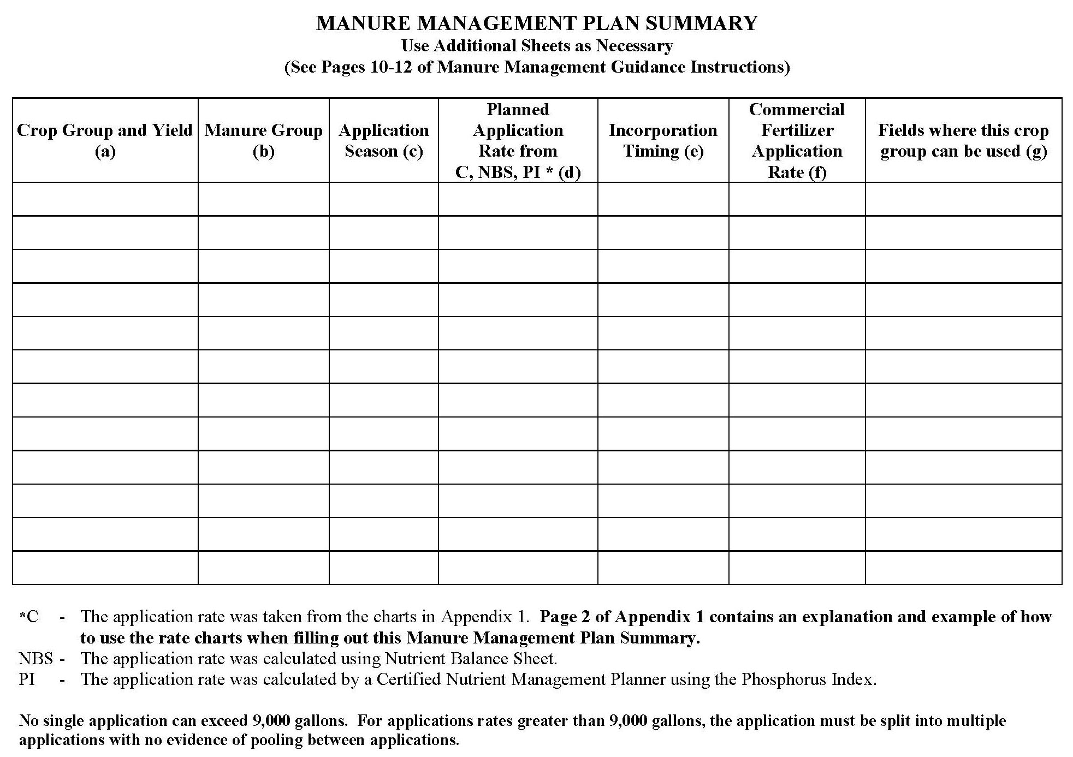
Manure Management Plan Summary (p.6)
This section must be completed if mechanically applying manure
List manure application rates by crop group
Summarized on the Manure Management Plan Summary
Notes:
At this point the farmers should have the blank Manure Management Plan Summary worksheet in front of them. This is page 6 of the Manure Management Plan Workbook section.

Slide 3
Determining Planned Application Rates
Before completing the “Planned Application Rates” column, 4 other columns must be completed
Crop Group and Yield
Manure Group
Application Season
Incorporation Timing
Different combinations of these factors will create multiple “crop group scenarios”
Notes:
The purpose of this and the following slides is to develop a list of crop scenarios that are determined by different combinations of crop/yield, manure group, manure application season, and applied manure incorporation timing.
Facilitators should become very familiar with these slides and the process and intended outcome. The Manure Management Plan Summary worksheet can be used to record the different steps in identifying these crop groups or this could be done a piece of “scratch paper”.

Slide 4
Determining Crop Groups & Yields
List the crops grown on the farm that might receive manure
Consider crop rotation
Same crop but different crop groups
Harvested differently
Corn Silage
Corn Grain
Following legume crops in the rotation
Corn Silage After Alfalfa
Corn Silage After Soybeans
Corn Silage After Corn
List the expected optimum yield for each crop group

Slide 5
Manure Management Plan Summary (p.6)
Crop Group and Yield (a) | Manure Group (b) | Application Season (c ) | Planned Application Rate from C, NBS, PI * (d) | Incorporation Timing (e) | Commercial Fertilizer Application Rate (f) | Fields where this crop group can be used (g)
Corn Silage (23 T/A)
Corn Silage After Alfalfa (23 T/A)
Grass Hay (4 T/A)
Note: No manure is applied to alfalfa on this farm so it is not listed.

Slide 6
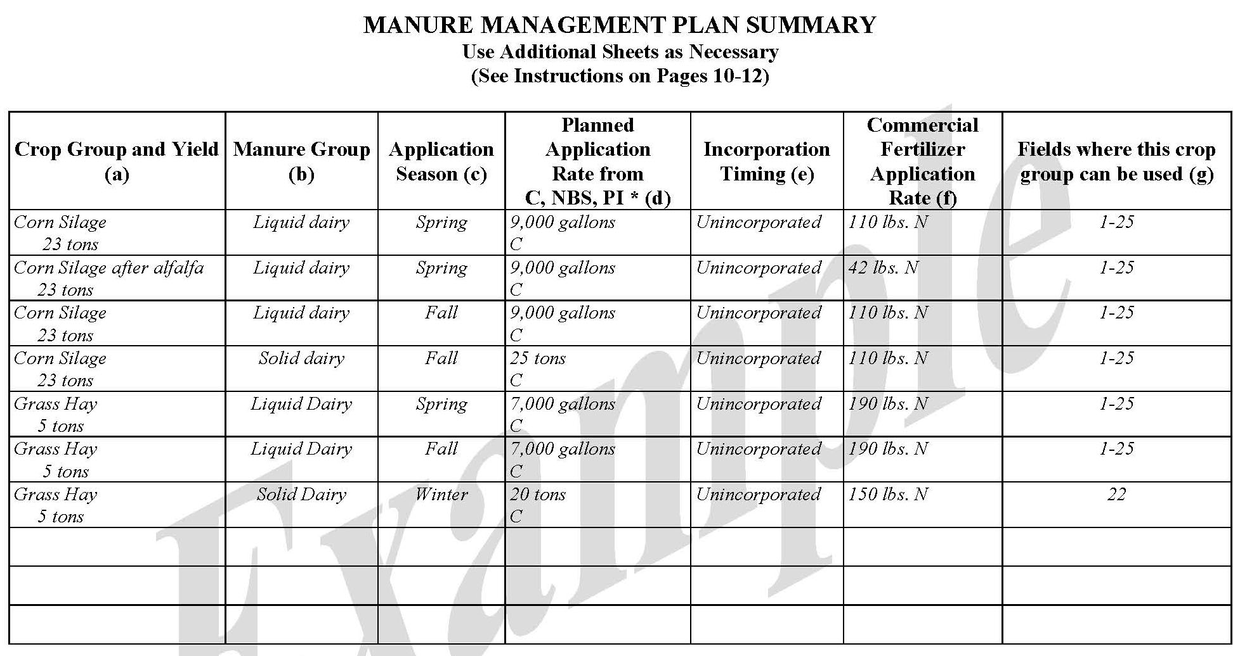
Manure Management Plan Exercise – Page 6
Complete Crop Group & Yield Column
Notes:
This exercise completes the “Crop Group and Yield (a)” column of the Manure Management Plan Summary worksheet.
Facilitators may want to refer participants to the completed example of the Manure Management Plan Summary worksheet. This is page 12 in “Land Application of Manure”.

Slide 7
Determining Manure Groups
To determine manure groups on the operation first identify the different storage locations on the farm
Where do you physically get the manure to load in the spreader?
Examples: storage tank, box stalls, stacking pad, broiler house
Second, name the manure group
Manure group names should mean something to you
Name should include the animal type
Dairy, swine, poultry, etc.
In some cases the name may need to include the manure type
Liquid or solid

Slide 8
Make a list of your farm’s manure groups on a separate sheet of paper
Manure Management Plan Exercise – Page 6

Slide 9
Assigning Manure Groups
Next the manure groups need to be assigned to the crop groups
A crop group will often receive more than one manure group, for example:
Corn silage receives dairy solid and dairy liquid
Each manure group is applied to the crop in different fields
Grass hay receives liquid manure but not solid manure
This requires adding duplicate crop group entries in the Manure Management Plan Summary for each manure group the crop receives

Slide 10
Manure Management Plan Summary (p.6)
Crop Group and Yield (a) | Manure Group (b) | Application Season (c ) | Planned Application Rate from C, NBS, PI * (d) | Incorporation Timing (e) | Commercial Fertilizer Application Rate (f) | Fields where this crop group can be used (g)
Corn Silage (23 T/A) | Liquid Dairy
Corn Silage After Alfalfa (23 T/A) | Liquid Dairy
Grass Hay (4 T/A) | Liquid Dairy
Corn Silage (23 T/A) | Solid Dairy

Slide 11
Manure Management Plan Exercise – Page 6
Complete Manure Group Column
Notes:
This exercise completes the “Manure Group (b)” column of the Manure Management Plan Summary worksheet.
Facilitators may want to refer participants to the completed example of the Manure Management Plan Summary worksheet. This is page 12 in “Land Application of Manure”.

Slide 12
Determining Application Seasons
Important aspect of manure application management
Determines how much nitrogen will be available to the crop
Two parts to this determination
When is the manure in a storage location land applied?
One manure group may have different application seasons
Dairy liquid – Spring
Dairy liquid – Fall
Typical application seasons
Spring (or summer)
Fall (early)
Winter (or late fall)
If a manure group is applied to a crop group in different seasons, duplicate crop group entries need to be added

Slide 13
Manure Management Plan Summary (p.6)
Crop Group and Yield (a) | Manure Group (b) | Application Season (c ) | Planned Application Rate from C, NBS, PI * (d) | Incorporation Timing (e) | Commercial Fertilizer Application Rate (f) | Fields where this crop group can be used (g)
Corn Silage (23 T/A) | Liquid Dairy | Spring
Corn Silage After Alfalfa (23 T/A) | Liquid Dairy | Spring
Grass Hay (4 T/A) | Liquid Dairy | Summer
Corn Silage (23 T/A) | Solid Dairy | Spring
Corn Silage (23 T/A) | Liquid Dairy | Fall
Corn Silage (23 T/A) | Solid Dairy | Fall
Corn Silage (23 T/A) | Solid Dairy | Winter

Slide 14
Manure Management Plan Exercise – Page 6
Complete Application Season Column
Notes:
This exercise completes the “Application Season (c)” column of the Manure Management Plan Summary worksheet.
Facilitators may want to refer participants to the completed example of the Manure Management Plan Summary worksheet. This is page 12 in “Land Application of Manure”.

Slide 15
Determining Incorporation Timing
Second important aspect of manure application management
Determines how much nitrogen will be available to the crop
Manure Application Rate Tables (Appendix 1)
Spring incorporation within 1 day
Spring incorporation with 1 week
Spring no incorporation
Fall
Winter with cover crop
Winter no cover crop
Other methods of determining application rates will use the Nutrient Balance Worksheet incorporation options

Slide 16
Manure Management Plan Summary (p.6)
Crop Group and Yield (a) | Manure Group (b) | Application Season (c ) | Planned Application Rate from C, NBS, PI * (d) | Incorporation Timing (e) | Commercial Fertilizer Application Rate (f) | Fields where this crop group can be used (g)
Corn Silage (23 T/A) | Liquid Dairy | Spring |  | No lncorporation
Corn Silage After Alfalfa (23 T/A) | Liquid Dairy | Spring |  | Inc. < 1 Week
Grass Hay (4 T/A) | Liquid Dairy | Summer |  | No lncorporation
Corn Silage (23 T/A) | Solid Dairy | Spring |  | No lncorporation
Corn Silage (23 T/A) | Liquid Dairy | Fall |  | No lncorporation
Corn Silage (23 T/A) | Solid Dairy | Fall |  | No lncorporation
Corn Silage (23 T/A) | Solid Dairy | Winter |  | Cover Crop
Corn Silage (23 T/A) | Liquid Dairy | Spring |  | Inc. < 1 Week
Manure Application Method
Spring | Incorporation within 1 day
 | Incorporation within 1 week
 | No Incorporation
Fall | No Incorporation
Winter | With cover crop
 | No cover crop

Slide 17
Manure Management Plan Exercise – Page 6
Complete Incorporation Timing Column
Notes:
This exercise completes the “Incorporation Timing (e)” column of the Manure Management Plan Summary worksheet.
Facilitators may want to refer participants to the completed example of the Manure Management Plan Summary worksheet. This is page 12 in “Land Application of Manure”.

Slide 18
Determining Planned Application Rates
A manure application rate must be planned for each crop group scenario
A field by field allocation is not required
Rates will be based on nitrogen or phosphorus
Different rates depending on the scenarios developed here:
Crop group
Legumes in the rotation
Yield differences
Manure group
Manure group application season
Manure incorporation timing
Nitrogen or phosphorus basis
A good starting point is to use your current manure application rates
If these rates are known pencil them in the column

Slide 19
Manure Spreader Calibration
Must know actual manure application rates
Planned application rates are worthless without application equipment calibration
Calibration of equipment is the only way to know actual manure application rates
Calibration ensures that application rates are realistic, practical, and attainable
Practical benefits of verifying actual application rates
Avoid over application of nutrients
Inefficient use of nutrients
Not available for other fields
False “need” for supplemental fertilizer
Avoid under application of nutrients
Decrease yield potential
Ideally should be done before planning
Use current rates as basis for the plan
Later may require modification of the plan

Slide 20
Manure Spreader Calibration Factsheet
Agronomy Facts 68: Manure Spreader Calibration
http://panutrientmgmt.cas.psu.edu/pdf/Facts68.pdf

Slide 21
Typical Application Rates
Use current, typical application rates as a starting point
If known
If planning confirms them
Use as Planned Application Rate
If planning requires a different rate
Use the new Planned Application Rate

Slide 22
Manure Management Plan Summary (p.6)
Crop Group and Yield (a) | Manure Group (b) | Application Season (c ) | Planned Application Rate from C, NBS, PI * (d) | Incorporation Timing (e) | Commercial Fertilizer Application Rate (f) | Fields where this crop group can be used (g)
Corn Silage (23 T/A) | Liquid Dairy | Spring | 9000 gal/A | No lncorporation
Corn Silage After Alfalfa (23 T/A) | Liquid Dairy | Spring | 9000 gal/A | Inc. < 1 Week
Grass Hay (4 T/A) | Liquid Dairy | Summer | 4000 gal/A | No lncorporation
Corn Silage (23 T/A) | Solid Dairy | Spring | 25 ton/A | No lncorporation
Corn Silage (23 T/A) | Liquid Dairy | Fall | 9000 gal/A | No lncorporation
Corn Silage (23 T/A) | Solid Dairy | Fall | 25 ton/A | No lncorporation
Corn Silage (23 T/A) | Solid Dairy | Winter | 25 ton/A | Cover Crop
Corn Silage (23 T/A) | Liquid Dairy | Spring | 9000 gal/A | Inc. < 1 Week

Slide 23
Manure Management Plan Exercise – Page 6
List Typical Application Rates (If Known)
Notes:
If the farmer knows his typical application rates these can be written in pencil in the “Planned Application Rate (d)” column. Or they can be noted on a separate piece of paper.

Slide 24
Determining Planned Application Rates
Three approaches may be used to determine manure application rates
MMM Appendix 1 – Manure Application Rate Tables (“C”)
Nutrient Balance Worksheets (“NBS”)
Nutrient Balance Worksheets incorporating the PA Phosphorus Index (“PI”)
Developed by authorized (trained) specialist
Notes:
Note: this presentation illustrates option 1, the Manure Application Rate Tables.

Slide 25
 | MMM Tables P Removal | Balance Sheet P Removal | MMM Tables N Based | Balance Sheet N Based | Balance Sheet P Index | Act 38 NMP
Time & Cost
Management Flexibility
Written By Specialist | No | No | No | No | Yes (Authorized) | Yes (Certified)
Soil Tests | No | No | Yes (< 200 ppm P) | Yes (< 200 ppm P) | Yes | Yes
Manure Analysis | No | No | No | No | No | Yes
Specific Crop Information | No (based on averages) | Yes | No (based on averages) | Yes | Yes | Yes (plus manure specific)
Application Rates | Lower | Lower | Higher (less fields ?) | Higher (less fields ?) | All Fields (N or P) | All Fields (N or P)
Simple-Easy-Inexpensive Complex-Difficult-Expensive
Very Restrictive Maximum Flexibility
Soil Test > 200 ppm P Options
Notes:
The purpose of this summary table is to illustrate the pros and cons of the different planning options. The two rows at the top with the arrows are the key points. If a farmer wants a simple-easy-inexpensive planning process then he will have to settle for more restrictive manure application rates. To obtain more flexibility in his application rates will require more complexity, and therefore, more time and expense in the planning process.
Facilitators are encouraged to become very familiar with this table and be able to discuss the nuances illustrated. Otherwise it is recommended that this slide not be used at all.

Slide 26
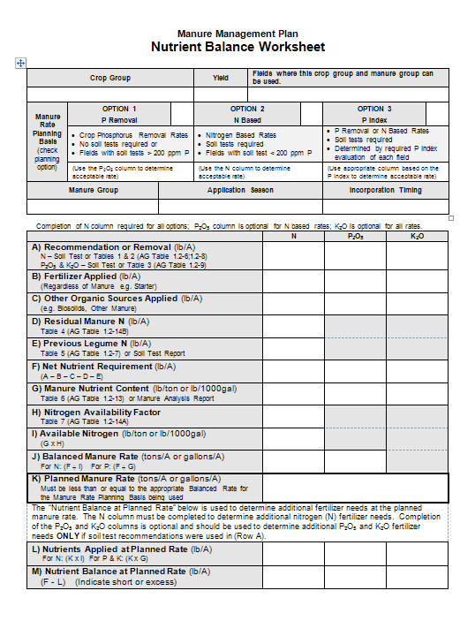
MMM Manure Application Rate Tables
Nutrient Balance Sheets

Slide 27
Rate Tables vs. NB Worksheets
Nutrient Balance Worksheets must be used for:
Manure types not included in the Rate Tables
Ostriches, llamas, etc.
Supplemental Tables available for: Sheep & Goats, Turkeys, and Veal
Crops not included in the Rate Tables
Alfalfa, soybeans, etc.
Double cropping
Multiple applications of manure
Different seasons of application
Different manure types
Winter application rates higher than permitted when using the Rate Tables
Phosphorus removal rate

Slide 28
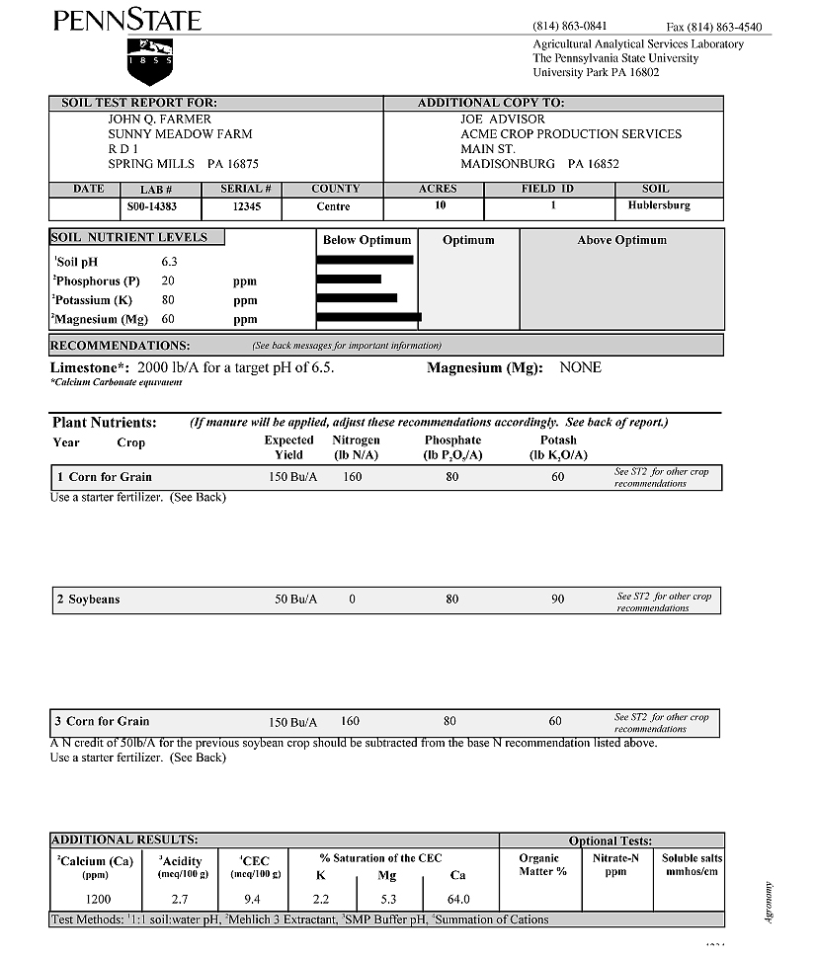
Soil Test Reports
Nitrogen based manure rate options require soil tests
Must be current within last 3 years
N based rates can only be used on fields with P levels < 200 ppm
Notes:
This and the following soil test slides are optional. The intent is to help farmers find the ppm P on their soil test reports

Slide 29
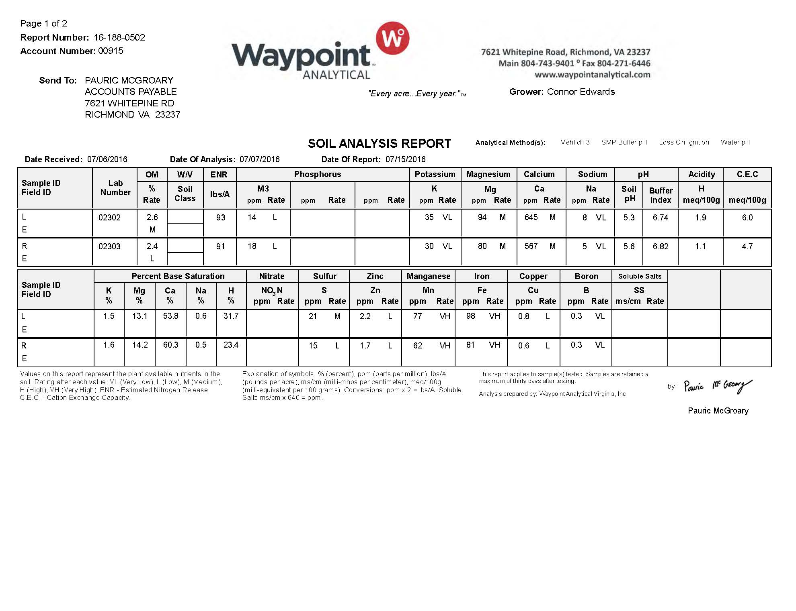

Slide 30
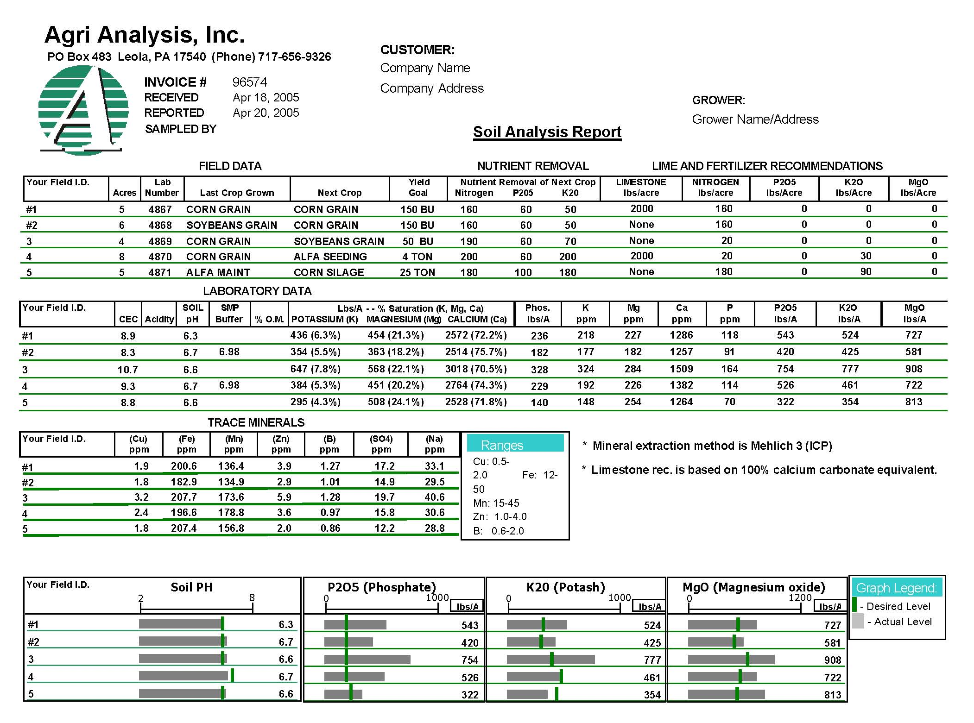
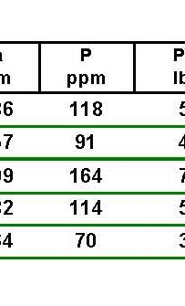

Slide 31
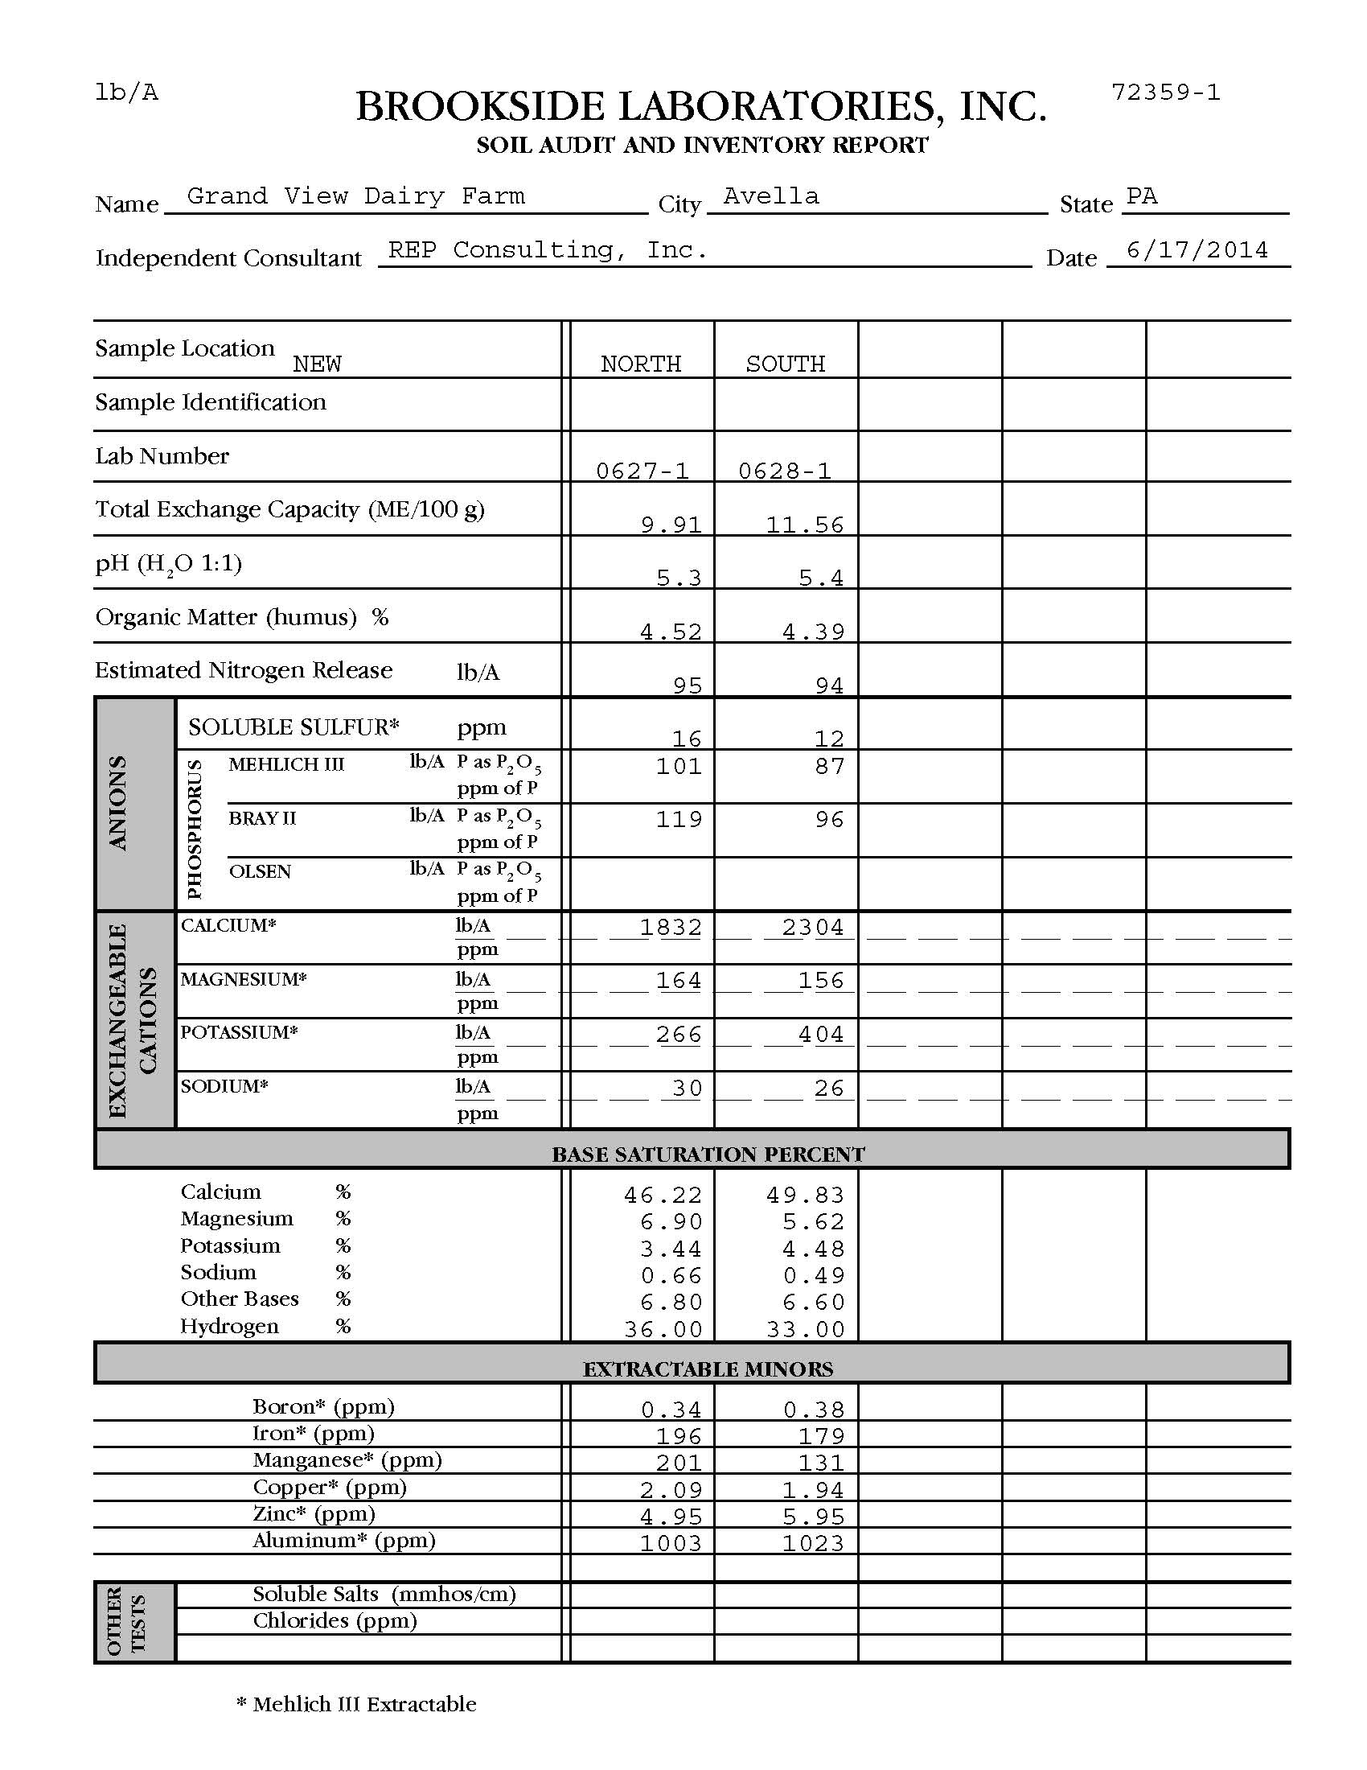

Slide 32
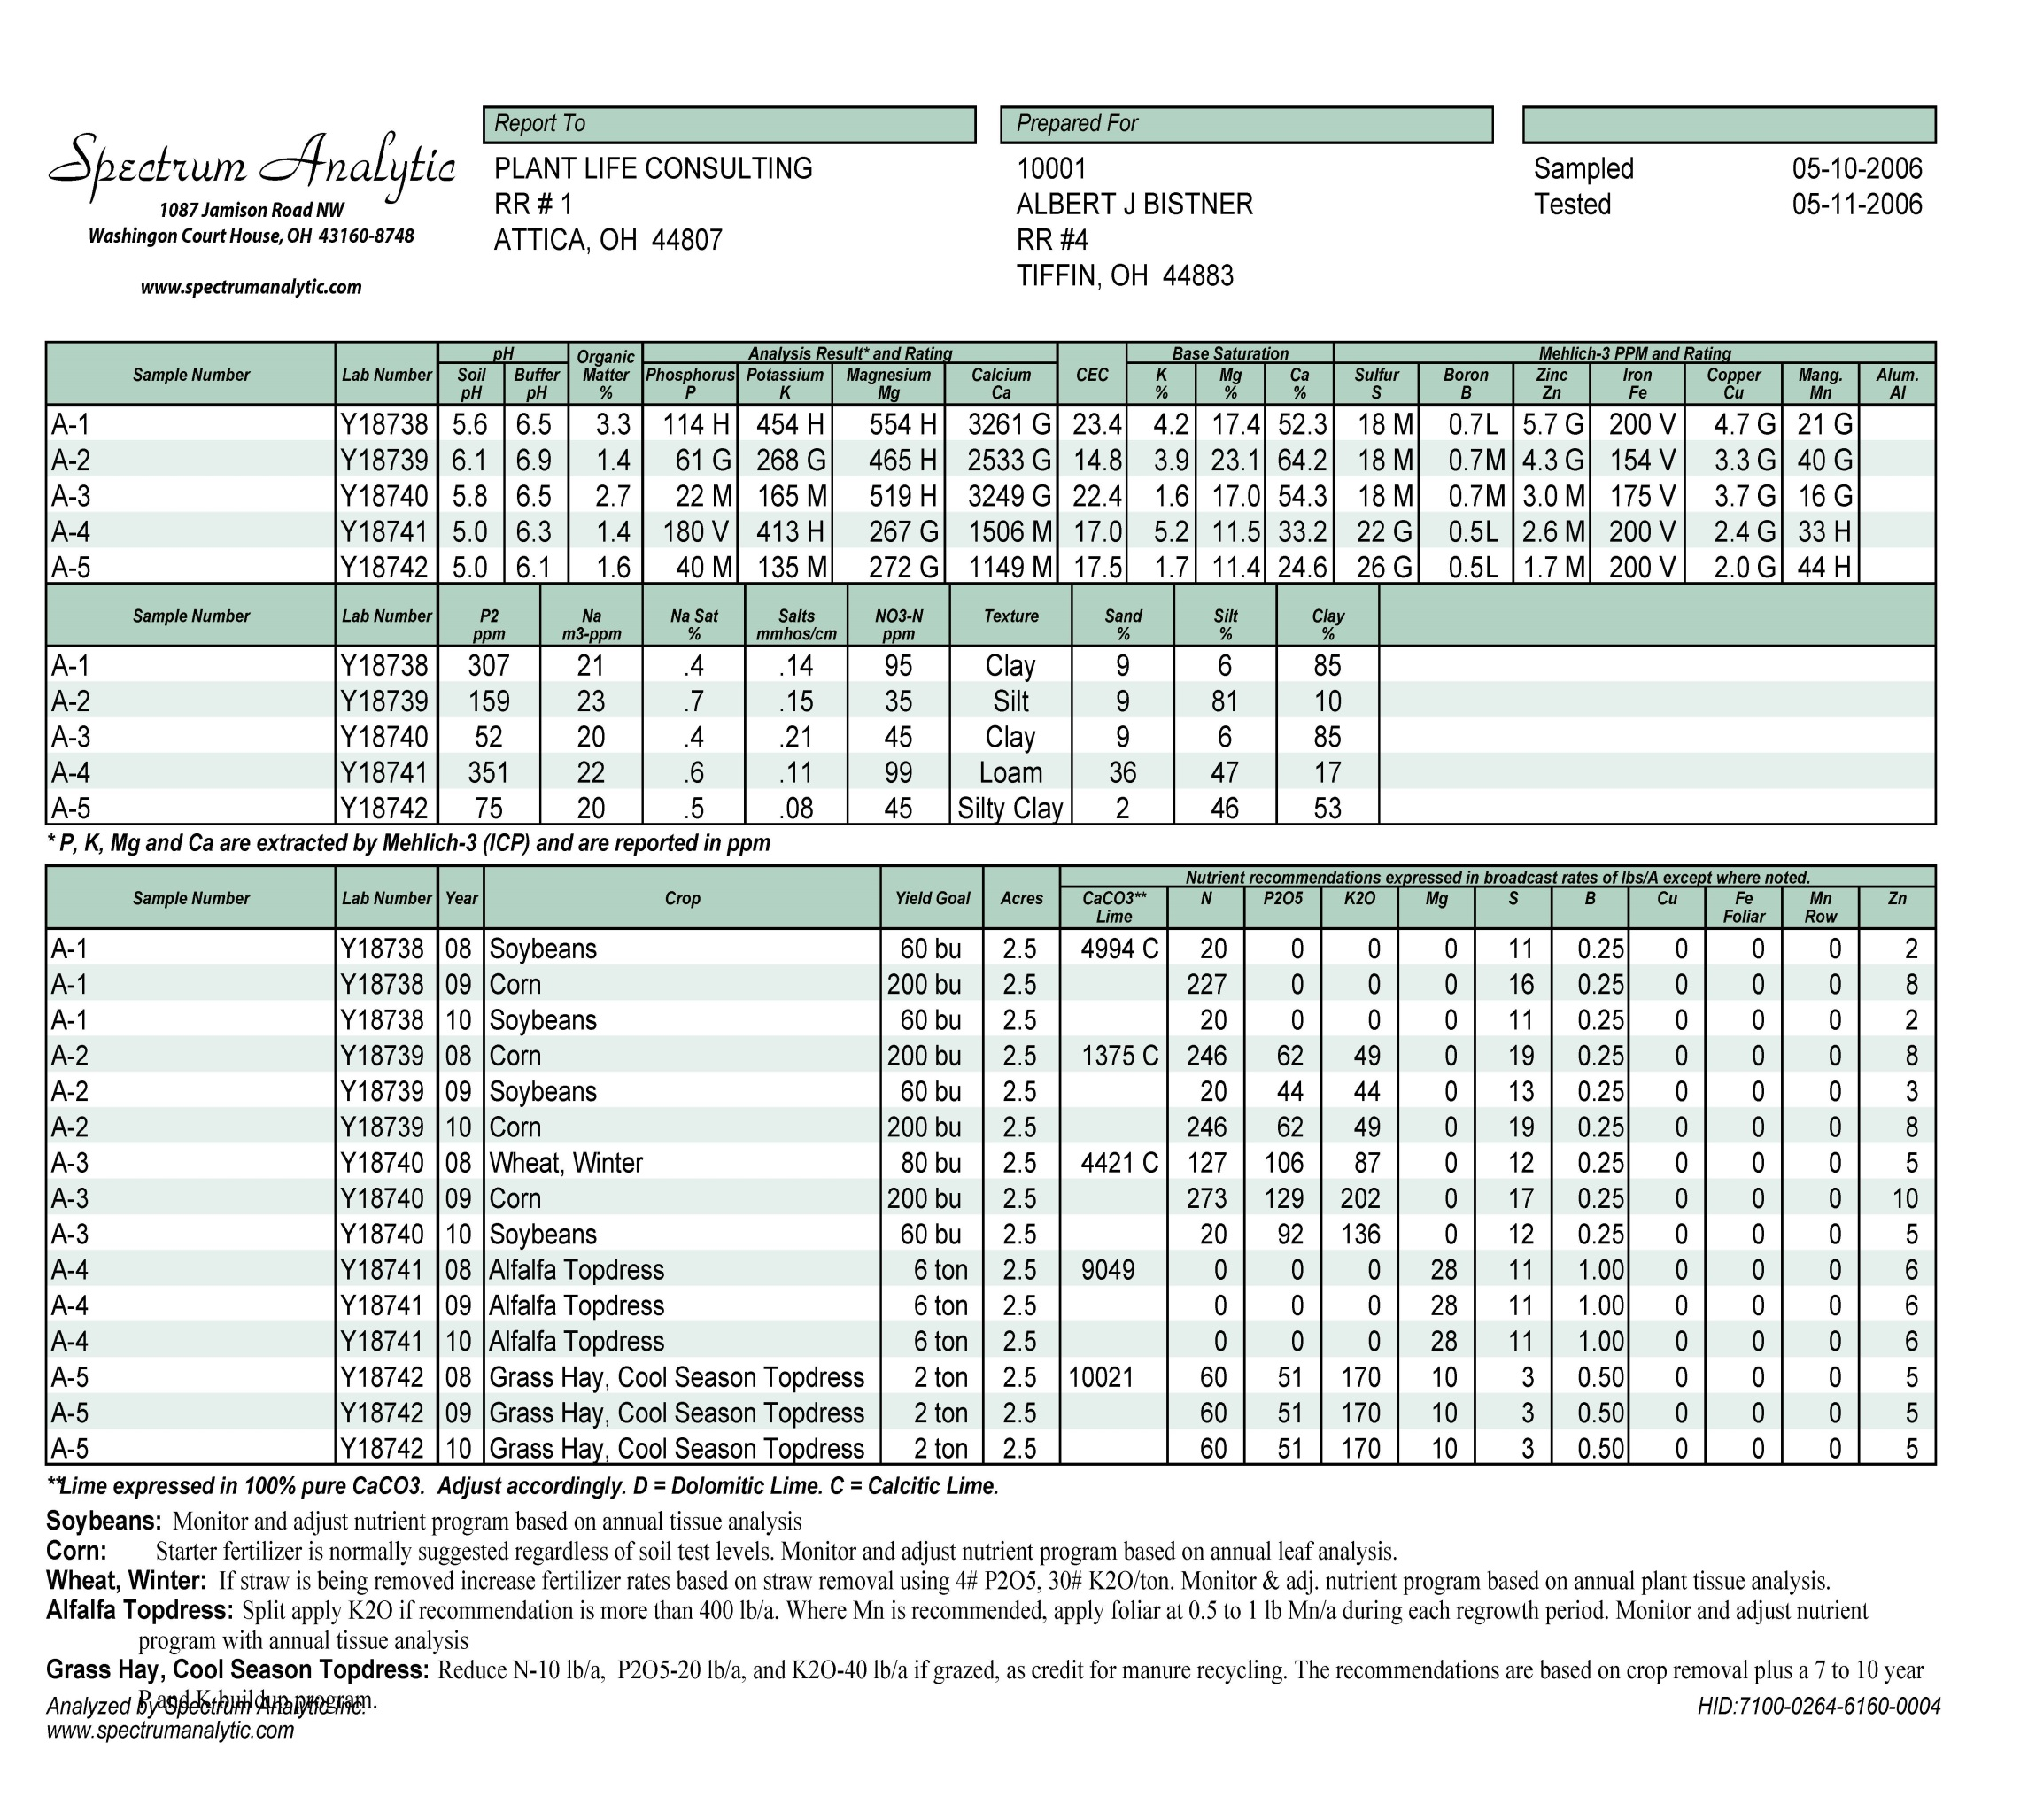

Slide 33
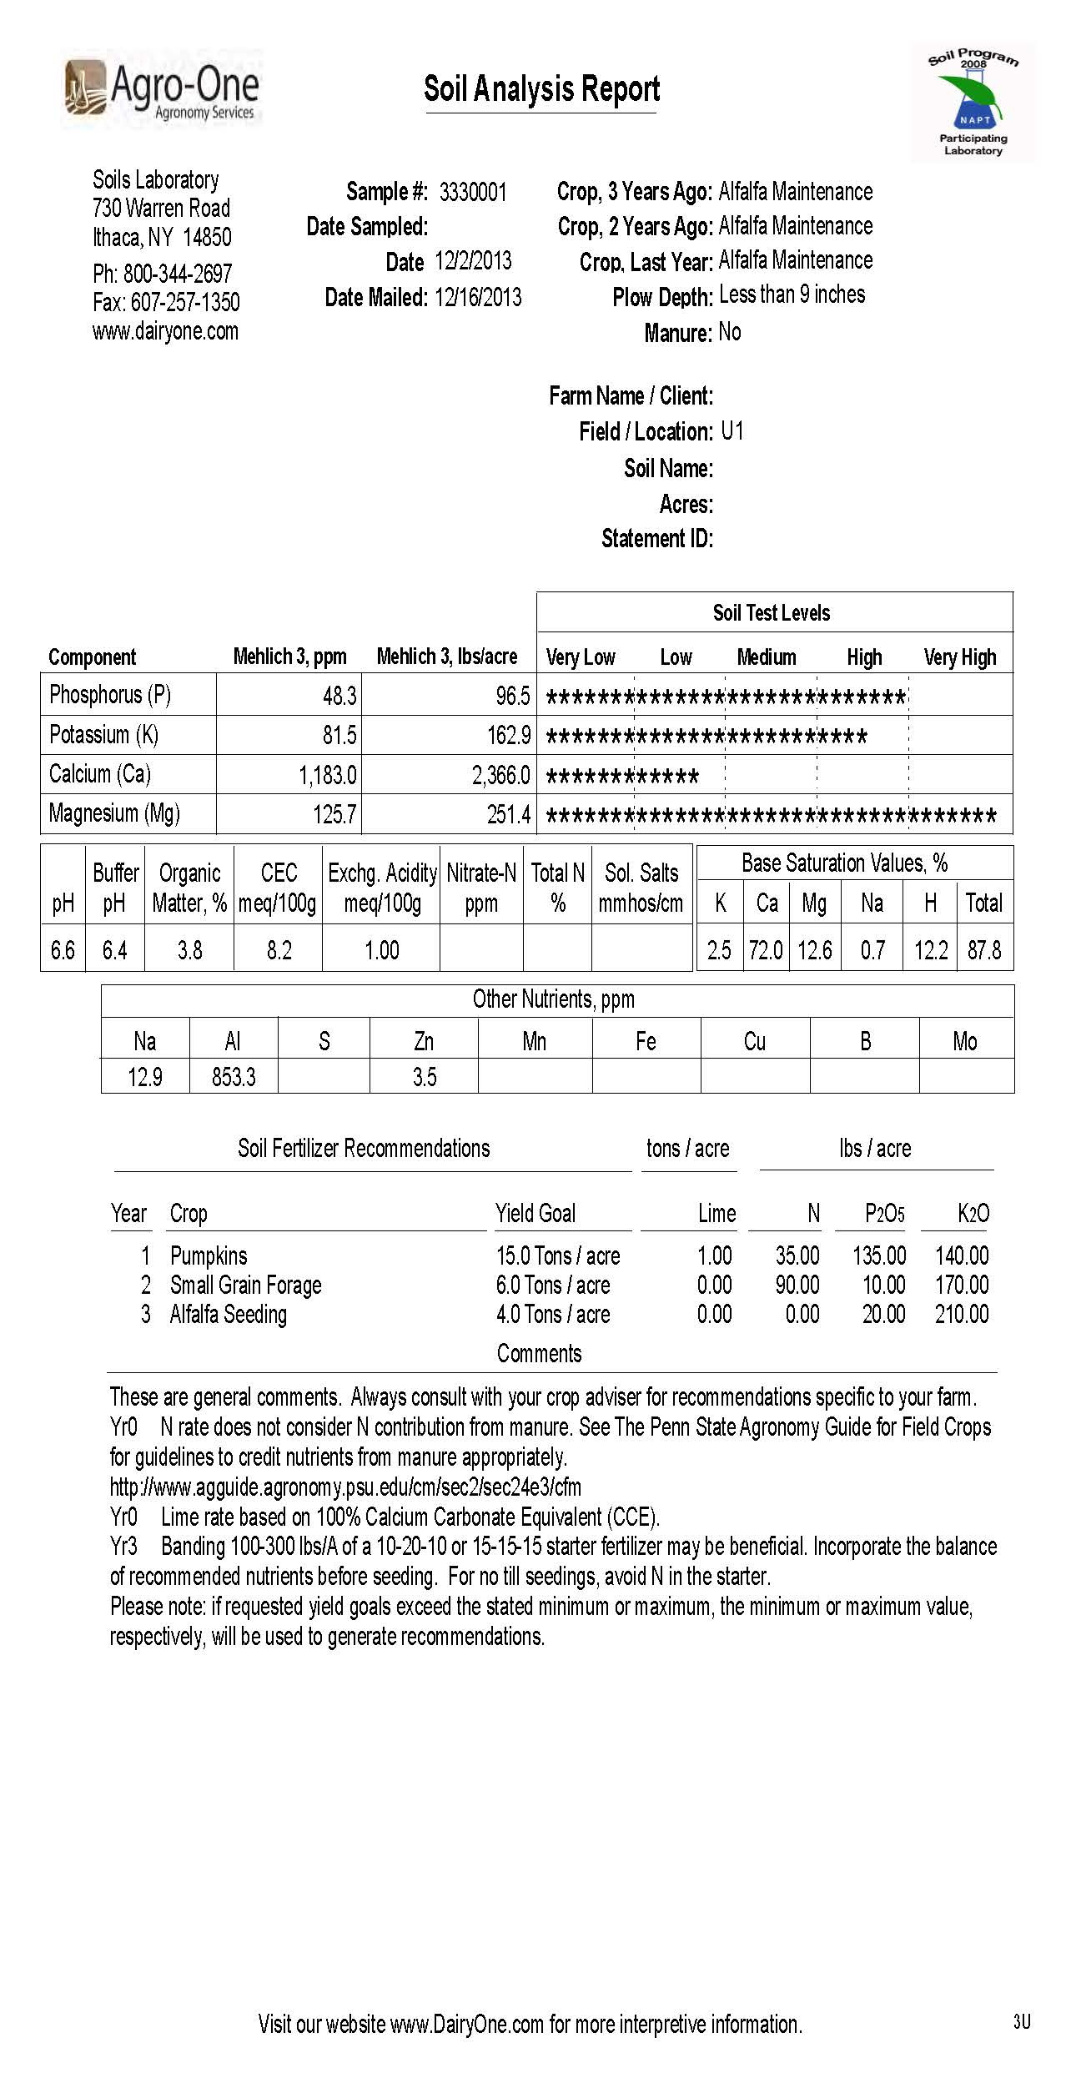

Slide 34
Using the MMM Manure Application Rate Tables
Crop Group and Yield (a) | Manure Group (b) | Application Season (c ) | Planned Application Rate from C, NBS, PI * (d) | Incorporation Timing (e) | Commercial Fertilizer Application Rate (f) | Fields where this crop group can be used (g)
Corn Silage (23 T/A) | Liquid Dairy | Spring | 9000 gal/A | No lncorporation
Corn Silage After Alfalfa (23 T/A) | Liquid Dairy | Spring | 9000 gal/A | Inc. < 1 Week
Grass Hay (4 T/A) | Liquid Dairy | Summer | 4000 gal/A | No lncorporation
Corn Silage (23 T/A) | Solid Dairy | Spring | 25 ton/A | No lncorporation
Corn Silage (23 T/A) | Liquid Dairy | Fall | 9000 gal/A | No lncorporation
Corn Silage (23 T/A) | Solid Dairy | Fall | 25 ton/A | No lncorporation
Corn Silage (23 T/A) | Solid Dairy | Winter | 25 ton/A | Cover Crop
Corn Silage (23 T/A) | Liquid Dairy | Spring | 9000 gal/A | Inc. < 1 Week
Notes:
Example #1.

Slide 35
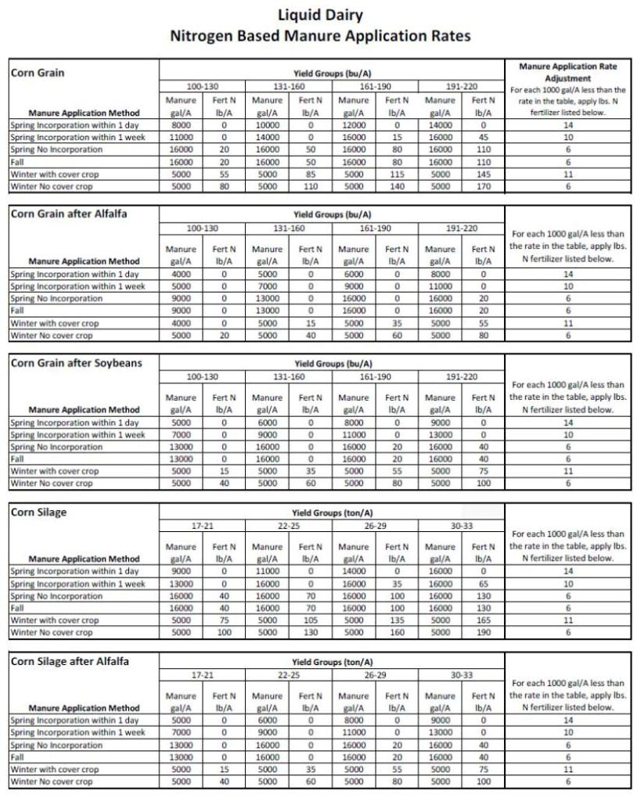
Step 1: Find the table in the back of the MMM (Appendix 1) for:
1. Rate basis N or P
2. Type of manure
Step 2: Find the crop in the table

Slide 36
Find the yield at the top
Find the application method in the left column
Read the rate from the table
Corn Silage | Yield Groups (ton/A) |  |  |  |  |  |  |  | Manure Application Rate Adjustment For each 1000 gal/A less than the rate in the table, apply lbs. N fertilizer listed below.
 | 17-21 |  | 22-25 |  | 26-29 |  | 30-33
Manure Application Method | Manure gal/A | Fert N lb/A | Manure gal/A | Fert N lb/A | Manure gal/A | Fert N lb/A | Manure gal/A | Fert N lb/A
Spring Incorporation within 1 day | 9000 | 0 | 11000 | 0 | 14000 | 0 | 16000 | 0 | 14
Spring Incorporation within 1 week | 13000 | 0 | 16000 | 0 | 16000 | 35 | 16000 | 65 | 10
Spring No Incorporation | 16000 | 40 | 16000 | 70 | 16000 | 100 | 16000 | 130 | 6
Fall | 16000 | 40 | 16000 | 70 | 16000 | 100 | 16000 | 130 | 6
Winter with cover crop | 5000 | 75 | 5000 | 105 | 5000 | 135 | 5000 | 165 | 11
Winter No cover crop | 5000 | 100 | 5000 | 130 | 5000 | 160 | 5000 | 190 | 6
No more than 9000 gal/A of liquid manure can be applied in a single application.
Spilt higher rates into multiple applications.
N based rates N are also limited to 3X P removal

Slide 37
Using the MMM Manure Application Rate Tables
Crop Group and Yield (a) | Manure Group (b) | Application Season (c ) | Planned Application Rate from C, NBS, PI * (d) | Incorporation Timing (e) | Commercial Fertilizer Application Rate (f) | Fields where this crop group can be used (g)
Corn Silage (23 T/A) | Liquid Dairy | Spring | 9000 gal/A C | No lncorporation
Corn Silage After Alfalfa (23 T/A) | Liquid Dairy | Spring | 9000 gal/A | Inc. < 1 Week
Grass Hay (4 T/A) | Liquid Dairy | Summer | 4000 gal/A | No lncorporation
Corn Silage (23 T/A) | Solid Dairy | Spring | 25 ton/A | No lncorporation
Corn Silage (23 T/A) | Liquid Dairy | Fall | 9000 gal/A | No lncorporation
Corn Silage (23 T/A) | Solid Dairy | Fall | 25 ton/A | No lncorporation
Corn Silage (23 T/A) | Solid Dairy | Winter | 25 ton/A | Cover Crop
Corn Silage (23 T/A) | Liquid Dairy | Spring | 9000 gal/A | Inc. < 1 Week
Farmer’s normal rate = 9000 gal/A.
This is less than the table rate of 16,000 gal/A.
Therefore the normal rate is OK.

Slide 38
Commercial Fertilizer & Fields
Complete the “Fields where this crop group can be used” column
Include all the fields that potentially have this management scenario over the crop rotation
Frequently this is all the fields on the farm
Complete the “Commercial Fertilizer Application Rate” column for each crop group scenario

Slide 39
Corn Silage | Yield Groups (ton/A) |  |  |  |  |  |  |  | Manure Application Rate Adjustment For each 1000 gal/A less than the rate in the table, apply lbs. N fertilizer listed below.
 | 17-21 |  | 22-25 |  | 26-29 |  | 30-33
Manure Application Method | Manure gal/A | Fert N lb/A | Manure gal/A | Fert N lb/A | Manure gal/A | Fert N lb/A | Manure gal/A | Fert N lb/A
Spring Incorporation within 1 day | 9000 | 0 | 11000 | 0 | 14000 | 0 | 16000 | 0 | 14
Spring Incorporation within 1 week | 13000 | 0 | 16000 | 0 | 16000 | 35 | 16000 | 65 | 10
Spring No Incorporation | 16000 | 40 | 16000 | 70 | 16000 | 100 | 16000 | 130 | 6
Fall | 16000 | 40 | 16000 | 70 | 16000 | 100 | 16000 | 130 | 6
Winter with cover crop | 5000 | 75 | 5000 | 105 | 5000 | 135 | 5000 | 165 | 11
Winter No cover crop | 5000 | 100 | 5000 | 130 | 5000 | 160 | 5000 | 190 | 6
Allowable Rate = 16,000 gal/A + 70 lb N/A
Planned Rate = 9000 gal/A
Difference = 7000 gal/A x 6 lb N/1000 gal = 42 lb additional fertilizer N required per acre
Total Fertilizer Required = 70 + 42 = 112 lb N/A

Slide 40
Using the MMM Manure Application Rate Tables
Crop Group and Yield (a) | Manure Group (b) | Application Season (c ) | Planned Application Rate from C, NBS, PI * (d) | Incorporation Timing (e) | Commercial Fertilizer Application Rate (f) | Fields where this crop group can be used (g)
Corn Silage (23 T/A) | Liquid Dairy | Spring | 9000 gal/A C | No lncorporation | 112 lb N/A | All Fields
Corn Silage After Alfalfa (23 T/A) | Liquid Dairy | Spring | 9000 gal/A | Inc. < 1 Week
Grass Hay (4 T/A) | Liquid Dairy | Summer | 4000 gal/A | No lncorporation
Corn Silage (23 T/A) | Solid Dairy | Spring | 25 ton/A | No lncorporation
Corn Silage (23 T/A) | Liquid Dairy | Fall | 9000 gal/A | No lncorporation
Corn Silage (23 T/A) | Solid Dairy | Fall | 25 ton/A | No lncorporation
Corn Silage (23 T/A) | Solid Dairy | Winter | 25 ton/A | Cover Crop
Corn Silage (23 T/A) | Liquid Dairy | Spring | 9000 gal/A | Inc. < 1 Week

Slide 41
Using the MMM Manure Application Rate Tables
Crop Group and Yield (a) | Manure Group (b) | Application Season (c ) | Planned Application Rate from C, NBS, PI * (d) | Incorporation Timing (e) | Commercial Fertilizer Application Rate (f) | Fields where this crop group can be used (g)
Corn Silage (23 T/A) | Liquid Dairy | Spring | 9000 gal/A C | No lncorporation | 112 lb N/A | All Fields
Corn Silage After Alfalfa (23 T/A) | Liquid Dairy | Spring | 9000 gal/A | Inc. < 1 Week
Grass Hay (4 T/A) | Liquid Dairy | Summer | 4000 gal/A | No lncorporation
Corn Silage (23 T/A) | Solid Dairy | Spring | 25 ton/A | No lncorporation
Corn Silage (23 T/A) | Liquid Dairy | Fall | 9000 gal/A | No lncorporation
Corn Silage (23 T/A) | Solid Dairy | Fall | 25 ton/A | No lncorporation
Corn Silage (23 T/A) | Solid Dairy | Winter | 25 ton/A | Cover Crop
Corn Silage (23 T/A) | Liquid Dairy | Spring | 9000 gal/A | Inc. < 1 Week
Notes:
Example #2 – Winter Application.

Slide 42
Winter Application Rates
All winter application rates are capped at the MMM limits
Liquid Manure - 5000 gallons per acre
Non-Poultry Dry Manure – 20 tons per acre
Poultry Dry Manure – 3 tons per acre
Solid Dairy
Nitrogen Based Manure Application Rates
Corn Silage | Yield Groups (ton/A) |  |  |  |  |  |  |  | For each Ton/A less than the rate in the table, apply lbs. N fertilizer listed below.
 | 17-21 |  | 22-25 |  | 26-29 |  | 30-33
Manure Application Method | Manure ton/A | Fert N lb/A | Manure ton/A | Fert N lb/A | Manure ton/A | Fert N lb/A | Manure ton/A | Fert N lb/A
Spring Incorporation within 1 day | 25 | 0 | 30 | 10 | 40 | 0 | 45 | 0 | 5
Spring Incorporation within 1 week | 35 | 0 | 45 | 0 | 50 | 15 | 50 | 45 | 4
Spring No Incorporation | 50 | 30 | 50 | 60 | 50 | 90 | 50 | 120 | 2
Fall | 50 | 30 | 50 | 60 | 50 | 90 | 50 | 120 | 2
Winter with cover crop | 20 | 50 | 20 | 80 | 20 | 110 | 20 | 140 | 4
Winter No cover crop | 20 | 90 | 20 | 120 | 20 | 150 | 20 | 180 | 2

Slide 43
Using the MMM Manure Application Rate Tables
Crop Group and Yield (a) | Manure Group (b) | Application Season (c ) | Planned Application Rate from C, NBS, PI * (d) | Incorporation Timing (e) | Commercial Fertilizer Application Rate (f) | Fields where this crop group can be used (g)
Corn Silage (23 T/A) | Liquid Dairy | Spring | 9000 gal/A C | No lncorporation | 112 lb N/A | All Fields
Corn Silage After Alfalfa (23 T/A) | Liquid Dairy | Spring | 9000 gal/A | Inc. < 1 Week
Grass Hay (4 T/A) | Liquid Dairy | Summer | 4000 gal/A | No lncorporation
Corn Silage (23 T/A) | Solid Dairy | Spring | 25 ton/A | No lncorporation
Corn Silage (23 T/A) | Liquid Dairy | Fall | 9000 gal/A | No lncorporation
Corn Silage (23 T/A) | Solid Dairy | Fall | 25 ton/A | No lncorporation
Corn Silage (23 T/A) | Solid Dairy | Winter | 20 ton/A C | Cover Crop | 80 lb N/A | Fields 3-8, 13-15
Corn Silage (23 T/A) | Liquid Dairy | Spring | 9000 gal/A | Inc. < 1 Week
The farmer’s normal rate (25 ton/A) would not be acceptable for this crop group because of the winter application rate limit.

Slide 44
Using the MMM Manure Application Rate Tables
Crop Group and Yield (a) | Manure Group (b) | Application Season (c ) | Planned Application Rate from C, NBS, PI * (d) | Incorporation Timing (e) | Commercial Fertilizer Application Rate (f) | Fields where this crop group can be used (g)
Corn Silage (23 T/A) | Liquid Dairy | Spring | 9000 Gal/A C | No lncorporation | 112 lb N/A | All Fields
Corn Silage (23 T/A) | Liquid Dairy | Spring | 9000 Gal/A C | Inc. < 1 Week | 42 lb N/A | All Fields
Corn Silage (23 T/A) | Liquid Dairy | Fall | 9000 Gal/A C | No lncorporation | 112 lb N/A | All Fields
Corn Silage (23 T/A) | Solid Dairy | Spring | 25 ton/A C | No lncorporation | 112 lb N/A | All Fields
Corn Silage (23 T/A) | Solid Dairy | Fall | 25 ton/A C | No lncorporation | 110 lb N/A | All Fields
Corn Silage (23 T/A) | Solid Dairy | Winter | 20 ton/A C | Cover Crop | 80 lb N/A | Fields 3-8, 13-15
Corn Silage After Alfalfa (23 T/A) | Liquid Dairy | Spring | 9000 Gal/A C | Inc. < 1 Week | 0 lb N/A | All Fields
Grass Hay (4 T/A) | Liquid Dairy | Summer | 4000 Gal/A C | No lncorporation | 212 lb N/A | All Fields

Slide 45
Manure Management Plan Exercise – Page 6
Complete Planned Application Rates, Fertilizer & Fields
Notes:
This exercise completes the “Planned Application Rate (d)”, “Commercial Fertilizer Application Rate (f)”, and Fields (g) columns of the Manure Management Plan Summary worksheet.
Facilitators may want to refer participants to the completed example of the Manure Management Plan Summary worksheet. This is page 12 in “Land Application of Manure”.

