Slide 1
Manure management plan summary – pasture rates
Completing a Manure Management Plan Workshop
v.12.2012
Notes:
This is an optional module that illustrates how to determine a mechanical manure application rate on pastures. It is to be used in conjunction with the factsheets for horses, dairy, beef, sheep and goats.

Slide 2
Mechanical Application on Pastures
Determining Mechanical Manure Application Rates Worksheets
For pastures where there will be grazing AND mechanical manure application
Five worksheets currently available
Beef
Dairy
Goat
Horse
Sheep

Slide 3
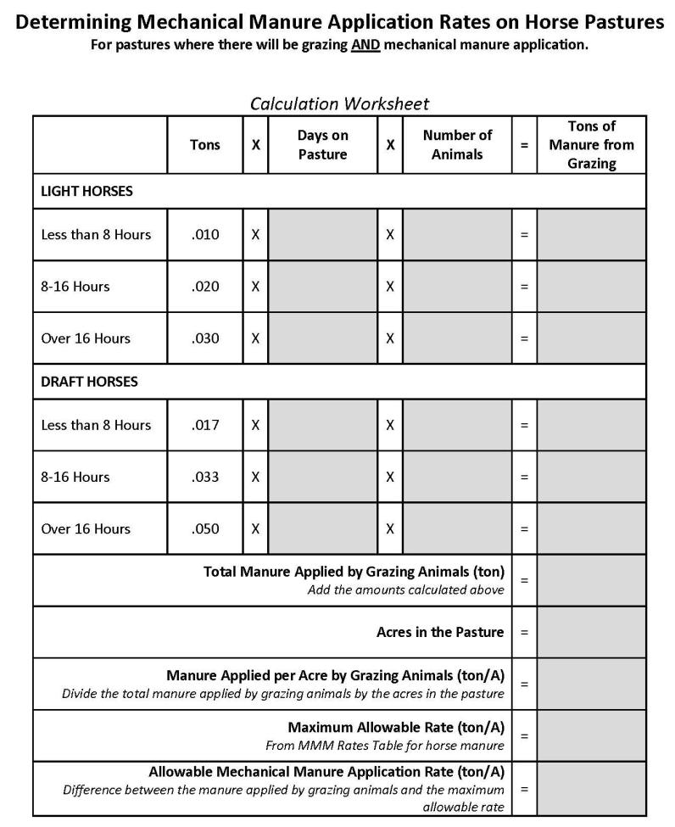
Each packet includes:
Worksheet
Instructions
Example

Slide 4
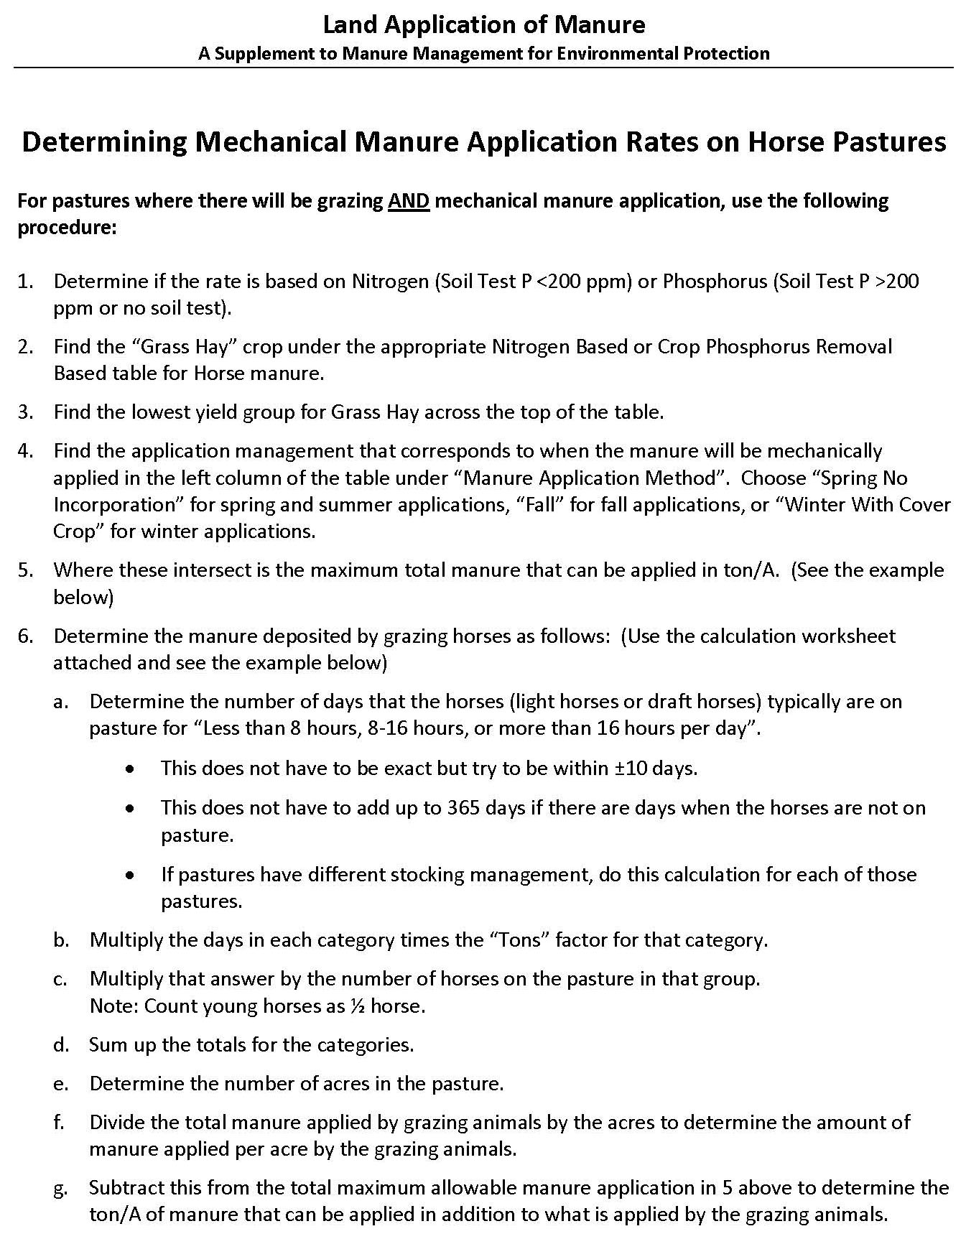
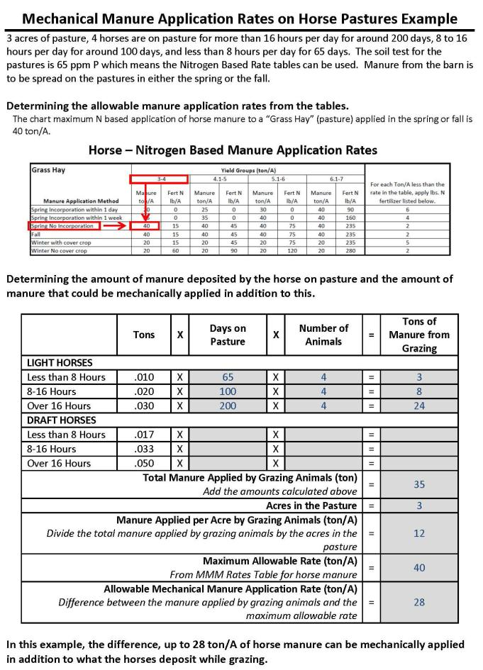

Slide 5
Steps To Determine Maximum Rate
Determine if the rate will be based on nitrogen or phosphorus
Nitrogen
Soil tests <200 ppm P
Phosphorus
Soil tests > 200 ppm P
No soil tests
Select the Manure Application Rate Table
Manure type
Animal type and solid manure
Rate basis
Nitrogen or Crop Phosphorus Removal
Select the “Grass Hay” crop group
Select the lowest yield for Grass Hay across the top

Slide 6
Steps To Determine Maximum Rate
Under “Manure Application Method” find the application method that corresponds to when the manure will be applied
Spring and summer applications
Choose “Spring No Incorporation”
Fall applications
Choose “Fall”
Winter applications
Choose “Winter With Cover Crop”
Note where the application method and manure in tons/acre intersect
This is the MAXIMUM amount of manure that can be applied per acre to the pasture

Slide 7
Horse Pasture Example
3 acre pasture
No soil test
Manure applied spring and fall
3 light horses
20 days: <8 hours
100 days: 12 hours
200 days: >16 hours
Total Maximum Manure – 10 T/A

Slide 8
 | Tons | X | Days on Pasture | X | Number of Animals | = | Tons of Manure from Grazing
LIGHT HORSES
Less than 8 Hours | .010 | X |  | X |  | =
8-16 Hours | .020 | X |  | X |  | =
Over 16 Hours | .030 | X |  | X |  | =
Total Manure Applied by Grazing Animals (ton) Add the amounts calculated above |  |  |  |  |  | =
Acres in the Pasture
Manure Applied per Acre by Grazing Animals (ton/A Divide the total manure applied by grazing animals by the acres in the pasture
Maximum Allowable Rate (ton/A) From MMM Rates Table for horse manure |  |  |  |  |  | = | 10
Allowable Mechanical Manure Application Rate (ton/A) Difference between the manure applied by grazing animals and the maximum allowable rate |  |  |  |  |  | =

Slide 9
Steps To Determine Grazing Manure
Use the “Calculation Worksheet”
Number of animals in each group
Days out of the year each group is grazed
Estimate to within + 10 days
Does not have to equal 365 days if there are days when animals are not on the pasture
If pastures are grazed differently calculate for each pasture
Multiply the following to determine the tons/acre from grazing
Worksheet “Tons” factor
Days on pasture
Number of animals
Add each line to determine “Total Manure Applied by Grazing Animals”

Slide 10
 | Tons | X | Days on Pasture | X | Number of Animals | = | Tons of Manure from Grazing
LIGHT HORSES
Less than 8 Hours | .010 | X | 20 | X | 3 | = | .6
8-16 Hours | .020 | X | 100 | X | 3 | = | 6.0
Over 16 Hours | .030 | X | 200 | X | 3 | = | 18.0
Total Manure Applied by Grazing Animals (ton) Add the amounts calculated above |  |  |  |  |  | = | 24.6
Acres in the Pasture
Manure Applied per Acre by Grazing Animals (ton/A Divide the total manure applied by grazing animals by the acres in the pasture
Maximum Allowable Rate (ton/A) From MMM Rates Table for horse manure |  |  |  |  |  | = | 10
Allowable Mechanical Manure Application Rate (ton/A) Difference between the manure applied by grazing animals and the maximum allowable rate |  |  |  |  |  | =

Slide 11
Steps To Determine Grazing Manure
Determine the number of acres in the pasture
Divide the total manure applied by the grazing animals by the acres
Amount of manure per acre applied by the grazing animals

Slide 12
 | Tons | X | Days on Pasture | X | Number of Animals | = | Tons of Manure from Grazing
LIGHT HORSES
Less than 8 Hours | .010 | X | 20 | X | 3 | = | .6
8-16 Hours | .020 | X | 100 | X | 3 | = | 6.0
Over 16 Hours | .030 | X | 200 | X | 3 | = | 18.0
Total Manure Applied by Grazing Animals (ton) Add the amounts calculated above |  |  |  |  |  | = | 24.6
Acres in the Pasture |  |  |  |  |  |  | 3
Manure Applied per Acre by Grazing Animals (ton/A Divide the total manure applied by grazing animals by the acres in the pasture |  |  |  |  |  |  | 8.2
Maximum Allowable Rate (ton/A) From MMM Rates Table for horse manure |  |  |  |  |  | = | 10
Allowable Mechanical Manure Application Rate (ton/A) Difference between the manure applied by grazing animals and the maximum allowable rate |  |  |  |  |  | =

Slide 13
Determine Mechanical Manure Rate
Subtract the manure applied per acre from the maximum allowable rate

Slide 14
Rate of mechanically applied manure cannot be greater than 1.8 tons/acre.
 | Tons | X | Days on Pasture | X | Number of Animals | = | Tons of Manure from Grazing
LIGHT HORSES
Less than 8 Hours | .010 | X | 20 | X | 3 | = | .6
8-16 Hours | .020 | X | 100 | X | 3 | = | 6.0
Over 16 Hours | .030 | X | 200 | X | 3 | = | 18.0
Total Manure Applied by Grazing Animals (ton) Add the amounts calculated above |  |  |  |  |  | = | 24.6
Acres in the Pasture |  |  |  |  |  |  | 3
Manure Applied per Acre by Grazing Animals (ton/A Divide the total manure applied by grazing animals by the acres in the pasture |  |  |  |  |  |  | 8.2
Maximum Allowable Rate (ton/A) From MMM Rates Table for horse manure |  |  |  |  |  | = | 10
Allowable Mechanical Manure Application Rate (ton/A) Difference between the manure applied by grazing animals and the maximum allowable rate |  |  |  |  |  | = | 1.8

Slide 15
Manure Management Plan Summary
Crop Group and Yield (a) | Manure Group (b) | Application Season (c ) | Planned Application Rate from C, NBS, PI * (d) | Incorporation Timing (e) | Commercial Fertilizer Application Rate (f) | Fields where this crop group can be used (g)
Pasture (3 T/A) | Solid Horse | Spring, Fall | 1.5 T/A ‘C’ | No Incorpor. | NA | Pastures 1, 2, 3

