Slide 1
Introduction to dep manure management plan
Completing a Manure Management Plan Workshop
v.01.2018
Notes:
This module is intended to provide a brief introduction to Manure Management Manual requirements regarding a manure management plan.
Facilitators should review and be familiar the introductory and general information pages of “Land Application of Manure” - specifically pages ii, iii, 1, 2, 24-26.

Slide 2
Animal Operations in Pennsylvania
All Animal Operations (AOs)
All operations generating or utilizing manure
Regulated by PA DEP
Concentrated Animal Operations (CAOs)
High animal density farms with >2,000 lbs of livestock weight/acre
Regulated by PA SCC
Concentrated Animal Feeding Operations (CAFOs)
Based on animal numbers and/or animal density
Farms >1,000 AEUs, CAOs >300 AEUs, EPA head #s
Regulated by PA DEP (for US EPA)
AOs (23,190+)
CAOs (1003+)
CAFOs (429+)
State Conservation Commission 2017

Slide 3
Manure Management Plan Requirements
Every PA farm that produces or land applies manure must have and implement a written Manure Management Plan (MMPs)
Includes imported manure
Includes pastures and animal concentration areas
MMPs can be prepared by the farmer or by a trained individual
The MMP format and worksheets from the Manual must be followed unless an alternative is approved by DEP
MMPs do not need to be submitted for approval
But must be available to DEP or Conservation District staff on request for inspection
Records of MMP implementation must be kept on the farm
Notes:
This slide outlines the key manure management plan requirements. Review “Land Application of Manure” pages ii and 1.

Slide 4
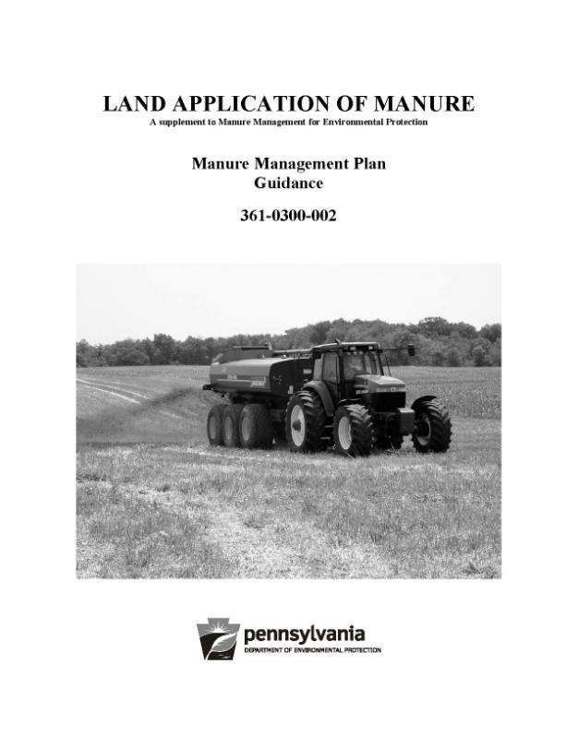
Land Application of Manure
Part I
Requirements for Manure Management Plans (MMPs)
MMP Guidance & Instructions
MMP Worksheet Examples
Glossary
Part II
Manure Management Plan Workbook
Planning Checklist
MMP Worksheets
Recordkeeping Forms
Part III
Appendix 1: Manure Application Rate Tables
Notes:
Explain the three sections of “Land Application of Manure” and especially note that each section is numbered separately and that this may be somewhat confusing in referencing pages throughout the workshop.
Also, it might be helpful to note that “Land Application of Manure” is a supplement of the Manure Management Manual for Environmental Protection. There are additional supplements to the manual.

Slide 5
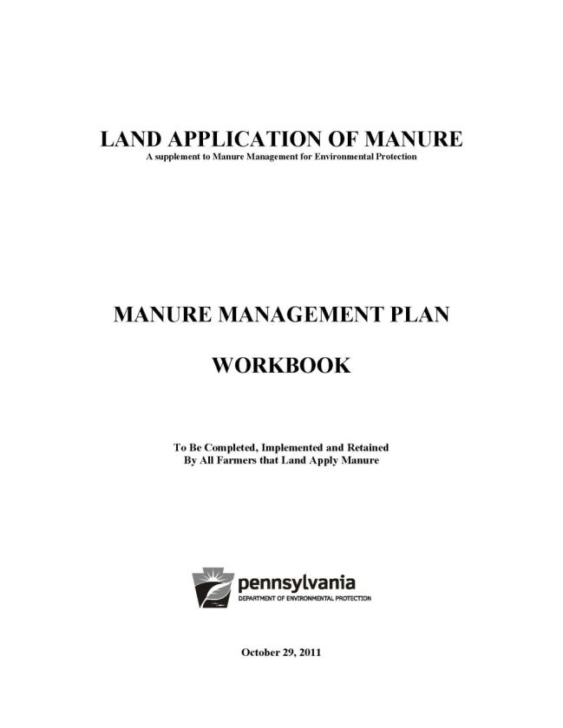
Manure Management Plan
Farm Map
MMP Worksheets
Contact Information Page
Operation Information Page
Environmentally Sensitive Areas Worksheet
Winter Application Worksheet
Manure Management Plan Summary
Manure Storage Facilities Worksheet
Pasture Management Worksheet
Animal Concentration Areas Worksheet
MMP Recordkeeping Forms
MMP Checklist
Notes:
This slide is intended to provide a quick overview of the various worksheets that make up a manure management plan. Review “Land Application of Manure” page 2 and note that some worksheets are required for all plans but others are only required if applicable.
It is recommended that workshop participants be given individual worksheets to be completed throughout the workshop rather than using the ones in the printed “Land Application of Manure” publication.

Slide 6
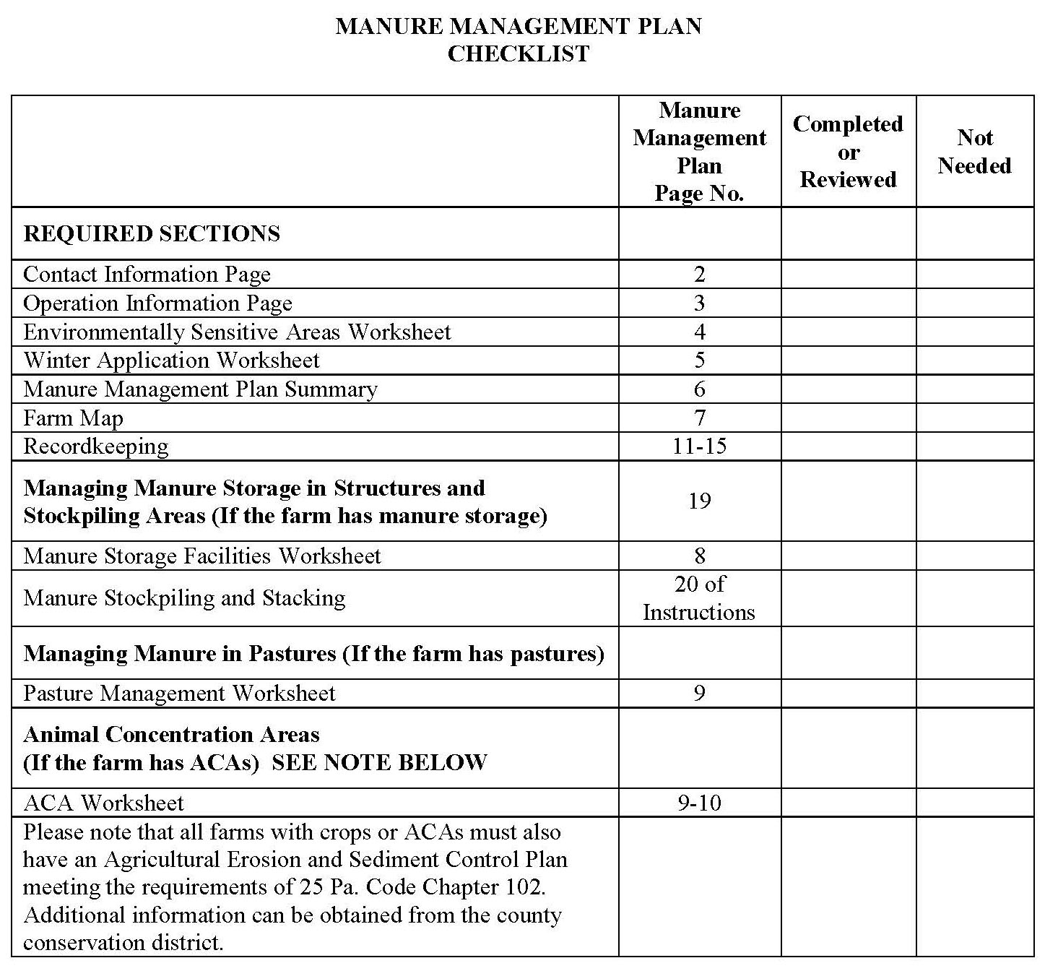
Manure Management Plan Checklist (p.1)
Notes:
Explain that this checklist is not part of the manure management plan but is a guide to make sure all required parts of the plan are completed.
It is recommended that this page not be completed throughout the workshop but at the end during the “Wrap-Up” module.

