Slide 1
Farm maps
Completing a Manure Management Plan Workshop
v.12.2012
Notes:
This module introduces the Farm Map component of a manure management plan. The primary focus is on what is required to be on the farm map.
Fully completing the farm map during the workshop will be very challenging and in most cases not achievable. Facilitators should give adequate time before the workshop considering how this component will be handled. Making sure farmers come with good maps is on approach. The other is to print out maps for each farmer beforehand and providing them to the farmers during the workshop.
Facilitators should review and be familiar the guidance on pages 13 and 14 of “Land Application of Manure”.

Slide 2
Farm Map (p.7)
Boundaries of the farm
Field information for all fields included in the plan
Individual field boundaries
Field identification
Number or name
Field acreage
Location and names of all roads adjacent to or within the farm
Notes:
This slide covers the base information required on the farm map. This information most likely will be applicable to all farms.

Slide 3
Additional Information Added Later
Environmental Sensitive Areas
Location and type of environmentally sensitive areas indentified on the worksheet
Associated manure application setbacks from these areas
Manure Storage Facilities
Location of existing and proposed manure storage facilities
Location of manure stockpiling or stacking areas
Pasture Management
Location of pastures
Animal concentration areas
Location of animal concentration areas
Winter Application of Manure
Notation of all fields that will receive winter applied manure
Identification of average slopes or the average NRCS slope designation
Notes:
This slide notes the other map information that is required to be on the manure management plan map. Not all farms will be have all of these map features.
Facilitators should explain that opportunity will be given throughout the workshops for these additional map features to be added.

Slide 4
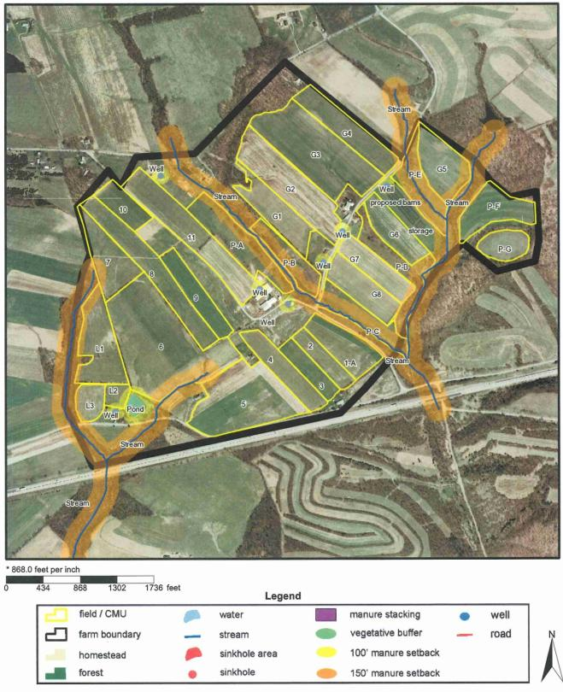
Farm Map Sources
Maps can be hand drawn
Best and recommended base map
Ag E&S or Conservation Plan map
Computer generated map
PA One Stop
Free
Relatively simple
GIS Software
www.paonestop.org
Notes:
General review of possible sources of farm maps.

Slide 5
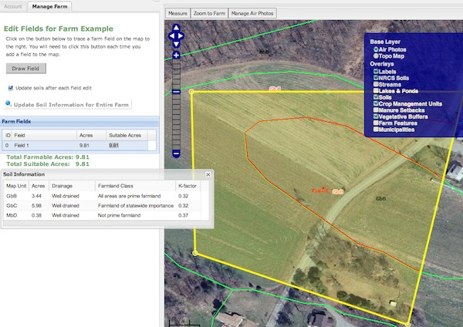
WWW.PAONESTOP.ORG
Free, easy to use online source
Developed by Penn State Extension
Notes:
The purpose of this slide is to introduce PAOneStop not to explain or review it in any depth.

Slide 6
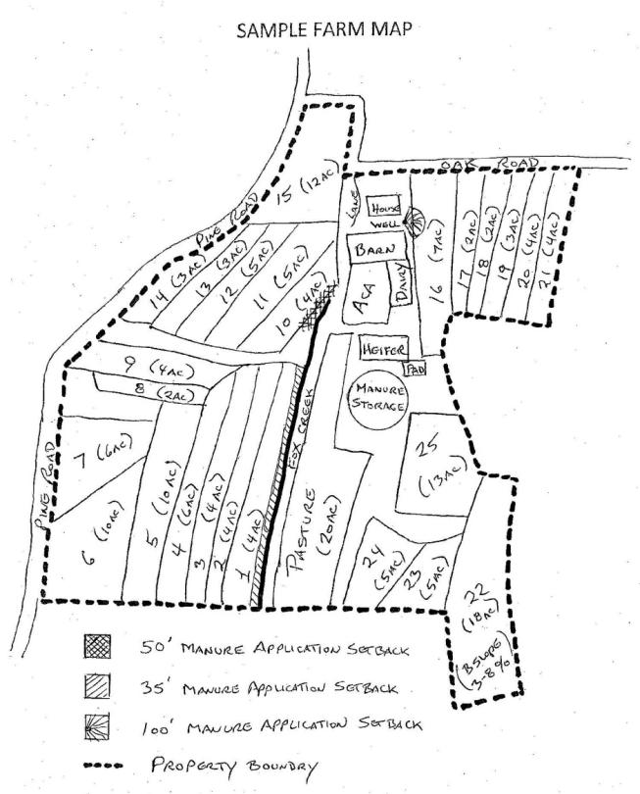
Take out maps
Farm Map Development
May need to be completed after all the sections of the plan are final and complete.
Notes:
This exercise should focus the base information is noted on the farm map.
Facilitators should be disciplined to not take too much time on this exercise.
Facilitators may want to refer participants to the completed example of the Farm Map. This is page 14 in “Land Application of Manure” and page 7 of the Manure Management Plan Workbook section.

