Slide 1
Environmentally sensitive areas
Completing a Manure Management Plan Workshop
v.02.2016
Notes:
This module focuses on completing the Environmentally Sensitive Areas Worksheet.
Facilitators should review and be familiar the guidance on pages 6 and 7 of “Land Application of Manure”.

Slide 2
Environmentally Sensitive Areas
STREAMS
WELLS
PONDS
Notes:
The point of this slide is to emphasize that farms contain many environmentally sensitive areas that need to be protected as much as possible from nutrient, sediment, and microbial impact.

Slide 3
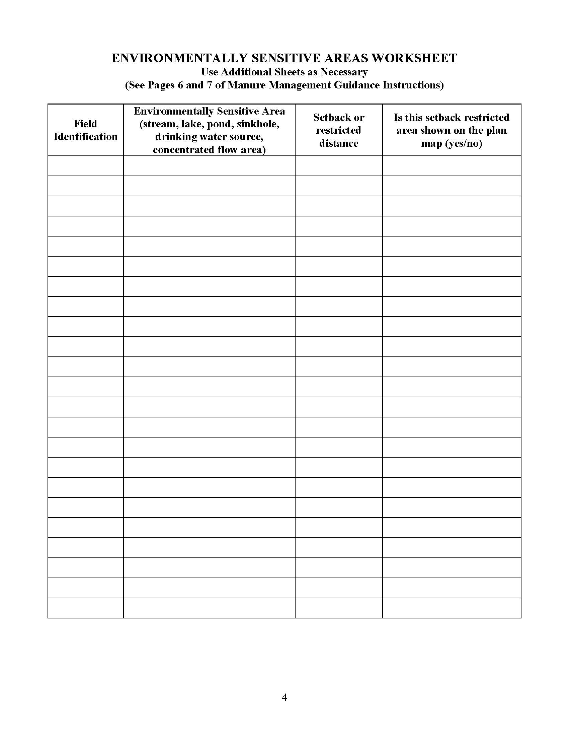
Environmentally Sensitive Areas Worksheet (p.4)
Environmentally sensitive areas
Streams, lakes, and ponds
Open sinkholes
Private drinking water sources
Public drinking water sources
Non-vegetated concentrated water flow areas
Above ground inlet to agricultural drainage system
Mechanical manure application setbacks are required
Regardless of the slope of the land or the ground cover
Notes:
At this point the farmers should have the blank Environmentally Sensitive Areas Worksheet in front of them. This is page 4 of the Manure Management Plan Workbook section.

Slide 4
Sensitive Areas & Manure Application Setbacks
No mechanical manure application within 100 feet of streams, lakes and ponds
Stream qualifications
Setback applicable only during the time of year when the stream generally flows
Not included are culvert outlets or a roadside swales that drain stormwater into a field where the stormwater infiltrates into the ground
Notes:
Beginning with this slide and following each of the environmentally sensitive areas required to be noted in the manure management plan are reviewed.
Here and throughout all the modules facilitators should feel free to use their own photos if they desire.

Slide 5
Options to Reduce 100 Foot Setback
Option 1: Within 50 feet of streams, lakes and ponds if related fields:
Have soil tests current within the last three years
Soil test phosphorus (Mehlich 3-P) levels are less than 200 parts per million (ppm)
No-till practices are used
When residue is removed, a cover crop must be planted
Option 2: Within 35 feet of streams, lakes and ponds
A permanent vegetated buffer is established and maintained along the water body

Slide 6
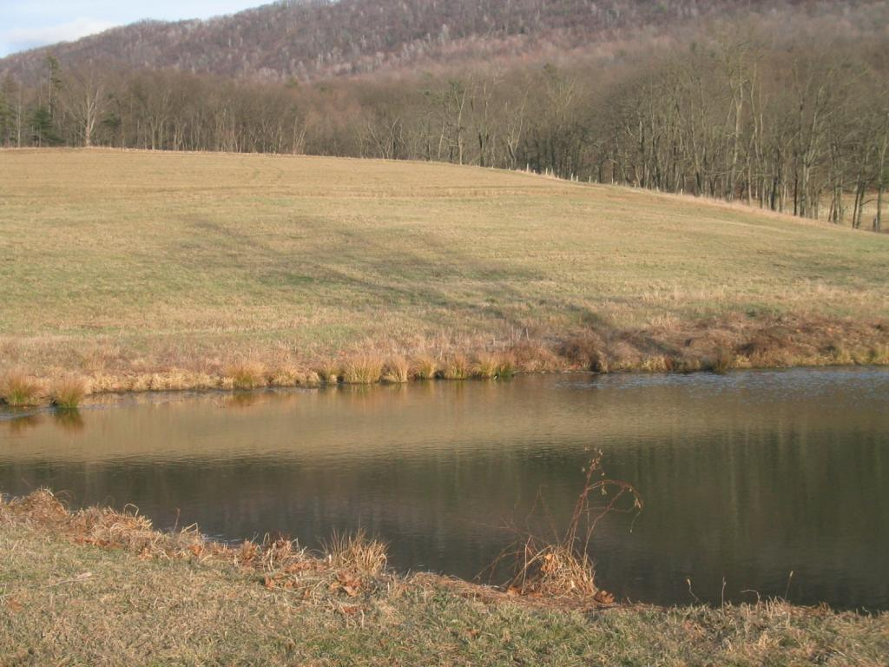
Sensitive Areas & Manure Application Setbacks
100 ft Setback if:
No BMPs
50 ft Setback if:
Soil Test <200 ppm P
No-till practices used
Residue or cover crop
35 ft Setback if:
Permanent vegetated buffer

Slide 7
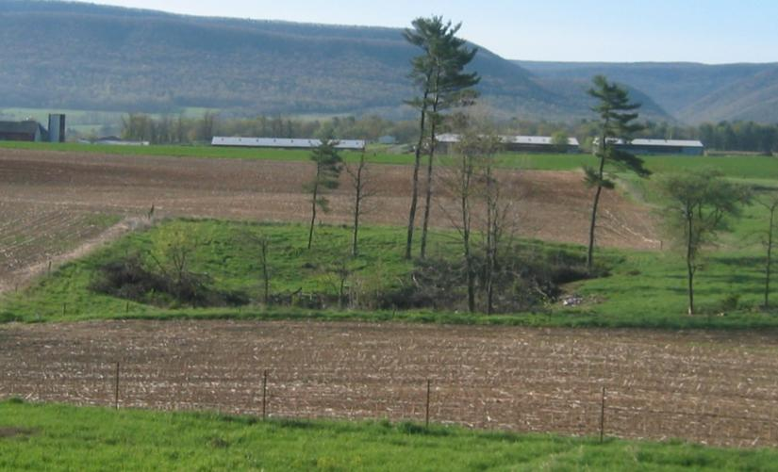
Sensitive Areas & Manure Application Setbacks
No mechanical manure application within 100 feet of an existing open sinkhole
100 ft

Slide 8
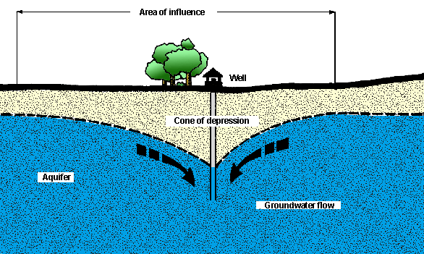
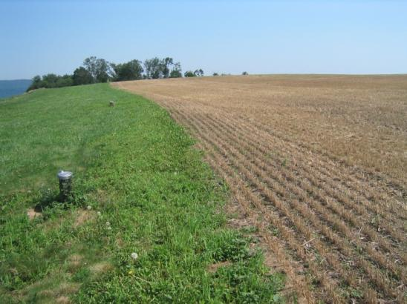
Sensitive Areas & Manure Application Setbacks
No mechanical manure application:
Within 100 feet of an active private drinking water source
Well or a spring
Within 100 feet of an active public drinking water source
Unless authority requires greater distances
100 ft
100 ft

Slide 9
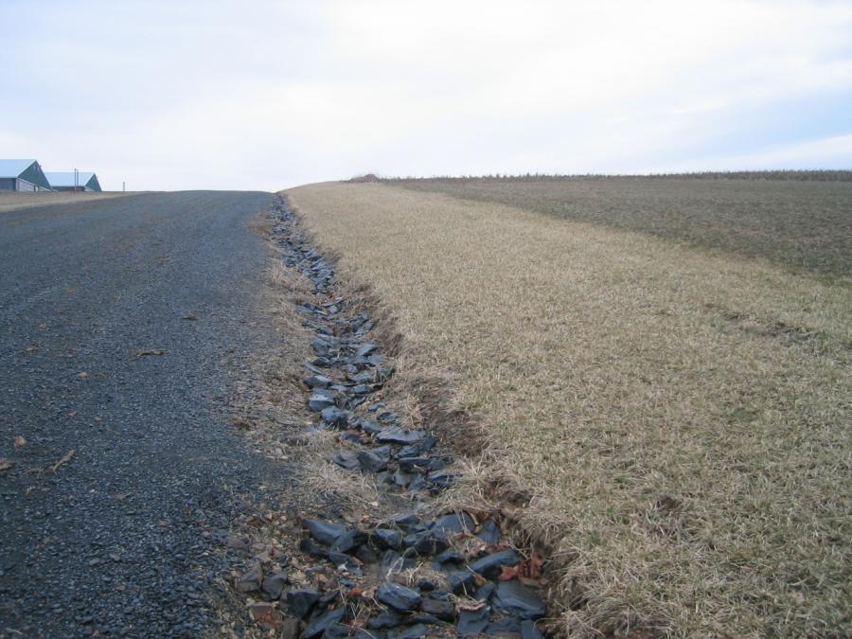
Sensitive Areas & Manure Application Setbacks
No mechanical manure application within the channel of a non-vegetated concentrated water flow area
Swale, gully or a ditch

Slide 10
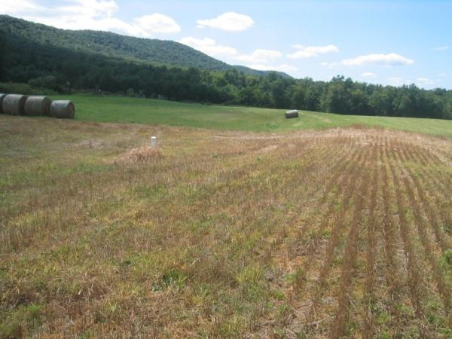
Sensitive Areas & Manure Application Setbacks
No mechanical manure application for winter application within 100 feet from an above ground inlet to an agricultural drainage system
Such as inlet pipes to piped outlet terraces
Where surface water flow is toward the above ground inlet

Slide 11
Complete operation information page d
Manure Management Plan Exercise – Page 3
Notes:
This exercise completes part d of the Operation Information Page noted which environmentally sensitive areas are on the farm.
Facilitators may want to refer participants to the completed example of the Operation Information Page. This is page 5 in “Land Application of Manure”.

Slide 12
Environmentally Sensitive Areas Worksheet (p.4)
List each field that contains or borders an environmentally sensitive area
List the environmentally sensitive feature
List the mechanical manure application setback distance
Note if the setback area is shown on the farm map
Notes:
This slide reviews the 4 columns of the Environmentally Sensitive Areas Worksheet.
At this point the farmers should have the blank Environmentally Sensitive Areas Worksheet in front of them. This is page 4 of the Manure Management Plan Workbook section.

Slide 13
Complete environmentally sensitive areas worksheet
Manure Management Plan Exercise – Page 4
Notes:
This purpose of this exercise is to complete the Environmentally Sensitive Areas Worksheet.
Facilitators may want to refer participants to the completed example of the Environmentally Sensitive Areas Worksheet. This is page 7 in “Land Application of Manure”.

Slide 14
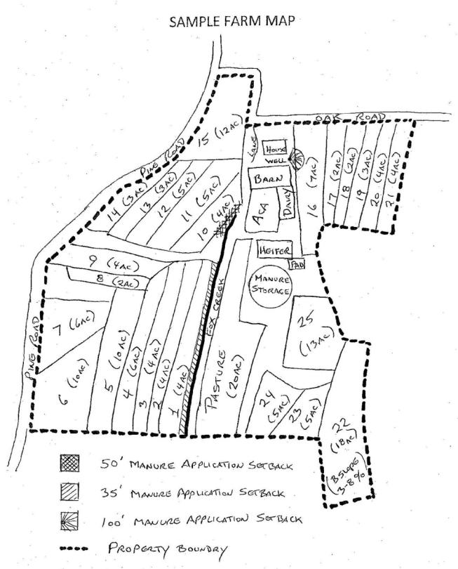
Locate areas & setbacks on the farm map
Farm Map Development
Notes:
This purpose of this exercise is to note each environmentally sensitive area on the farm map with the associated setback if applicable.
Facilitators may want to refer participants to the completed example of the Farm Map. This is page 14 in “Land Application of Manure” and page 7 of the Manure Management Plan Workbook section.

