Slide 1
Contact information page
Completing a Manure Management Plan Workshop
v.12.2012
Notes:
This module is focuses on the completion of the Contact Information Page.
Facilitators should review and be familiar the guidance on page 3 of “Land Application of Manure”.

Slide 2
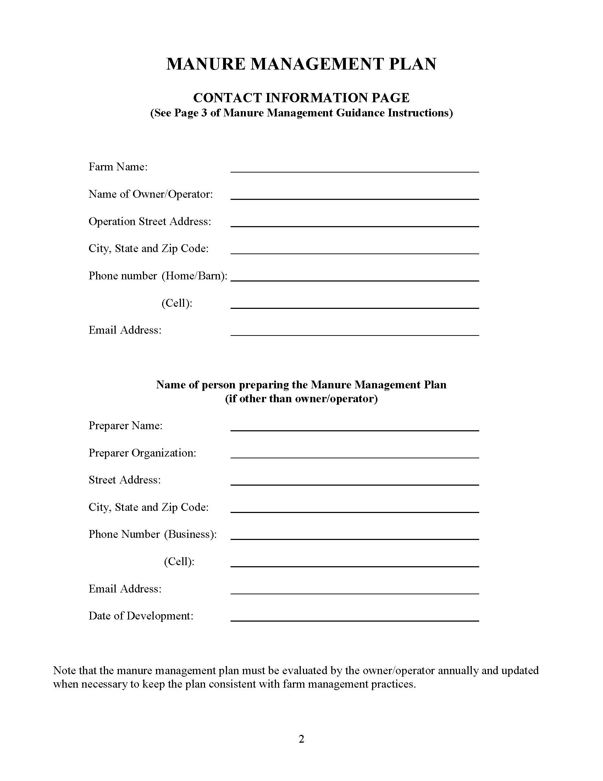
Contact Information Page (p.2)
Section 1: Farm and operator information
Must be completed
Section 2:Plan preparer information
Complete only if the plan was prepared by someone other than the owner/operator
Date of development line
Required
Date when plan is fully completed
Notes:
At this point the farmers should have the blank Contact Information Page in front of them. This is page 2 of the Manure Management Plan Workbook section.
Important to note that the Date of Development should not be completed until the plan is fully completed.

Slide 3
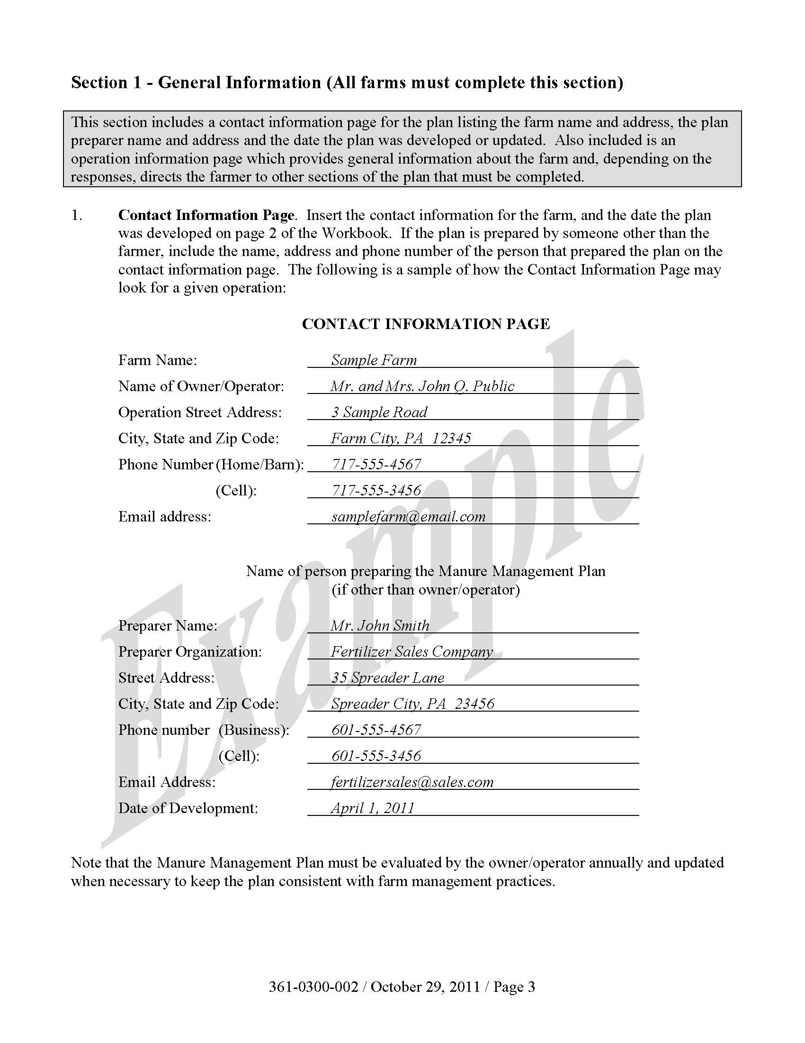
Complete contact information page
Manure Management Plan Exercise – Page 2
“Date of Development” may need to be completed later when the plan is fully complete.
Notes:
The stop sign here and throughout the modules indicates that at this point the participants in the workshop should complete the noted section of the plan.
Facilitators may want to refer participants to the completed example of the Contact Information Page. This is page 3 in “Land Application of Manure”.

Slide 4
Contact Information Page (p.2)
The plan must be evaluated annually
Updated if farm management practices have changed
A good time to do this is during the late summer or early fall
Beginning a new crop year
Record the date of the update underneath the “Date of Development”

