Slide 1
concentration animal operations calculation
Completing a Manure Management Plan Workshop
v.01.2018
Notes:
This is an optional module that may be included at the beginning of workshop to determine if any participants are CAOs.

Slide 2
Guidance Factsheet
Agronomy Facts 54
Pennsylvania’s Nutrient Management Act (Act 38): Who Is Affected?
Used to identify Concentrated Animal Operations (CAOs) in Pennsylvania
Based on animal density
CAOs require an Act 38 nutrient management plan
MMP is not acceptable for a CAO
Table 1. Standard Animal Weights
Used to calculate Animal Equivalent Units (AEUs)

Slide 3
Definitions
Animal Unit (AU)
One thousand pounds of live weight of livestock or poultry regardless of actual individual numbers
Animal Equivalent Unit (AEU)
One thousand pounds live weight of livestock or poultry on an annualized basis regardless of the actual individual numbers
Annualized Basis
Based on the actual number of days out of 365 that the animals are on the operation
AEUs Per Acre
An animal equivalent unit per acre of cropland suitable for application of animal manure
Concentrated Animal Operation (CAO)
Agricultural operations with 8 or more AEUs where the animal density exceeds two AEUs per acre on an annualized basis

Slide 4
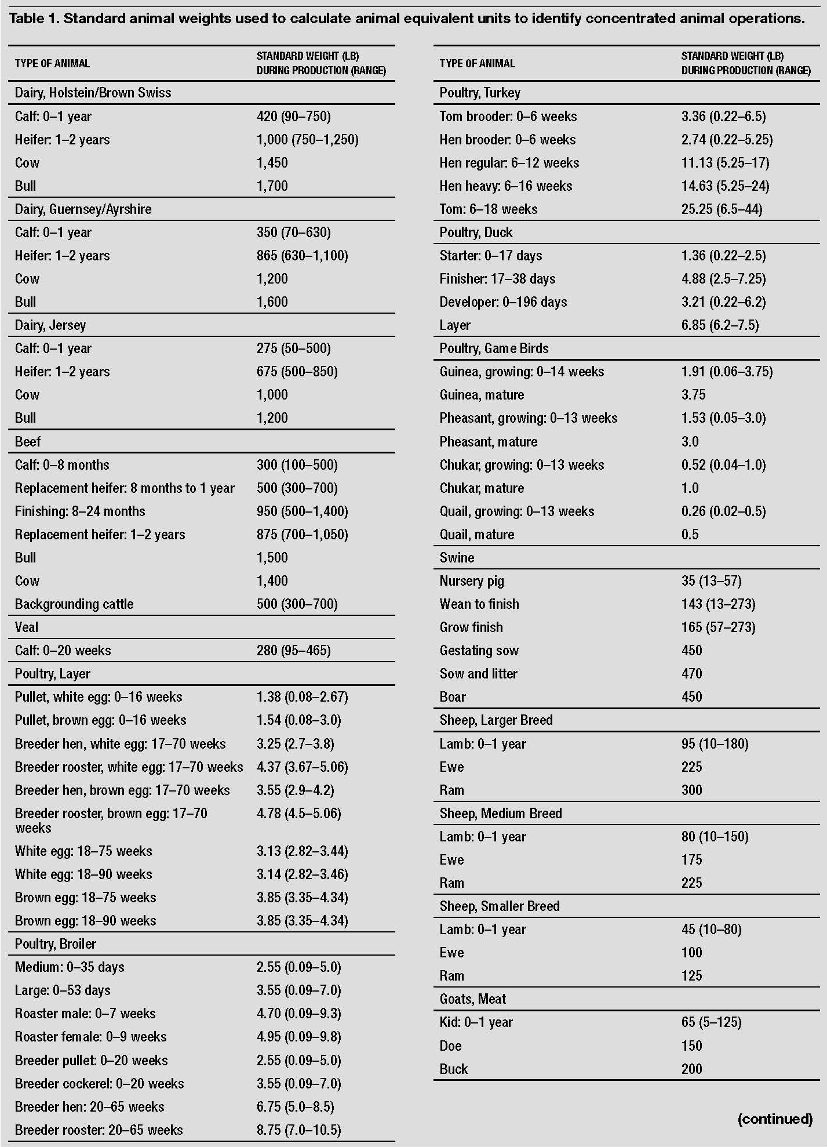
Agronomy Facts 54 - Table 1
Notes:
Use these tables for animal weights for the sample problem. Weight tables can be found on Penn State’s Agronomy Facts 54, PA’s Nutrient Management Act (Act 38): Who is Affected?; Table 1.

Slide 5
Animal Type | No. Animals | X | Animal Weight (lbs) | ÷ | 1000 | X | Production Days | ÷ | 365 | AEUs
 |  | X |  | ÷ | 1000 | X |  | ÷ | 365
 |  | X |  | ÷ | 1000 | X |  | ÷ | 365
 |  | X |  | ÷ | 1000 | X |  | ÷ | 365
 |  | X |  | ÷ | 1000 | X |  | ÷ | 365
 |  | X |  | ÷ | 1000 | X |  | ÷ | 365
 |  | X |  | ÷ | 1000 | X |  | ÷ | 365
 |  | X |  | ÷ | 1000 | X |  | ÷ | 365
 |  | X |  | ÷ | 1000 | X |  | ÷ | 365
 |  | X |  | ÷ | 1000 | X |  | ÷ | 365
 |  | X |  | ÷ | 1000 | X |  | ÷ | 365
 |  |  |  |  |  |  | Total AEUs =
 |  |  |  |  | Acres available for manure ÷
 |  |  |  |  | Animal Density: AEUs/Acre =

Slide 6
Animal Inventory: 8 Draft Horses, 6 Mules, and 4 Ponies on farm entire year
15 Grow Finish Hogs on farm for 100 days
Land Inventory: Farmstead - 2 Acres
Woodland - 5 Acres
Pasture - 10 Acres
Rented Cropland - 12 Acres
Animal Type | No. Animals | X | Animal Weight (lbs) | ÷ | 1000 | X | Production Days | ÷ | 365 | AEUs
 |  | X |  | ÷ | 1000 | X |  | ÷ | 365
 |  | X |  | ÷ | 1000 | X |  | ÷ | 365
 |  | X |  | ÷ | 1000 | X |  | ÷ | 365
 |  | X |  | ÷ | 1000 | X |  | ÷ | 365
 |  |  |  |  |  |  | Total AEUs =
 |  |  |  |  | Acres available for manure ÷
 |  |  |  |  | Animal Density: AEUs/Acre =
Notes:
Fill in the chart using the example provided and use the equation to decide if this sample farm is a CAO or an AO. Then use the process to determine if your own farm would classify as either a CAO or an AO.

Slide 7
Animal Inventory: 8 Draft Horses, 6 Mules, and 4 Ponies on farm entire year
15 Grow Finish Hogs on farm for 100 days
Land Inventory: Farmstead - 2 Acres
Woodland - 5 Acres
Pasture - 10 Acres
Rented Cropland - 12 Acres
Animal Type | No. Animals | X | Animal Weight (lbs) | ÷ | 1000 | X | Production Days | ÷ | 365 | AEUs
Draft Horses | 8 | X | 1800 | ÷ | 1000 | X | 365 | ÷ | 365 | 14.4
Mules | 6 | X | 1100 | ÷ | 1000 | X | 365 | ÷ | 365 | 6.6
Ponies | 4 | X | 600 | ÷ | 1000 | X | 365 | ÷ | 365 | 2.4
Hogs | 15 | X | 165 | ÷ | 1000 | X | 100 | ÷ | 365 | .68
 |  |  |  |  |  |  | Total AEUs = |  |  | 24.08
 |  |  |  |  | Acres available for manure ÷ |  |  |  |  | 22
 |  |  |  |  | Animal Density: AEUs/Acre = |  |  |  |  | 1.09
Notes:
Fill in the chart using the example provided and use the equation to decide if this sample farm is a CAO or an AO. Then use the process to determine if your own farm would classify as either a CAO or an AO.

Slide 8
Calculate your farm’s animal density and CAO status
Manure Management Plan Exercise
Animal Type | No. Animals | X | Animal Weight (lbs) | ÷ | 1000 | X | Production Days | ÷ | 365 | AEUs
 |  | X |  | ÷ | 1000 | X |  | ÷ | 365
 |  | X |  | ÷ | 1000 | X |  | ÷ | 365
 |  | X |  | ÷ | 1000 | X |  | ÷ | 365
 |  | X |  | ÷ | 1000 | X |  | ÷ | 365
 |  |  |  |  |  |  | Total AEUs =
 |  |  |  |  | Acres available for manure ÷
 |  |  |  |  | Animal Density: AEUs/Acre =
Notes:
Please take the time now and calculate your farms total AEUs and total animal density, so you will know if you are a CAO or AO.

Slide 9
Concentrated Animal Operations (CAOs)
Concentrated Animal Operation (CAO)
Must have at least 8 AEUs
Animal density is greater than 2 AEUs per acre
CAOs are required to have an Act 38 nutrient management plan
Written by a certified specialist
May participate in the workshop for the educational benefit
Cannot substitute a manure management plan

Slide 10
 | DEP Manure Management Plan | Act 38 Nutrient Management Plan
Written By | Farmer | Certified Nutrient Management Planner
Cost | May be of no cost to farmer | Cost varies by operation
Who Needs One | Farms that produce or land apply manure | Concentrated Animal Operations
Regulates | Animal Concentration Areas Manure Storages Pasture Mechanical Manure Application
Agency | Regulated by DEP | Regulated by SCC
Approval | None required | Approved by Conservation District Board
Liability Protection | None claimed | Limited liability for civil complaints

