Slide 1
Animal concentration areas worksheet
Completing a Manure Management Plan Workshop
v.02.2016
Notes:
This module focuses on completing the Animal Concentration Areas Worksheets.
Facilitators should review and be familiar the guidance on pages 22-23 of “Land Application of Manure”.

Slide 2
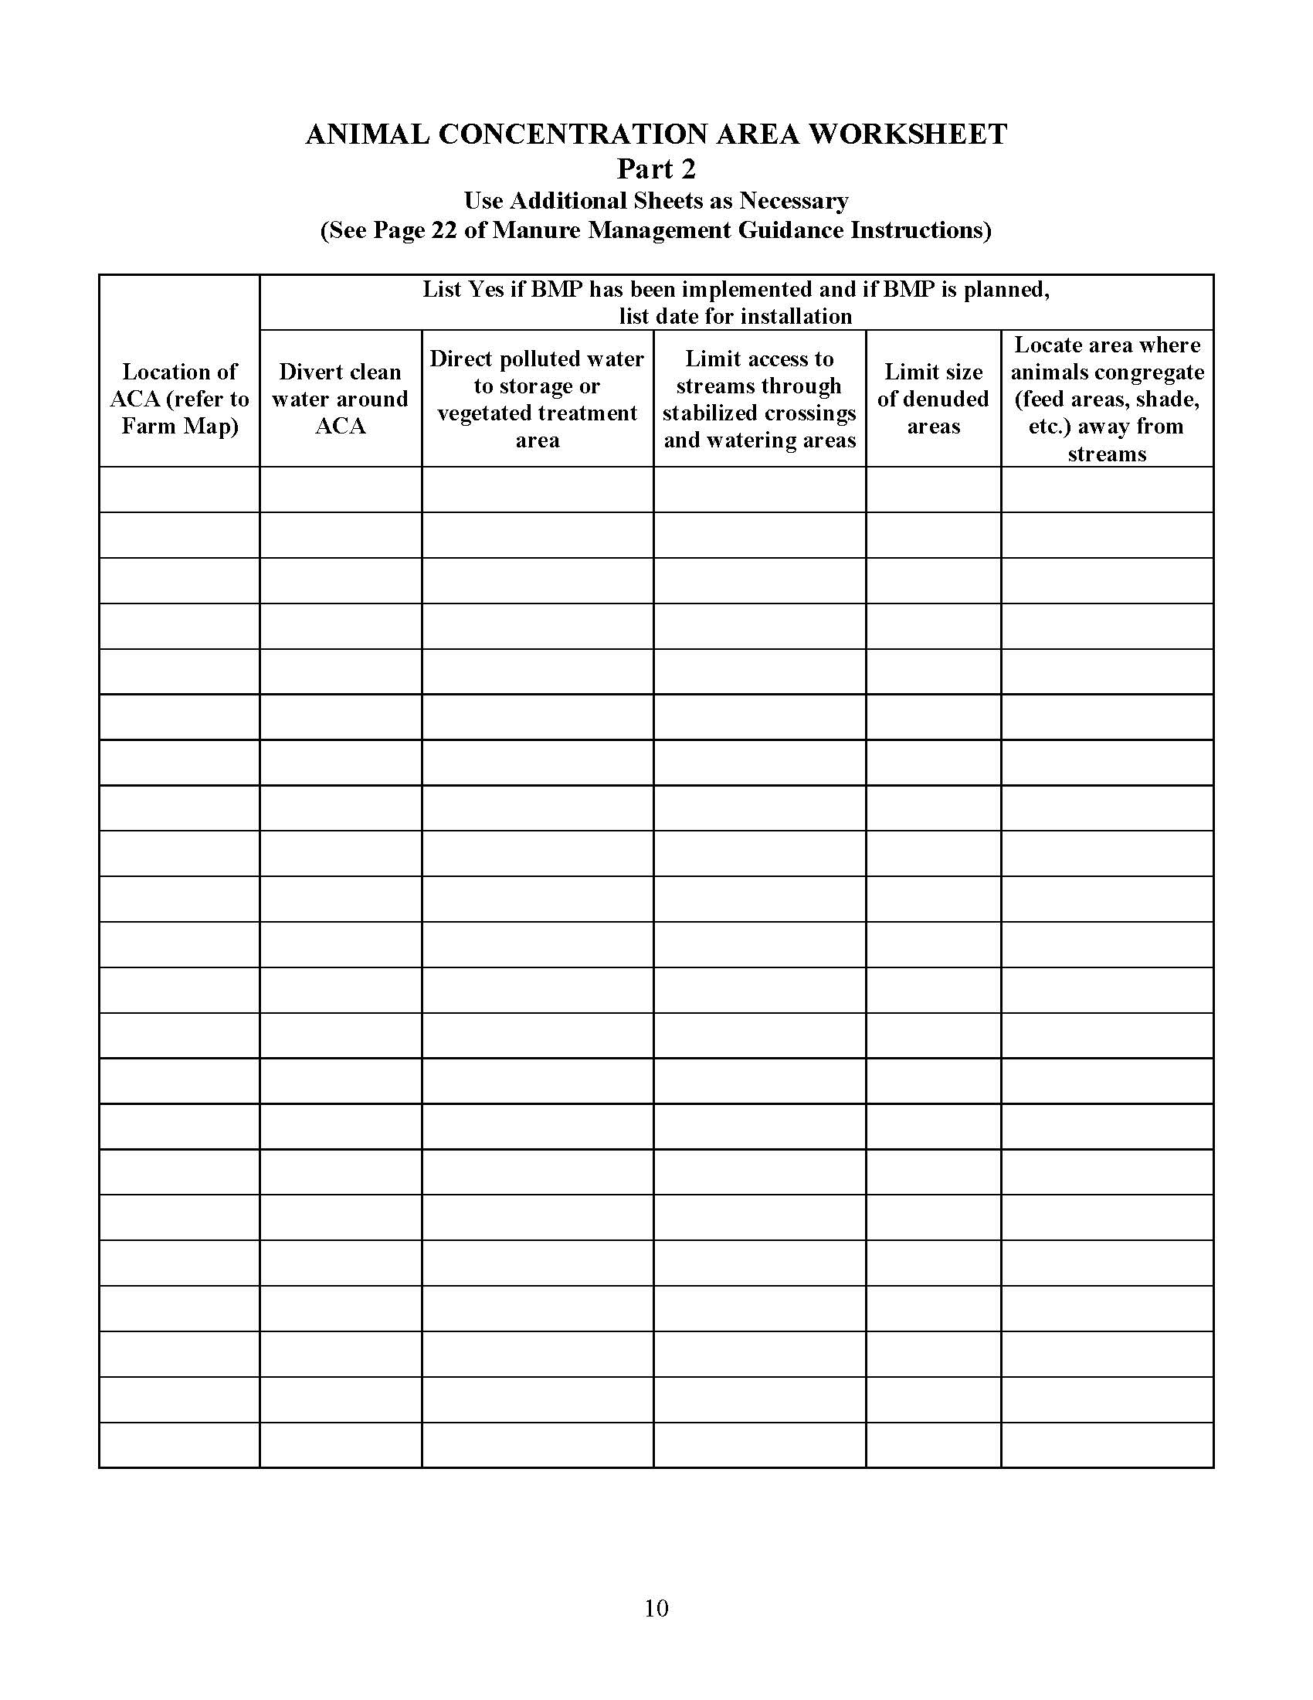
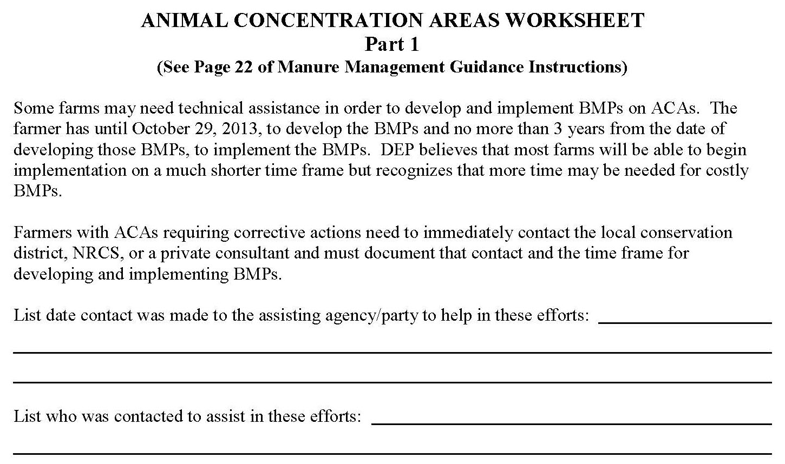
Animal Concentration Areas Worksheet (pp.9 & 10)
Worksheet has two parts or sections
Complete Part 2 first
Identify ACAs
Locate each ACA on the Farm Map
Evaluate ACA management
List BMPs
BMPs currently implemented
BMPs planned to correct problems
Complete Part 1 if technical assistance is required
BMP selection, design and implementation
Two recommendations
Evaluation and planning should be done on site
Secure technical assistance in the entire process
Notes:
At this point the farmers should have the blank Animal Concentration Areas Worksheets in front of them. This is pages 9 and 10 of the Manure Management Plan Workbook section.

Slide 3
Animal Concentration Areas (ACAs)
Two categories of areas must be evaluated
Animal Concentration Areas
Sometimes called “Animal Heavy Use Areas”
Pasture Animal Congregation Areas
Animal concentration areas (ACAs)
Barnyards, feedlots, loafing areas, exercise lots or other similar animal confinement areas
That will not maintain the dense vegetation of a pasture
Does not include pastures meeting the pasture requirements
See Pasture Management requirements
Pasture animal congregation areas
Animal congregation areas around waterers, feeders, and shade
Access lanes if animals congregate in them for extended periods of time
Usually non-vegetated with accumulation of manure and urine

Slide 4
ACA Identification
First, develop an initial list of current ACAs that will need to be evaluated
Permanent confinement areas
Barnyards
Feedlots
Exercise lots
Loafing areas
Temporary confinement areas
Winter feeding or confinement areas in pastures, cropland, or woodland
Vegetated or cropped most of the year
A final list of ACAs for the Manure Management Plan should be made after the evaluation and planning process
Some current ACAs may be eliminated
New ACAs may be planned and implemented

Slide 5
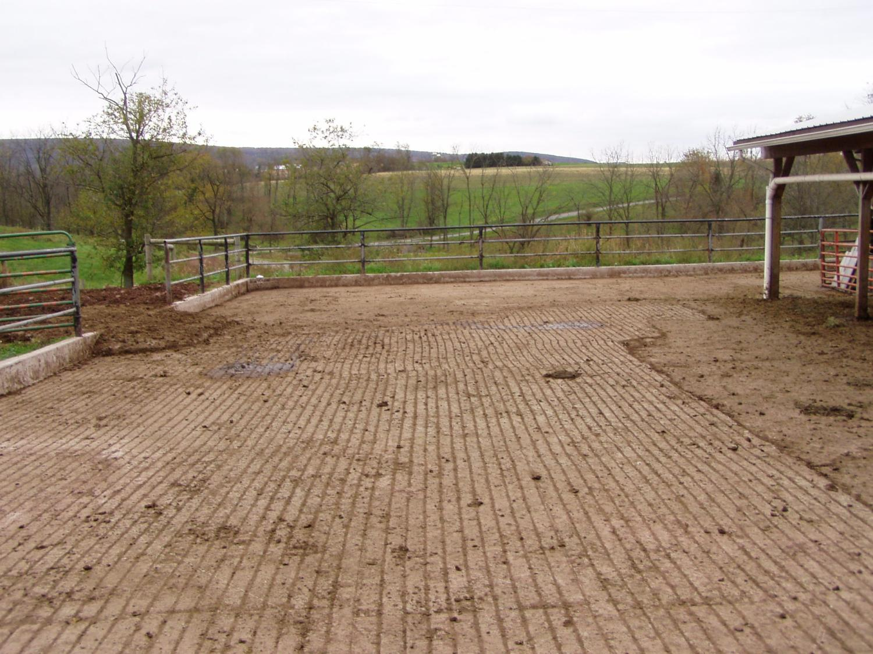
Notes:
This and the following slides show various types of ACAs.

Slide 6
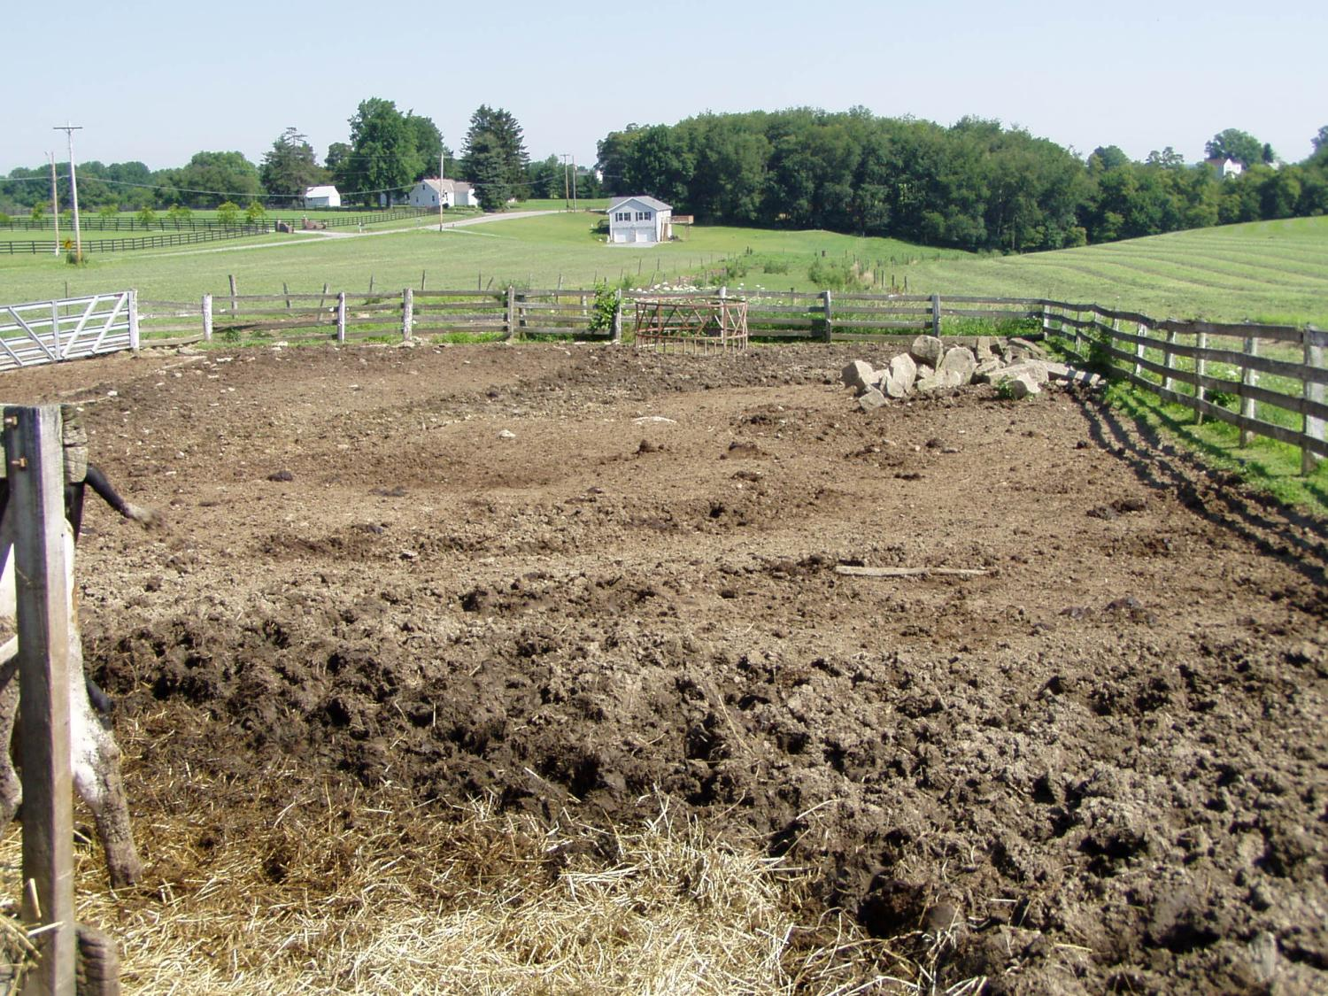

Slide 7
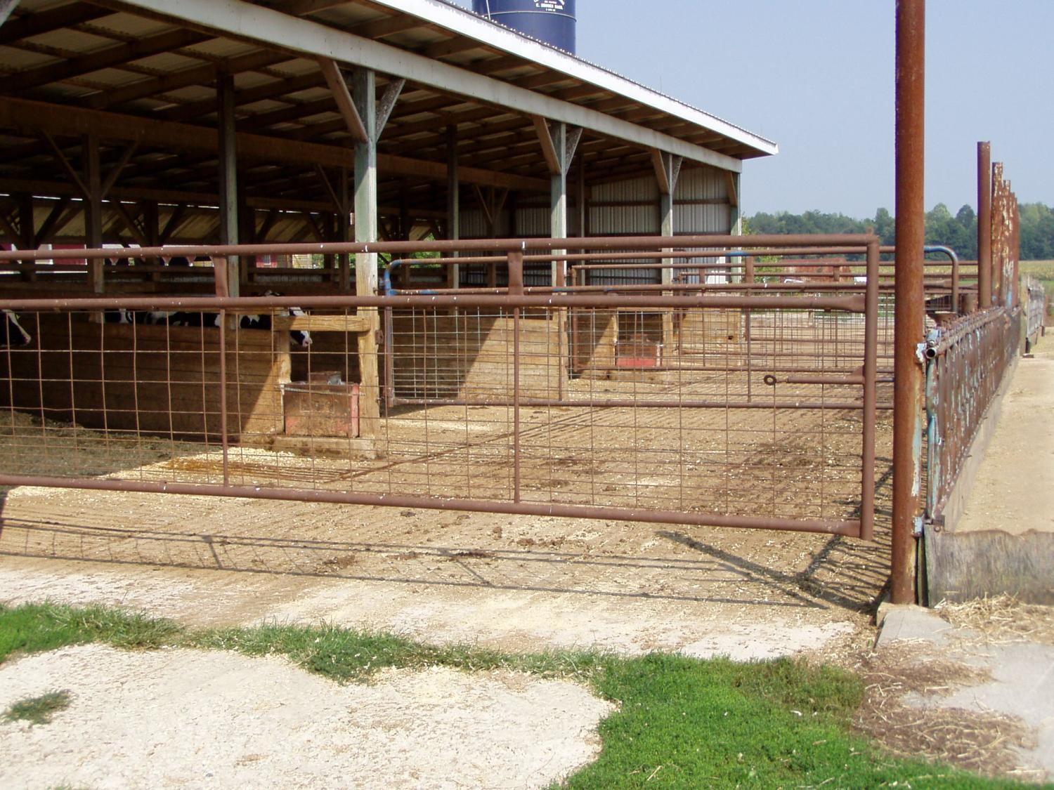

Slide 8
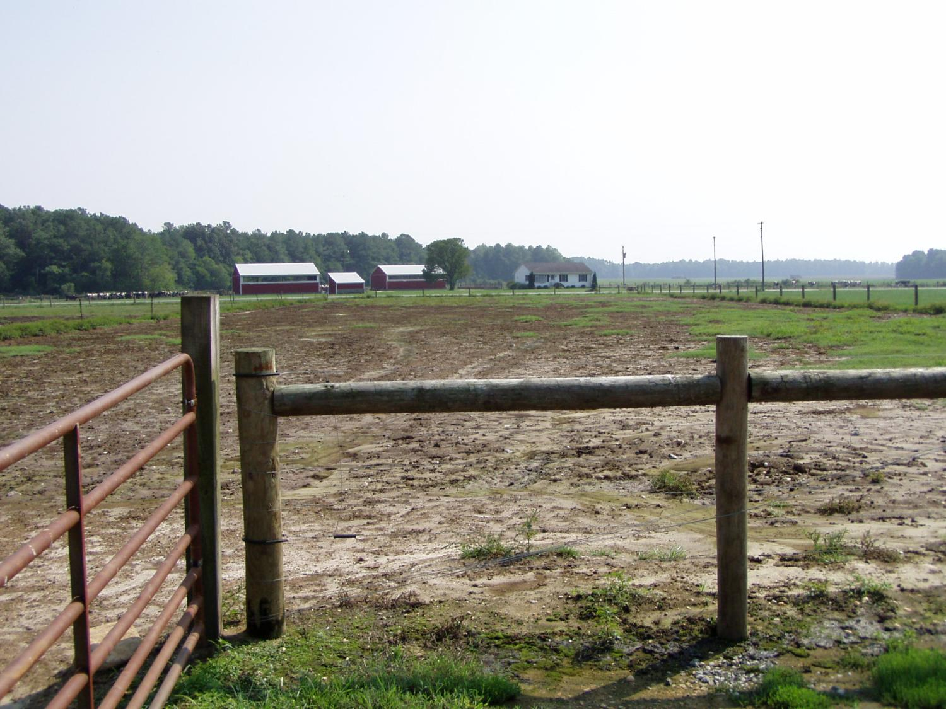

Slide 9
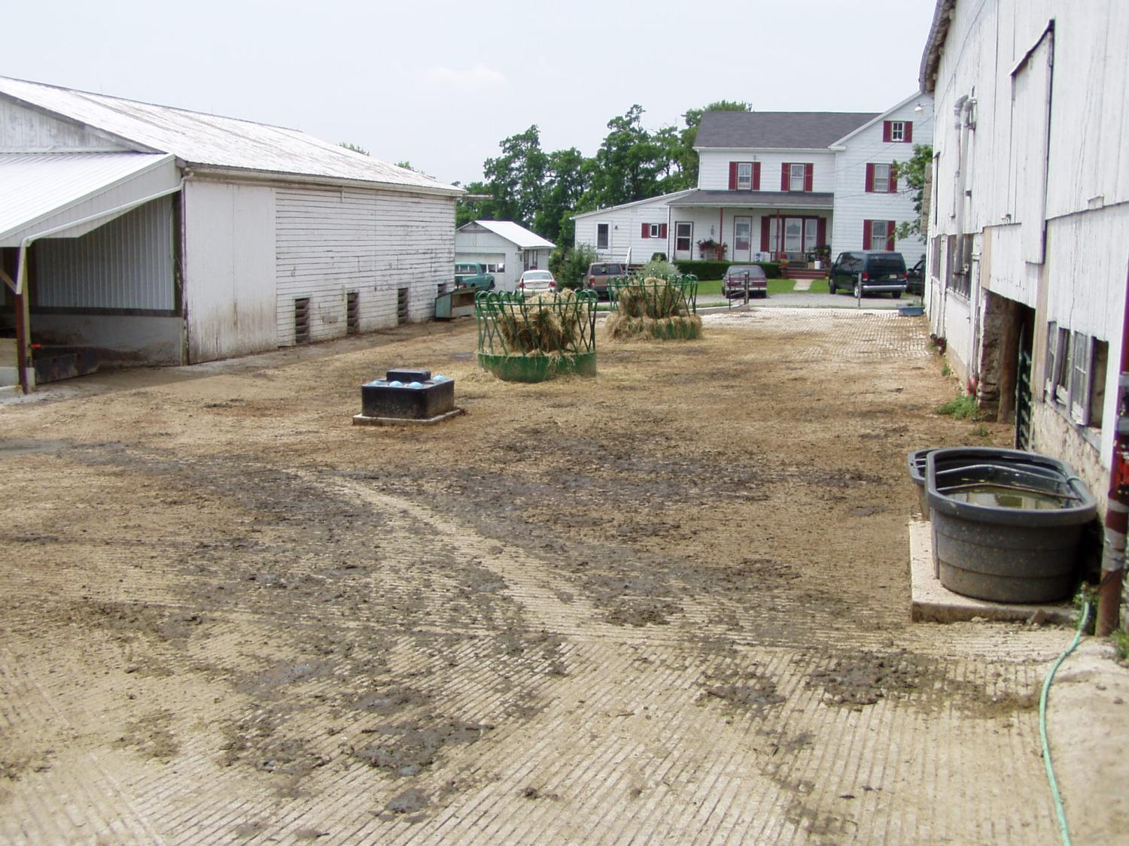

Slide 10
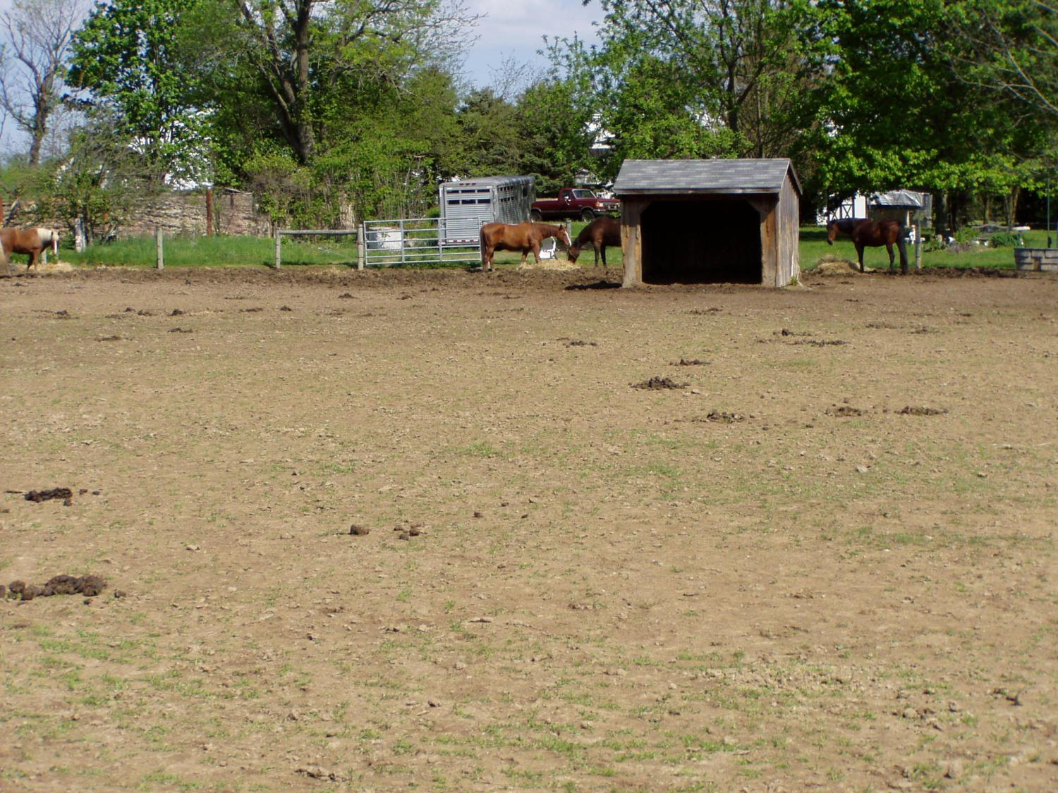

Slide 11
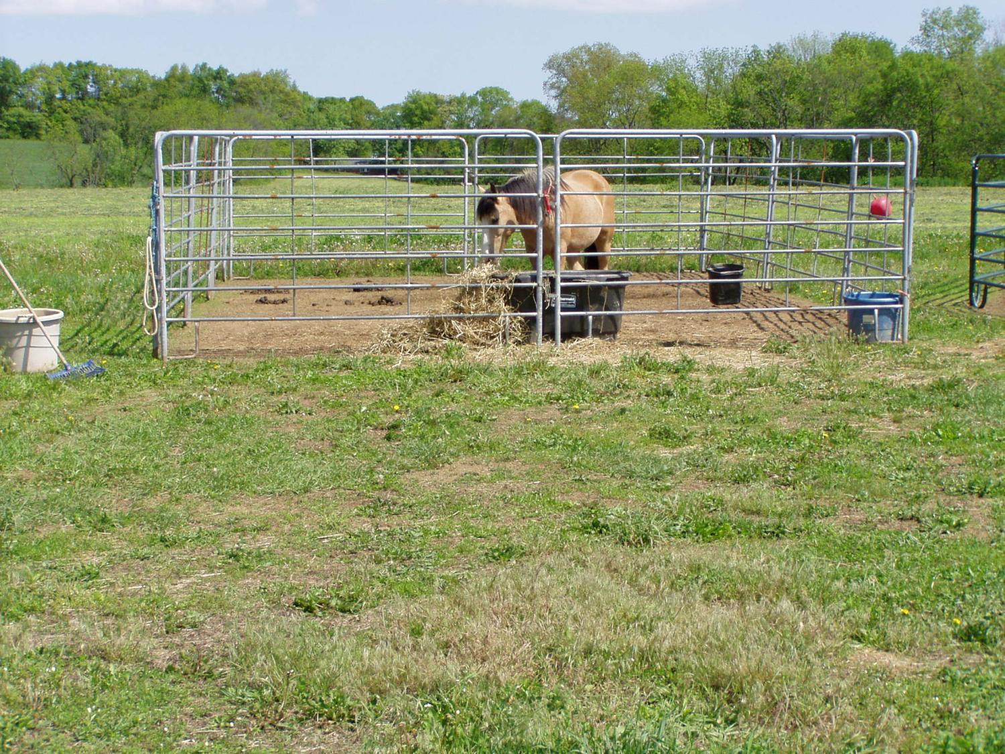

Slide 12
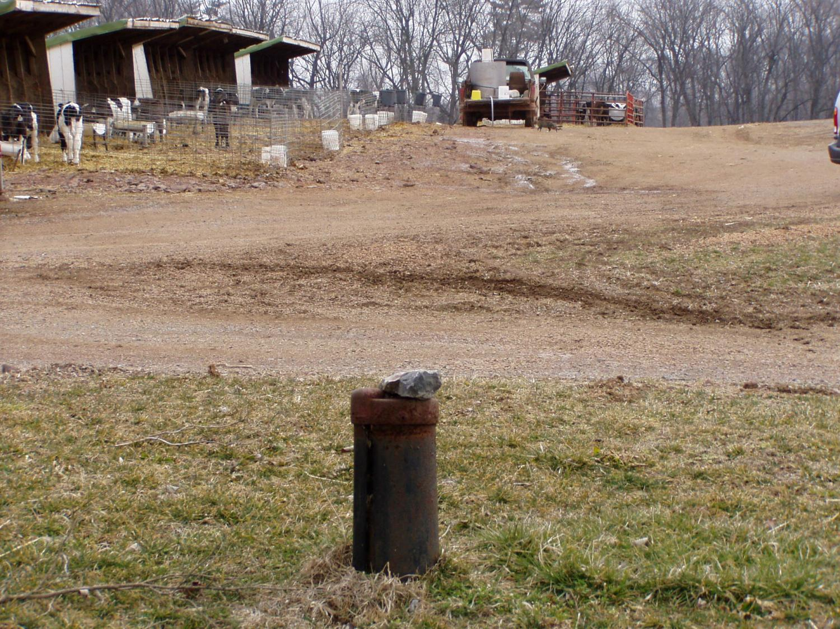
Notes:
Groupings of calf hutches is an ACA.

Slide 13
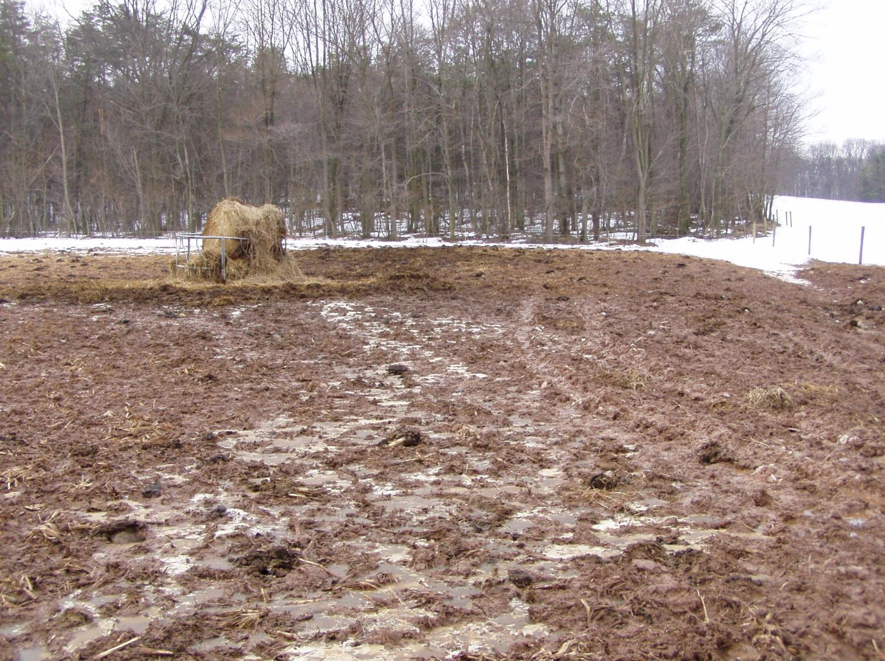
Notes:
Winter feeding areas that may be crop land during the growing season are ACAs. They are seasonal ACAs.

Slide 14
Pasture Congregation Areas
Second, develop a list of pasture animal congregation areas that will need to be evaluated
Animal congregation areas around waterers, feeders, and shade
Access lanes
If animals congregate in them for extended periods of time
Make a distinction between congregation vs. travel
Access lanes, gate areas, etc.
Usually non-vegetated with accumulation of manure and urine
Both permanent areas and temporary or seasonal areas

Slide 15
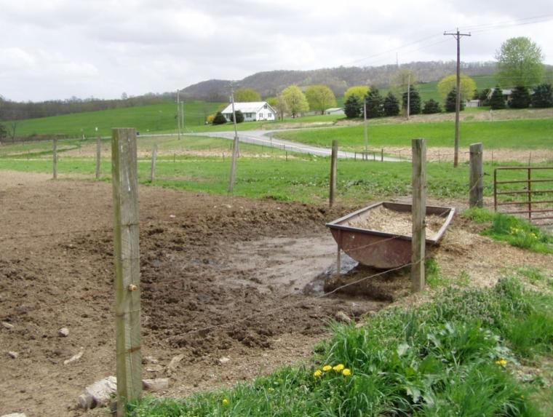
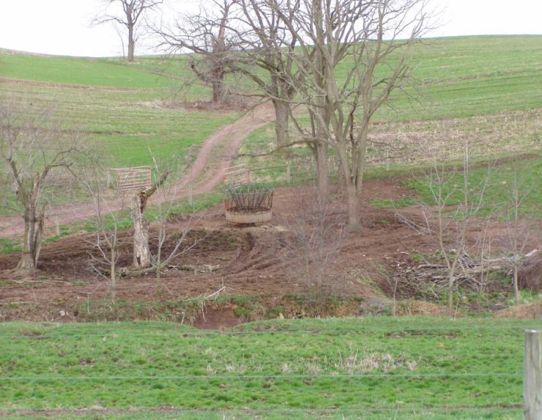
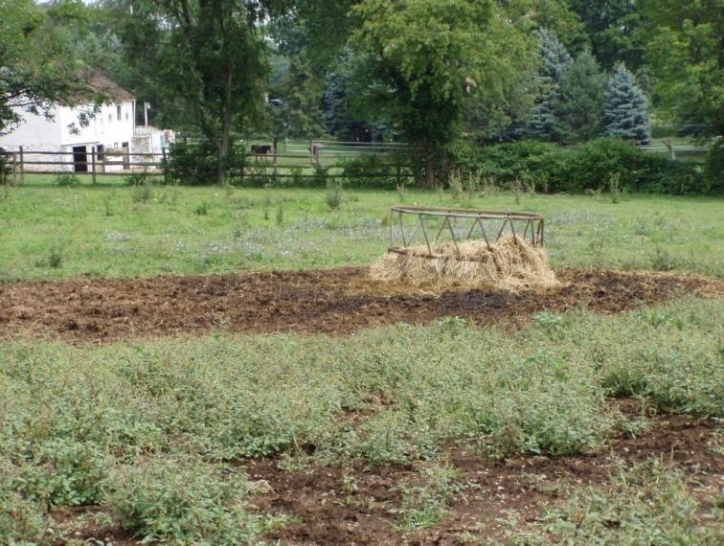
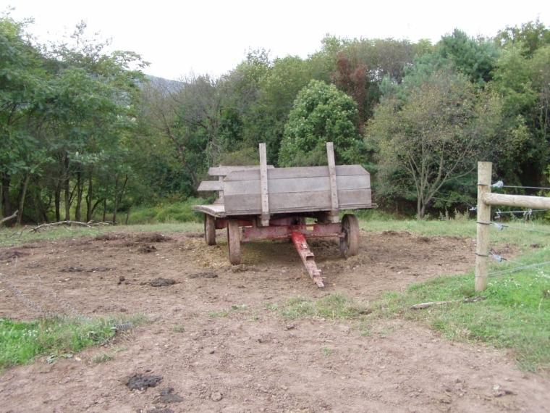
Notes:
This and the following slides show congregation areas within pastures that may be ACAs if stormwater leaves these areas and discharges into surface or groundwater.

Slide 16
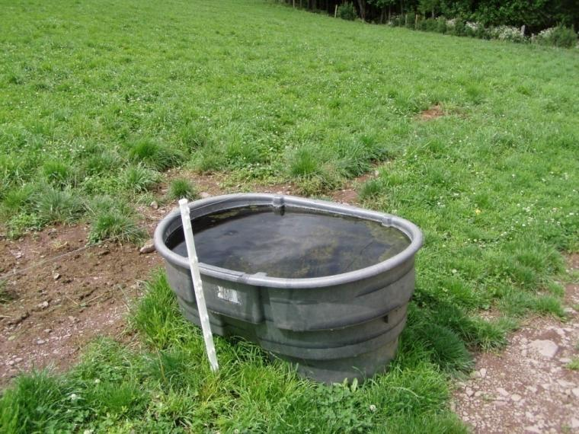
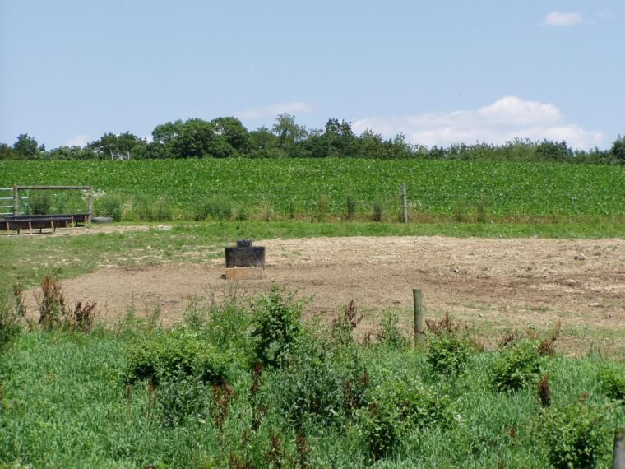
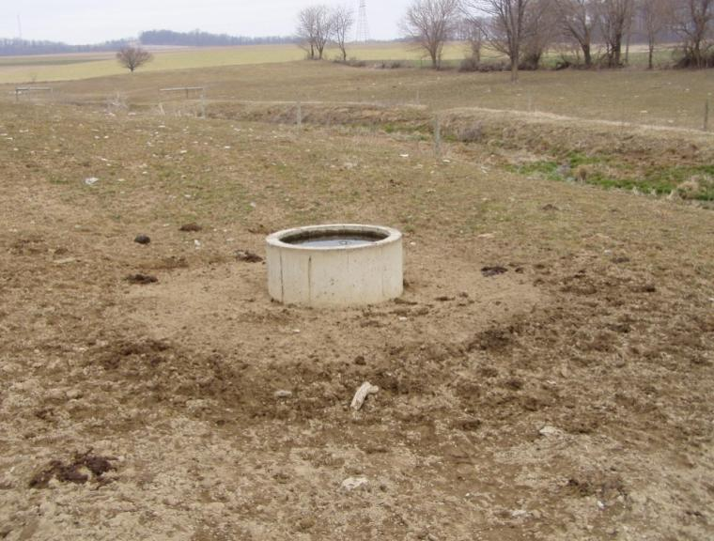
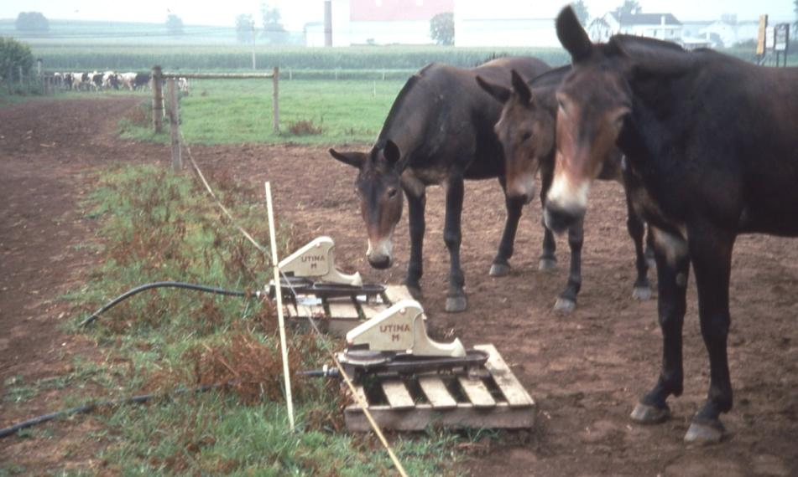

Slide 17
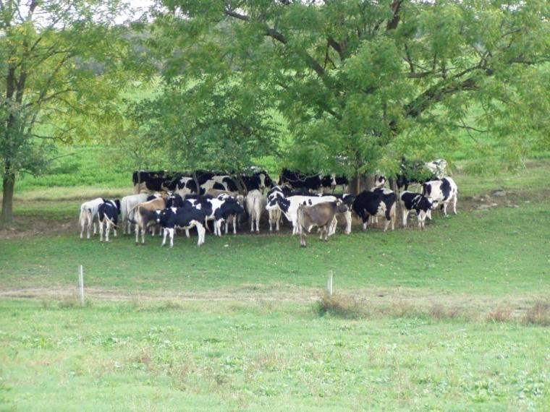
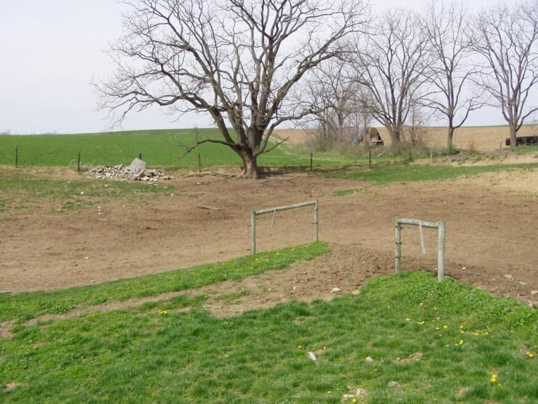
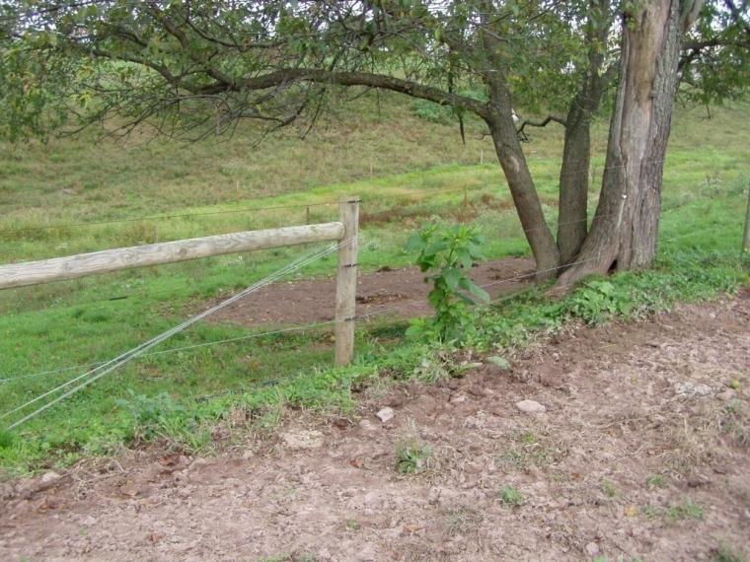
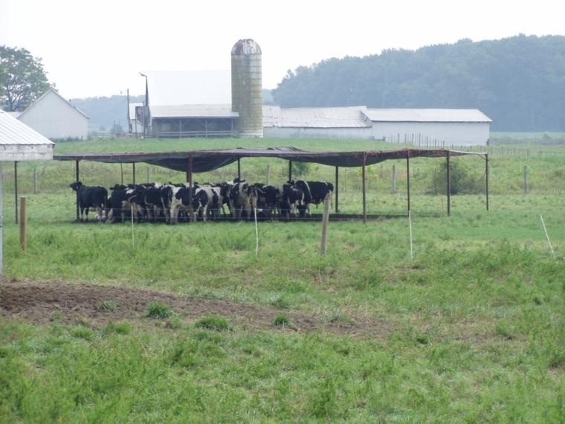

Slide 18
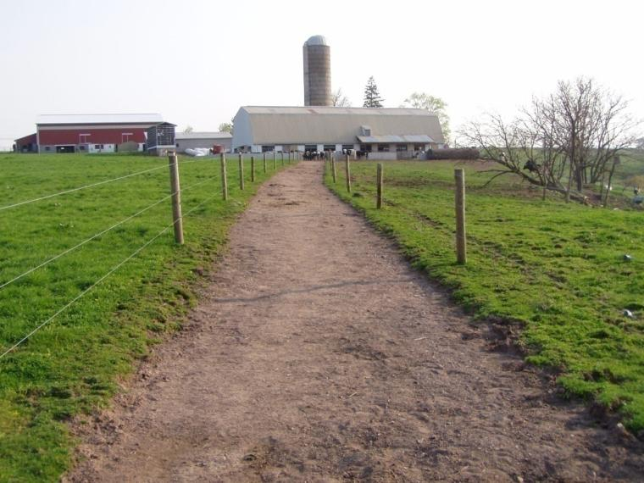
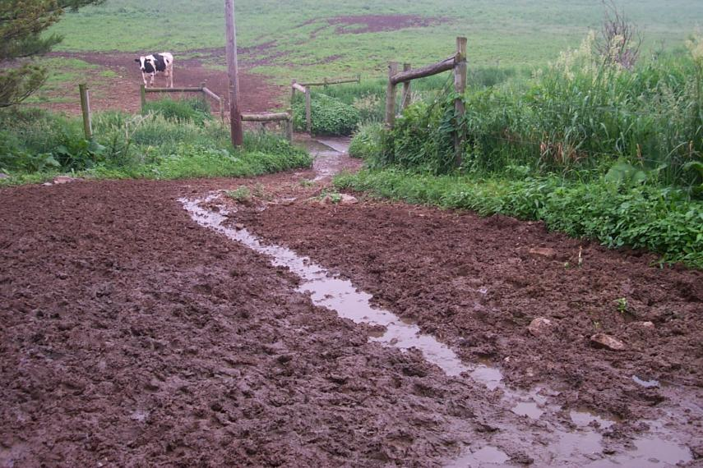
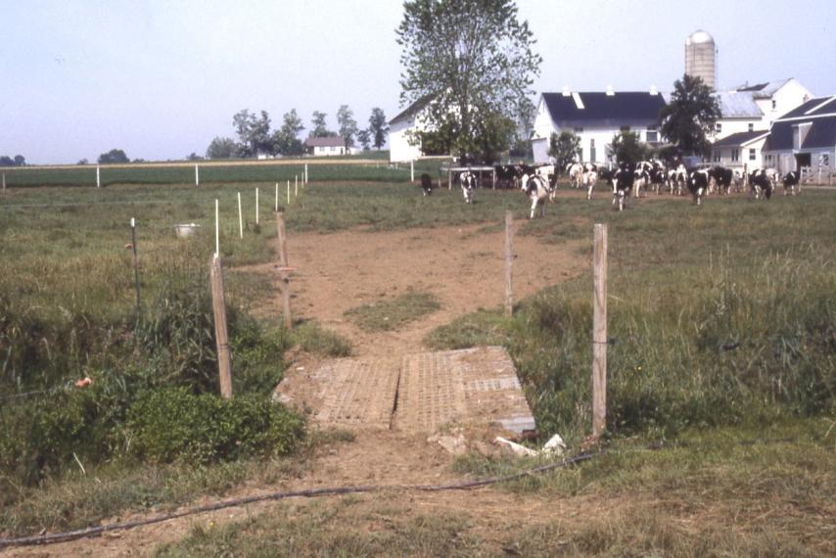
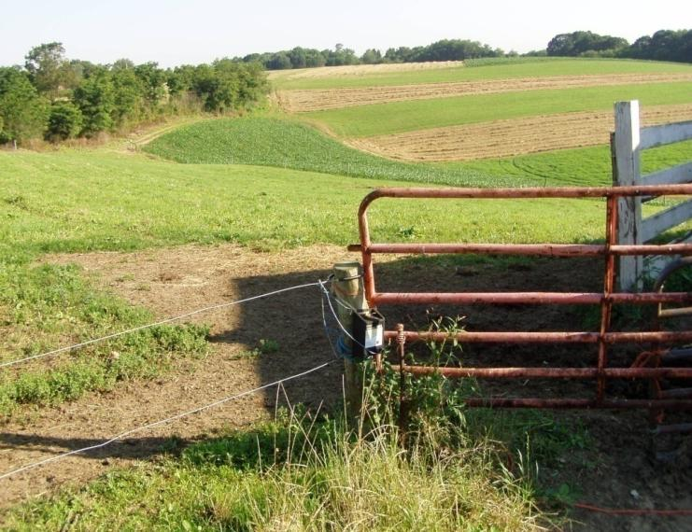
Congregation vs. Travel
Notes:
This slide attempts to illustrate that travel areas generally are not ACAs. The focus should be on congregation areas where a lot of manure is deposited. The photo in top right hand corner of the slide shows a travel area that is so wide it also seems to be a congregation area.

Slide 19
Manure Management Plan Exercise – Page 3
Complete operation information page i
Notes:
This exercise completes part i of the Operation Information Page noting if manure storages exist on the farm.
Facilitators may want to refer participants to the completed example of the Operation Information Page. This is page 5 in “Land Application of Manure”.

Slide 20
ACA Management Requirements
Divert clean water flow from upslope fields, driveways, barn roofs, etc. away from the ACA
Direct polluted runoff or allow it to flow from the ACA area into a storage facility or best management practice such as a correctly sized and well maintained vegetative filter strip
Limit animal access to surface waters to only properly implemented livestock crossings
Animals may not have free access to streams adjacent to or within ACAs
Minimize the size of denuded areas such as sacrifice lots
Keep animal congregation areas as far away from water bodies as practical
Relocate movable structures creating animal congregation areas annually where appropriate and practical
Remove manure routinely from ACAs, where practical
Generally four times per year
Notes:
The next two slides focus on the evaluation of ACAs. This is moving toward completing Animal Concentration Areas Worksheet – Part 2. Animal Concentration Areas Worksheet – Part 1 will be completed after Part 2.

Slide 21
ACA Evaluation
The next step is to evaluate each ACA listed
Strongly suggest working with NRCS, conservation district, or private specialists
Focus
Are the “ACA Management Requirements” adequately met?
Primary concerns
Keep upslope water from entering the ACA
Treat contaminated water leaving the ACA
Direct to manure storage or to adequate treatment system
Cannot discharge into surface water or groundwater (sinkholes)
Locate congregation areas as far away from water bodies as possible
Consistent removal of accumulated manure
Use the “Animal Concentration Area Worksheet – Part 2)
BMPs are implemented and adequate (“Yes”)
BMPs are not implemented or adequate (Date of Implementation)

Slide 22
Pasture Congregation Areas Evaluation
One evaluation consideration:
Does runoff from the area discharge into streams, lakes, ponds, or sinkholes?
If no:
Not required to list the area
If yes:
The area must be listed as part of the evaluation
The runoff problem must be corrected

Slide 23
ACA Evaluation Questions
Is clean water adequately diverted from the ACA?
Is polluted runoff directed to a manure storage or correctly sized treatment area?
Are stream crossings and watering areas in the ACA stabilized?
Is the ACA properly sized?
Are congregation areas as far from water bodies as possible?
Notes:
At this point the farmers should have the blank Animal Concentration Areas Worksheet – Part 2 in front of them. This is page 10 of the Manure Management Plan Workbook section.

Slide 24
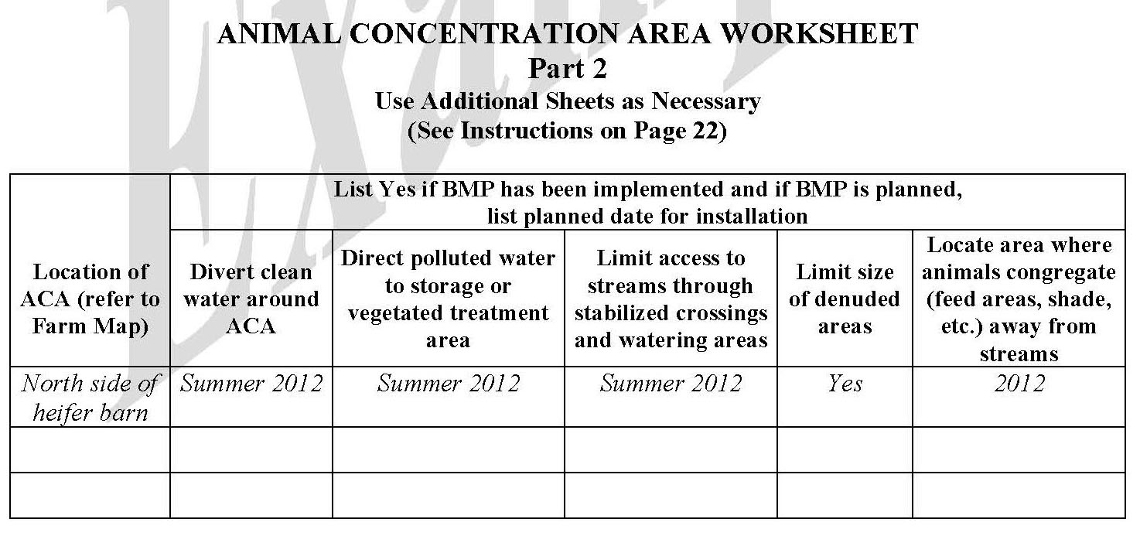
Complete animal concentration area worksheet part 2
Manure Management Plan Exercise – Page 10
Notes:
This exercise completes the Animal Concentration Areas Worksheet – Part 2.
Facilitators may want to refer participants to the completed example of the Animal Concentration Areas Worksheet – Part 2. This is page 23 in “Land Application of Manure”.

Slide 25
Correcting ACA Problems
Action to address ACA “problems” must be taken immediately
Immediately implement management changes that do not require professional design
Moving feeders and waterers, installing fence, removing accumulated manure, establishing vegetative buffers, etc.
Record implementation date or “Yes” if already implemented
Some changes require professional design and construction
Complete Animal Concentration Area Worksheet Part 1
Date when assisting agency was contacted
Name of the person contacted
Implementation requirements
BMPs that require professional design and construction have up to 3 years from the plan development date to be implemented
Notes:
All identified problems must be addressed.
Professional design and construction assistance may be needed.

Slide 26
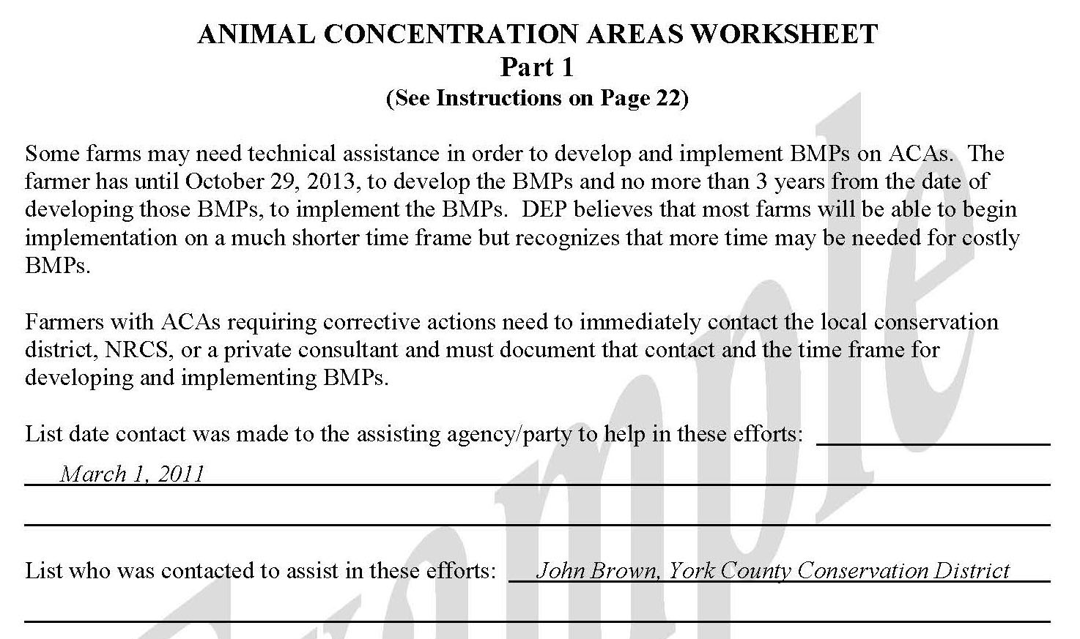
Complete animal concentration area worksheet part 1
Manure Management Plan Exercise – Page 10
Notes:
This exercise completes the Animal Concentration Areas Worksheet – Part 1.
Facilitators may want to refer participants to the completed example of the Animal Concentration Areas Worksheet – Part 1. This is page 23 in “Land Application of Manure”.

Slide 27
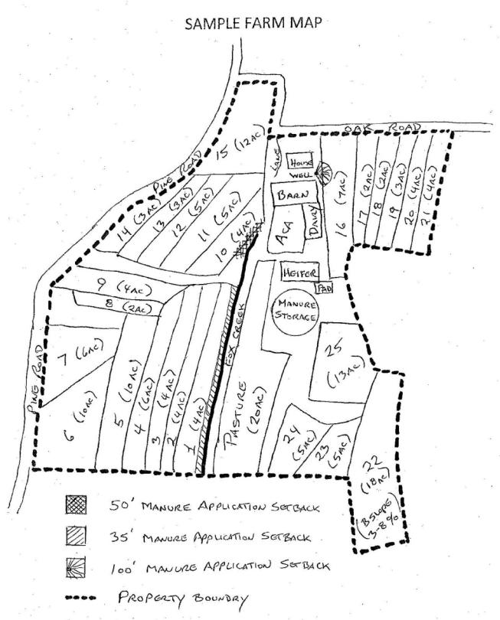
Note acas on the farm map
Farm Map Development
Notes:
This purpose of this exercise is to note each animal concentration area location on the farm map.
Facilitators may want to refer participants to the completed example of the Farm Map. This is page 14 in “Land Application of Manure” and page 7 of the Manure Management Plan Workbook section.

